Slide 1
POINT OF CARE URINE DRUG SCREEN COLLECTION, TESTING AND REPORTING CARL VINSON VAMC
WITH AMERICAN SCREENING CORPORATION PRECISION PLUS MULTI PANEL DRUG TEST

Slide 2
USE THIS KIT FOR SAMPLES WITH TESTS ORDERED IN ADDITION TO PRECISION CUP URINE DRUG SCREEN.

Slide 3
SUBMIT THE CUP AND ALL TUBES INCLUDED IN THE KIT TO THE LAB. MAKE SURE CUP AND TUBES ARE LABELED WITH AT LEAST TWO PATIENT IDENTIFIERS, DATE AND TIME OF SAMPLE COLLECTION

Slide 4
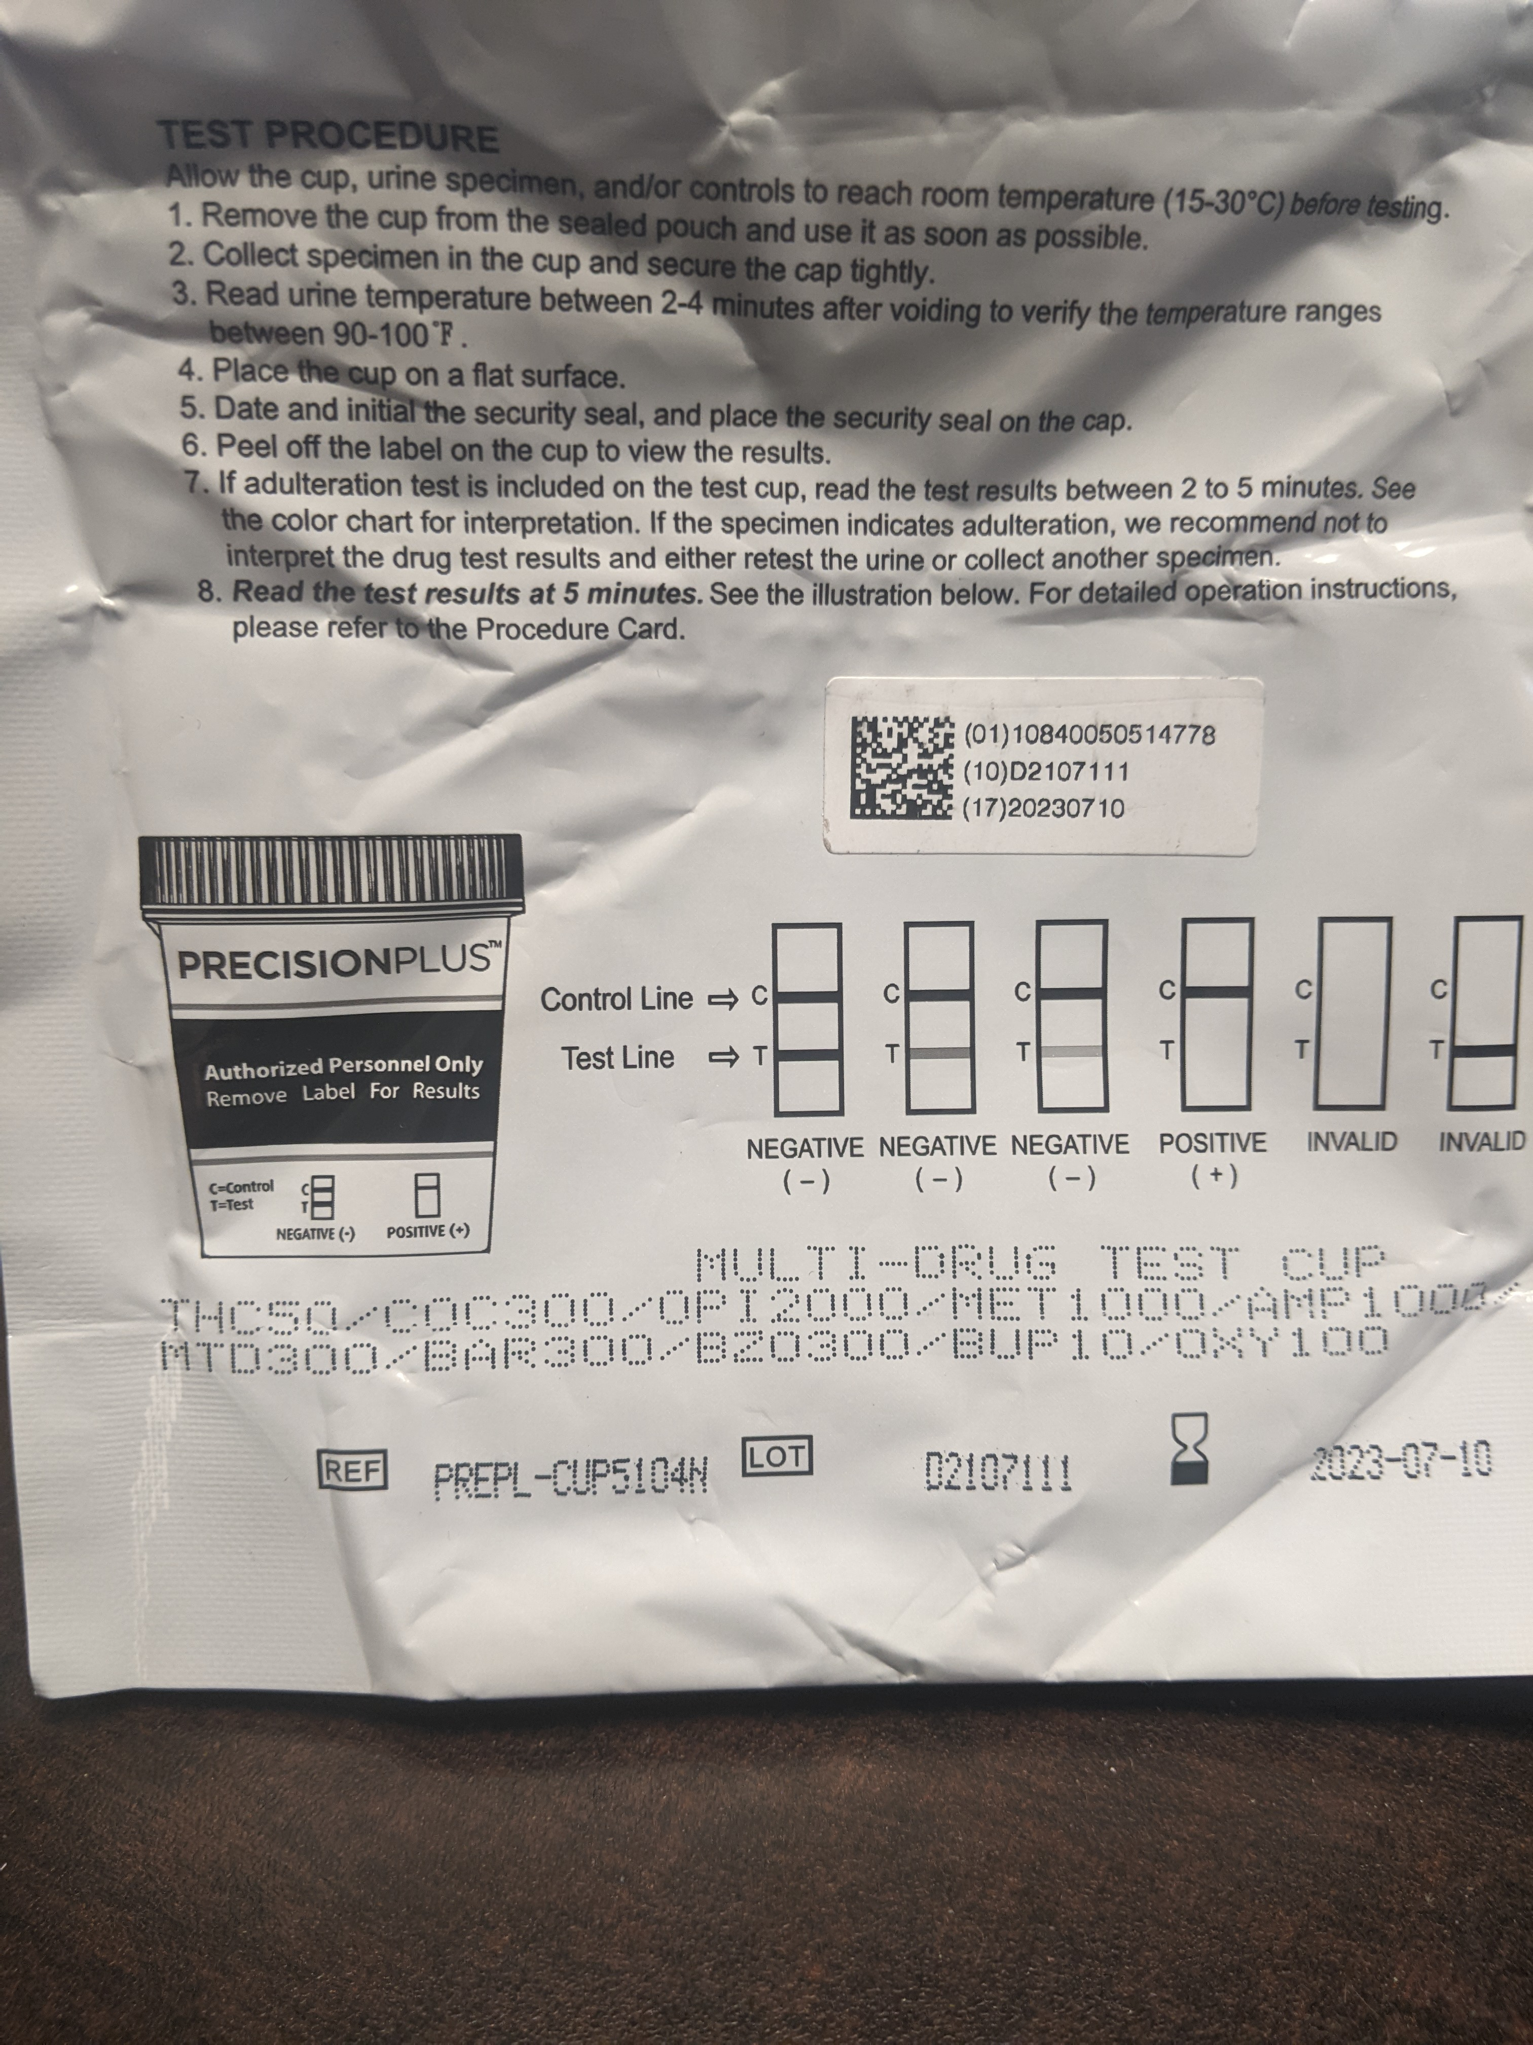
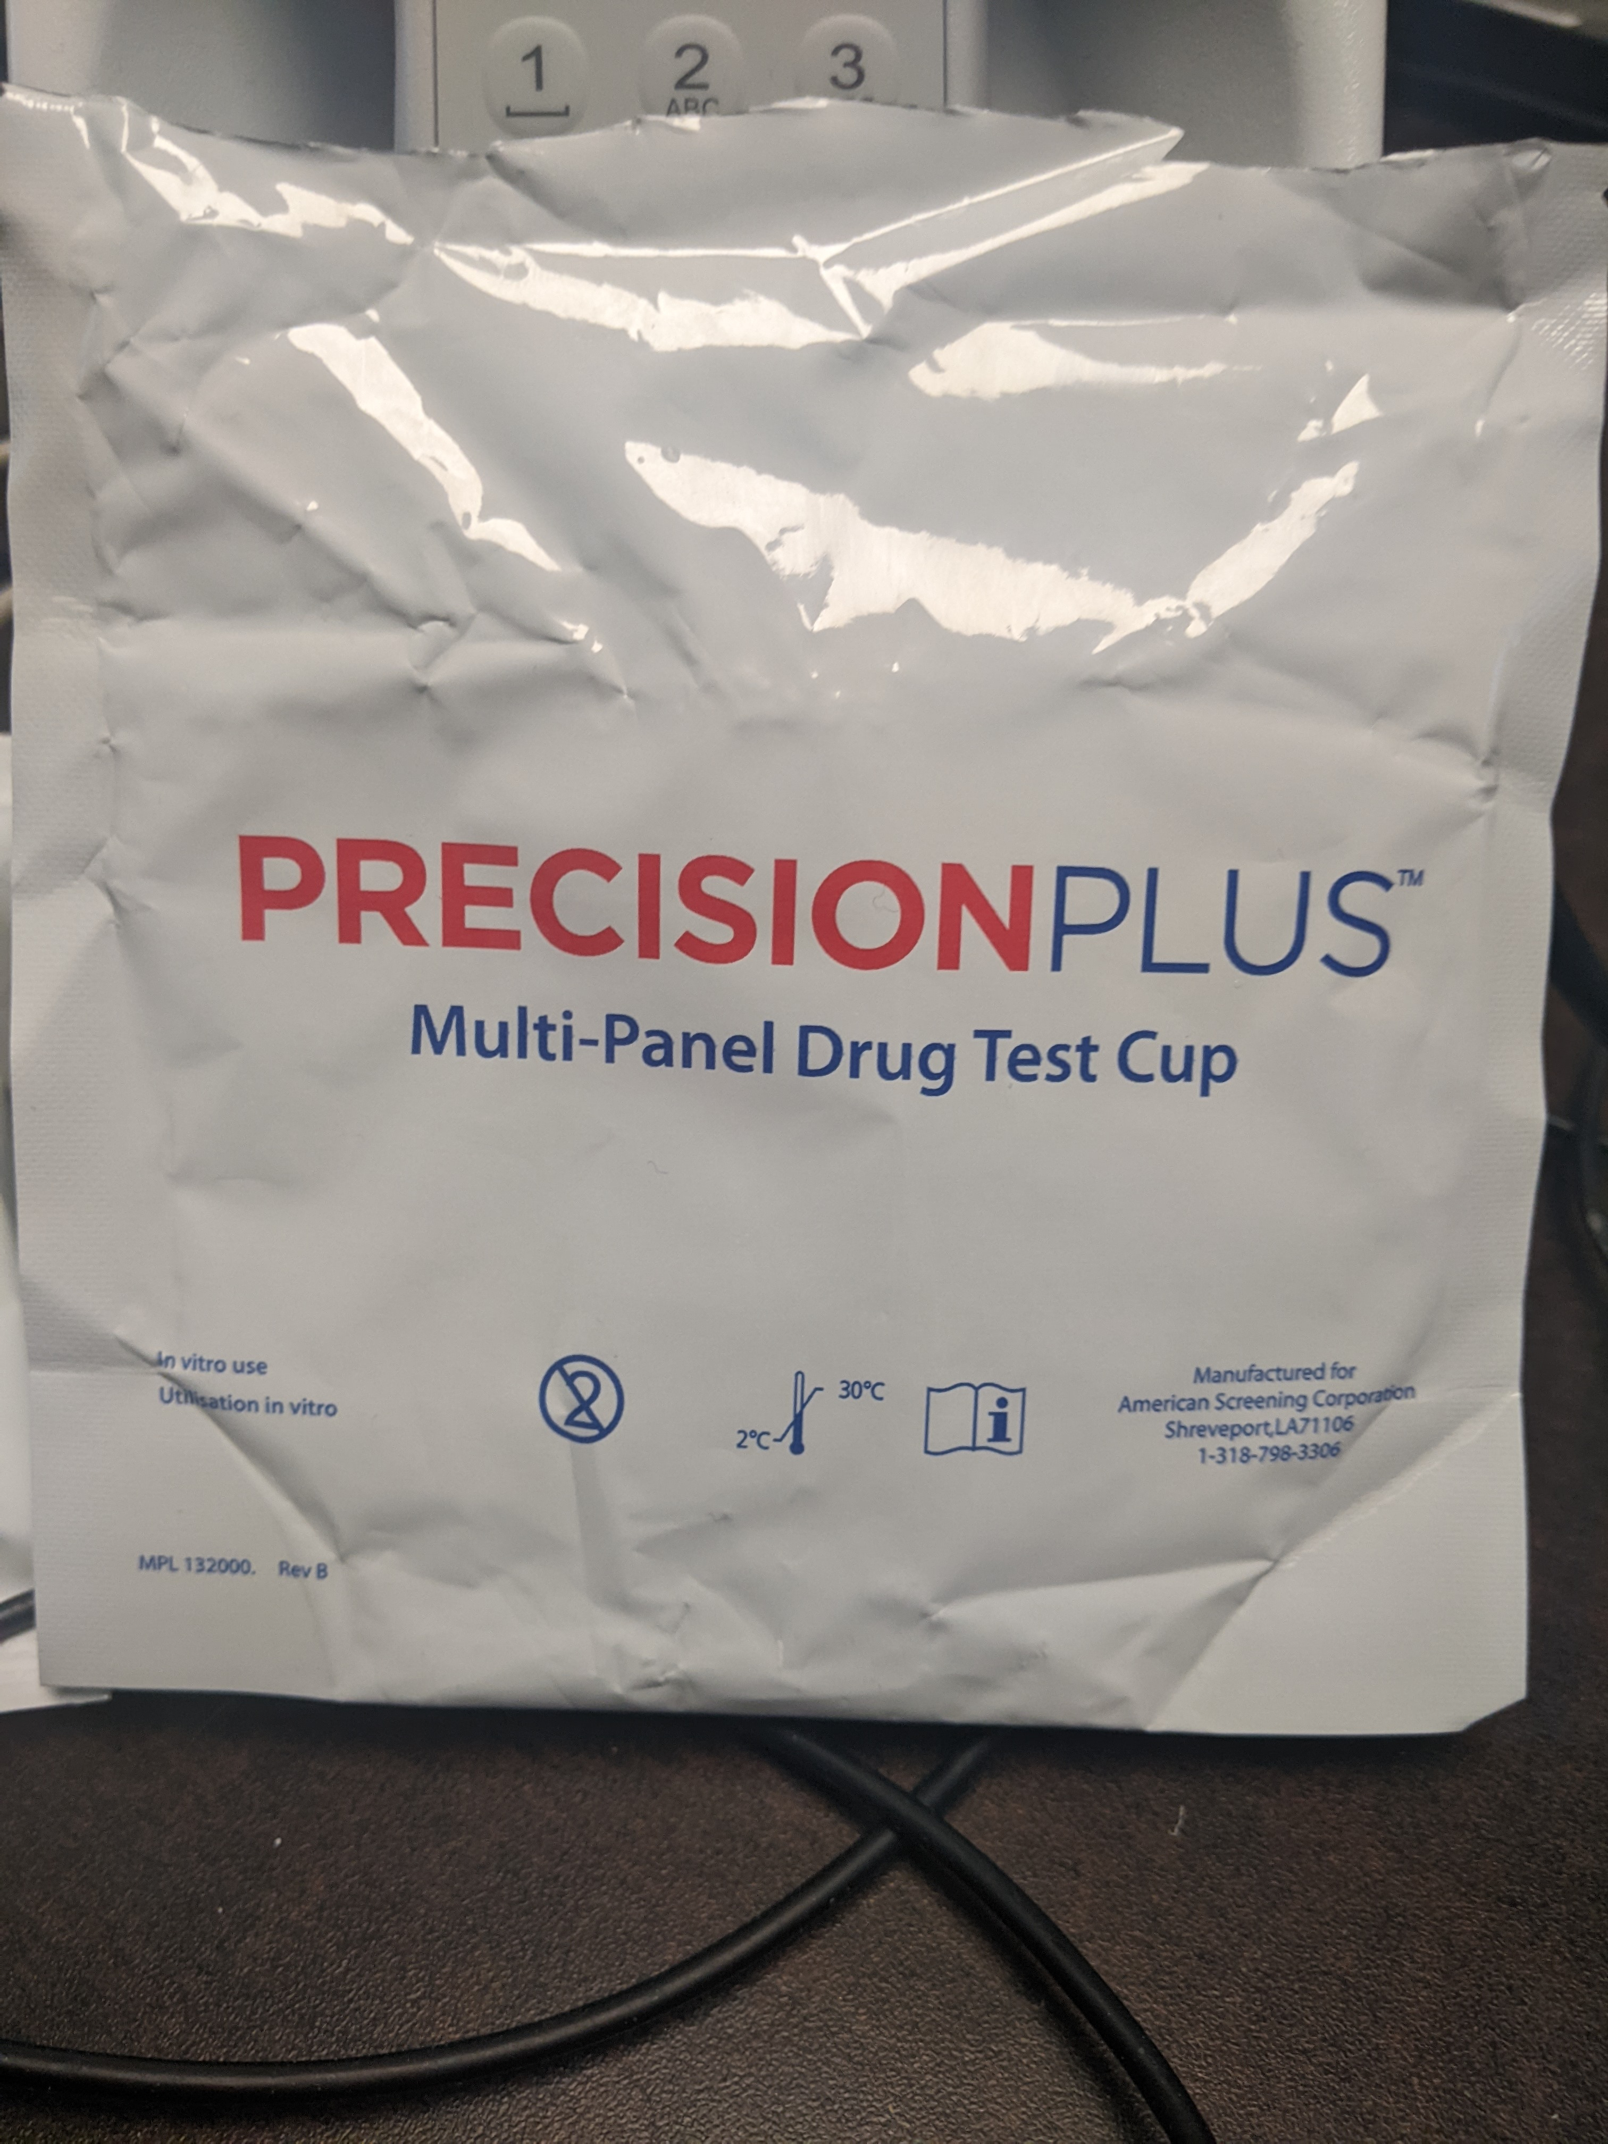
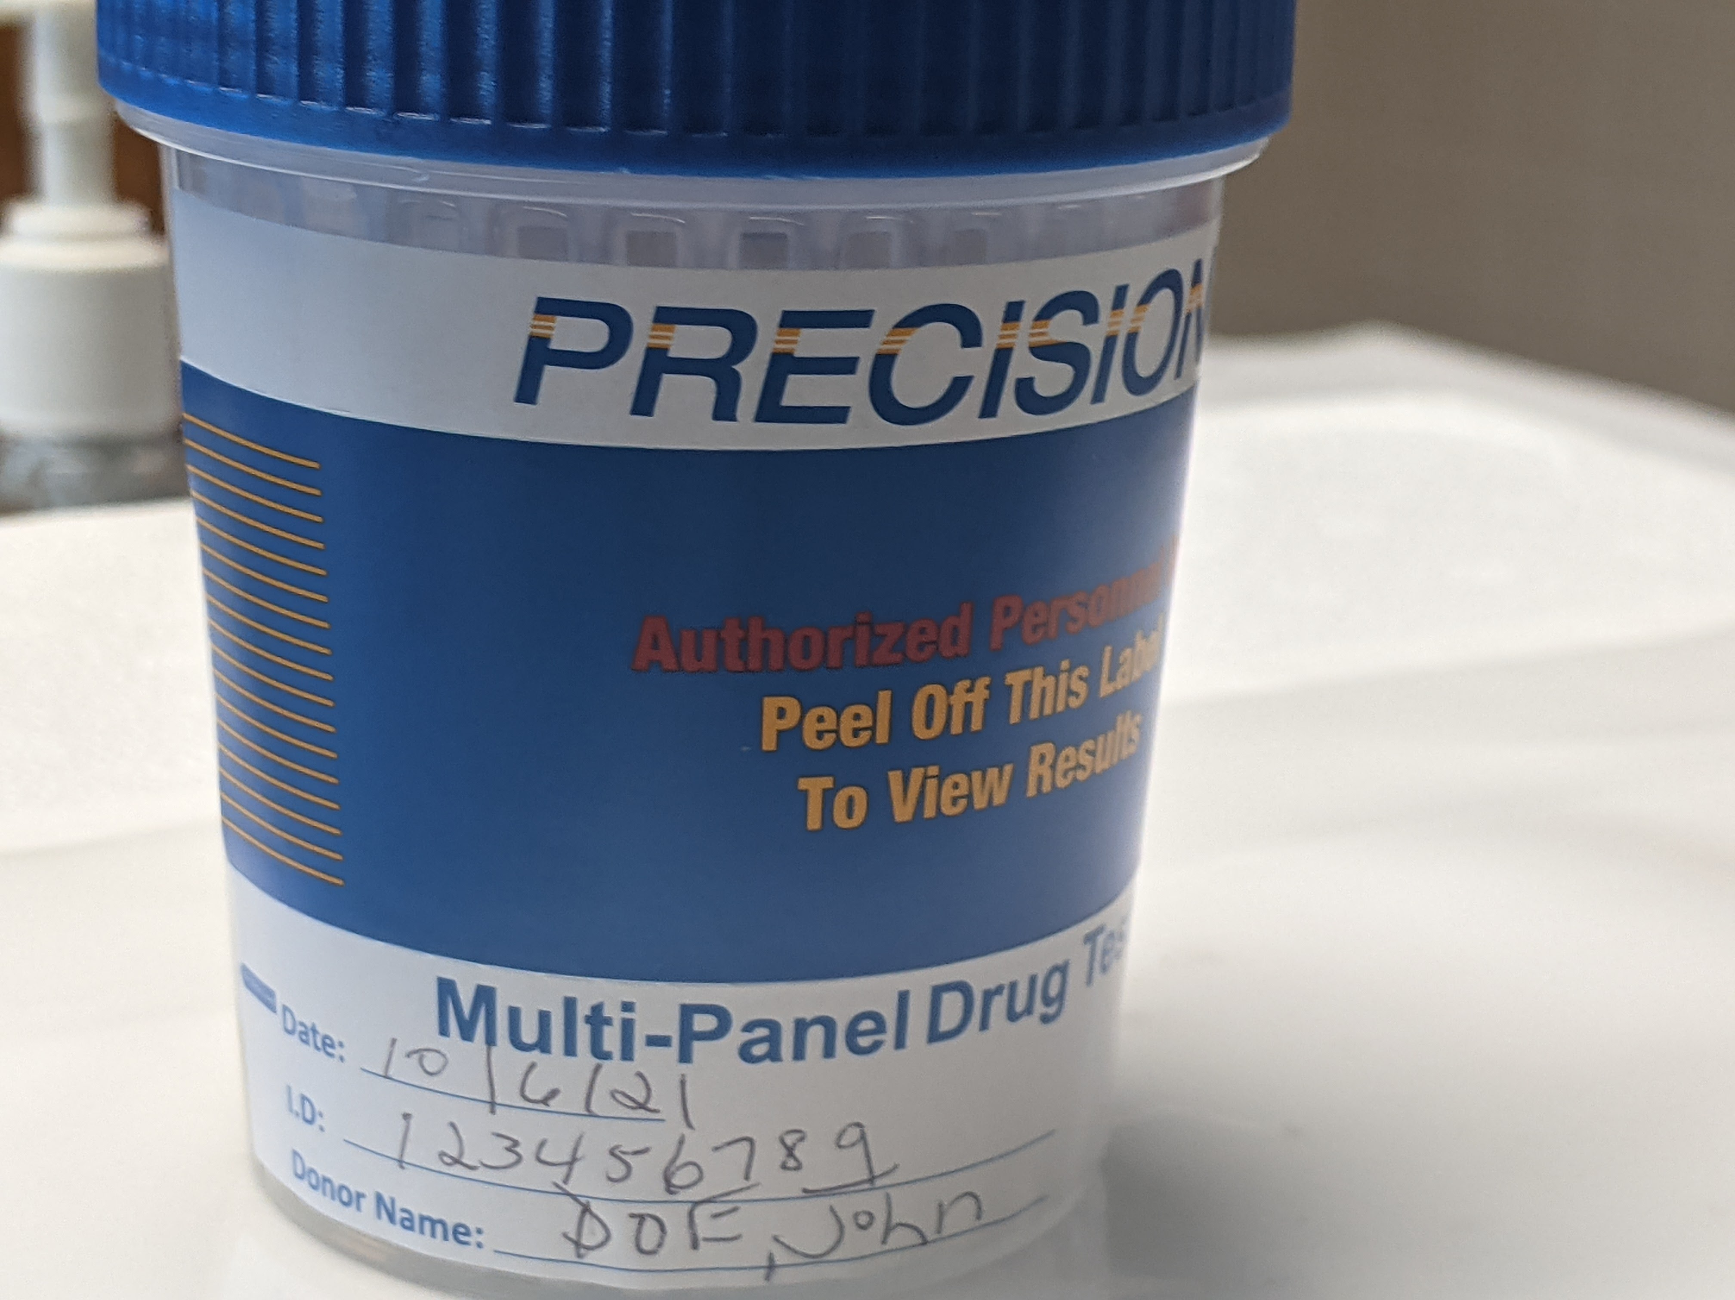
Pour off patient urine sample from bd blue capped cup or HAVE PATIENT collect specimen directly into precision plus multi drug panel cup. FOLLOW DIRECTIONS FOR TESTING AND RESULT INTERPRETATION ON THE PACKAGE. DO NOT USE EXPIRED CUPS. MAKE SURE CUP IS LABELED WITH AT LEAST TWO PATIENT IDENTIFIERS AND COLLECTION DATE. DO NOT SEND PRECISION CUP TO LAB FOR CONFIRMATION TESTING. DO NOT POUR OFF SAMPLE FROM PRECISION CUP TO OTHER CONTAINERS.

Slide 5
CLICK BELOW FOR THE FULL PROCEDURE ON USING THE PRECISION PLUS MULTI-PANEL TEST CUP

Slide 6
ENTER ALL RESULTS INTO PATIENT’S CPRS CHART USING TEMPLATE TITLED “ MH-URINE DRUG SCREEN POINT OF CARE”.

Slide 7
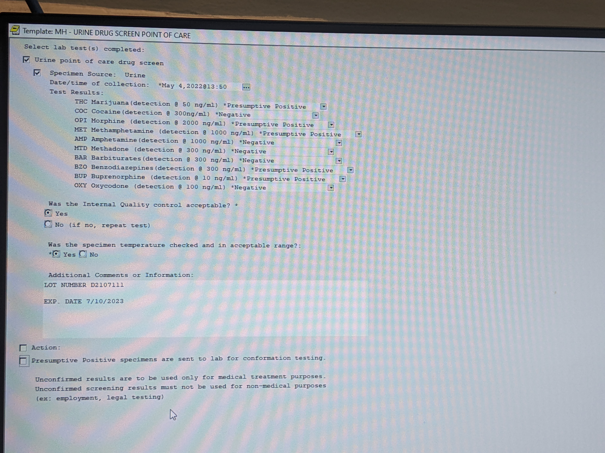
CONSULT THE EXAMPLE BELOW FOR COMPLETE REQUIREMENTS WHEN ENTERING INFORMATION INTO THE TEMPLATE. RESULTS FOR EACH DRUG, THE INTERNAL QUALITY CONTROL, SPECIMEN TEMPERATURE, CUP LOT NUMBER AND EXPIRATION DATE ARE ALL REQUIRED.

Slide 8
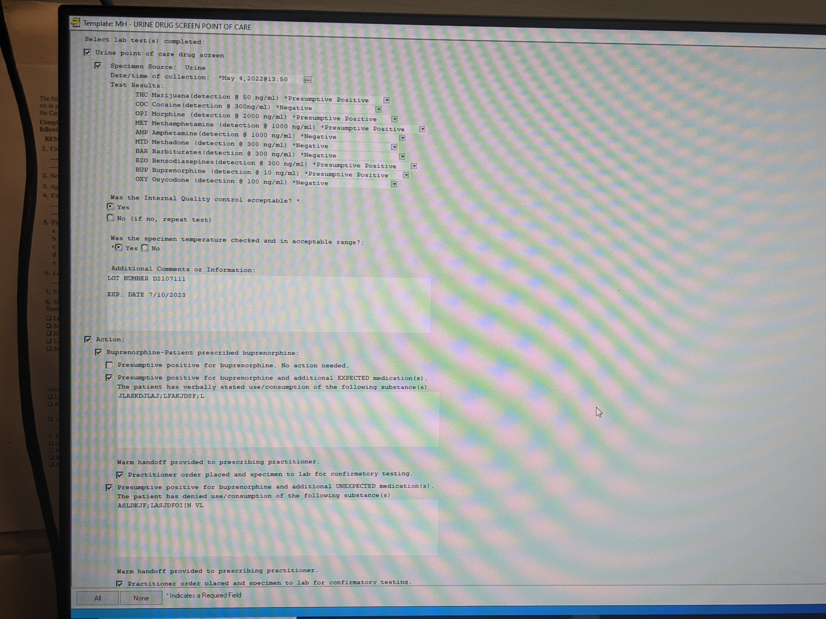
Additional fields are available in the template. They may be completed as required by your service line management and/or providers

Slide 9
QUESTIONS?Contact LISA LEE
LISA.LEE10@VA.GOV
EXT 72124

