Slide 1
Professional Collector Training
Introduction
Students
Instructor
Background
Federal vs. Private
Collector Training
Collection process (A to Z)
Laboratories
MRO’s
Drugs being tested
Federal Regulations
Teaching Techniques
Written Exam

Slide 2
Background
Federal Programs
5 panel
Split specimen
Urine only
MRO required
Trained collectors
Certified labs
Private programs
9 Panel (or more)
Single bottle
Urine, Hair, Saliva, Sweat
MRO not required
(unless required by state law)
No collector training required
Non-certified labs and instant devices

Slide 3
Federal Register Subpart Overview
Subpart D – Collectors
Subpart E – Collection Sites
Subpart F – Federal Drug Testing Custody and Control Forms
Subpart G – Specimen Collection Containers
Subpart H – Specimen Collection Procedure
Subpart M – Medical Review Officer

Slide 4
Subpart D – Collectors
Qualification Training:
All steps to complete Custody and Control Form (CCF)
“Problem” Collections (Insufficient Sample)
Fatal Flaws and Correctable Flaws

Slide 5
Subpart D - Collectors
Initial Proficiency:
5 Error Free mock drug screens:
one uneventful
one insufficient quantity of urine
one temperature out of range
one test where the donor refuses to sign the CCF
one test where the donor refuses to initial the specimen bottle seals.
A trainer must monitor and evaluate the new collector’s performance
Written Exam

Slide 6
Subpart D - Collectors
Refresher Training for Collectors:
At least every 5 years
Error Correction Training:
Discrepancies- Accumulation of 5 in a twelve month period.
Fatal Flaw
3 mock drug screens to correct.
Must document that training has occurred.
No collection must be done until training is complete.

Slide 7
Subpart D - Collectors
Gender Requirements
Normal tests: It is permissible to collect for the opposite gender
Directly Observed Collections: Same Gender! (No Exceptions). Transgender donors are observed by a collector whose gender matches the donor’s identified gender.
Monitored Collections: Same Gender or Medical Professional
Notes:
Directly Observed Requirements: No Exceptions. Never. Nada. Zilch
Monitored: May cross gender if monitor is a medical professional in the jurisdiction they are collecting (Doctor, Nurse, Physician Assistant)

Slide 8
Subpart D – Collectors
Who may not serve as a collector?
The donor
Employee of the Laboratory
Co-worker from the same testing pool
Friend or relative
Immediate supervisor*

Slide 9
Subpart E – Collection Sites
Where can a urine collection take place?
Private
Secure
Water for hand washing
Work area – Materials needed

Slide 10
Subpart F- Federal Custody and Control Form (CCF)
Which form is to be used to collect a specimen for VA employees?
2021 Federal CCF, for current and potential employees of the VA.
Old forms are no longer acceptable.

Slide 11
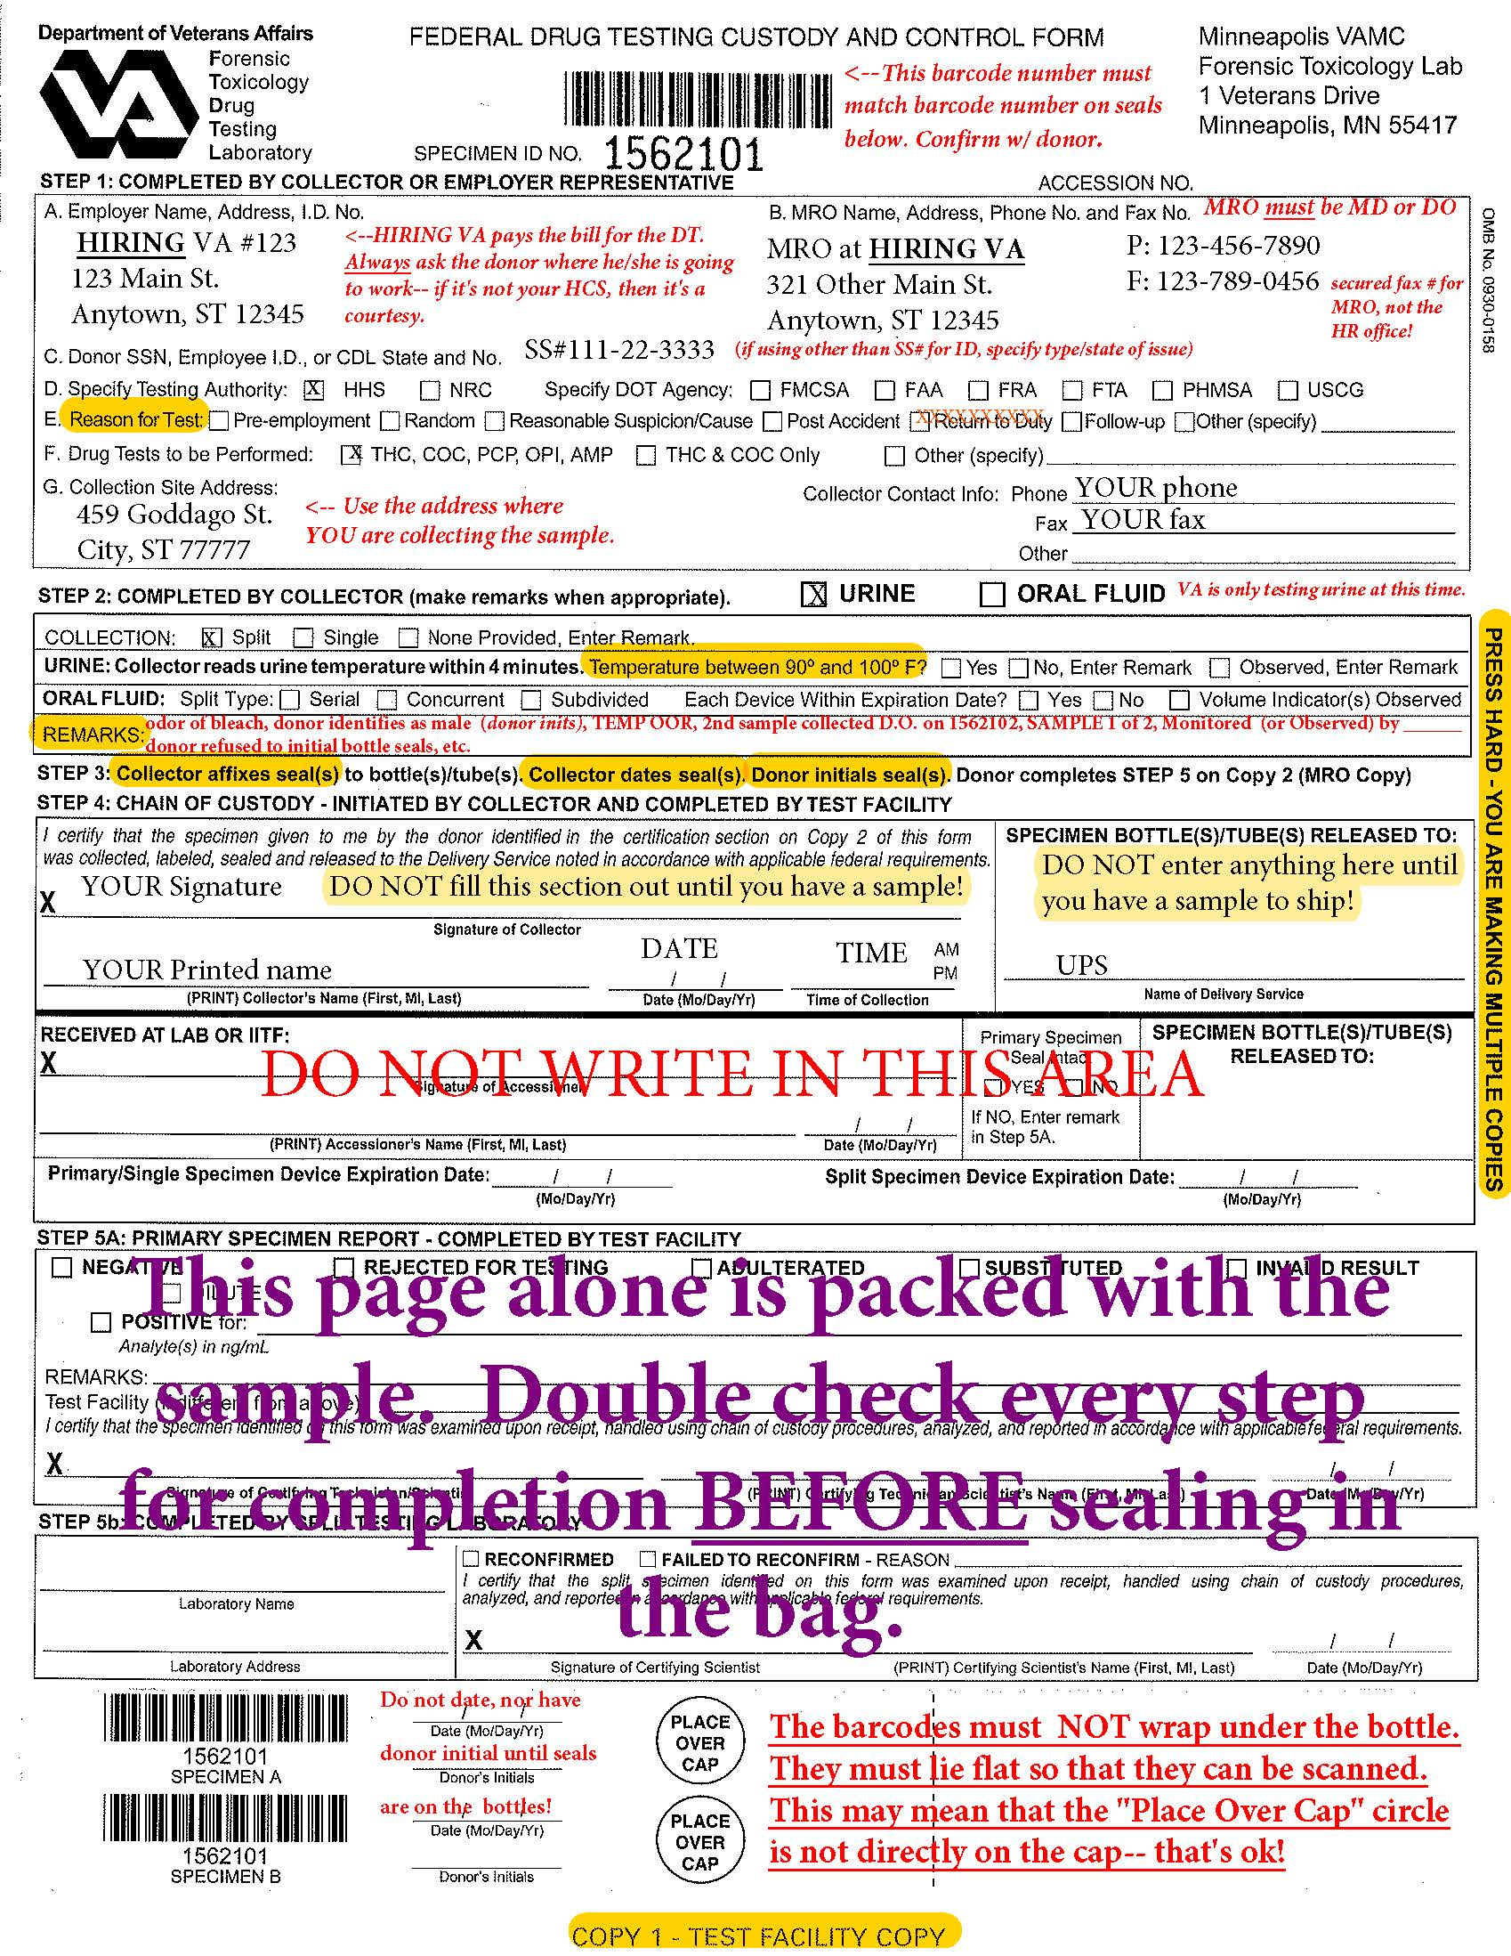
Federal CCF: Step 1
A. Employer Name and Address
B. MRO Name, address, phone, or Fax
C. Donor ID *if DL is used, include the State
D. Testing Authority
E. Reason for Test
F. Drug Tests to be performed
G. Collection Site Address
Notes:
VA is in a random pool administered by HR. They do 1 Last Chance agreement with any self admittance. Safe Harbor.

Slide 12
Federal CCF: Step 2
Completed by Collector-URINE
Temperature- choose applicable option
Specimen Collection- VA only allows SPLIT URINE SAMPLES. ORAL FLUID is not used for testing at this time.
Observed Collection (enter remark as needed)

Slide 13
Federal CCF: Step 4
Signature of Collector
Printed name of Collector
Time
Date
Specimen Bottle Release
Notes:
Donor may refuse to offer any of this information. Collector must write in the donor name (minimum)

Slide 14
Federal CCF: Step 5
Donor certification
Donor prints their name
Donor signs their name
Places Date and DOB

Slide 15
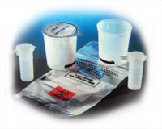
Subpart G – Specimen Collection Containers
A single-use collection
container/cup capable of
holding up to 55mL
Two bottles which can be
sealed for transport, one must
hold 35 mL and one must hold
at least 20 mL

Slide 16
Prior to Specimen Collection Procedure
Place this sign outside of the interview room

Slide 17
Prior to Specimen Collection Procedure
Read to Donor Before Starting the Interview

Slide 18
This privacy notice should be on display in the interview room. It is on the back of the donor copy.

Slide 19
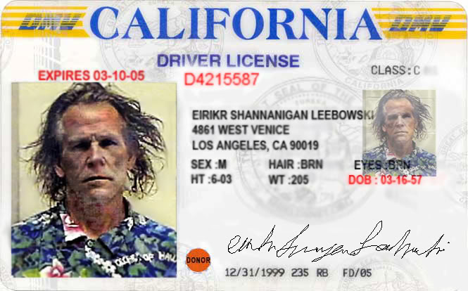
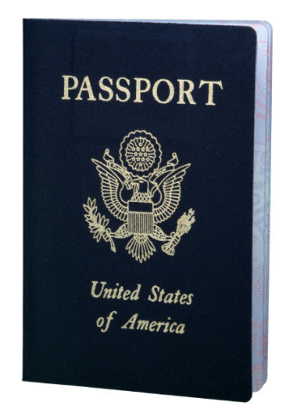
Subpart H – Specimen Collection Procedure
Introduction
Be Polite
To the point
Identification
Government Issued,
Company Issued, Passport (If SS# not used indicate type (“DL# with State”, “Passport #” etc.)
Federal Agency Representative
Initiate the CCF
Choice of Drug Testing Kits
Notes:
Act out good intro, bad intro and lax intro
To the point – Exemplify – do not muddy the water
Identification: HHS Collector Handbook 6

Slide 20
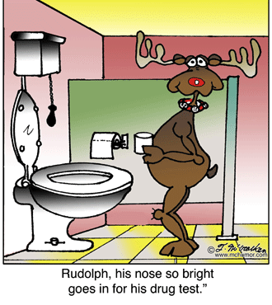
Collection Procedure
Secure the donor
Outerwear
Pockets
Refusal to comply is
refusal to test
Donor may ask for an itemized
receipt for items stored in locker.
This is ok, but DON’T offer it if it
isn’t requested!
Notice: No hats, coats, or bulky pockets

Slide 21
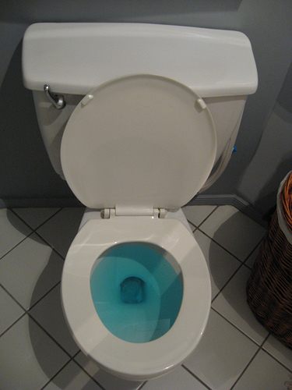
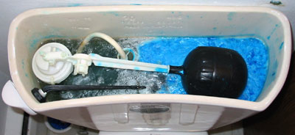
Collection Procedure
Secure the collection site
Must secure all water sources
Toilet water blue
Remove or secure all soaps, other
potential adulterants
Visually check for unauthorized materials
Repeat after each collection

Slide 22
Collection Procedure
Instruction to the Donor:
Wash hands before
45mL minimum
Do not flush toilet
Exit stall as soon as possible
Do not wash hands until instructed

Slide 23
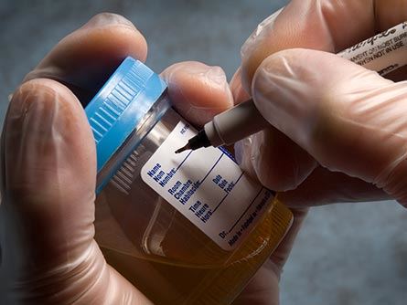
Donor Presents Specimen to Collector
Check Temperature (90-100)
Required amount of urine
Signs of tampering
Donor to witness as you seal the specimen
Seal the specimen with tamper-evident seal
Initial and Date
Specimen Bag
Donor to Complete page 2 of the CCF
Complete Checklist

Slide 24
Post Collection Checklist
-Serves as a double check before mailing sample.
-Make the process interactive with the donor.
(Good idea to print double sided with QNS form on back)

Slide 25
Monitored Collection
Requirements:
Same Gender or medical professional (e.g. nurse, doctor, PA, technologist, or tech licensed in the collection jurisdiction.)
May use another person to monitor
DO NOT WATCH (see Direct Observation)
Listen for sounds, watch for other evidence of tampering.
Write monitors name in remarks section of CCF if someone other than the collector.

Slide 26
Direct Observation
As a collector you must do a direct observation when:
A Federal Agency requests it
Positive drug test, negative dilute, adulterated, substituted, or invalid, or
Temperature out of range
Signs of tampering
Unusual color, excessive foaming when shaken, unusual odor

Slide 27
Direct Observation (Cont.)
**You must confer with site manager prior to proceeding with an observed collection
Explain process to donor
Donor and Collector MUST be same Gender
If not, you must use an “observer” who is the same gender as the donor (see handout); and,
If observer is someone other than the collector, complete D.O. form and write “observed by name” in remarks section.
Transgender donor writes his/her gender in remarks and initials it..
Notes:
Inform

Slide 28
Direct Observation Form

Slide 29
Direct Observation (Cont.)
Use remarks section of CCF to create forensic tie
Example:
first attempt=Temp out of range, 2nd specimen will be collected under DO, Spec ID: 987645. #1 of 2
Second Specimen Remark:
1st Spec ID 987644, #2 of 2

Slide 30
Direct Observation (Cont.)
Direct Observation Collection Process
Same steps as normal test
Collector enters collection room with donor
Collector watches urine exit the body and enter into the collection container
Do not use mirrors or video camera

Slide 31
Subpart K– Drug Testing Laboratories
Laboratories: HHS Certified
Blind Samples
Test for the following under DHHS
THC (Marijuana)
Cocaine
Phencyclidine (PCP)
Opiates (includes oxycodone, oxymorphone, hydrocodone, hydromorphone
Amphetamines (includes MDMA & MDA)

Slide 32
DIRECT OBSERVATION COLLECTION

Slide 33
Subpart M– Medical Review Officers
Qualifications
Licensed Physician with knowledge
regarding the pharmacology and
toxicology of illicit drugs
Certification Training
Knowledge of Collection Procedures
Understanding of lab findings and interpreting the results.

Slide 34
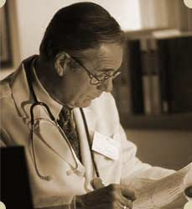
Medical Review Officer MRO (cont.):
Responsibilities
The MRO is the “Gatekeeper”
Release both “positive” and “negative” results
They work for the employee/donor

Slide 35
Subpart N –Split Specimen Test
When, Where and How?
72-hour rule (Donor has 72 hrs to decide).
Donor request goes through the MRO.
MRO makes request to the lab
The specimen (bottle B) is shipped to another lab for additional testing

Slide 36
Subpart I – Problems in Drug Testing
Common problems
Refusals
Donor Fails to:
Appear
Remain at the collection site
Provide a sample (unwilling or unable)
Allow “observer” or “monitor” to perform duties
Undergo medical evaluation
Cooperate with process

Slide 37
What to do with Refusals?
Action Items
Notify the Agency’s HR representative by telephone as soon as possible
Document “REFUSAL to Test” on CCF
Send all copies of Federal CCF to the Agency’s designated representatives

Slide 38
Insufficient Sample aka “Shy Bladder”
This form should be filled out and used as a worksheet in situations where the donor does not provide at least 45mL on the initial attempt. Attach to and file with Collector Copy of CCF

Slide 39
Collector Errors
If you make an error you should:
Make a line through the erroneous information, leaving the original info legible
Write the correct info near the original annotation
Initial and date the change
Submit an MFR if sample is already sealed

Slide 40
Memorandum for the Record
MFR should be filled out as soon as it is discovered that an error was made. Send to Tox lab and MRO. Attach original to collector copy.

Slide 41
Correctable Flaws
1. Collector failed to sign: Collector submits memo stating that he/she was the collector, and it was an oversight.
2. Forms: specimen submitted on a non-Federal or expired Federal CCF. Collector sends memo explaining why incorrect form was used and ensures all required information is contained.
Both types must be corrected within 5 business days or specimen is rejected.

Slide 42
Fatal Flaws
1. Specimen ID on seal does not match ID on CCF, or is missing on one or the other.
2. Bottle seal is broken or shows evidence of tampering on primary bottle AND Bottle B cannot be re-designated as primary specimen.
3. Collector’s printed AND signed name are omitted on the CCF.
4. Primary specimen is QNS and Bottle B cannot be re-designated as primary specimen (QNS, seal broken, etc.)
Testing process ceases, specimen is rejected.

Slide 43
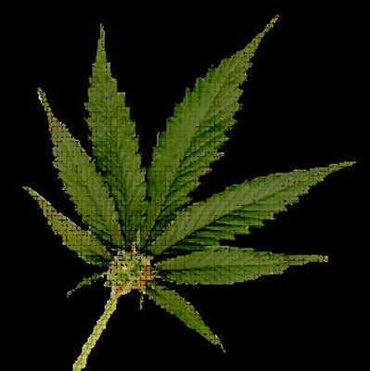
Marijuana (THC)
Physical Effects
Red Eyes
Increased Heart Rate
Dry Mouth
Increased Appetite
Strong Odor
Unexplained emotional responses (uncontrollable laughter)
Behavioral
and Performance Effects
Impaired Short-Term Memory
Impaired Reaction
Reduced Concentration
Respiratory Problems
Distorted Time and Distance
Distorted
Vision

Slide 44
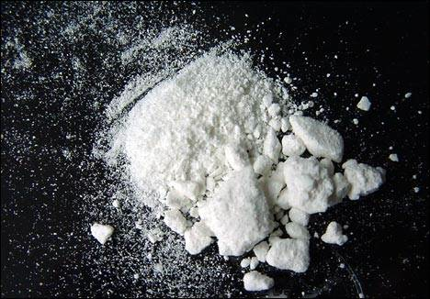
Cocaine
Physical Effects
Euphoria
Increased Respiration and Heart Rate
Dilated Pupils (large)
Distorted Vision
Visual and Auditory Hallucinations
Behavior
and Performance Effects
Overreaction
Easily Irritated
False Security
Attention Deficiency
Anxiety
Depression

Slide 45
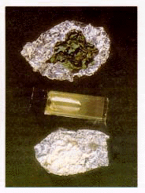
PCP
Physical Effects
Increased Heart Rate
Increased Blood Pressure
Impaired Speech
Hallucinations
Sweating and Flushness
Loss of Coordination
Dizziness
Numbness
Behavioral
and Performance Effects
Changes in Perception
Sense of Invulnerability
Impaired Coordination
Unrealistic Sense of Strength
Violent Outbursts
Paranoia

Slide 46
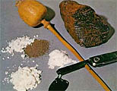
Opiates
Physical Effects
Relaxation
Increased Pain Tolerance
Decreased Pupil Size
Cold-Moist-Blue Skin
Weight Loss
Bruising and Scabbing (injection site)
Behavior
and Performance Effects
False Security
Intoxication displays similar to those of “being drunk”
Inability to Concentrate
Vision Distortion (decreased pupils)
Extreme “highs” and “lows”
Excessive Fatigue

Slide 47
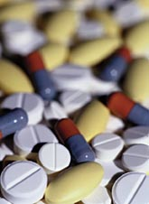
Amphetamines
Physical Effects
Unrealistic Alertness
Dilated Pupils
Dry Mouth
Euphoria
Weight Loss/Decreased Appetite
Changes in Hygiene
Increases in Physical Activity
Nervous “Ticks”
Behavior
and Performance Effects
Irritability
Over-estimation of Abilities
Apparent Loss of Abilities
Paranoia
Volatile Moods
Aggressiveness

Slide 48
Conclusion
Things to remember
Collect specimens as you would want your specimen collected.
Inspect the collection sites regularly
Double check all CCF’s before sealing them
Remember to be a “collector” when you are a collector.

Slide 49
Question & Answer Mock Collections Written Exam

