Slide 1

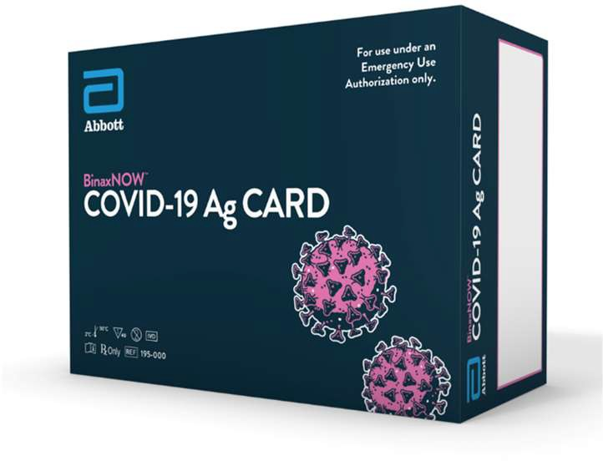
BinaxNOW™
COVID-19 Ag Card
Overview
Emergency Use Authorization Granted by FDA

Slide 2
Intended Use: Key Points
The BinaxNOW™ COVID-19 Ag Card is intended for the qualitative detection of nucleocapsid protein antigen from SARS-CoV-2 in nasal swabs from individuals suspected of COVID-19 by their healthcare provider within the first seven days of symptom onset.
Antigen is generally detectable in nasal swabs during the acute phase of infection.
Negative results should be treated as presumptive and confirmation with a molecular assay, if necessary, for patient management, may be performed.
Proprietary and confidential — do not distribute

Slide 3
BinaxNOW™ COVID-19 Ag Card
Emergency Use Authorization
The BinaxNOW™ COVID-19 Ag Card is only for use under the Food and Drug Administration’s Emergency Use Authorization
What is Emergency Use Authorization (EUA)?
FDA emergency access mechanism
Health & Human Services declare when circumstances exist to justify use of diagnostics under EUA for the diagnosis of COVID-19
It is not full FDA clearance or approval and is temporary, until the declaration is terminated or revoked.
Proprietary and confidential — do not distribute

Slide 4
BinaxNOW™ COVID-19 Ag Card
Emergency Use Authorization
Test Site Obligations:
Notify relevant public health authorities on intent to run test
Report all results to healthcare providers and include the Healthcare Provider Fact Sheet. Healthcare providers to include Patient Fact Sheet with results
Utilize product as outlined in the BinaxNOW COVID-19 Ag Card Instructions for Use
Ensure all operators are trained to perform and interpret the test
Have process in place for reporting test result to Healthcare Providers & relevant public health authorities
Per Product Insert: Collect performance data and report any significant deviations from the product performance characteristics via email to FDA/HHS and to Abbott Technical Support
Retain all records associated with EUA until otherwise directed by FDA
Proprietary and confidential — do not distribute

Slide 5
COVID-19 CARES Act Reporting Requirements
Reporting requirements apply to COVID-19 testing sites performing testing, including:
Laboratories that perform clinical testing under a Clinical Laboratory Improvement Amendments (CLIA) certificate
Non-laboratory COVID-19 testing locations
Other facilities or locations offering COVID-19 point-of-care tests, or in-home tests
Reach out to state agencies for specific guidance on implementation for reporting
Proprietary and confidential — do not distribute

Slide 6
Government Resources for COVID-19 Testing
PREP Act Coverage for COVID-19 Testing
  Guidance from the Department of Health and Human Services
FDA’s FAQ on Testing for SARS-CoV-2
  FDA Recommendations for Health Care Providers
Proprietary and confidential — do not distribute

Slide 7
BinaxNOW™ COVID-19 Ag Card Technical Overview

Slide 8

BinaxNOW™ COVID-19 Ag Card
Product Overview
Test Summary | Rapid lateral flow immunoassay for the qualitative detection of SARS-CoV-2
Testing Environment | Point of Care settings with a CLIA Certificate of Waiver, Compliance or Accreditation
Specimen Type | Direct nasal swab
Time to Result | Results visually read at 15 minutes *Results should not be read after 30 minutes
Waste Disposal | All components should be discarded as Biohazard Waste
PPE for Specimen Collection & Handling | Refer to CDC Guidelines for collecting, handling and testing clinical specimens (link in Product Insert)
Proprietary and confidential — do not distribute

Slide 9
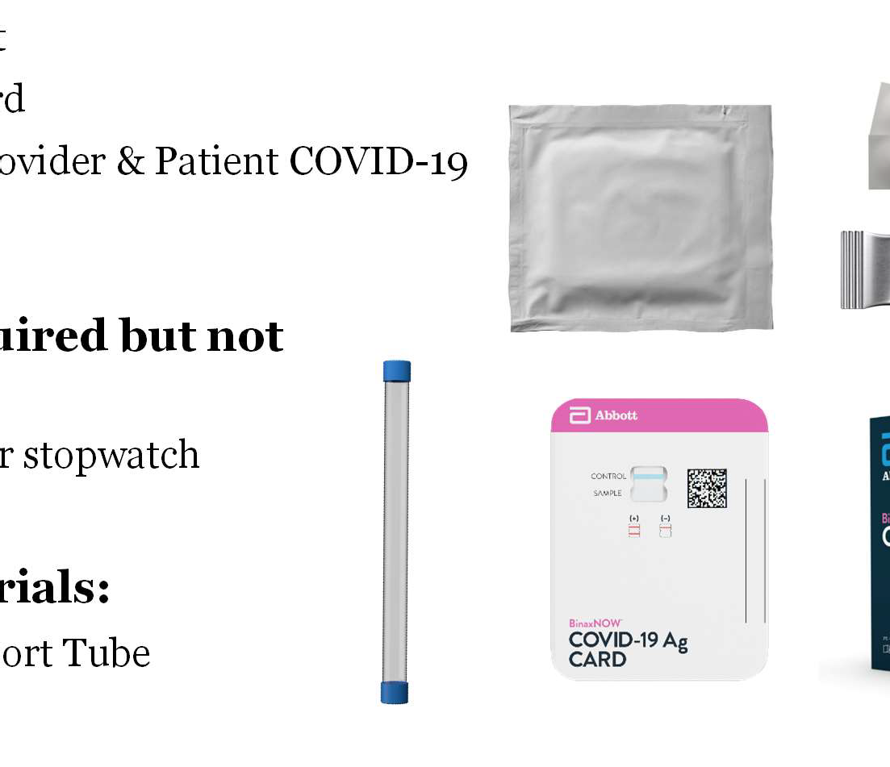
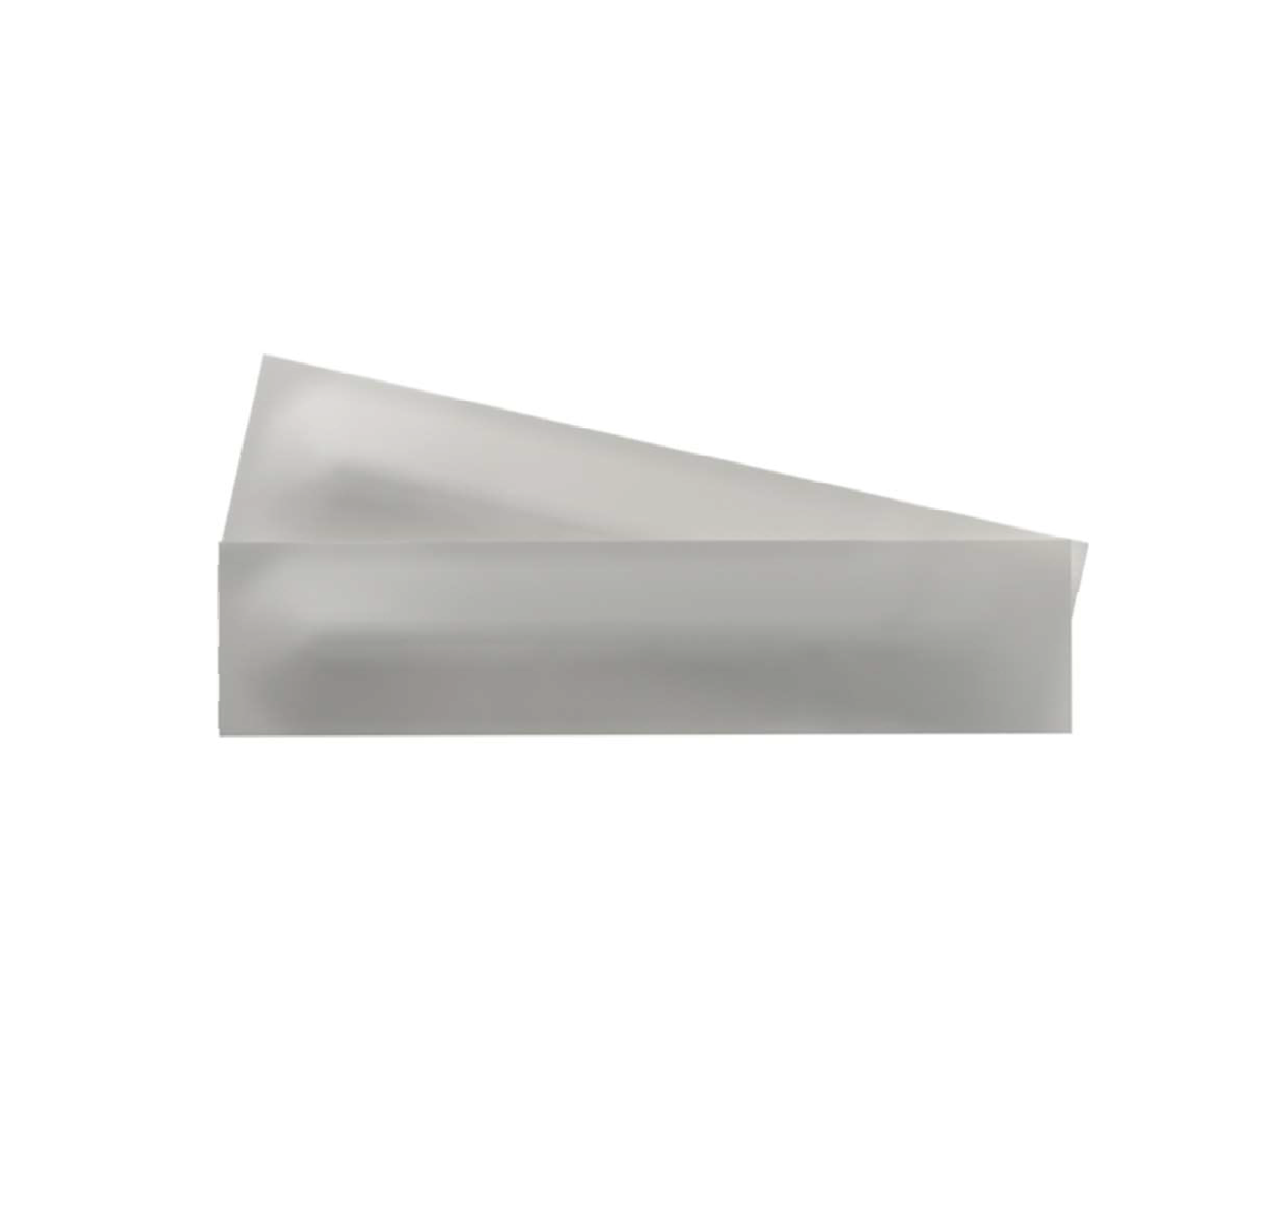
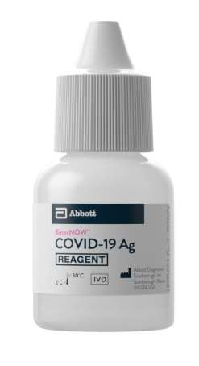
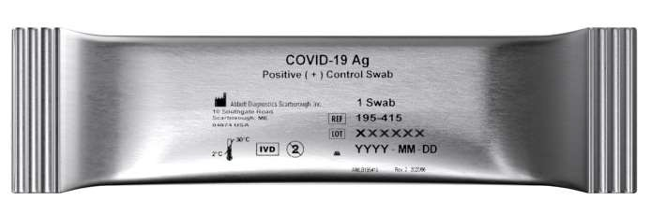
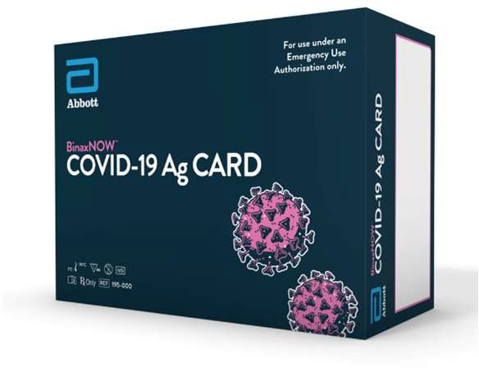
Reagent and Materials
Materials Provided:
40 Test Cards
Extraction Reagent
Patient Collection Nasal Swabs
Positive Control Swab
Blank Nasal Swab for Negative Control
Product Insert
Procedure Card
Healthcare Provider & Patient COVID-19 Fact Sheets
Materials Required but not Provided:
Clock, timer or stopwatch
Optional Materials:
Plastic Transport Tube
Storage & Stability:
Store kit at 2-30°C
Ensure all test components are at room temperature before use
Stable until the expiration date marked on the outer packaging
Proprietary and confidential — do not distribute

Slide 10
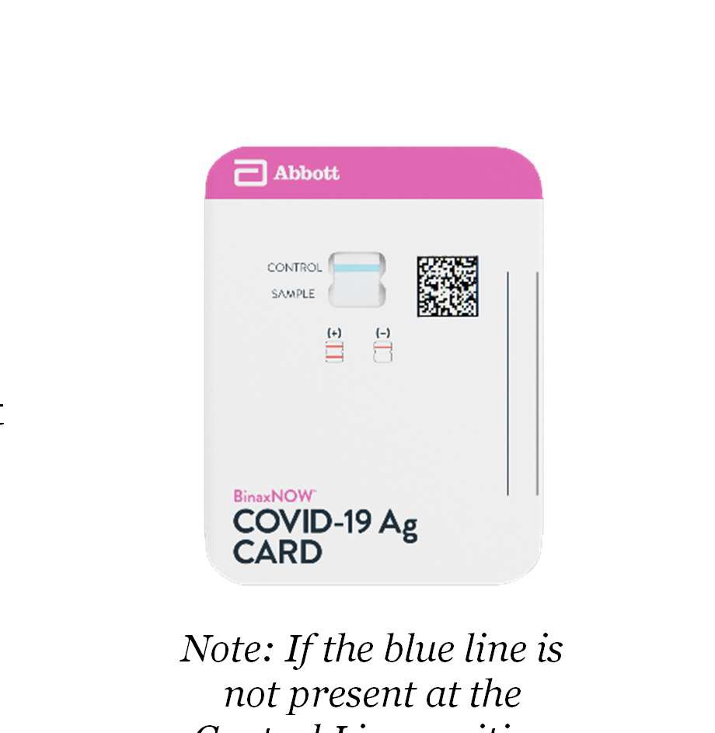
Quality Control
Internal Procedural Controls:
BinaxNOW™ COVID-19 Ag Card has built-in procedural controls
In an untested card there will be a blue line at the Control Line position
In a valid, tested device, the blue line washes away and a pink/purple line appears, confirming that the sample has flowed through the test strip and the reagents are working
Note: If the blue line is not present at the Control Line position prior to running the test, do not use and discard
Proprietary and confidential — do not distribute

Slide 11
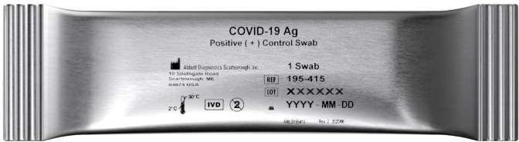
When is Quality Control Required?
External Positive & Negative Controls:
Good laboratory practice suggests the use of positive and negative controls to ensure that test reagents are working properly and that the test is correctly performed
BinaxNOW™ COVID-19 Ag Card kits contain a positive control swab and sterile swabs that can be used as a negative control
Required Frequency:
New shipments received
Untrained operators
Conforming with local, state, and/or federal regulations, accrediting groups, or lab’s standard QC procedures.
Note: If correct results are not obtained, contact the Abbott Technical Services Team at
1-800-257-9525 between 8 a.m. and 8 p.m. EST Monday-Friday before testing patient specimens
Proprietary and confidential — do not distribute

Slide 12
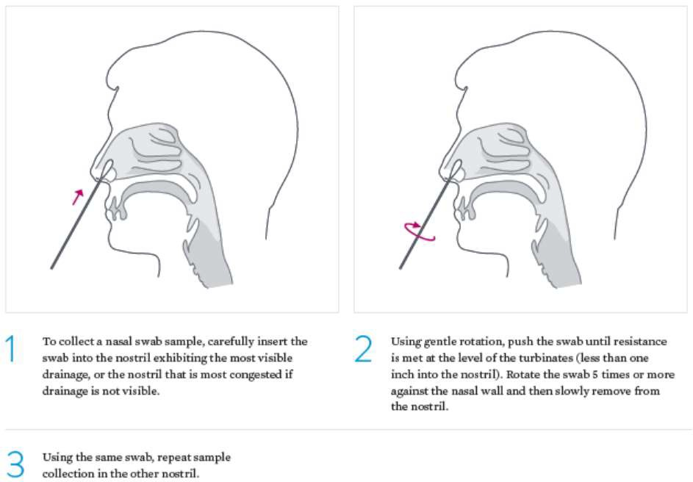
Nasal Swab Sample Collection
Only the swab provided in the kit is to be used for nasal swab collection
Insert the nasal swab into the nostril exhibiting the most drainage or congestion
Using gentle rotation, push the swab until resistance is met
  At the level of the nasal turbinates
  Less than one inch into nostril
Firmly sample the nasal wall by rotating the swab in a circular path against the nasal wall 5 times or more for a total of 15 seconds
Slowly remove the swab
Using the same swab, repeat sample collection in the other nostril

Slide 13

Specimen Transport & Storage
For best performance, direct nasal swabs should be tested as soon as possible after collection.
If immediate testing is not possible:
Do not return the nasal swab to the original paper packaging
To avoid contamination and preserve sample integrity, place the nasal swab in a clean, unused, tightly capped plastic tube & label with the patient information
The sample is stable in the plastic tube at room temperature (15-30°C) for up to one (1) hour prior to testing
If greater than one (1) hour delay occurs, dispose of sample & collect new sample

Slide 14
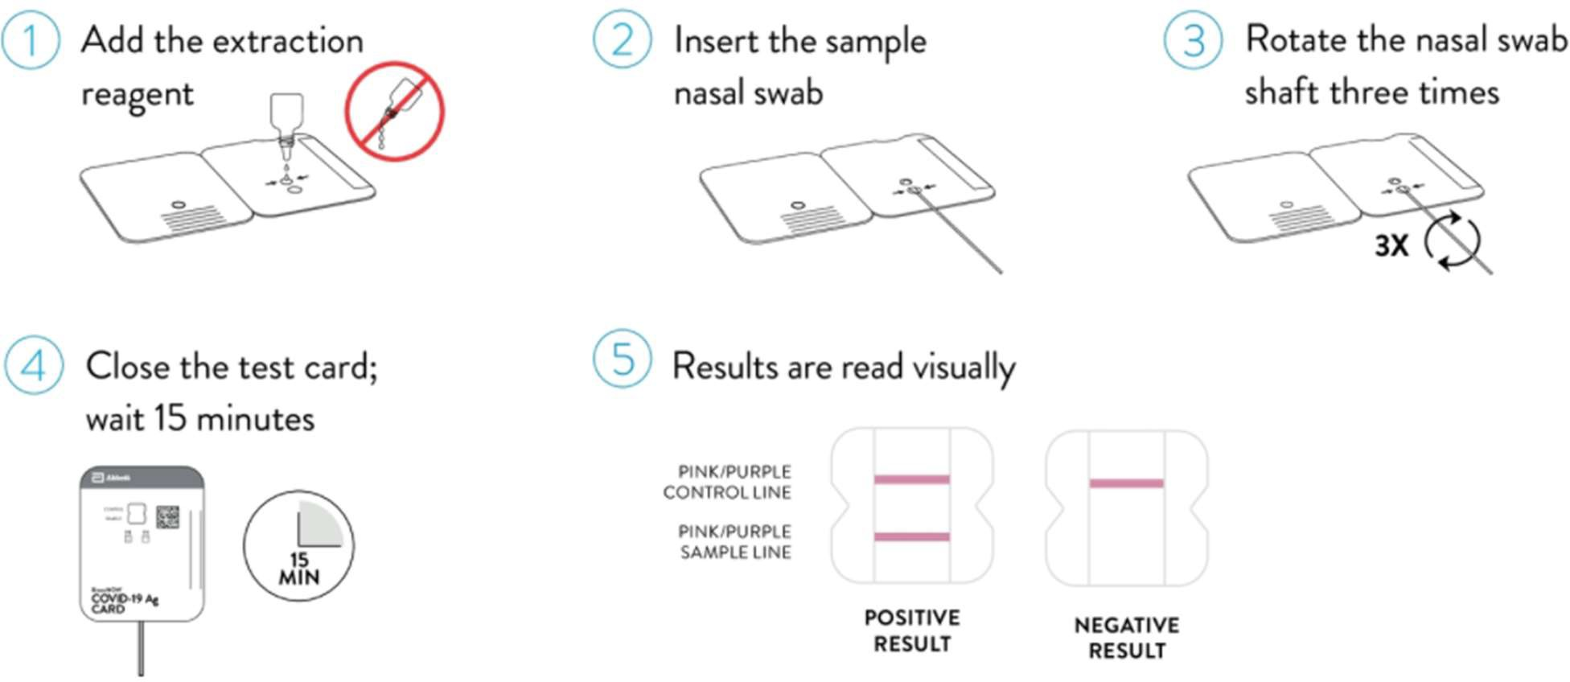
BinaxNOW™ COVID-19 Ag Card Test Procedure Overview
Proprietary and confidential — do not distribute

Slide 15
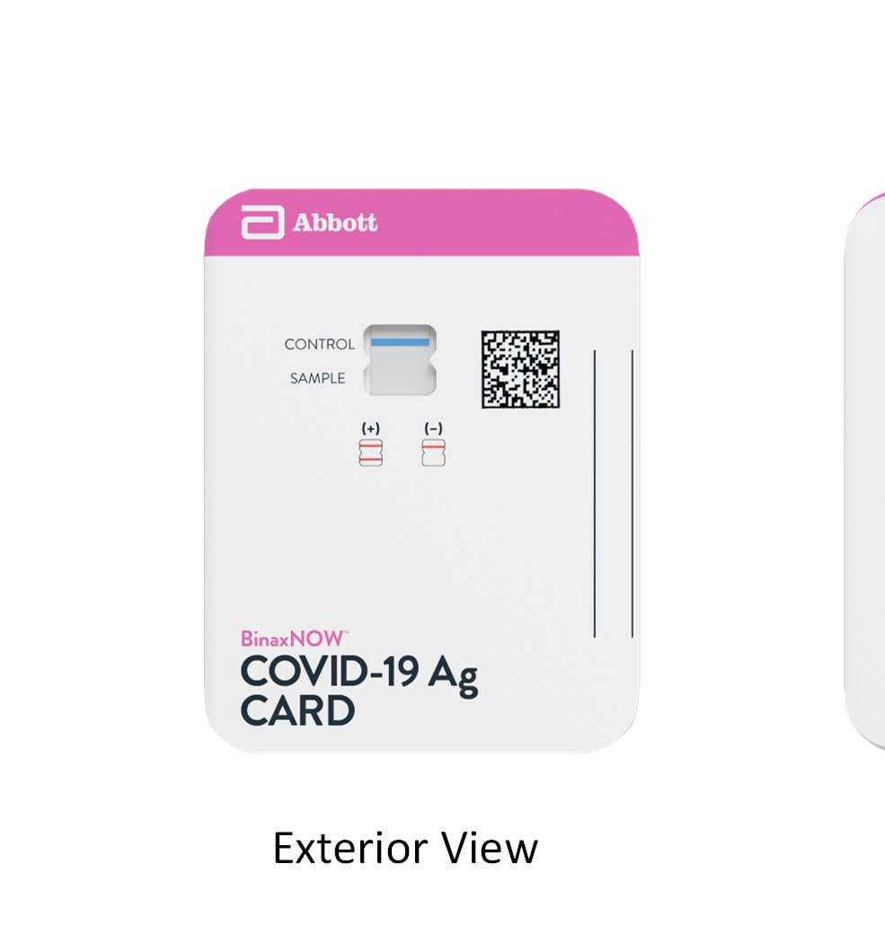
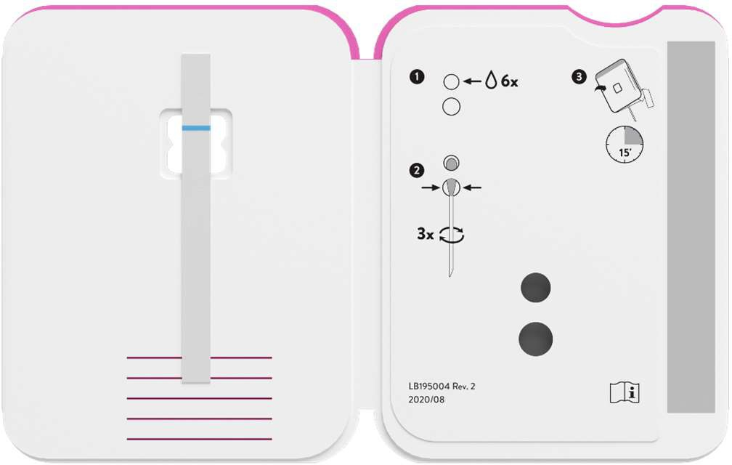
BinaxNOW™ COVID-19 Ag Card Overview
Exterior View
Interior View

Slide 16
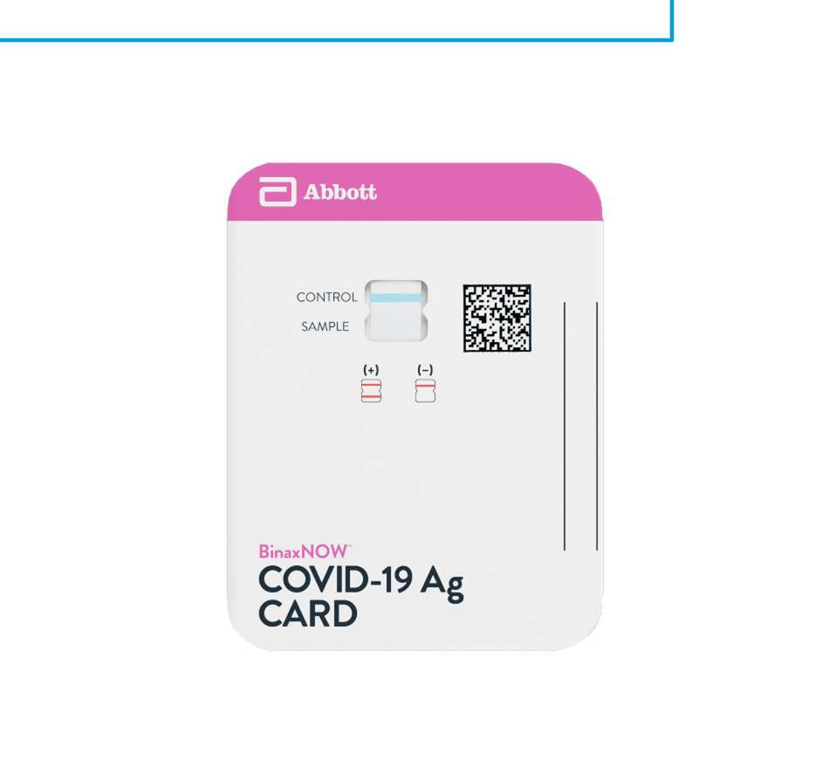
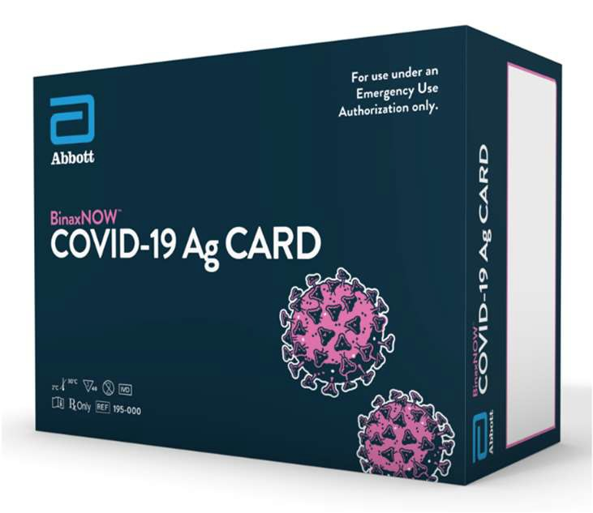
BinaxNOW™ COVID-19 Ag Card Procedure
Key Points
Prior to Beginning a Test Remember to:
Ensure all components are at room temperature
Open test card j ust prior to use
Lay test card flat for use
Ensure Blue Control Line is present
Proprietary and confidential — do not distribute

Slide 17
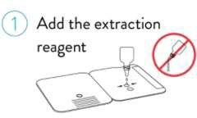
BinaxNOW™ COVID-19 Ag Card Procedure
Key Points
Step 1:
Hold extraction reagent bottle vertically to ensure adequate volume
Add 6 drops for a Patient test
Add 8 drops for a Quality Control test
Proprietary and confidential — do not distribute

Slide 18
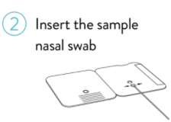
BinaxNOW™ COVID-19 Ag Card Procedure
Key Points
Step 2:
Insert swab into the bottom hole of the test card
Firmly push swab upwards until the swab tip is visible in the top hole
Proprietary and confidential — do not distribute

Slide 19
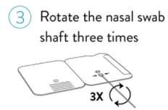
BinaxNOW™ COVID-19 Ag Card Procedure
Key Points
Step 3:
Rotate swab shaft 3 times CLOCKWISE (to the right).
False negative results can occur if the sample swab is not rotated (twirled) prior to closing the card
Proprietary and confidential — do not distribute

Slide 20
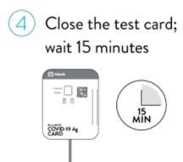
BinaxNOW™ COVID-19 Ag Card Procedure
Key Points
Step 4:
Peel off adhesive liner from the right edge of the test card
Close and securely seal the card
To ensure proper test performance read results at 15 minutes and not before
Results should not be read after 30 minutes
Proprietary and confidential — do not distribute

Slide 21
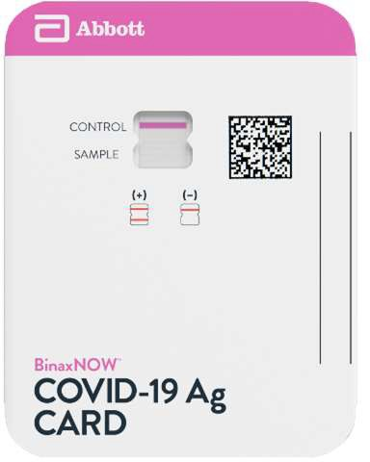
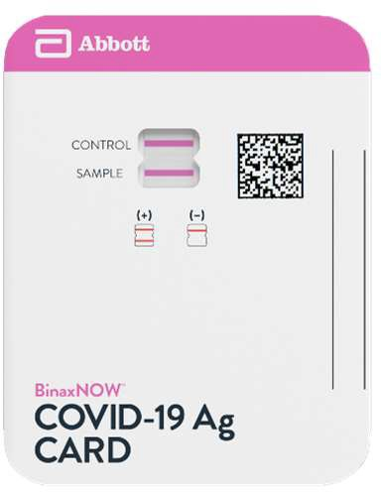
Result Interpretation
Negative
One pink/purple colored line in the top half of the window, in the Control Line position
Indicates a negative result & no antigen detected
Positive
Two pink/purple colored lines in both the Control & Sample Line position
Indicates COVID-19 antigen was detected
Any visible pink/purple line is positive
Proprietary and confidential — do not distribute

Slide 22
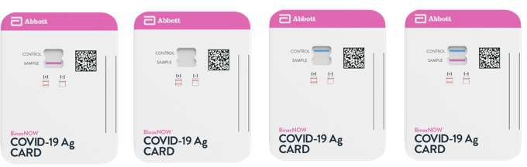
Result Interpretation
Invalid
The assay is invalid & should be repeated if:
Only the Sample Line is present
No lines are present
Blue Control Line remains blue
Test should be discarded as Biohazard waste
Proprietary and confidential — do not distribute

Slide 23
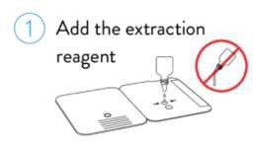
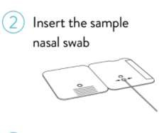
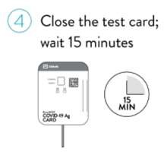
Near-Patient Workflow: No Swab Transport*
(Collect Patient Swab First, Prior to Test Procedure)
Collect Nasal Swab
Collect Nasal Swab
Step 1: Add the Extraction Reagent
Step 3: Rotate (twirl) swab shaft 3 times clockwise (to the right)
Within 3 minutes of adding extraction reagent drops, insert swab into test card
Step 2: Insert sample into bottom hole and push firmly upwards so tip is visible in top hole
Step 4: Peel off adhesive liner, close and securely seal card. Read results in the window 15 minutes after closing the card
*Swab will not be moved from immediate testing area where sample collection is performed
Proprietary and confidential — do not distribute

Slide 24
Test Limitations

