Slide 1
LABORATORY MEDICAL WASTE CONTAINMENT GUIDELINES
For carl vinson va medical center

Slide 2
WHY DO WE ADDRESS MEDICAL WASTE MANAGEMENT?
TO PROTECT OURSELVES
TO COMPLY WITH REGULATORY REQUIREMENTS
VHA Directive 1850.06 Waste Management and Containment

Slide 3
The “DON’T”S FOR USING MEDICAL WASTE CONTAINERS
XXX Don’t xxx
XXX DON’T XXX
XXX DON’T XXX
Add items that aren’t sharps or don’t contain biohazard material
FILL CONTAINERS SO FULL THAT AUTOMATIC LIDS WON’T CLOSE OR STAY CLOSED
USE CLEAN CONTAINERS FOR CLEAN STORAGE WITHOUT LABELING THEM WITH CONTENTS

Slide 4
XXX DON’T XXX
LEAVE SLIDING DOORS ON CONTAINERS OPEN WHEN NOT IN CONTINUOUS USE

Slide 5
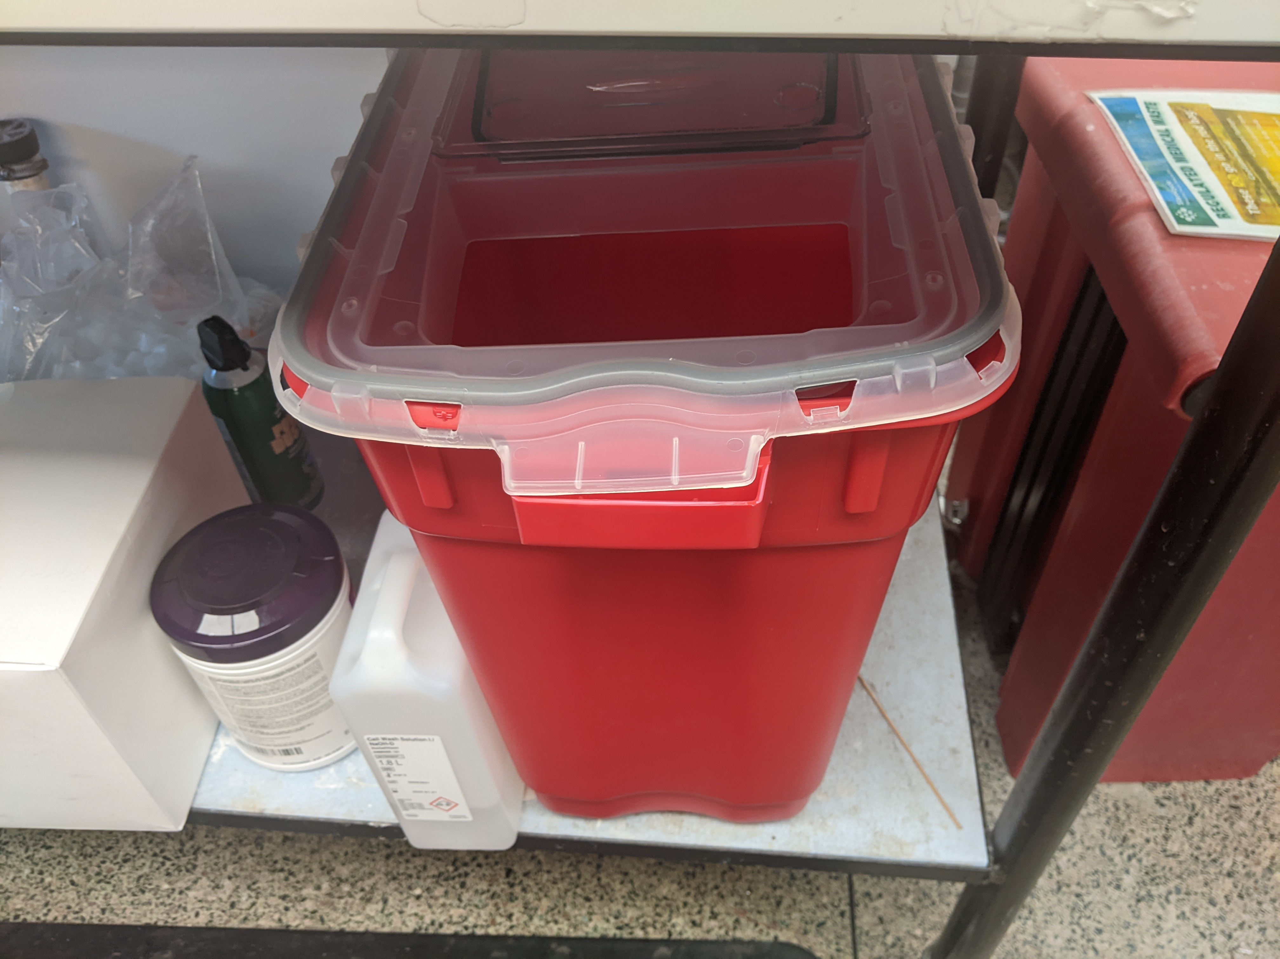
XXX DON’T XXX
USE CONTAINERS WITHOUT SNAPPING ON THE LID PROPERLY

Slide 6
The “DO”S FOR USING MEDICAL WASTE CONTAINERS
Do
DO
DO
ATTACH LIDS TO CONTAINERS FIRMLY AND SLIDE DOOR SHUT WHEN NOT IN CONTINUOUS USE
SEPARATE CORROSIVE AND BIOHAZARD WASTE INTO THE APPROPRIATE CONTAINER
LABEL CLEAN CONTAINERS USED FOR STORAGE WITH CONTENTS

Slide 7
QUESTIONS?
ASK LISA LEE, LAB SAFETY OFFICER
Lisa.lee10@va.gov

