Slide 1

http://myva.va.gov/
April 2015
Notes:
Thank you for joining the conversation today; I wanted to follow up with you on our previous conversation about MyVA.
At a high level, MyVA is our effort to eliminate barriers to serving Veterans and to become a true Veteran-centric organization.

Slide 2
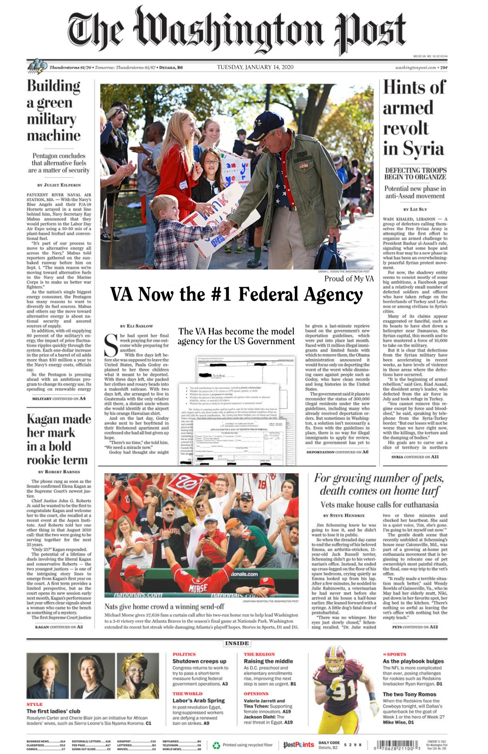
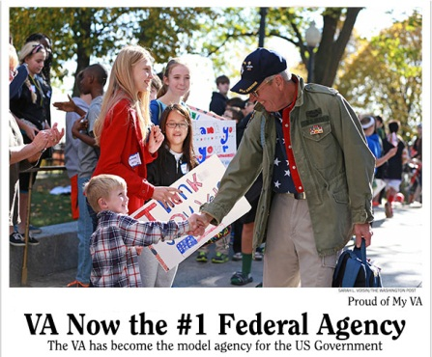
Our Goal…
Notes:
This is our goal for VA. If you fast forward five years, we want the VA to be viewed by all as the model government agency. We want Veterans to be proud of the VA that serves them and honors their commitment. We want our Employees to think that the VA is the most exciting/vibrant place to work at in the government. We want the general public to be proud of the VA and believe that it is the “best bang for the buck” of taxpayer dollars.

Slide 3
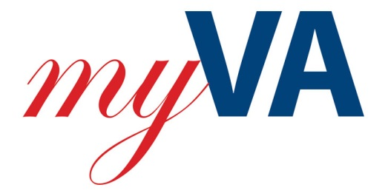
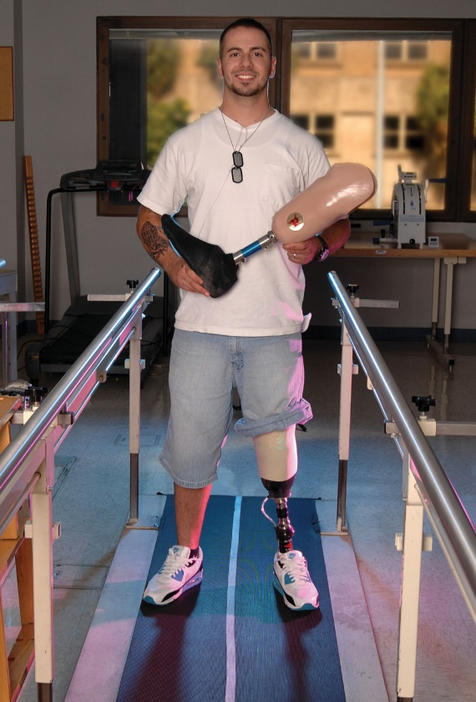
is about…
Putting the Veteran’s interest first.
Empowering employees and helping them deliver excellent customer service to improve the Veteran experience.
Improving or eliminating processes that impede good customer service.
Rethinking our internal structures and processes to become more Veteran-centric and productive.
Notes:
It is an employee-driven process where we will all identify processes that keep us from serving Veterans as well as we should be
There will be some restructuring and process changes, but at this point, we don’t know how we’ll be adjusting. Those answers will come as we continue to have conversations and hear from employees

Slide 4
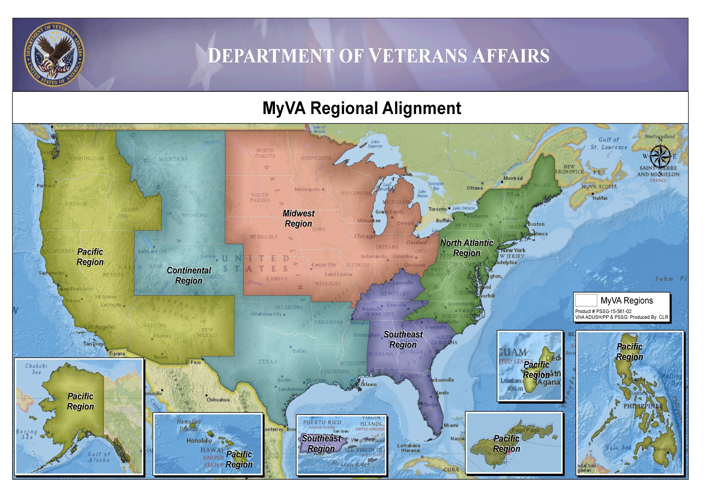
We Have Agreed To One Map –
5 Regions To Which We Will Migrate
Notes:
We’ve heard a lot about the MyVA regional alignment. It’s one of the most highly visible results of MyVA…but its just the beginning of an important journey.
Regionalization FAQs
What are the next steps?
Through this regionalization, VA will align existing services across traditional boundaries, allowing VA to standardize the approach to Veterans across the country. Additionally, this decision will allow VA to develop and support regional Veterans Experience offices once locations are approved.
What is the timeline when you expect VA will have all new structures in place and be fully staffed at regional offices?
Each organization will be responsible for aligning their own structures to support the new regional structure with a target date of 30 June 2015. A Regionalization Task Force has been established to synchronize the integration of these changes and will make recommendations to senior leadership to manage milestones, as appropriate.
Does this mean there will be a decrease in the number of VISNs or VBA Areas?
As each organization makes decisions about how to align within the regions, they will be responsible for making sure their field structures fits within the new regions. Each organization is responsible for recommending and making any changes they deem necessary and appropriate.

Slide 5
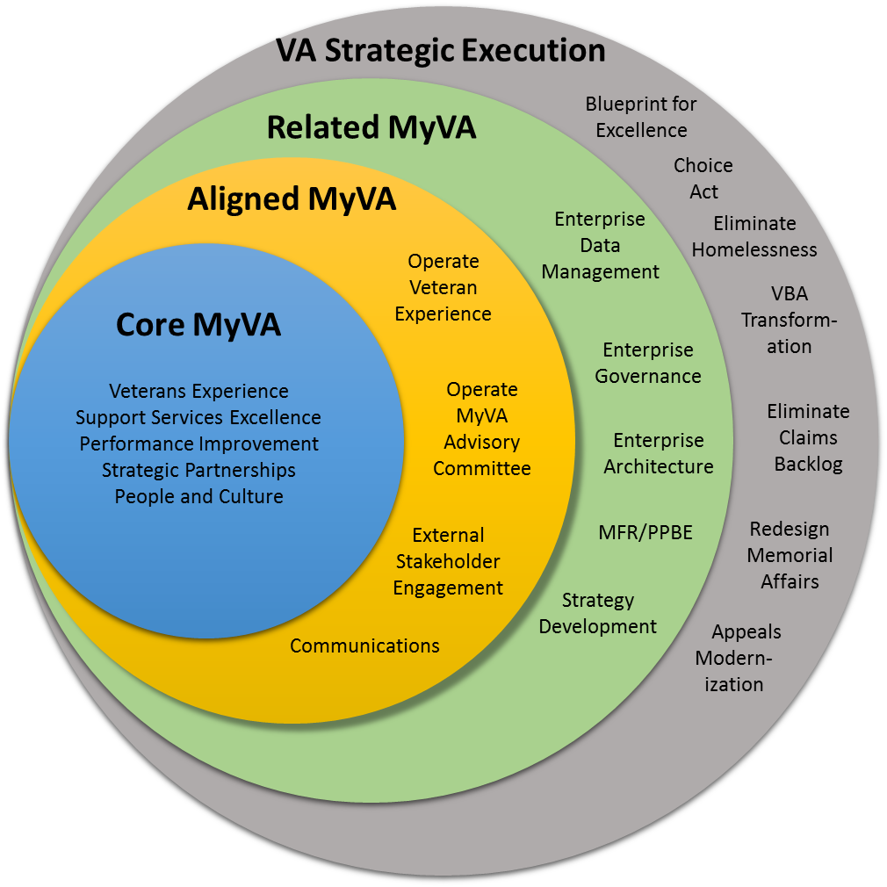
MyVA is a mindset and a cultural shift that places the Veteran at the center of everything we do.
Notes:
MyVA efforts places the Veteran at the center of our work and all of us have a big part to play in making this vision a reality.

Slide 6

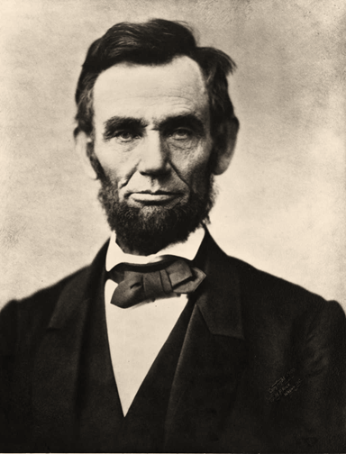
Our Mission
Fulfill Lincoln’s promise - “To care for him who shall have borne the battle, and for his widow, and his orphan” by serving and honoring America’s Veterans and their families
Our Core Values
Integrity, Commitment, Advocacy, Respect, Excellence
Our Roadmap
  Deliver on current commitments to Veterans: Increase Access to Care; Eliminate the Backlog; and End Veterans Homelessness
  Innovate to Improve the Veteran experience: Establish a VA-wide customer-service organization that will design and implement a superior Veteran Experience and leverage Strategic Partnerships as a force multiplier.
  Empower our Leaders and Employees: Realign internal Support Services to improve efficiency, reduce costs, and increase productivity; remove processes that impede good customer service while establishing a culture of continuous Performance Improvement; and focus on People and Culture to attract, retain and develop high performers
Our Vision
To deliver world-class service, defining success by Veterans’ outcome one Veteran at a time, while integrating across VA programs to optimize productivity and efficiency
Our Guiding Principles
Think and act with a Veteran-centric mindset
Optimize VA’s unique competencies
Serve as responsible stewards of taxpayer resources
Our Culture
A collaborative, inclusive,
and results-oriented
culture that
inspires trust
Notes:
The MyVA Lincoln Chart represents the mission, values, and principles that define MyVA.

Slide 7
To achieve this vision, MyVA has five primary focus areas
1
  Improving the Veterans’ experience by examining our Veteran-facing processes and organizations from the Veteran’s perspective to enable every Veteran to have a seamless, integrated, and responsive VA customer service experience every time.
  Achieving support services excellence by identifying common services that are performed in support of VA mission components, and seeking to optimize these services to increase efficiency and eliminate duplication. These services include: Human Resources, Legal Services, Information Technology, Acquisitions & Logistics, Real Property Facilities Management, Public Affairs, Congressional Affairs, Budget & Finance, and Security & Preparedness.
  Establishing a culture of continuous performance improvement, so conditions are set at the local level for issues to be raised, addressed, and solutions replicated across as many facilities as needed to achieve enterprise level results
  Enhancing strategic partnerships by making better “matches” and formal partnerships between community, nonprofit, and other organizations and the work being done for Veterans at VA facilities across the country.
  Improving the employee experience and focusing on “people and culture” so employees are empowered to better serve Veterans.
2
3
4
5
Notes:
This slide shows five areas in which MyVA will concentrate on improving.
The five primary focus areas not only examine our interaction with Veterans but how we conduct business between VA administrations, state and local Veteran service organizations, and with our follow coworkers.

Slide 8
is about…
The Blueprint for Excellence
The Blueprint is VHA’s framework to rebuild the Veterans’ trust and become a truly Veteran-centric health system. It sets high expectations for health care innovation and a positive culture of service.
Notes:
The Blueprint for Excellence is, essentially, VHA’s framework for meeting the goals of MyVA. We need a defined path for rebuilding trust with Veterans and the Blueprint gives us that.

Slide 9
is…
The Blueprint for Excellence
Improve Performance
Promote a Positive Culture of Service
Advance Health Care Innovation for Veterans and the Country
Increase Operational Effectiveness and Accountability
Notes:
We’ll be hearing more about the Blueprint in the coming months, but there are ten strategies, which fit into 4 broad themes.

Slide 10
is…
The Blueprint for Excellence
MyVA |  | The Blueprint for Excellence
Improving the Veteran Experience |  | Improve Performance
Improving the employee experience and focusing on people and culture |  | Promote a Positive Culture of Service
Achieving support services excellences |  | Increase Operational Effectiveness and Accountability
Establishing a culture of continuous performance improvement |  | Advance Health Care Innovation for Veterans and the Country
Enhancing strategic partnerships
Notes:
You can see very direct linkages between MyVA and the Blueprint for Excellence.

Slide 11
is about…
Veterans’ Experience
Our Mission:
  Supporting VA’s delivery of excellent care and benefit experiences that prioritize the perspectives and needs of Veterans, their families, supporters and communities
Our Approach:
  Understand our customers, their needs, and their expectations
  Understand existing efforts to meet customer needs and align programs to achieve coherence and consistency
  Support the administrations to improve customer experience by advising, sponsoring or owning initiatives as appropriate
  Foster solutions at the local level by training, supporting and empowering employees to contribute to excellent customer experiences
  Foster productive collaboration at the community level among the diverse range of local stakeholders
Notes:
Individually, almost every one of us is keenly focused on providing excellent care & customer service to Veterans. As an entire organization, we can do better. MyVA is an opportunity to determine what we need to do as a whole, to ensure that Veterans have an exceptional experience EVERY time they interact with VA.
A few of the things we’re working on:
Unified Digital Experience
Designing and launching a 21st Century customer-focused digital platform
Customer Data Integration
Building a shared customer picture across all of VA’s lines of business
Community Veterans Engagement Boards
Creating forums to proactively and directly address Veteran issues and improve the Veteran experience at the local and national levels
These are just a few examples of things that are happening in VA. Some initiatives are transparent, but many will impact you directly by giving you better tools to do your job. Take “Customer Data Integration” as an example; imagine a Veteran from out of town walking through the front door of a medical center asking for medical care. Now think about what it would look like if you could instantly access their medical record, even if they normally received care in another network on the other side of the country.

Slide 12
is about….
Support Services
Our Mission:
Optimize the organization, functions and activities of VA’s core support functions to best serve our internal customers to the ultimate benefit of Veterans
    Our Work:
    From the perspective of the client (VA’s internal organizations), determine the “as-is”, and propose a future state for nine support services in three waves:
    Pilot (being looked at now): Security and Preparedness
    Group 1: Human Resources, Information Management/Information & Technology, Finance, Procurement (gathering the facts now)
    Group 2: Real Property, Public Affairs, Legislative Affairs, General Counsel (to be examined later this year)
Notes:
Throughout the Department of Veterans Affairs there are many functions that have been replicated in each of the Administrations; and example might be human resources. The Department has HR, VHA has HR, NCA and VBA have HR offices. Support Services will bring some of those functions together to reduce complexity in decision making and better leverage resources. This will result in an improved experience for each of us…so we can devote more attention to taking care of Veterans.
The Support Services initiative is about:
Making it quicker and easier to get the supplies, equipment, and services you need to serve Veterans
Filling your HR vacancies quicker and with better qualified applicants
Making finance easier and more responsive
Aligning IT with your business needs
Ensuring the safety and security of your workplace
Delivering on promises documented in service level agreements
It is NOT about:
Centralizing all services
VA Administrations losing control of their own people or support
The loss of jobs, positions, or titles
Changing all job descriptions, duty locations, or support roles for those employees currently providing support services

Slide 13
is about…
Performance Improvement
Our Mission:
Partner across VA to identify and execute select process improvements, while establishing an enterprise-wide strategy and infrastructure that supports a culture of continuous performance and outcome improvement
Our Work:
Leveraging the ideas submitted by employees and through other channels to support improvements at the ground level and up
Employee Anecdotes about MyVA
“The VA 101 training reinforces why we are here, which is great for morale of employees. They feel less lost in a large system.” – VA Employee
“While I know not all changes we suggested at our site, or others across the nation, can (or should) be implemented, I left (the VA 101 deep-dive) feeling optimistic that my thoughts and suggestions were valued and heard. Not only that, I have faith that the feedback and ideas gathered across the country will make it to senior leadership ears and influence change!” –VA Employee
Notes:
Examples of performance improvements underway include:
Developing new VA 101 training for all employees to build their knowledge and awareness of critical VA and Veteran-specific topics
Expanding Guest W-Fi in all VHA facilities and clinics so Veterans and their families have Internet access
Standardizing signage and way-finding materials such as maps so Veterans can more easily navigate our facilities
Creating an integrated town hall guide book for VA facilities to use to strengthen outreach and to plan and execute integrated town halls with Veterans
Examining how to implement a direct scheduling process for ear and eye care so Veterans can bypass primary care and schedule appointments directly with Audiology and Optometry
Developing an employee organizational phonebook to update employee information in VA databases and improve search capabilities so employees can more easily locate colleagues and answer Veterans’ questions
Providing project management support to the Veterans Crisis Line’s modernization plan and to six Leadership VA projects
Reviewing the burial eligibility process to allow pre-need burial eligibility for Veterans while Veterans are still alive
Working with partners to examine how to establish an external foundation to help VA expand outreach and services for Veterans
Identifying electronic opportunities to share Human Resource documents, rather than mailing them to reduce costs

Slide 14
is about….
Strategic Partnerships
Our Mission:
Leverage resources external to VA on an effective and consistent basis, at all levels of the Department to improve the Veteran experience, while enhancing productivity and efficiency.
Our Work:
Empowering employees to develop responsible, productive, and mutually beneficial partnerships at all levels to meet new and emerging Veterans’ needs.
Notes:
Strategic partnerships is recognizing that VA can’t do it alone. We need to work with other advocates of Veterans to ensure we are meeting the needs of our customers consistently. We’ve worked with Veterans Service Organizations for many years and the idea this builds on that foundation.
Examples of the work being done with on strategic partnerships:
Finalizing a VA Directive that provides key elements for exploring, establishing, managing, and evaluating public-private partnerships for all employees.
Developing and implementing a new VA Strategic Partnerships 101 Training for all employees to increase their awareness and knowledge of relevant partnership information, strategies, and capabilities.
Creating an External Partnership Website that provides the public with important partnership information, such as identified VA partnerships needs, ways that VA can partner, proper access points, funding opportunities, etc.
Developing a Strategic Partnership Award Program that recognizes responsible and productive partnerships that are providing significant Veteran community impact.
Creating a Toolkit to provide standardized resources that equip and empower all employees to build and enhance effective community partnerships.
Building an Intranet Website that provides a centralized access point for strategic partnerships information, resources, and tools.
Completing a relational database that allows employees to view and input engagement and partnership activities across the Department.

Slide 15
is about….
People and Culture
Our Mission:
Support VA with world class management teams where leaders at all levels consistently execute the MyVA vision, the integration of MyVA culture principles, the I CARE values through their behaviors, and commit to hold themselves, their employees and each other accountable for the accomplishment of:
  Responsible, Performance-Oriented Culture
  Planned Career Paths and Development
  Capable and Engaged Employees
  Attraction and retention of high performing candidates
Our Work:
To recruit, develop, empower, and retain top talent and foster a culture that inspires trust through collaboration, inclusion, and a focus on results.
Notes:
What’s happening at the national level:
What can you do locally?
Idea House
Submit, discuss, and/or rate ideas
Process Improvement Teams
Create or participate on local teams
I CARE
Take the training, recommit to our values, recognize a colleague
SECVA Visits and Town Halls
Host or attend town halls and other forums to meet and discuss action being taken and issues/challenges
Surveys
Respond to surveys, make your voice heard
Survey Action Planning
Participate on a local survey action planning team to help improve your workplace
Training & Development
Explore T&D opportunities and develop an Individual Development Plan (IDP);
Visit MyCareer@VA: http://mycareeratva.va.gov/
Leading Practices
Identify leading practices in your workplace, seek relevant promising practices to pilot
Wellness
Participate in Wellness programs
Hiring
Refer contacts and colleagues to appropriate vacancy announcements; spread positive news about VA

Slide 16
What’s Next?
In the coming days, we want you to engage in team discussions with your supervisors and coworkers.
How do you think Veterans feel about their experience with VA?
What do Veterans currently experience when they first enter our facility?
Is the outcome of the Veteran Experience consistent from area to area?
What prevents us from maximizing the Veteran Experience?
What can you do to enhance the Veteran Experience?
What can you and your work team do to improve efforts at putting Veterans first?
What information, training, or tools do you and your work team need in order to improve efforts at putting Veterans first?
Offer your suggestions through the MyVA IdeaHouse or, if a suggestion can be implemented locally, directly to XXXX.
Notes:
Following this town hall / staff meeting, each of you should engage in a conversation with your coworkers regarding what role you can play in MyVA.

