Slide 1
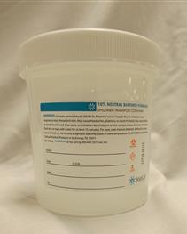
Formalin Spill Response Process
Specimen Cup with Formalin

Slide 2
Spill Kit
Existing Chemotherapy Spill kits may also be used for Formalin spills.
If a Chemo Spill kit is not currently stocked in your area, contact Logistics to acquire one.
Ensure spill kits are stored in an area readily accessible to where formalin specimen cups are used.
Train employees on location of spill kit

Slide 3
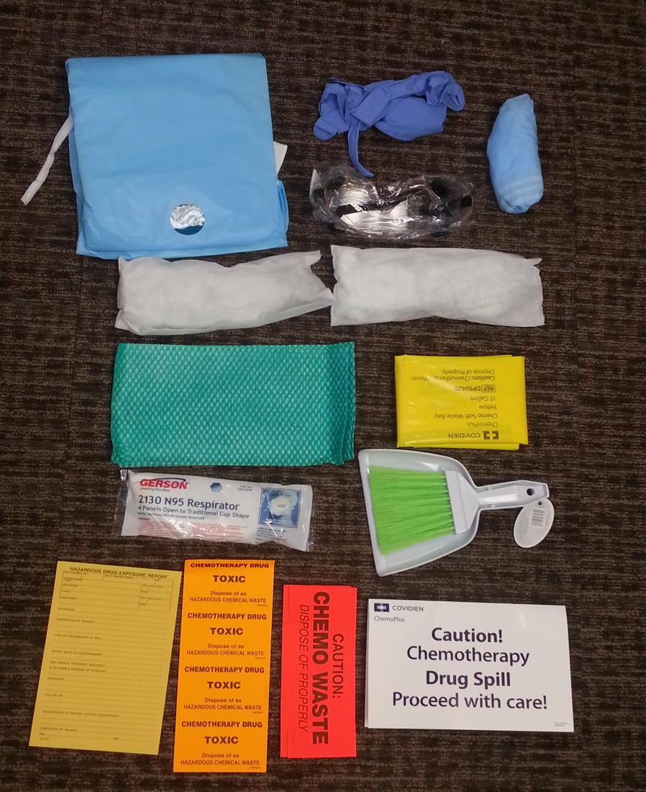
Chemo Spill Kit (Covidien)
1. Gown
2. Nitrile gloves (2)
3. Goggles
4. Booties
5. Absorbent pillows (2)
6. Absorbent towels (3)
7. Yellow Chemo bag (2)
8. N95 Respirator
9. Scoop & brush
10. Caution sign
11. Chemo waste labels
12. Hazardous drug report
2.
1.
4.
3.
5.
6.
7.
8.
12.
11.
9.
10.

Slide 4
Spill Kit Contents
Only the following items will be used:
  Nitrile Gloves (must wear to prevent skin contact)
  Goggles (must be worn unless spill < 5mL)
  Gown (must be worn unless spill > 5mL)
  Absorbent Pillows (use to absorb liquid)
  Absorbent Towels (absorb any remaining liquid)
  Yellow Bag(s)
    Use small bags to capture all PPE/absorbent materials contaminated with formalin
  NOTE: Do not use N-95 respirator, it does not provide protection against formalin

Slide 5
Instructions
In case of spill, isolate area
  Remove patient/staff as far away from spill as possible
  Notify supervisor/program manager (if notification will not delay spill clean up)
Get spill kit and remove required items (gloves, goggles, gown (if needed), pillows, towels and small yellow bag)
Don PPE (gloves/goggles/gown) and use absorbent pillows and towels to clean up spilled formalin
  If employee experiences irritation of eyes/respiratory tract, leave area immediately and call Safety (42933/42934)

Slide 6
Instructions
Place contaminated PPE/absorbent materials in the yellow bag
  Use sharpie to clearly mark bag with “Danger, Formaldehyde”
  Call Safety immediately to collect bag (42933/46490).
    Formalin (formaldehyde must be disposed of as Hazardous Waste)
    Do not allow EMS to take away formalin waste bag

Slide 7
Instructions
After formalin has been cleaned-up, contact EMS for terminal cleaning
  Special training not required for EMS personnel who perform terminal cleaning after this type of spill
Perform required notifications
  Contact supervisor to complete ASISTS report
  Complete ePIR if patient was injured/exposed during the spill
  Notify supervisor/program manager of area where spill occurred if not done previously

Slide 8
Questions
Contact Safety (Industrial Hygienist) if there are any questions regarding:
  Spill kits
  Clean-up procedures
  Training/education
  Etc.
Phone: x42933 or michael.moran6@va.gov

