Slide 1
Clinical Faculty Development updates for 2016 and beyond
Patricia A. Boyer, MSHS, MLS(ASCP)^{CM}
Program Director, Zablocki VA Medical Center School of Medical Technology

Slide 2
Today’s Overview
1
2
Evaluating student performance
3
Instructor “Testimonials”
Review the roles and responsibilities of clinical preceptors

Slide 3

Learning Objectives – Clinical Preceptor
Describe roles and responsibilities of clinical preceptors in the laboratory
Discuss how student performance can be measured and evaluated
List the commons errors associated with evaluations

Slide 4
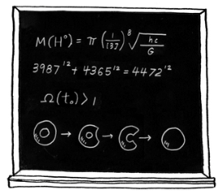

Medical Laboratory Scientists as Educators

Slide 5
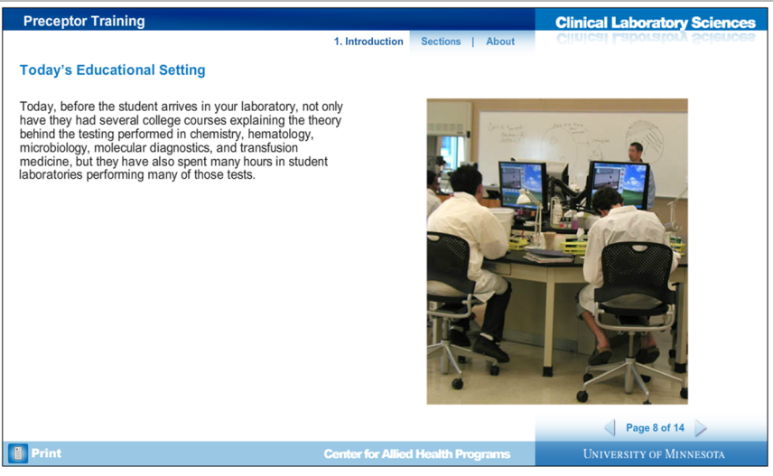
Today’s Educational Setting
© 2016 Regents of the University of Minnesota. All rights reserved.

Slide 6
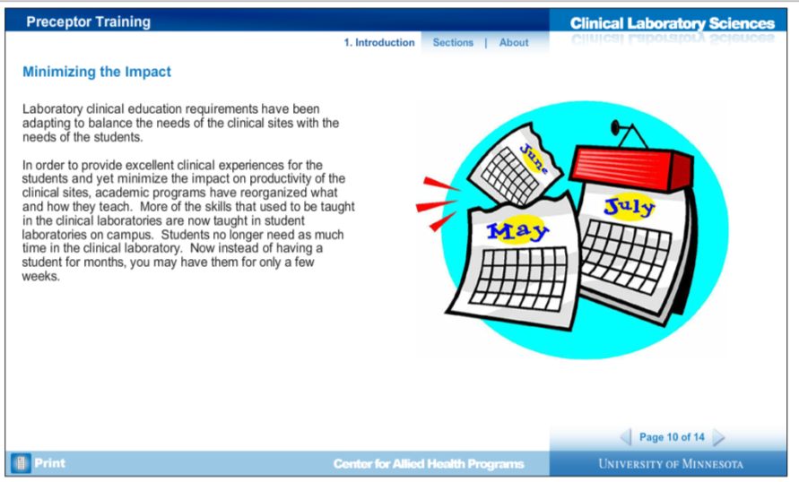
Balancing Education and Laboratory Services
© 2016 Regents of the University of Minnesota. All rights reserved.

Slide 7
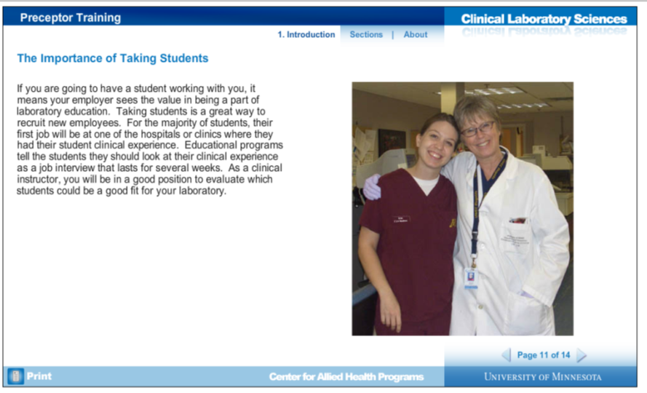
The Importance of Taking Students
© 2016 Regents of the University of Minnesota. All rights reserved.

Slide 8
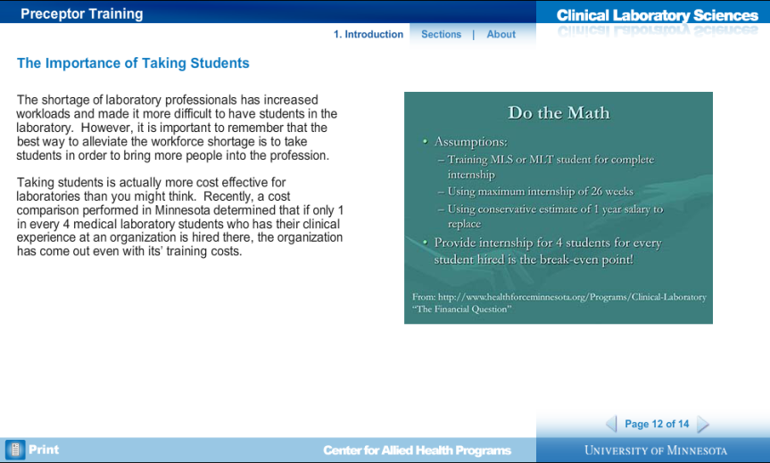
© 2016 Regents of the University of Minnesota. All rights reserved.

Slide 9
Today’s Educational Setting
© 2016 Regents of the University of Minnesota. All rights reserved.

Slide 10
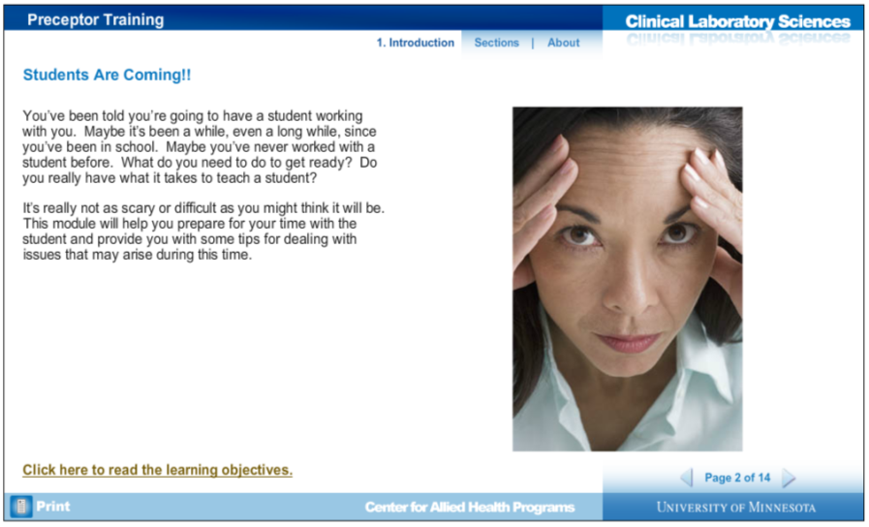
http://dol.ahc.umn.edu/htdocs/CLS_PreceptorTraining.html
© 2016 Regents of the University of Minnesota. All rights reserved.
Notes:
The website listed on this slide has more information about Clinical Laboratory Science preceptor training. I have picked and chosen certain items as they pertain to our particular program and needs. Feel free to explore more through the web link, though.

Slide 11
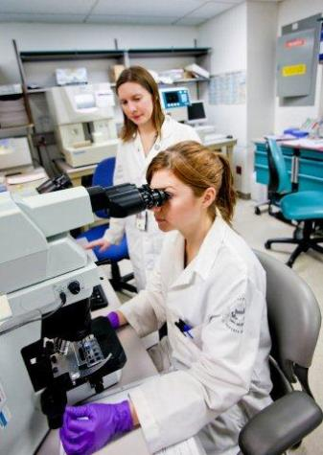
Clinical Site Bench Preceptor
Individual who works directly with the student
Responsibilities:
  Choose & coordinate activities
  Primary person who will guide and evaluate the student
  Explain the relevance of what they are doing and why
  Ongoing feedback, reinforce appropriate behavior and performance
Notes:
The Clinical Preceptor is the individual who works directly with the student while they are attending their clinical experience. They may be responsible for choosing and coordinating the activities the student performs while in their section of the laboratory, including working directly with the student at the bench. The Clinical Preceptor is the primary individual(s) who will guide and evaluate the student and explain the relevance of what they are doing and why. They should provide ongoing feedback to students and reinforce appropriate behaviors and performance. Along the way, the student should gain confidence in their abilities as a laboratorian.

Slide 12
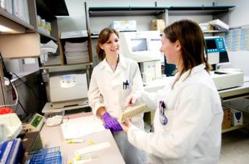
Clinical Experiences
Provide opportunities for students to develop the cognitive and technical skills of the profession
Give exposure to the true working environment where:
They must respond to stimuli
Sort out information
Handle situations that are not clear cut
Accept responsibility for their work

Slide 13
Unique learning opportunities in the clinical rotations:
One-on-one supervision allows students to perform most of the tests and procedures themselves.
Almost all of the tests are performed in real time on real patient specimens, and students usually become competent enough at the end of a rotation to perform most tasks with minimal supervision.
Students are provided with a complete set of competencies that detail which tasks need to be achieved at specific levels of mastery.

Slide 14
“I don’t remember everything!”
Do not worry that you need to teach the students everything you learned as a student.
The clinical preceptor is not meant to reteach the theory behind the laboratory tests – students have received plenty of lectures and student labs that have taught them the theory. The preceptor should know where to find answers to these questions, though.
The main role of a clinical preceptor is there to teach things like workflow and interactions with other professionals.

Slide 15
Strengths of Clinical Instruction
Focus on real situations and problems in the context of professional practice
Students can practice skills after learning them and they may be more motivated learners by the relevance and their active participation in the healthcare team
Professional thinking, behavior, and attitudes are “modeled” by teachers
Low student to teacher ratio

Slide 16
Potential Problems of Clinical Instruction
Passive observation rather than active participation of learners
Inadequate supervision
Inadequate feedback or only summative feedback
Little opportunity for reflection and discussion
Student exposure to inappropriate role models
Variability and haphazard nature of teaching may occur when many instructors are involved in clinical teaching
Focus on factual recall instead of on developing problem solving skills and attitudes

Slide 17
What Makes a Good Preceptor?
A good preceptor will:
  Be a role model of the profession
  Teach the student those things they could not learn in the student laboratory
  Ask the student questions
  Provide the student with timely and constructive feedback
  Be patient (Remember, this is their first time in a clinical laboratory!!)

Slide 18
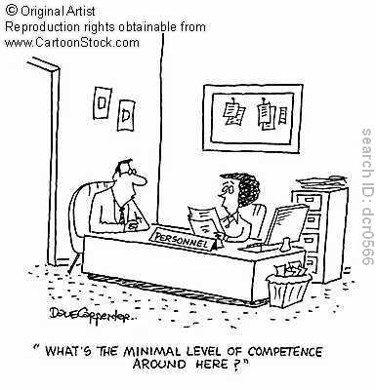
What is our goal for our students?
Entry-level competence with a background to eventually achieve proficiency and expertise

Slide 19
Points to remember when teaching…
DO
Welcome
Put yourself in the learner's shoes
Ask good, interesting, probing questions
Monitor progress and give feedback
Set shared achievable goals
Encourage
DON’T
Confine the learner to passive roles
Be vague about your expectations
Be “nit­picking”
Leave feedback to the final assessment
Appear unprepared
Humiliate
Notes:
It is important to discuss what activities are planned for the day. Encourage the student to be an active learner, to tell you when they do understand and to ask questions. However, you may need to ask probing questions to test their understanding as well. Once the student gains confidence and becomes more comfortable with the clinical routine and you are comfortable with their performance, allow the student more independence to test their abilities. You must still watch over them as they perform their work and you may need to revise your expectations as the student progresses through their clinical experience.

Slide 20

Clinical Instructor/Preceptor (Your) Roles
Orient student to policies and procedures of the department.
Provide instruction and evaluation in order that the student can achieve the objectives of the curriculum.
Educate students in principles and techniques and provide practice in laboratory testing so they develop confidence in their ability.
Serve as a role model in the clinical setting.
Maintain service expectations while providing clinical education.
Direct students to appropriate resources and readings.
Notify Program Director promptly of concerns/problems about student.
Provide evaluation data to Program Director.
Notes:
We have many roles, and we may wear many hats in our jobs here. You are a role model, whether you realize it or not (or want to be or not). You are part coach, part supervisor, and part teacher.

Slide 21
The Clinical Experience
Bridge the gap between student lab and new employee training process.
What students need in the clinical setting is to be shown how to work with multiple specimens; integrate workload; and work with more sophisticated instrumentation that is not available on campus.
The clinical experience is not just about performing laboratory testing, it is also about building confidence and pride; about building the next generation of laboratory practitioners.

Slide 22
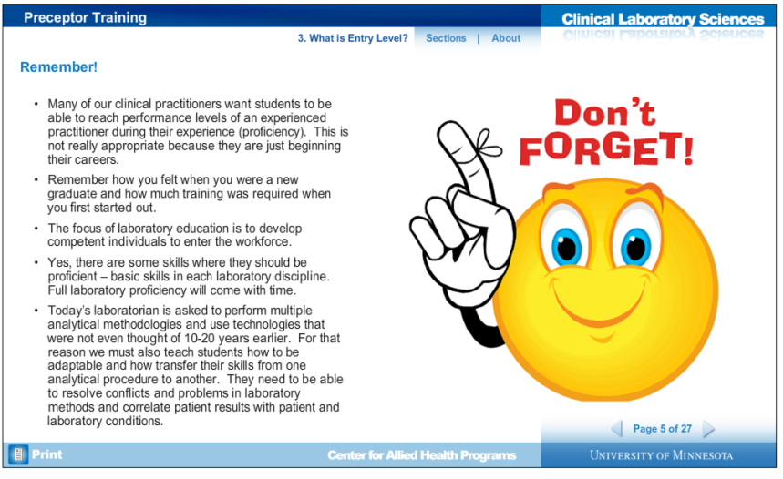
© 2016 Regents of the University of Minnesota. All rights reserved.

Slide 23
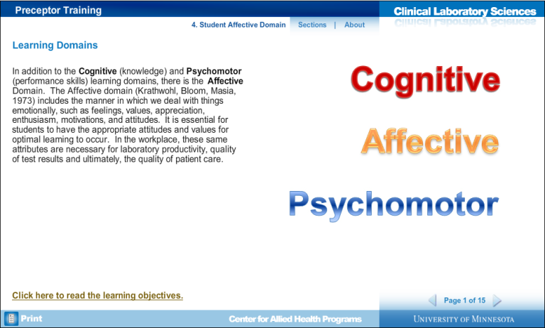
© 2016 Regents of the University of Minnesota. All rights reserved.

Slide 24
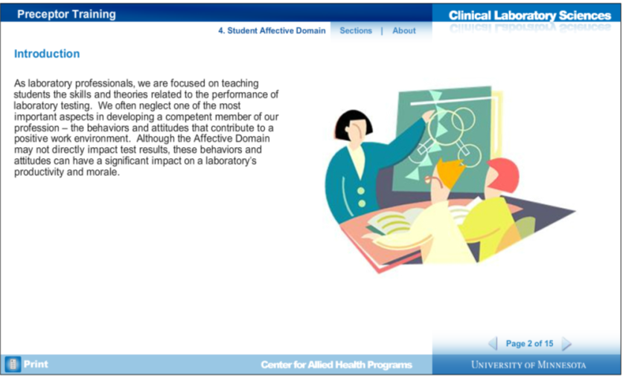
© 2016 Regents of the University of Minnesota. All rights reserved.

Slide 25
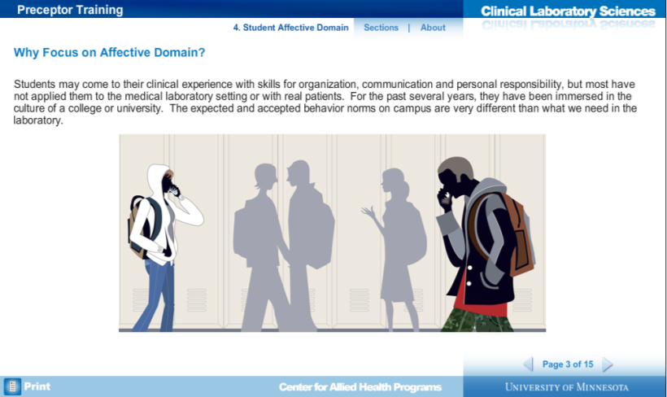
© 2016 Regents of the University of Minnesota. All rights reserved.

Slide 26
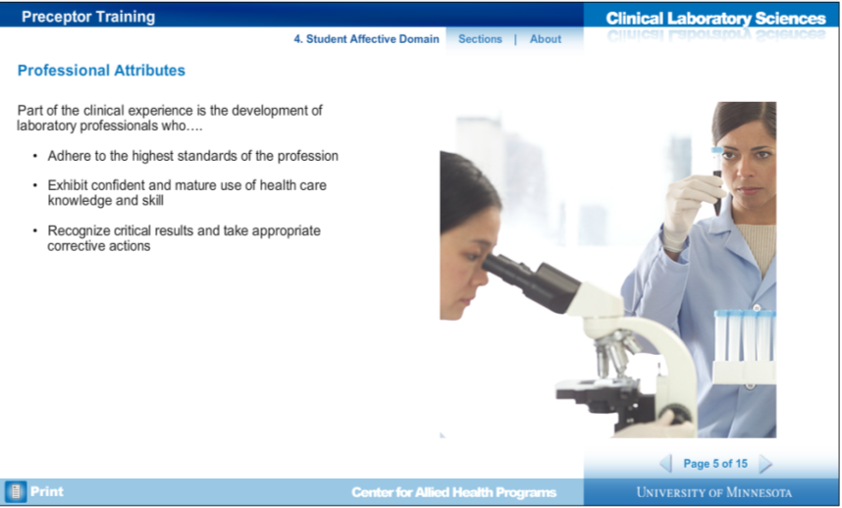
© 2016 Regents of the University of Minnesota. All rights reserved.

Slide 27
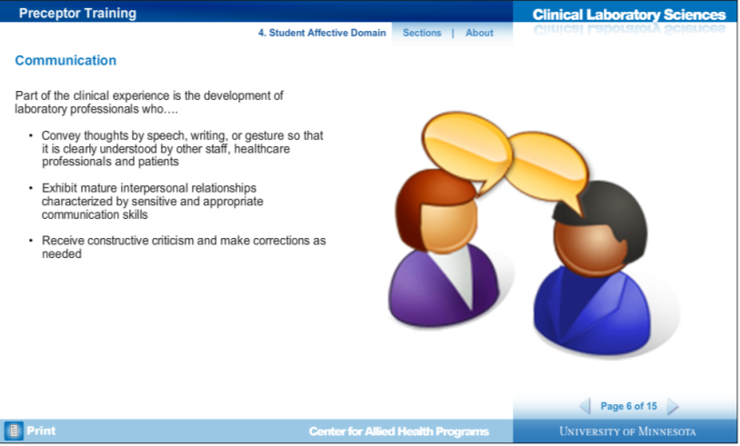
© 2016 Regents of the University of Minnesota. All rights reserved.

Slide 28
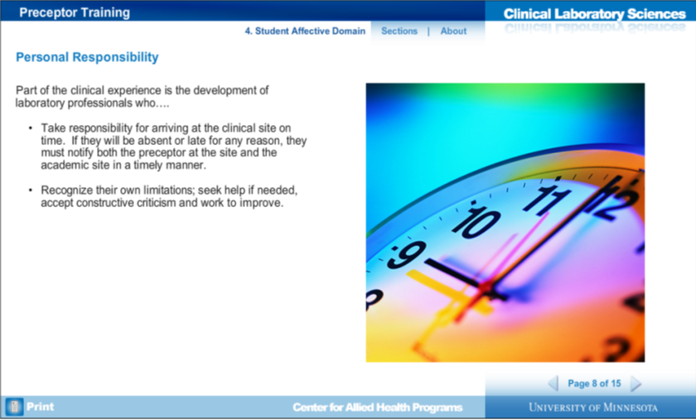
© 2016 Regents of the University of Minnesota. All rights reserved.

Slide 29
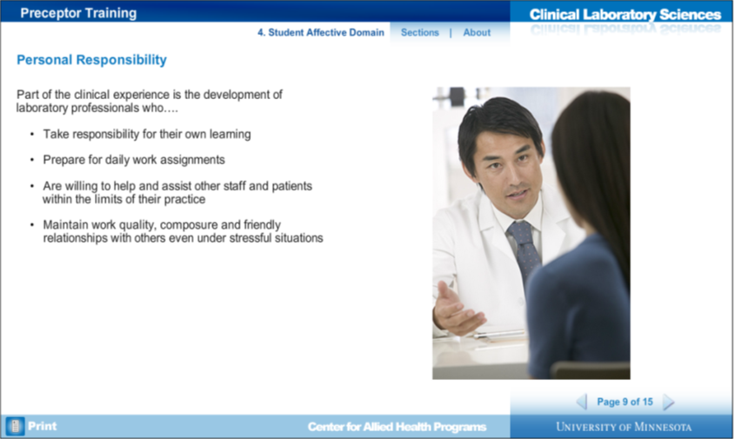
© 2016 Regents of the University of Minnesota. All rights reserved.

Slide 30
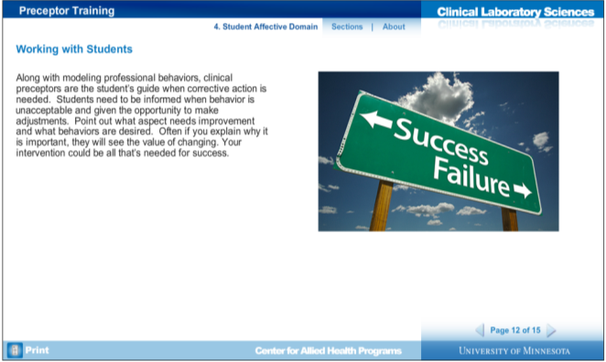
VERY IMPORTANT INFO ON THIS SLIDE-
PLEASE READ CAREFULLY
© 2016 Regents of the University of Minnesota. All rights reserved.

Slide 31
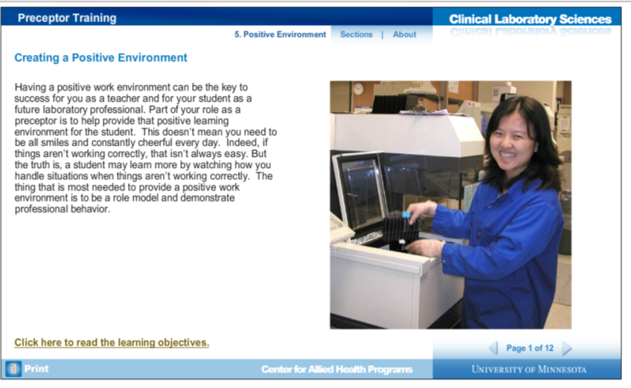
© 2016 Regents of the University of Minnesota. All rights reserved.

Slide 32
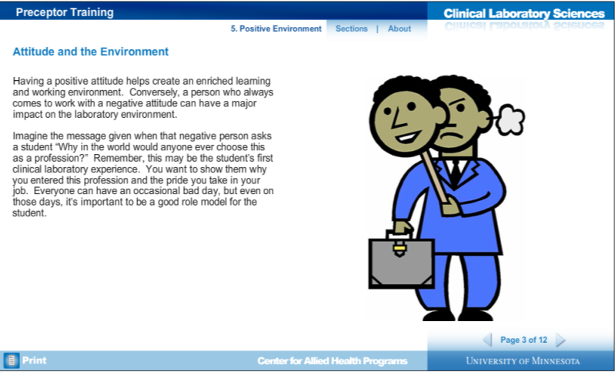
© 2016 Regents of the University of Minnesota. All rights reserved.

Slide 33
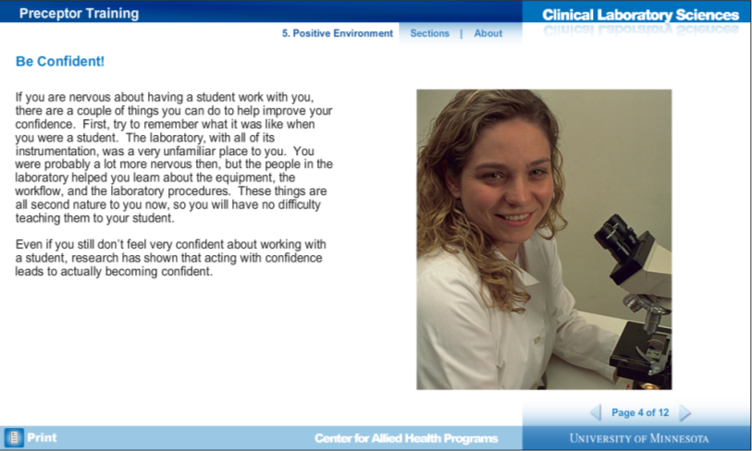
© 2016 Regents of the University of Minnesota. All rights reserved.

Slide 34
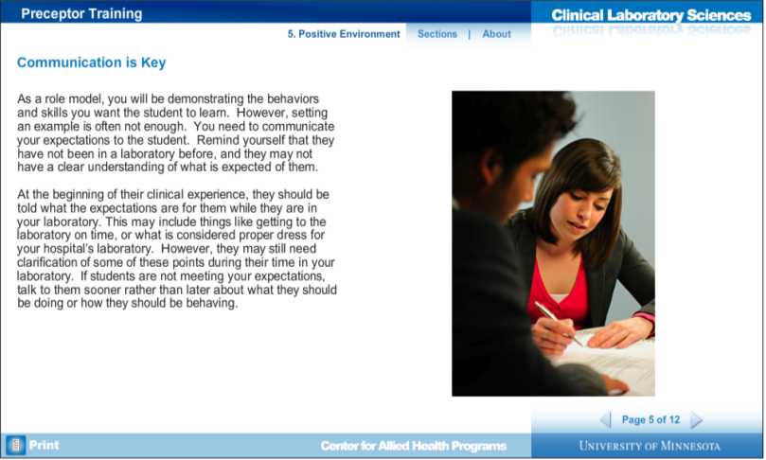
© 2016 Regents of the University of Minnesota. All rights reserved.

Slide 35
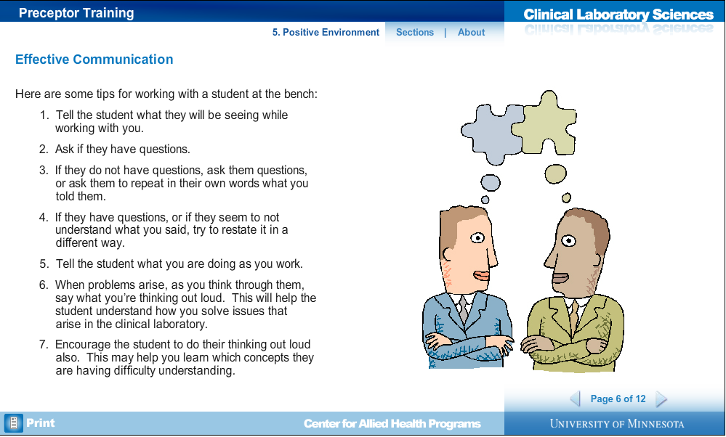
© 2016 Regents of the University of Minnesota. All rights reserved.

Slide 36
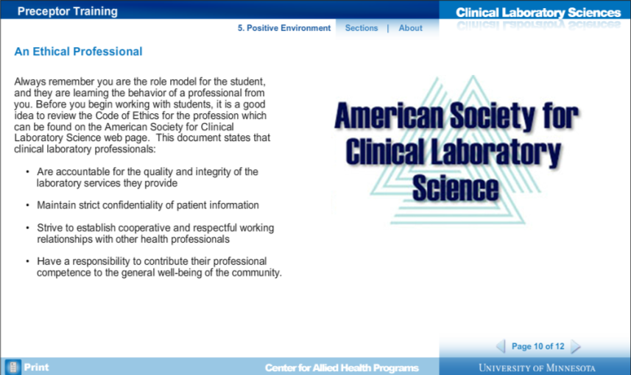
© 2016 Regents of the University of Minnesota. All rights reserved.

Slide 37
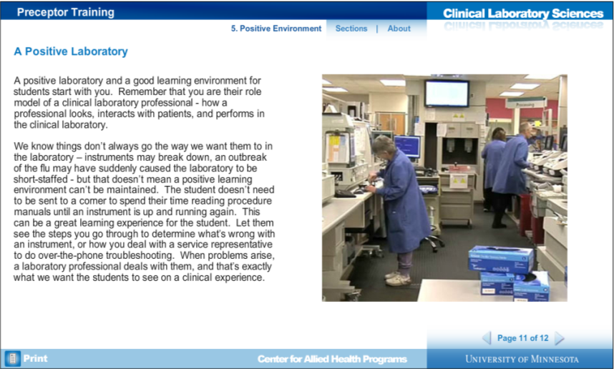
© 2016 Regents of the University of Minnesota. All rights reserved.

Slide 39
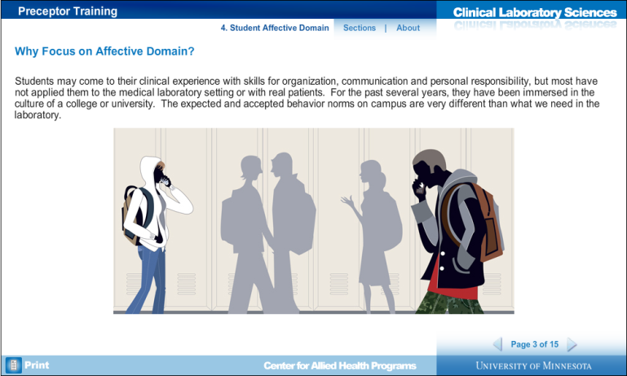

Slide 40
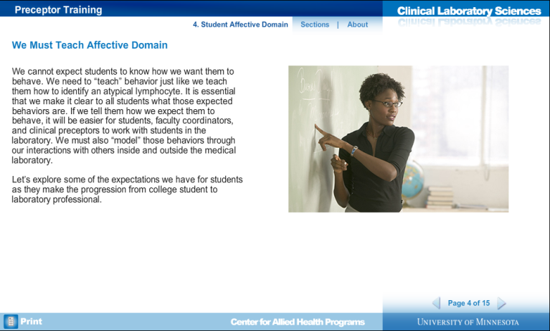

Slide 41


Slide 42
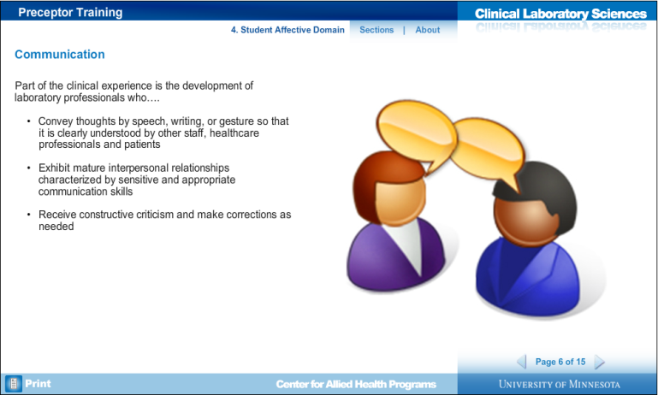

Slide 43
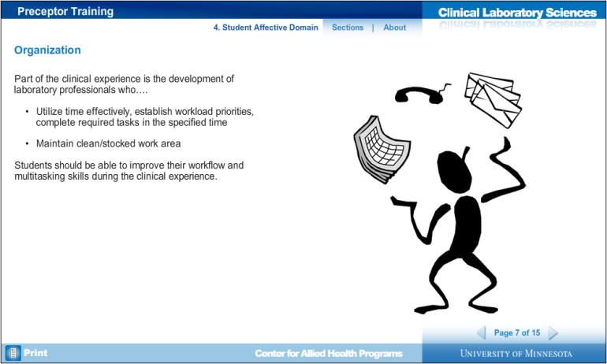

Slide 44
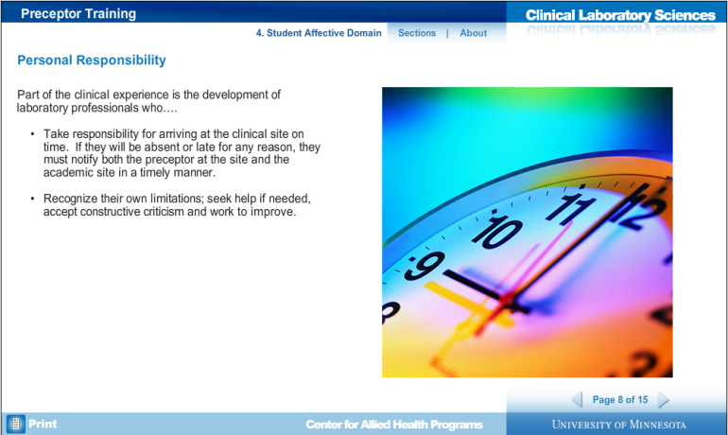

Slide 45


Slide 46
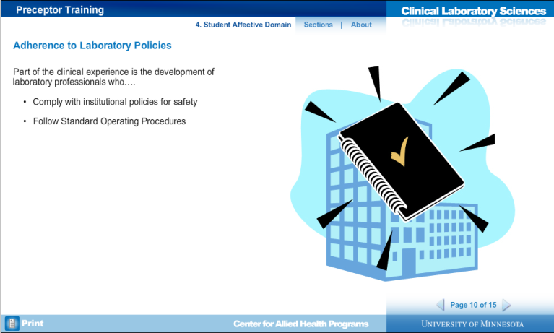

Slide 47
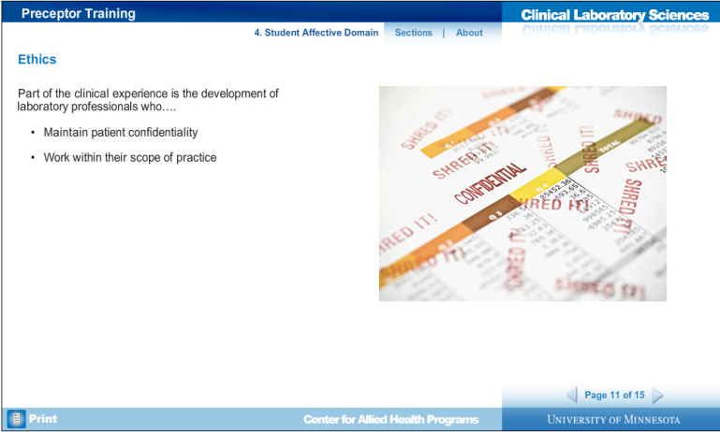

Slide 48
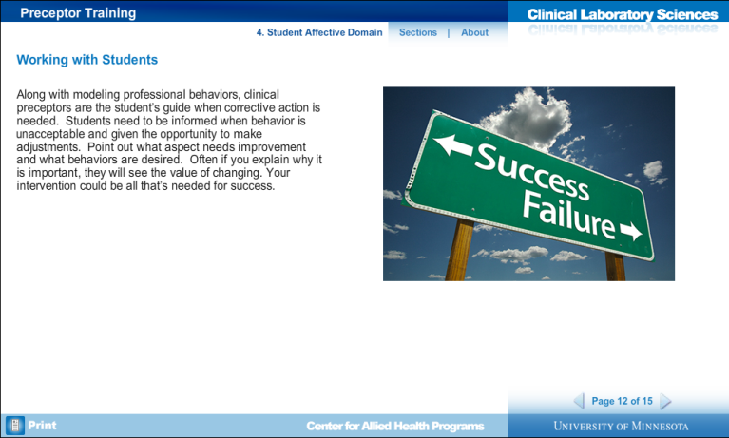

Slide 49
NAACLS Standards
Evaluation systems must be related to the objectives and competencies described in the curriculum for both didactic and applied components. They must be employed frequently enough to provide students and faculty with timely indications of the students’ academic standing and progress and to serve as a reliable indicator of the effectiveness of instruction and course design.
Notes:
NAACLS = National Accrediting Agency for Clinical Laboratory Science.
Besides this blurb in their Standards of Accredited Programs, there are no explicit requirements laid out for programs to use in determining how to evaluate students. There is no silver bullet or perfect way to evaluate students in the clinical setting. It is complex and may even sometimes be neglected.

Slide 50

Methods of Evaluation
Objective tests = CCCC exams
Direct observation
  Anecdotal records
  Checklists
  Rating scales
Judging the work produced by the student
Notes:
The core exams and previous coursework evaluate the student’s knowledge, or cognitive skills. Our primary evaluations then are of psychomotor and affective objectives, so the manual or physical performance of procedures and professional attitudes and values that guide behaviors. Student performance in the clinical laboratory can readily be observed but it is not always easy to obtain objective information for evaluation (grading) purposes.
Checklists work best for psychomotor objectives, and rating scales are better for measuring affective objectives.

Slide 51

The competency checklist is a guide for both the student and the preceptor.
It tells you what activities will be performed, at what level they should be
performed, which activities are essential and which may only need to be discussed.
These checklists try to be competency based, and some areas may have the
activities listed in a schedule format with suggestions for what needs to be done and what should be accomplished at certain points of a clinical rotation.

Slide 52
Direct Observation:
Rating Scales
Advantages
  Can evaluate affective domain
  Less time than anecdotal records
  More objective when traits are defined
Disadvantages
  Errors associated with rating scales:
Susan J. Beck, Ph.D., CLS(NCA) and Vicky A. LeGrys, D.A., CLS(NCA) , The University of North Carolina at Chapel Hill Copyright 2007: ASCLS
Notes:
Advantages: The results of the tool can yield specific, concrete feedback for the student when filled out thoughtfully and with specific comments to support evaluating decisions.
Disadvantages: Our tool often relies on instructor recall of student performance, which is unreliable and may be influenced by the students most recent performance. Also, while we use specific definitions for anchor points to help the objectivity of the tool, there are inherent subjective judgments that can be made by even the most well-meaning instructor/evaluator. These are as follows.

Slide 53
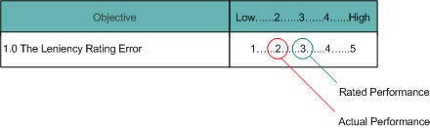
Error of leniency
Occurs when an instructor’s ratings of a student tend to be higher than they should be. This usually occurs because the instructor knows and likes the student.

Slide 54
Leniency
It is sometimes difficult to give a student a poor grade. However, it is important to do so when necessary, in order for the program director and/or academic site to provide the needed remediation for the student to be successful in the future.

Slide 55
Error of central tendency
Some instructors hesitate to give high or low ratings and tend toward an average rating for all students. This is especially true if the instructor does not know the student well or has not had much time to observe the student’s work or behavior.
Notes:
I call this the “benefit of the doubt”

Slide 56
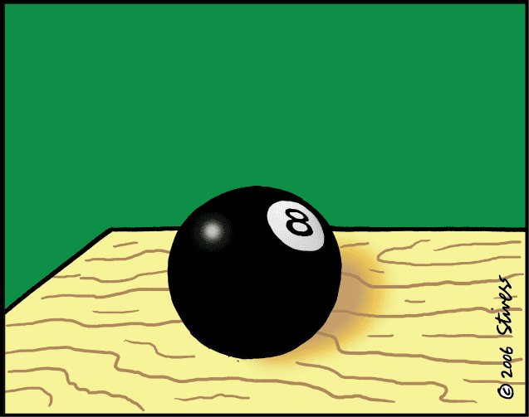
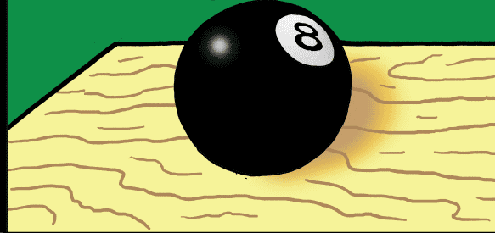
Eh, give ‘em a 3
Student was quiet but seemed to know what they were doing…
With student only the last two days…decent
Magic eight ball illustrating the error of central tendency
Notes:
Magic eight ball – error of central tendency

Slide 57
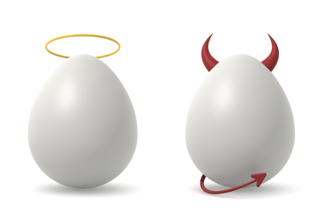
Halo Effect
This occurs when the evaluator has a general impression of the student and this impression influences the judgment of all of the student’s traits.

Slide 58
Contrast error
This error occurs when the evaluators contrast the trait in themselves and in the student (or when they compare students to one another).
Evaluation should be based on individual student’s attainment of objectives and not on comparison of student performances.

Slide 59
Proximity error
The instructor may tend to rate traits that are placed next to one another on the rating scale form in a similar fashion.
Instructors may tend to rate students who rotate together in a similar fashion – similar to error of central tendency
Notes:
One student may “drag” another student down, or vice versa.

Slide 60
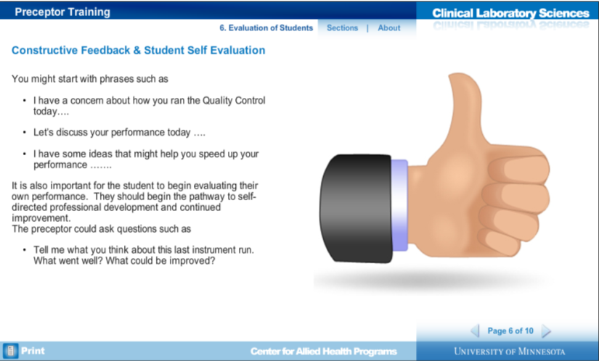
How can you give good feedback?
© 2016 Regents of the University of Minnesota. All rights reserved.

Slide 61
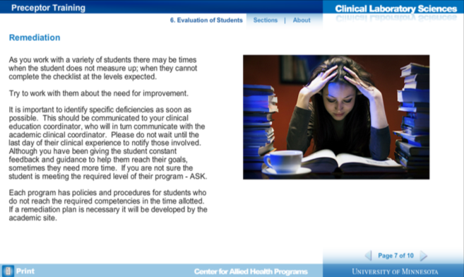
Please communicate problems with the program director ASAP.
© 2016 Regents of the University of Minnesota. All rights reserved.

Slide 62
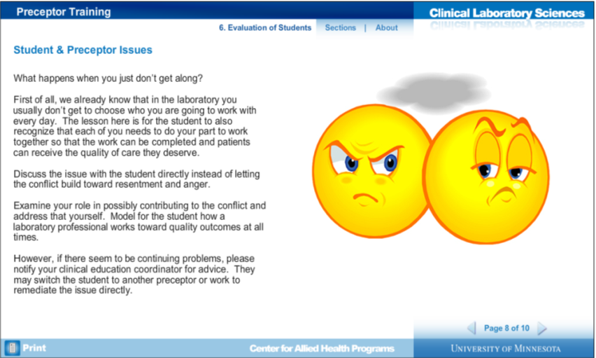
© 2016 Regents of the University of Minnesota. All rights reserved.

Slide 63
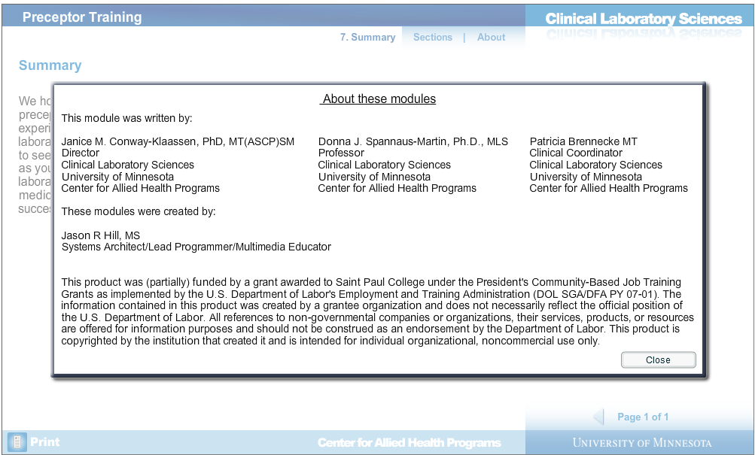
References
© 2016 Regents of the University of Minnesota. All rights reserved.

Slide 64

The following testimonials are things written by some of your peers who have received excellent and positive feedback from students. None of these were written by the program director, but they are anonymous and honest feedback.
Notes:
These are things written by some of your peers who have received excellent and positive feedback from students.

Slide 65
I really don’t have a strategy on how I teach the students. It just comes naturally. I guess this is how I engage with a student and it helps develop teacher/student respect.
Ask them how their rotations are going, what they like/don’t like, ask where they are from (a little personal info), get to know them a bit.
Gather their respect, be interested in their clinical, ask if they understand or have any questions.
Have “fun”…don’t be all “by-the-book” and rigid all the time. This doesn’t mean goof-off though.
Take your job seriously; this may rub off on them.
Do not go on the internet, gossip, talk bad about your job, or crank the radio with them. You can be “cool” without doing this.
Take the time to go the extra-mile if your student asks a question. Show them references to use to help them learn.
If I’m working with a student all week I explain to them how the week will go. Give them an idea of what to expect and what I expect from them (responsible for their check-off sheets, etc.)
If there is down-time, I tell them to study or stock.
If we establish guidelines early in the clinical, this should carry-through and they should know what is expected of them.
Teaching is part of our job duty and it’s not going to change, so make the best of it.
Notes:
I think it helps me to know what it was like years ago with “older” techs. Our relationship was different, we respected the techs because they were older vs now the students and the techs are similar in age and gaining respect in a teacher/student relationship may be more difficult (especially if personalities differ). Some of the things I see now, would never fly years ago, but it’s the age gap that changes the environment of the teacher/student. This is not the case with all young techs/students though. It may come down to the personality of the individuals, both teacher and student. Good teachers may want to teach and have a good attitude about it. Teaching is part of our job duty and it’s not going to change, so make the best of it.

Slide 66
Teachable Moments
I think the biggest issue a lot of techs have when students are around is making them read or study when an area gets busy. I like to use these times as learning experiences so the students can learn how to act in those situations and deal with stress.
I think the only thing keeping this lab from always having great reviews is techs’ attitudes towards teaching and even their jobs. Students don’t get excited to hear about techs’ complaints about work.

Slide 67
Last Testimonial
One of the most important things I try to be mindful of when working with students is that they need us to be patient with them. As students, they are being flooded with A LOT of information in oftentimes short amounts of time, and it is difficult. They will make mistakes and do things that normally drive us crazy, but I always try to keep my expression of frustration to a minimum. I feel that expressing a lot of frustration can really diminish confidence, and it is important to make these situations teachable moments without undermining confidence and initiative later on in the rotation.
Keeping those things in mind, I try to use repetition as a way of solidifying tasks and procedures. I prefer to show a student a task first as I walk them through it. The next time the task needs to be completed I let them perform the task, with help if need be. After completing a task a couple of times, they are usually pretty comfortable performing that task. I feel this is a slower way to deliver a lot of information, yet it still allows the student to learn by actually doing. I am always actively involved in the process to answer questions or help out in any other way.

Slide 68
References
Beck, S.J. & LeGrys, V.A. (2007). Clinical Laboratory Education. Bethesda, MD: American Society for Clinical Laboratory Science.
Beck, S.J. & LeGrys, V.A. (1988). Clinical Laboratory Education (1st ed.). Norwalk, CT: Appleton and Lange.
Department of Labor. CLS interactive modules. Center for Allied Health Programs, University of Minnesota. Retrieved January 15, 2016 from http://dol.ahc.umn.edu/htdocs/CLS_DOLModules.html

