Slide 1
VHA SDS/Chemical Inventory Service training – General user
How to Search the Inventory for an SDS

Slide 2
Objective:
The objective of this training is to demonstrate the usage of the VHA SDS/Chemical Inventory Service supported by CEOSH.
It is designed to help you…
Search
Find
Print
a Safety Data Sheet (SDS) from your site’s inventory

Slide 3
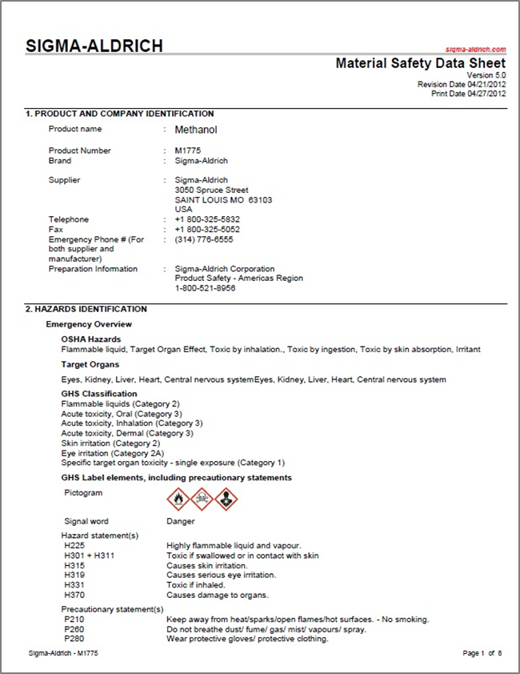
Introduction
SDS: document that provides important information regarding the health and safety aspects of a product or chemical
Chemical products are made from a variety of constituent materials, which can lead to different handling requirements for each product based on the hazards associated with the ingredients.

Slide 4
Introduction
An SDS includes information such as:
Procedures for handling the product in a safe manner
Health effects
Toxicity
First aid
Storage
Protective equipment
Proper disposal of item

Slide 5
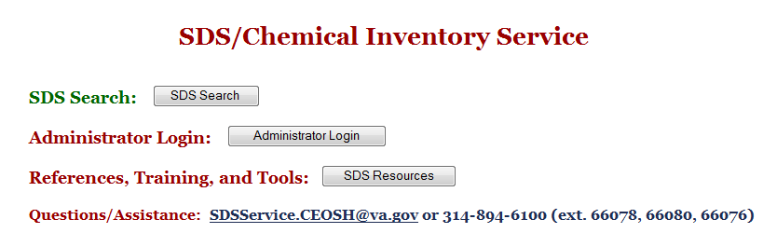
Accessing the “Search Inventory” Feature
Access the chemical management system through the CEOSH website at http://vaww.ceosh.med.va.gov/ceosh/MSDS/shtml or click on Quick Navigation Links (“SDS 3E System” under Facility Resources)on Milwaukee VAMC sharepoint page.
Click on the “SDS Search” button to access the chemical management service. This button will take you directly to the Search Inventory feature.

Slide 6
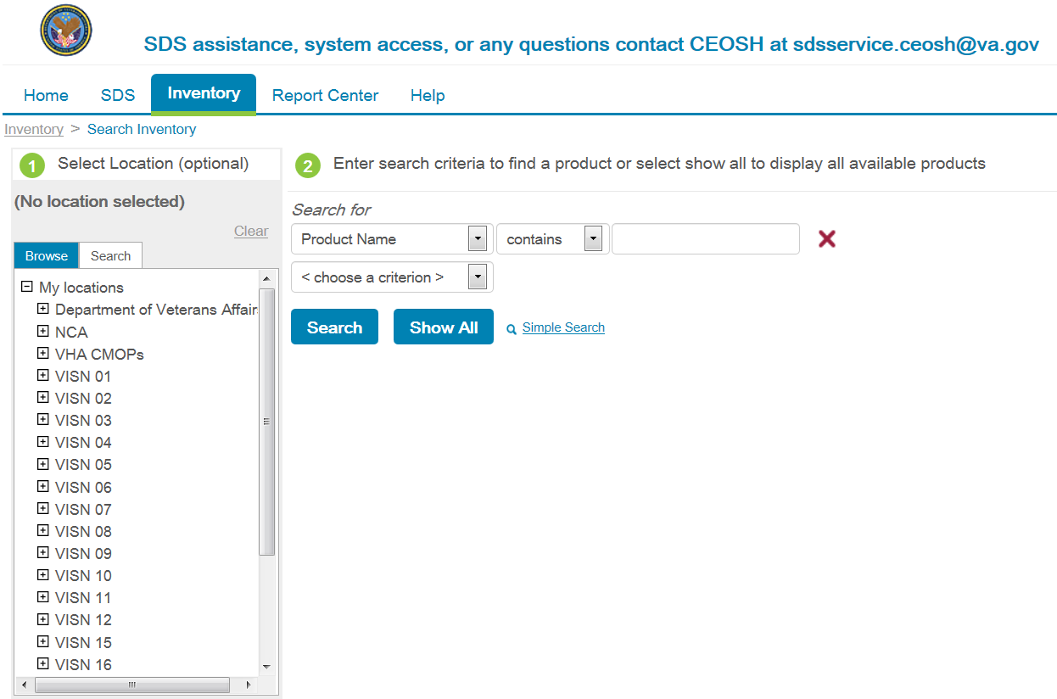
Search Inventory for an SDS
The Search Inventory feature has two steps shown in green circles.
1 – Select Location and 2 – Enter search criteria to find a product.

Slide 7
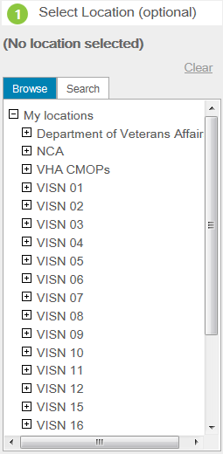
Select a Location
Step 1
Select “My Locations”
Under My Locations, a box with a “+” indicates there are details under the option that can be expanded.
After an option has been expanded, the symbol in the box changes to a “-” or “.” to indicate the full details are shown for that option.

Slide 8
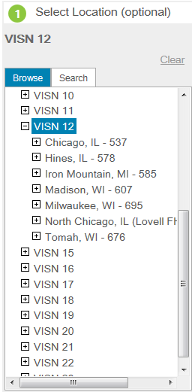
Select a Location
Step 2
Simply click on VISN 12. The location will highlight in BLUE and you will see the names of facilities appear under VISN 12 title.

Slide 9
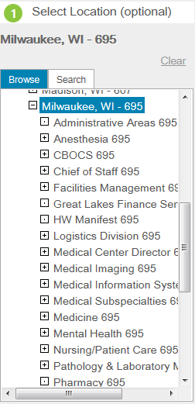
Select a Location
Step 3
Click on Milwaukee. The location will highlight in BLUE and you will see the names of the divisions/general areas appear.
Note: You can skip steps 4 & 5 and proceed to Search for Products. This searches the entire medical center inventory for products that match your criteria.

Slide 10
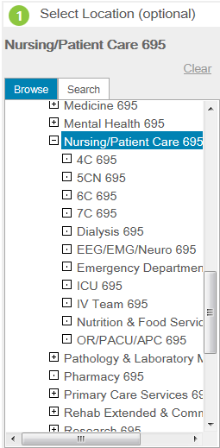

Select a Location
Step 4
You can dig down further into a facility by clicking the to reveal all the different sub-areas for that location.
Note: You can skip step 5. This searches the division/general area inventory for products that match your criteria.

Slide 11
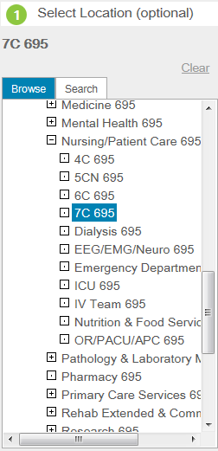
Select a Location
Step 5
Click on desired sub-area and the location will highlight in BLUE (selected area)
Note: This searches your specific area inventory for products that match your criteria.

Slide 12
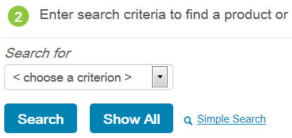
Search for Products
After selecting your location, there are two ways to find products:
1) Search all products
2) Search for specific products in your inventory
Clicking on the “Show All” button will display all products in the inventory for the area you selected.

Slide 13
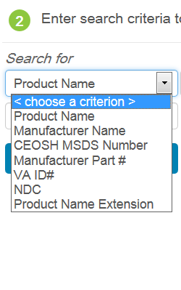
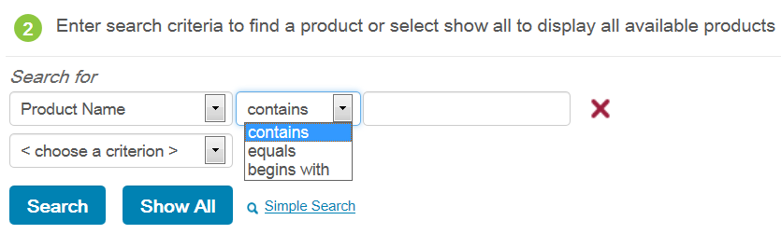
Search for Specific Products
Alternatively, you can use the search criteria filters to limit the products which appear in your search results.
By selecting “choose a criterion”, you can select additional criteria and refine your search even further.

Slide 14
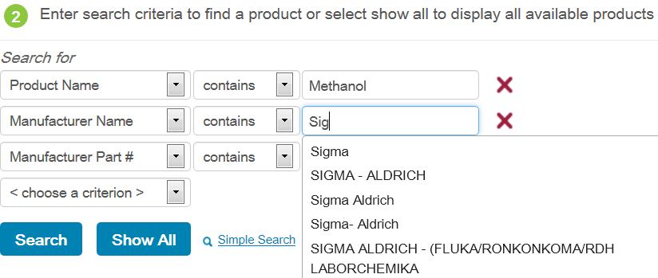
Search for Specific Products
Add words to the blank or drop down list in the third column to complete your search refinement.
Upon entering text into the blank field, suggested text begins to appear to help you streamline your search.
After you enter your criterion, click on the “Search” button to view the results.

Slide 15
Product Search Tips
The search feature can allow you to get as general or narrow as needed to find the desired product.
If you have the product in hand, it is helpful to search for the product name as it is written on the label.
You can use as few or as many search fields as required.
Search results are organized alphabetically to assist you in finding the SDS for which you are looking.

Slide 16
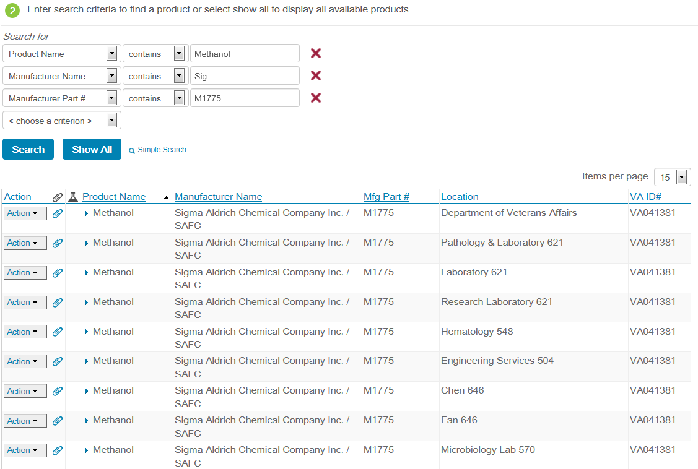
Example Search for Methanol from Sigma

Slide 17
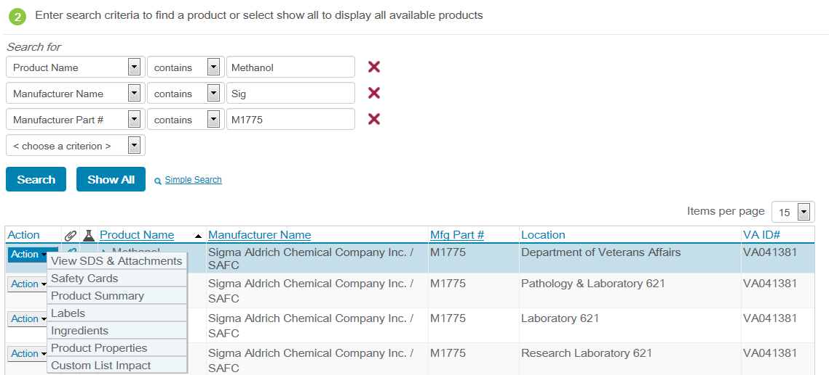
View Product SDS Information
Additional information can be viewed for each product by clicking on the “Action” button to the left of the product name.
The Action button shows the additional information you can view for the product: SDS & attachments, labels, ingredients, and product summary, etc.

Slide 18
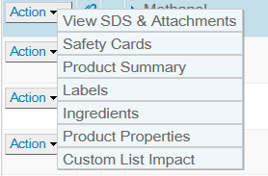
View Product SDS Information
To view the SDS, select the “View SDS & Attachments” link from the Action list.
If you select “View” again, an Adobe PDF document of the SDS will appear in a new window.
You may then view, print, and/or save the document electronically as needed.

Slide 19
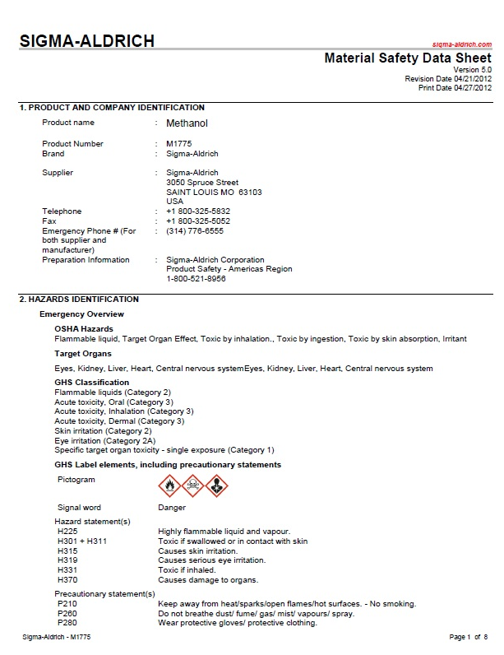
View Product SDS Information
This is a sample SDS document of Methanol by Sigma.

Slide 20
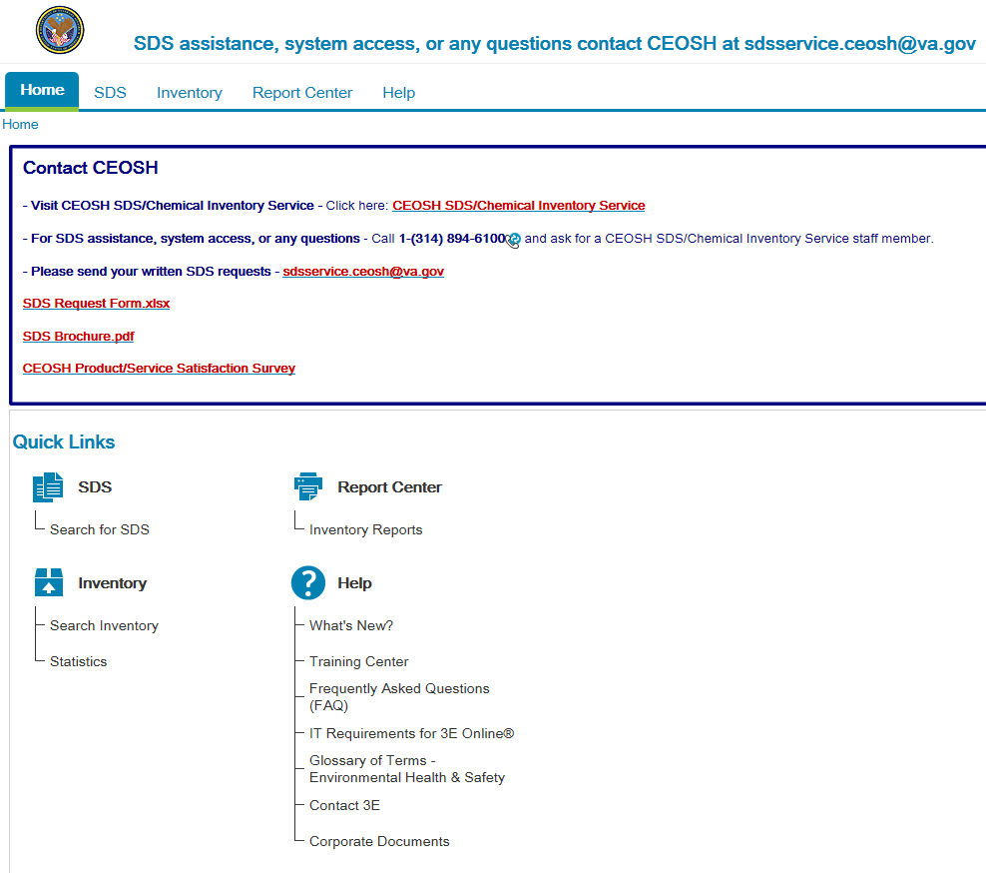
Can’t Find It?
Ask for Help if Unable to Locate an SDS
- If you are unable to find an SDS in your inventory, you can email a request to CEOSH at sdsservice.ceosh@va.gov.
- Direct contact with 3E should be limited to afterhours emergencies.
- If you have an immediate need for an SDS, contact your local Safety Office at
X46490 or x42933.

