Slide 1
MAXAIR Controlled Air Purifying Respirator (CAPR)-Disposable Lens Cuff (DLC) System
Train-the-Trainer

Slide 2
When/Why do I need the CAPR
MAXAIR CAPR DLC is a powered air purifying respirator (PAPR).
It provides protection against airborne infectious diseases such as TB, SARS, etc.
It is used instead of the N-95 mask and provides a higher level of protection
CAPR must be used when:
Treating a patient with suspected/confirmed airborne infectious disease
Entering a patient room with posted Airborne Precautions

Slide 3
Requirements to Wear/Use CAPR
Must complete the following in order to use the CAPR
Complete the Respirator Medical Questionnaire
Receive training on how to use the CAPR
Training and Medical Questionnaire is required initially (prior to 1st use) and annually thereafter

Slide 4
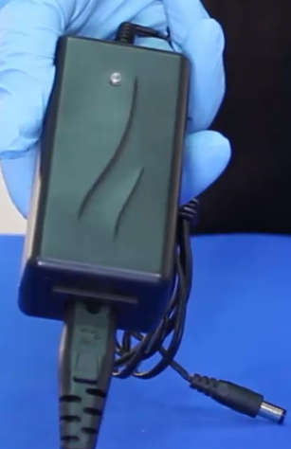
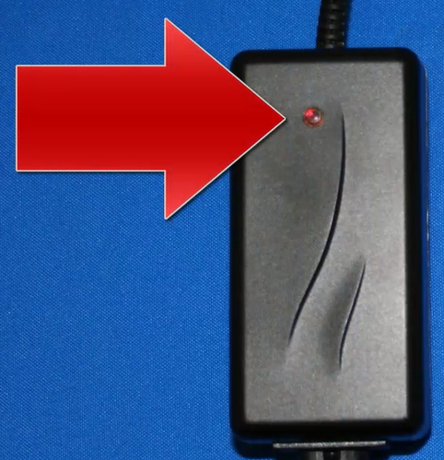
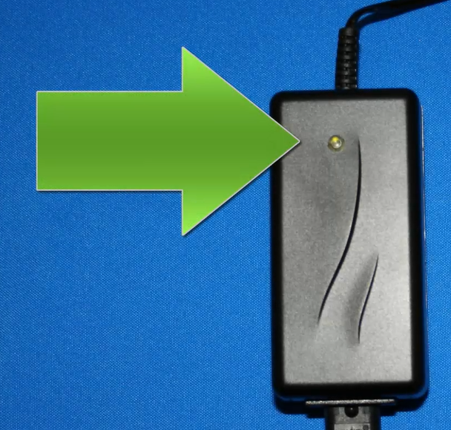
Battery Charging
LED Off: Charger not plugged into power source
LED RED: Battery is charging
LED Green: Charger has power/battery is charged and ready to use

Slide 5
Battery Charging
Do not leave battery on charger for extended periods of time (more than a week)
Once battery is charged, it can be disconnected from the charger
After use, plug battery into the charger
If the green LED stays on, charging is not needed
If the LED turns Red, battery needs to be charged
Once light turns green after charging, it can be disconnected

Slide 6
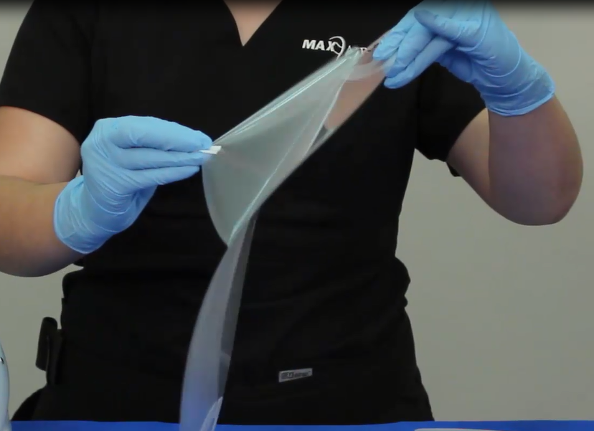
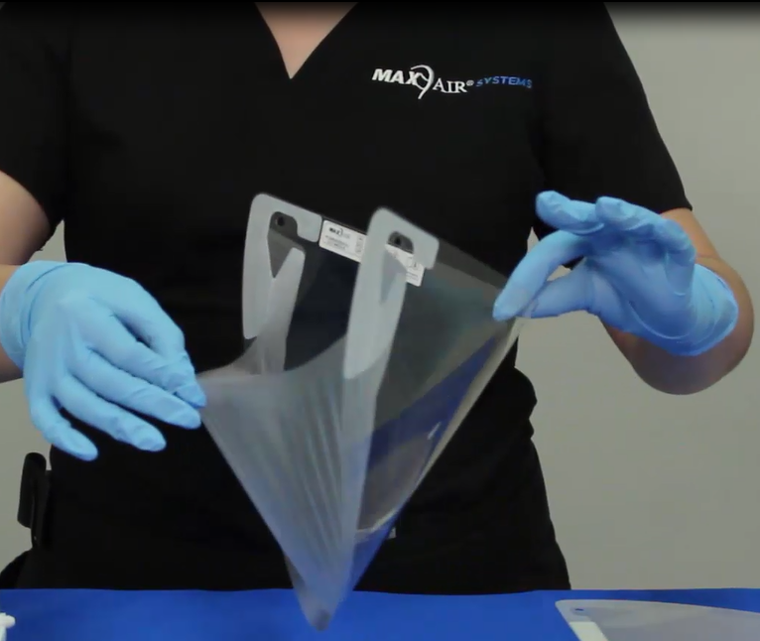
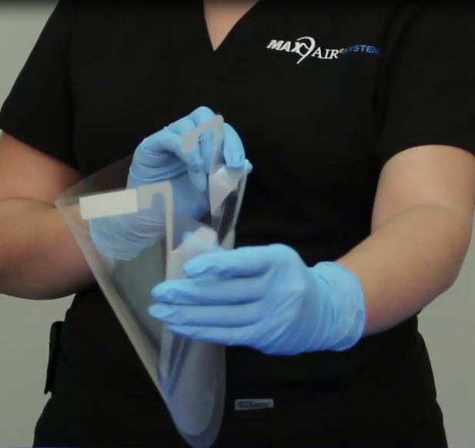
Prepare Disposable Lens Cuff (DLC)
Don DLC
Remove protective lens cover and throw it away
Pull cuff away from lens
Pull away plastic tabs

Slide 7
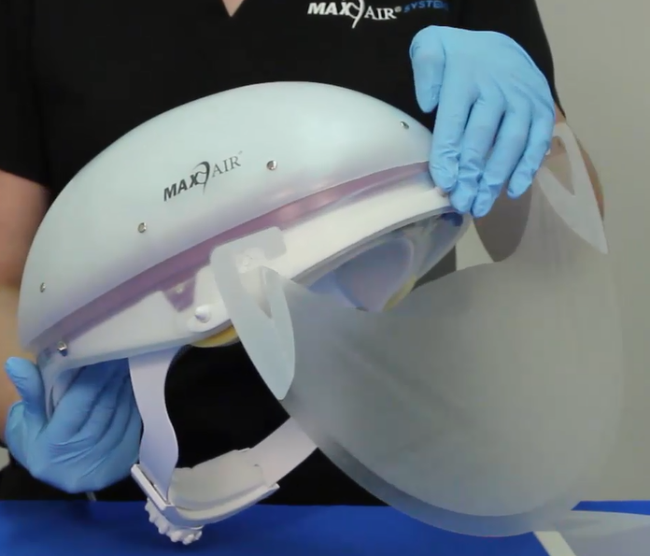
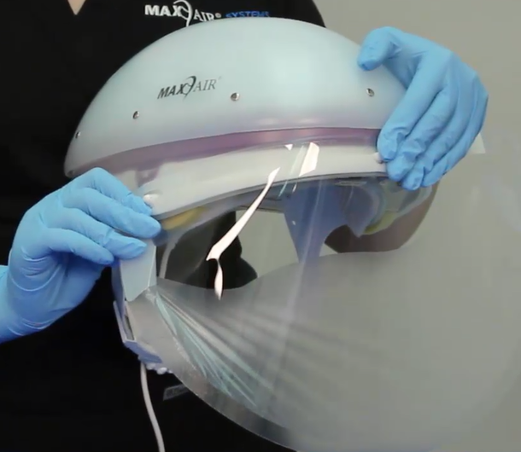
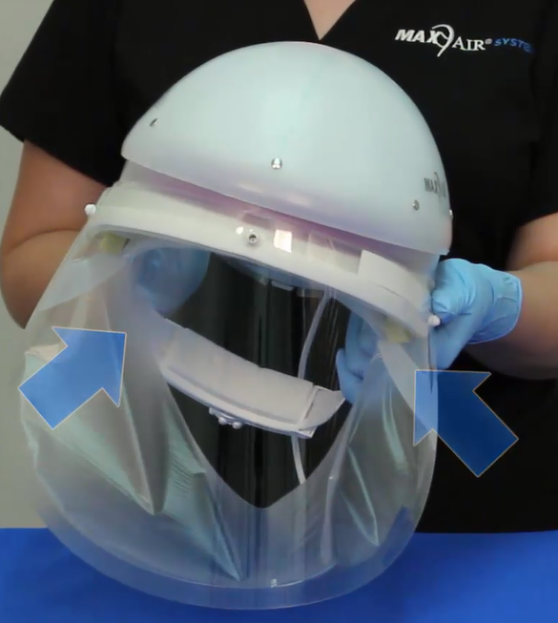
Attach DLC to Helmet
Place center hole on long adapter on front of helmet
Connect side holes to helmet side adapters
Plastic tabs should rest on side foam on interior of helmet

Slide 8
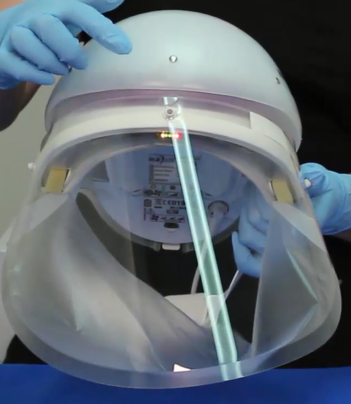
Operation Check
Plug CAPR cord into battery
Ensure indicator lights are functioning
All lights come on initially
3 green lights – battery 75-100% charged
2 Green Lights – battery 50-75% charged
1 Green Light – Battery 25-50% charged
Red Light – Low battery <25% charged
Yellow Light – Low air flow; Do not use, contact Safety to inspect/replace
Fully charged battery good for 8-10 hours

Slide 9
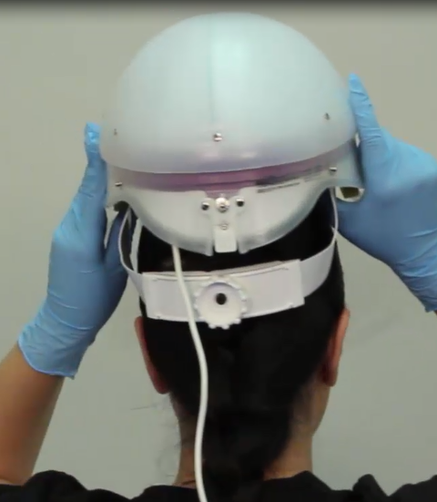
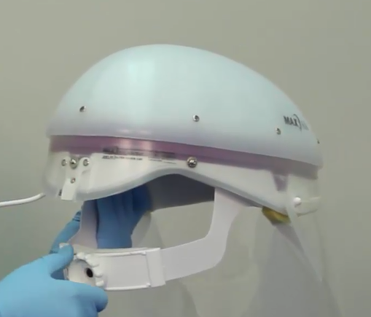
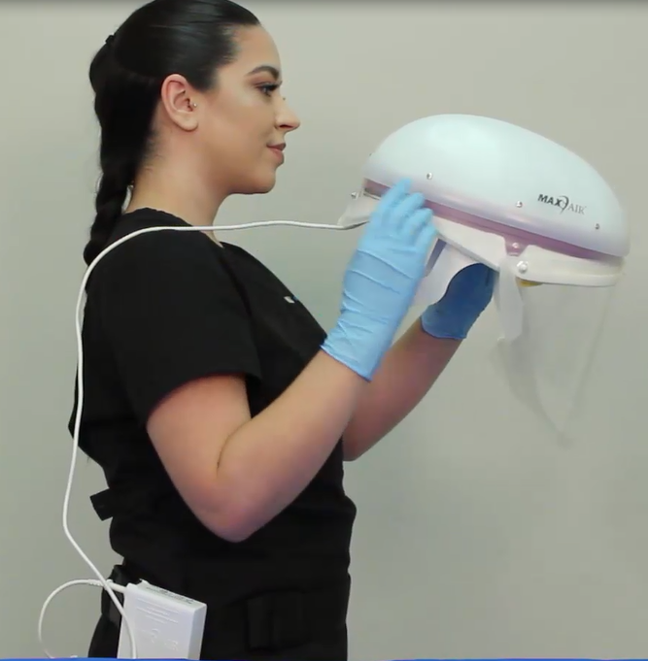
DON CAPR Helmet
Place bonnet on head (Bonnet keeps interior of helmet cleaner)
Extended ratchet to fully open position (Turn counter clockwise)
Place cable over right shoulder
Don on head starting at rear of head

Slide 10
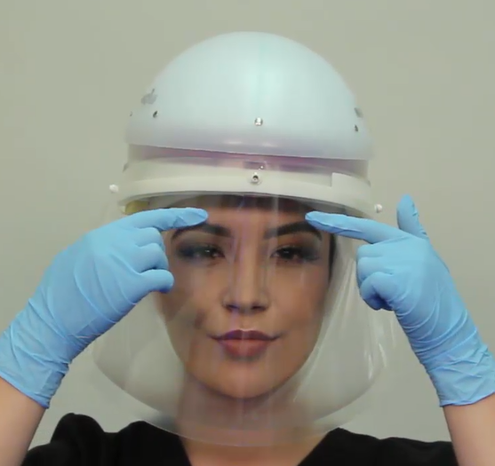
DON CAPR Helmet
Pull cuff around edges of your face and under chin
Run fingers back & forth to ensure slight tension
Ensure helmet is on straight and positioned about ½ inch above eyebrows
Tighten ratchet (turn clockwise) until snug; not too tight (causes pain) or too loose (falls off)

Slide 11
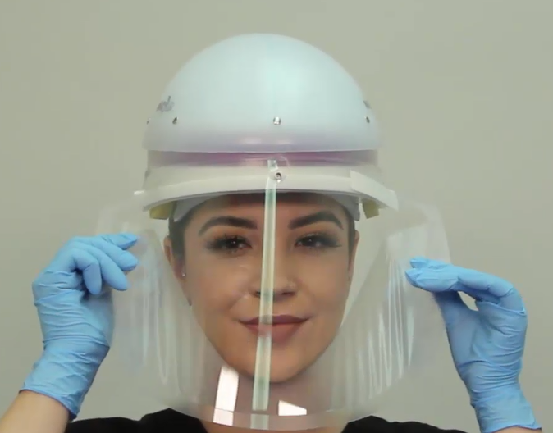
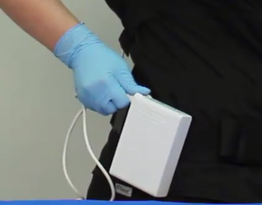
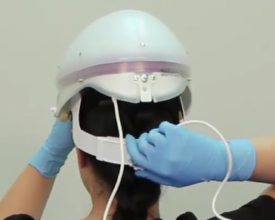
Doff CAPR
Grab sides of DLC and pull outwards
Then pull DLC forward and upward away from you
Place DLC in trash or Red Bag waste if contaminated
Unplug cord from battery to turn off (press down black tab on battery and pull cord)
Turn ratchet counter clockwise to loosen and remove helmet

Slide 12
DECON CAPR
Use Cavi-wipe or Sani-cloth
Wipe exterior/interior of helmet and battery cable after each use
Allow to dry
Return CAPR to storage container between uses

Slide 13
CAPR Maintenance
Occupational Safety and Health will
Perform monthly inspections
Repair/replace damaged components
Provide training and/or train super users
CAPR Users will
Inspect CAPR prior to use for any damage
Contact OS&H if CAPR is damaged/does not operate correctly and when yellow LED stays on after initial ops check
Decontaminate CAPR after each use

