Slide 1
Health.edu
Texas Tech University Health Sciences Center

Slide 2
OBJECTIVES
Identify formaldehyde.
Recognize the OSHA (Occupational Safety and Health Administration) Standard.
Indicate spill kit procedures.

Slide 3
OSHA WEBSITE www.osha.gov
Formaldehyde standard: 29 CFR 1910.1048
Applies to all occupational exposures to gas, solutions and materials that release formaldehyde:
Appendix A – technical guidelines for formalin
Appendix B – sampling strategy and analytical methods
Appendix C – medical surveillance
Appendix D – non-mandatory medical disease questionnaire
Appendix E – fit testing procedures (removed to 1910.134)

Slide 4
Formaldehyde: What is it?
Flammable, colorless liquid with a strong, pungent, irritating odor.
Used in the production of: Resins
Particleboard
Plywood
Foam insulation
Fiberglass
Carpets
Household cleaners
Personal care products (Q-15)

Slide 5
Formaldehyde: Laboratory Use
Typically sold as formalin, a methanol-stabilized water solution that contains from 37-50% formaldehyde

Slide 6
Formaldehyde: Laboratory Use
Formaldehyde vapors slightly heavier than air.
If incorrectly handled, can result in asphyxiation in poorly ventilated, enclosed, or low-lying areas.
For sensitized persons odor is NOT an adequate indicator of formaldehyde presence.

Slide 7
HEALTH EFFECTS
Exposure to formaldehyde can cause acute or chronic health effects.
Formaldehyde is toxic, and is classified as a human carcinogen (US EPA) and has been linked to cancers of the lung, nose, and throat.
Formaldehyde is also considered a possible mutagen and teratogen, meaning it has been shown to impair DNA in laboratory experiments and may contribute to congenital defects.
Formaldehyde is an irritant, corrosive and a strong sensitizer .

Slide 8
Formaldehyde: Acute Exposure
Acute symptoms of formaldehyde fume exposure are listed to the right.
Chronic exposure to high levels of formaldehyde vapors can cause conjunctivitis, laryngitis, bronchitis or bronchial pneumonia.

Slide 9
Formaldehyde: Acute Exposure
Most formaldehyde exposures occur by:
Inhalation: some persons have developed chronic asthma or bronchitis following exposure, most often as a result of accidental spill involving a single exposure to a high concentration of formaldehyde.
Skin and eye contact: An air concentration of 2 ppm is quickly irritating to the eyes, causing redness, pain and blurred vision, while 20 ppm can cause permanent clouding of the cornea or blindness after only one exposure. Direct skin contact can cause white discoloration, drying, cracking and scaling of the skin. A previously exposed person may react to future exposures with allergic dermatitis or hives.

Slide 10
Formaldehyde standard: 29 CFR 1910.1048
Due to the potential devastating effects of overexposure to formaldehyde, OSHA and other regulatory agencies have established occupational exposure limits for airborne concentrations of formaldehyde.

Slide 12
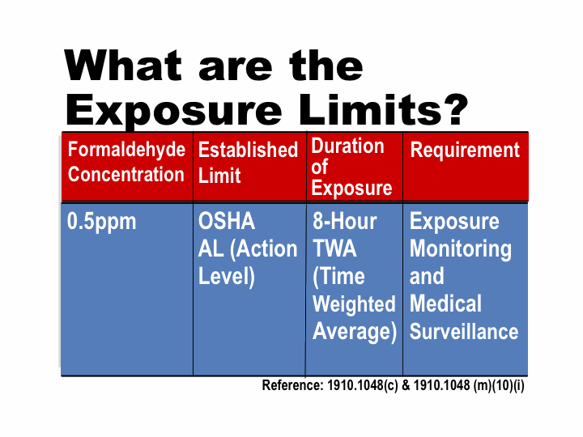

Slide 15
Exposure monitoring
To determine whether occupational exposure limits for formaldehyde are exceeded, exposure monitoring is performed.
Monitoring is done by accurately sampling formaldehyde levels in the immediate work area and calculating the airborne exposure levels.
Results of monitoring must be communicated to employees within 15 working days after the results are received.

Slide 16
Exposure monitoring
Regulated areas must be clearly separated from the rest of the work area and entry must be restricted to persons who have been trained to recognize the hazards of formaldehyde. Hazard identification signs such as this one must be posted at all entrances.

Slide 17
SAFE WORK PRACTICES
Local ventilation, such as a certified chemical fume hood, is the most efficient engineering control for limiting employee exposure to any toxic or volatile chemical, including formaldehyde.
Personal protective equipment is required whenever handling formaldehyde. For most operations, basic PPE consists of:
1) Eye protection
2) Formaldehyde-resistant lab coat or apron
3) Chemical resistant gloves. Butyl or nitrile gloves are recommended for use with formaldehyde - in general, latex gloves DO NOT provide adequate protection from formaldehyde).

Slide 18
SAFE WORK PRACTICES
As much as possible, dilute and handle formaldehyde in a chemical fume hood.
To minimize fumes, open lids on formaldehyde solutions only as long as it takes to complete your task.
Manipulate and transfer the smallest volume of formaldehyde needed.
Use spill pads or other absorbent material when pouring formaldehyde.
Never heat or stir formaldehyde solutions at the open bench.

Slide 19
Know what to do in the event of an emergency
Know the location of the nearest eyewash or safety shower.
If formaldehyde comes in contact with skin or eyes, flush immediately with copious amounts of water for at least 15 minutes.
Consult the Material Safety Data Sheet (MSDS).
Contact your safety Services Office.
Evacuate if necessary.
Be sure to report any exposure incidents to your supervisor.

Slide 20
Spill cleanup
Minor spills of formaldehyde solutions should be cleaned up immediately.
Be sure to wear appropriate PPE.
Absorb the spill using paper towels, absorbent pads or a formaldehyde neutralizing powder. If dry absorbents are used, scoop the absorbed material into a plastic bag using a dustpan, being careful not to breathe the dust from the absorbent.
Never place contaminated materials in an ordinary trash can. Call safety service for disposal.

Slide 21
Spill cleanup
Major spills must be cleaned by a trained operator wearing appropriate respiratory protective equipment (many labs define a major spill as any spill greater than 50 mL of 37% formaldehyde or more than 1 L of dilute solution).
After a major spill, do the following:
Immediately turn off ignition sources
Evacuate the area
Close all doors to contain vapors
Call for help

