Slide 1
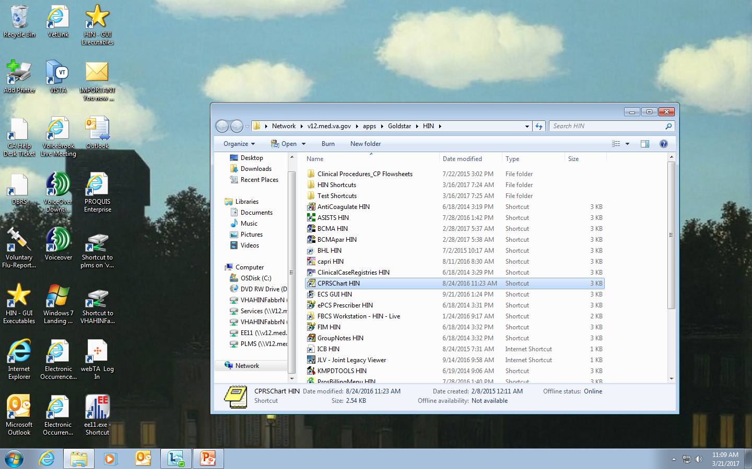
Sign into CPRS.

Slide 2
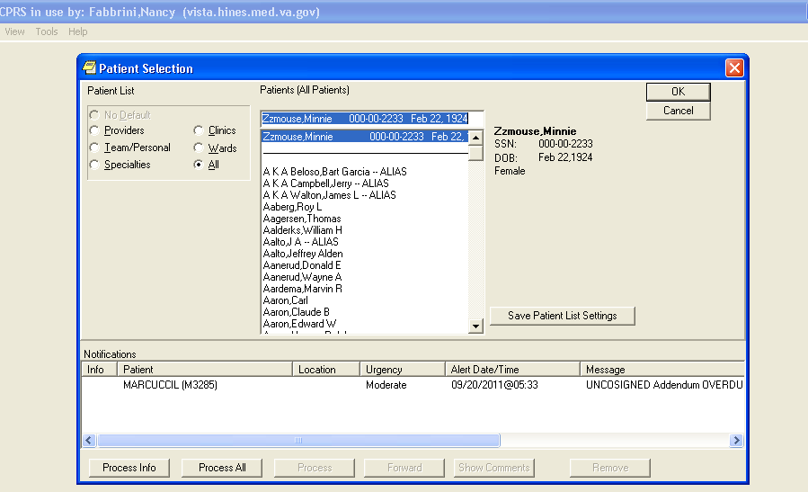
Select the correct patient and hit “OK”.

Slide 3
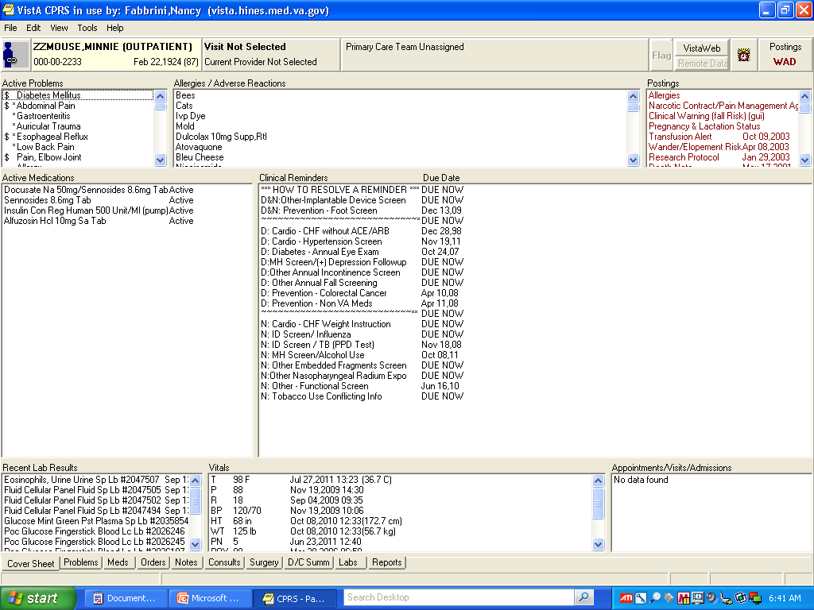
This is the “Cover Sheet” screen. This screen shows “Active Problems” , a list of “Active Medications and
the tabs along the bottom : Problems, Meds, Orders, (Progress) Notes, Consults, Surgery, Discharge Summary,
LABS, and Reports.

Slide 4
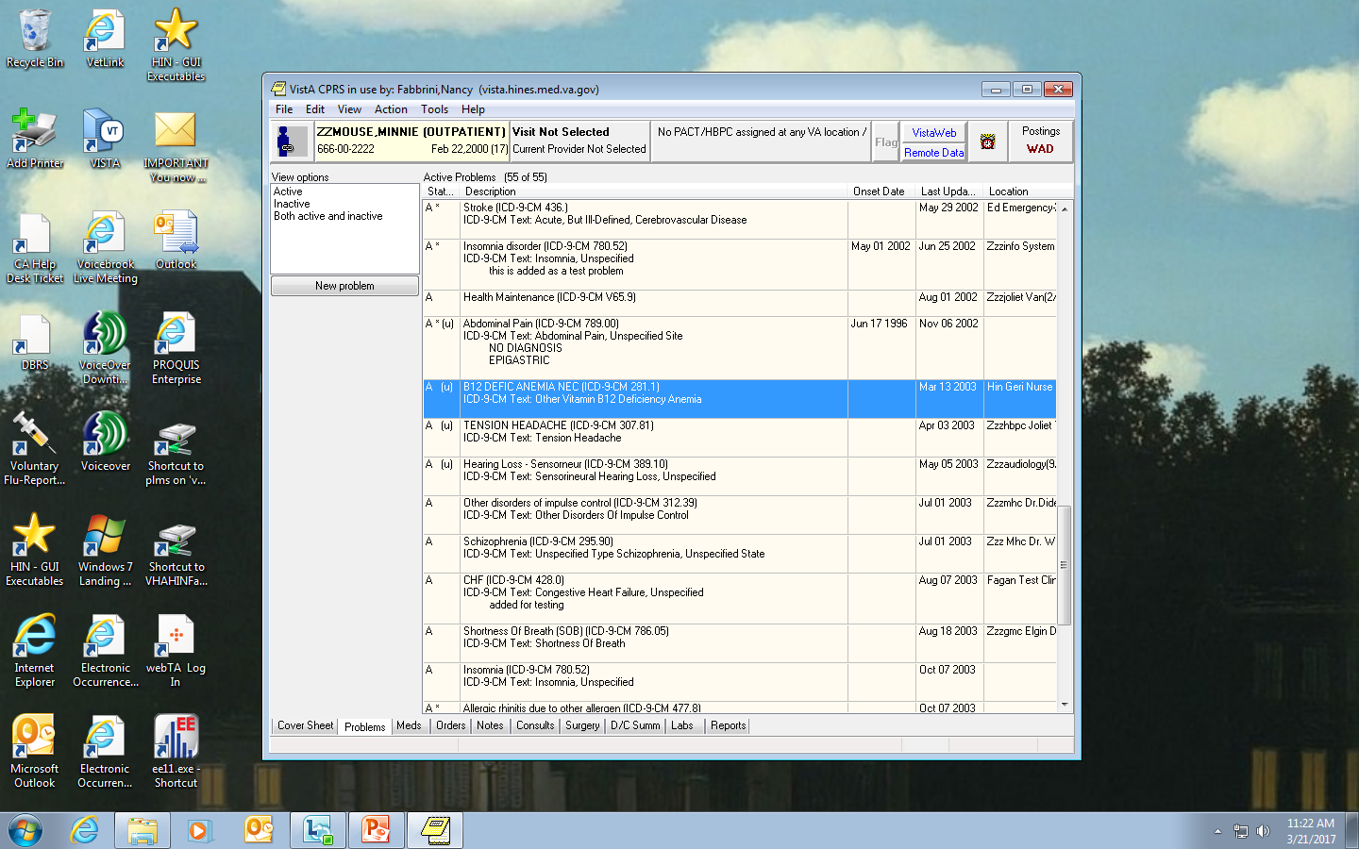
For details on “Active Problems”, you can click on the “Problems” tab, which opens a more
detailed list .

Slide 5
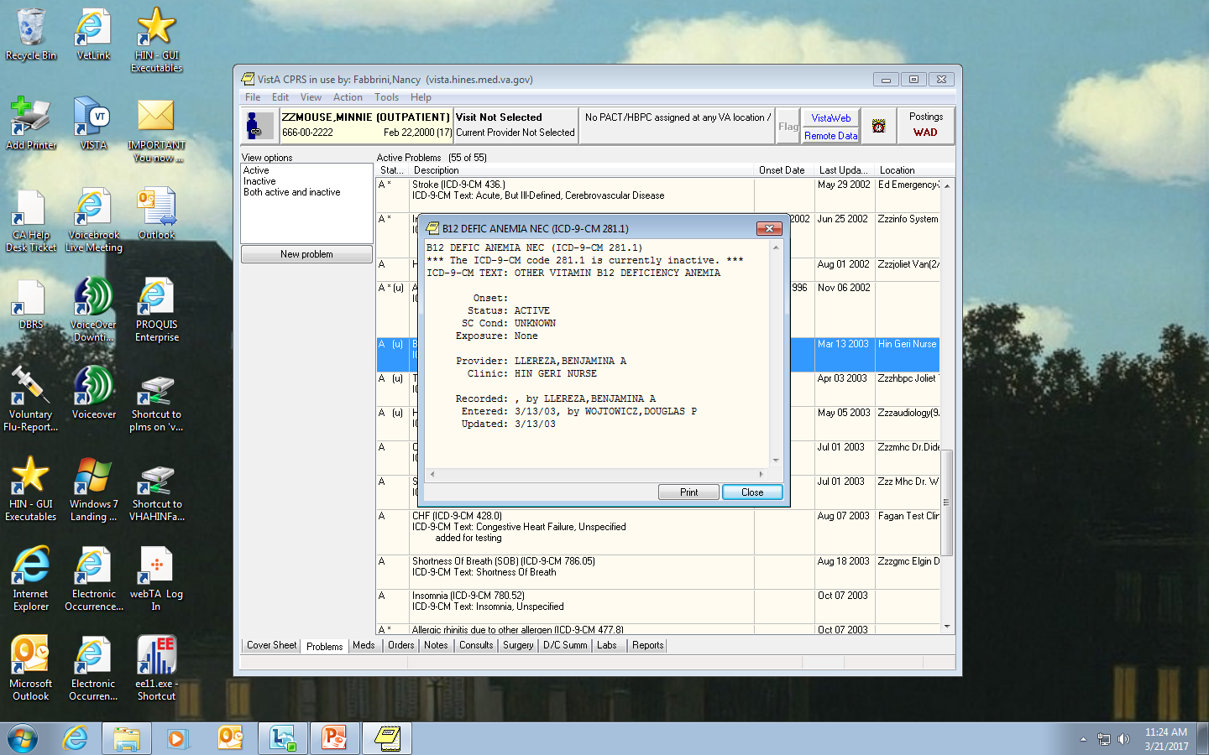
The description box gives details of the problem.
You can see that this patient was diagnosed with Anemia in 2003.
Back to the “Cover Sheet” tab…

Slide 6
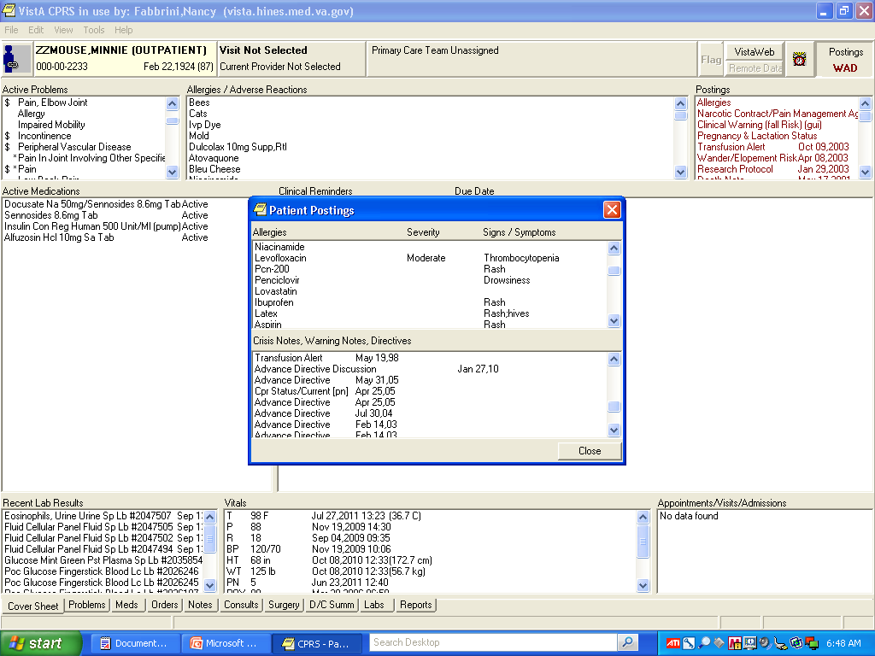
Patient “Postings” on the top right side has a list of warnings, allergies, and the DNR/DNI directives
(should a patient choose that option). Clicking on “Allergies” at the top of the list, opens a
descriptive box with detailed information. As you can see, this patient has an “allergy” to Levofloxacin,
which causes a thrombocytopenia.

Slide 7
“Active Medications” can be seen in the center left of the “Cover Sheet.”
The “Meds” tab can be used to look more closely at the patients medication use and history.

Slide 8
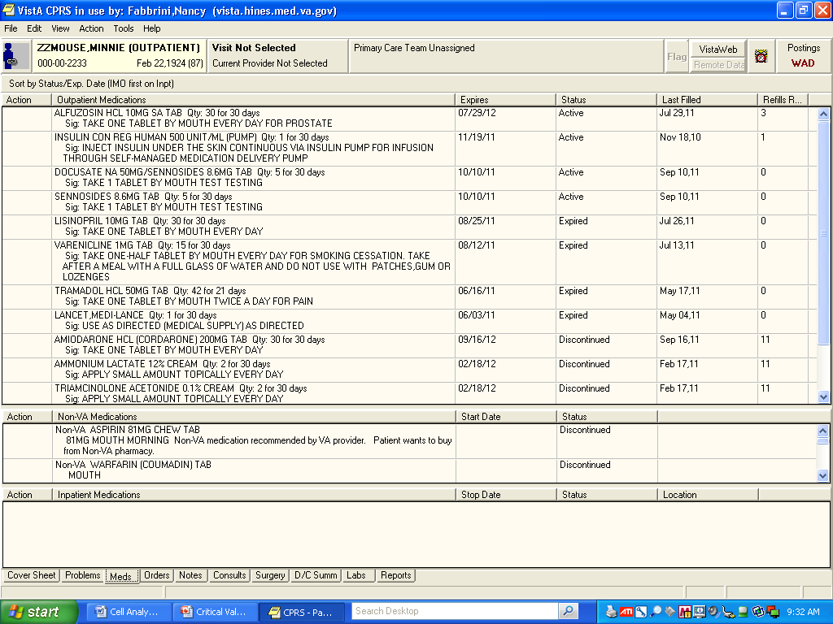
The “Meds” tab shows Outpatient, Non-VA, and Inpatient medications that are active, discontinued, and expired. This patient is an outpatient, so the Outpatient Medications are on top. If she were an Inpatient, the inpatient medication would be on top. Non-VA meds cover anything prescribed by an outside provider.
If you have a patient with a delta check, you will be able to review this list to see if any medications might be a reason for the delta check. As on the cover sheet, if you double click on any medications, a description box will appear.

Slide 9
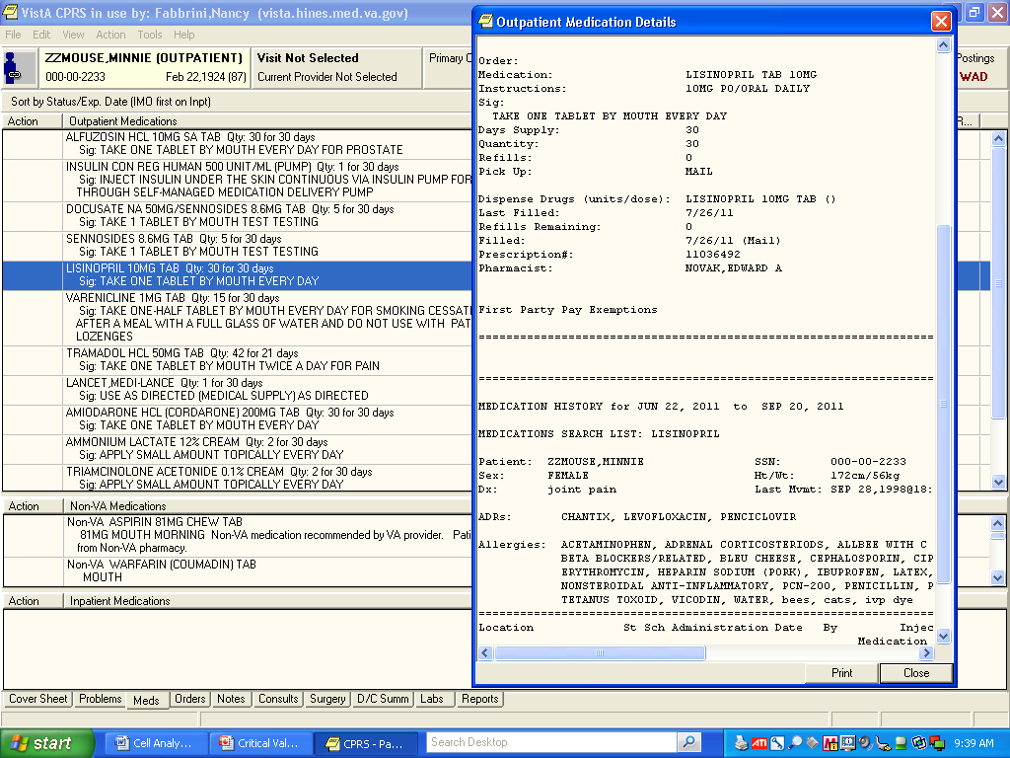
Double-clicking on Lisinopril opens a detailed description box, telling when the
Prescription was refilled, major interactions, etc.)

Slide 10
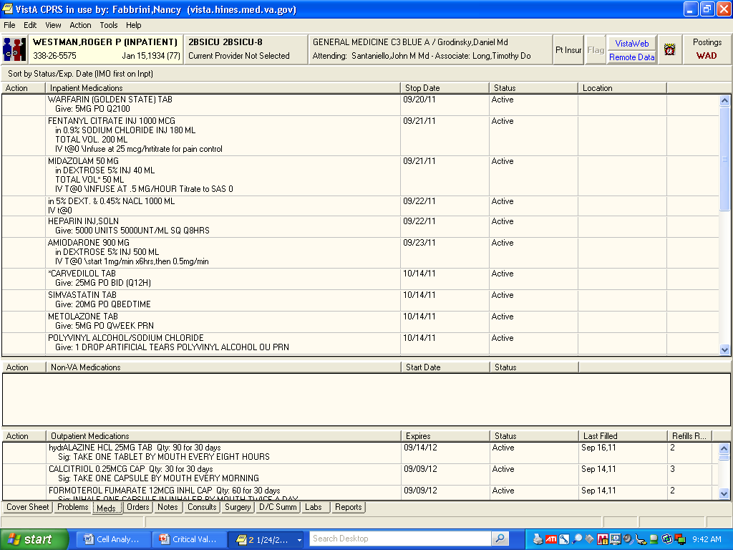
This is an example of the “Meds” tab from an inpatient. The inpatient medications are
now on top. You will also notice that the “Primary Care” box is now populated
with the name of a provider

Slide 11
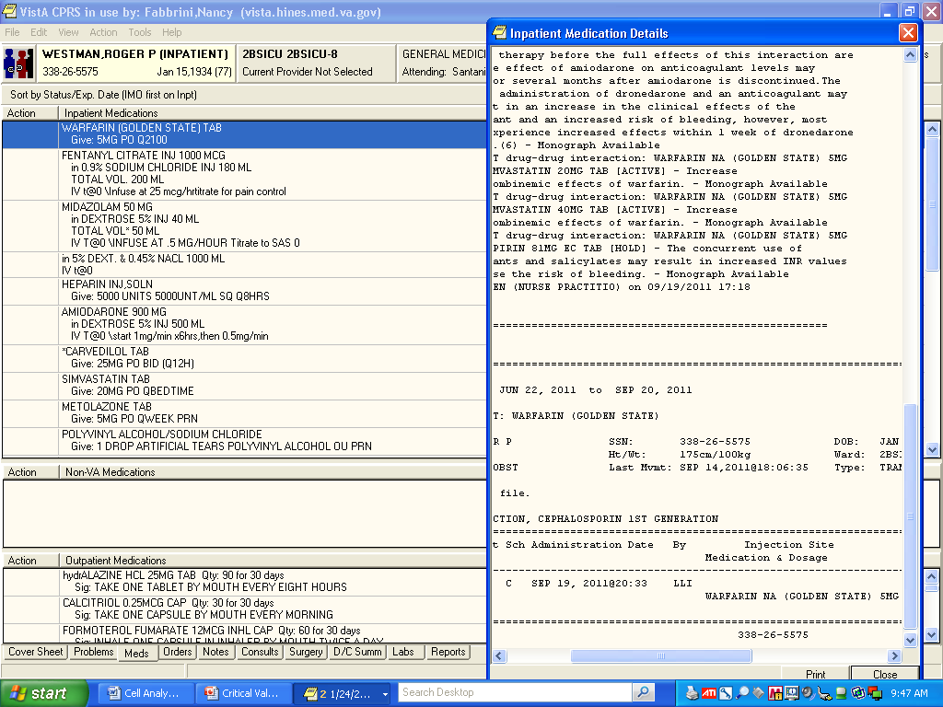
For inpatients who are receiving “Unit-dose” medications (Simvastatin, Carvedilol,
Warfarin, or SQ heparin for example), clicking on the medication will give you a description box
showing med interactions and dosage history.

Slide 12
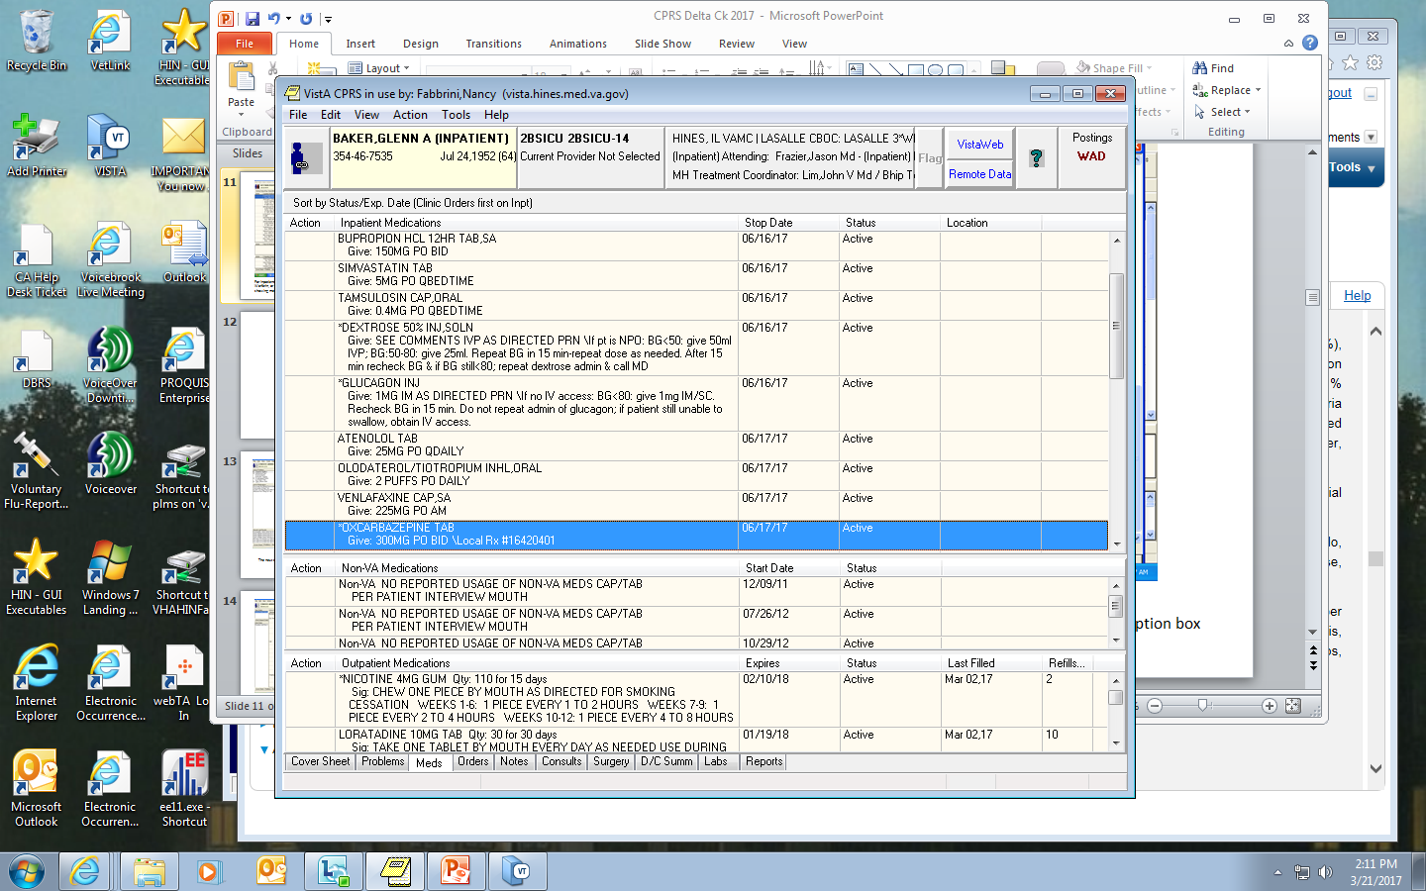
You have a patient with thrombocytopenia and you are reviewing his medications. Nothing stands out as a
possible cause of a lowered platelet count, however, you don’t recognize the drug “Oxcarbazepine”. How can you
Find out if this drug could cause thrombocytopenia? Select Tools .

Slide 13
Under the “Tools” pull down menu, select “Medical Library/Clinical Resources”. From the second pull down menu, select “Clinical References/Virtual Library”.

Slide 14
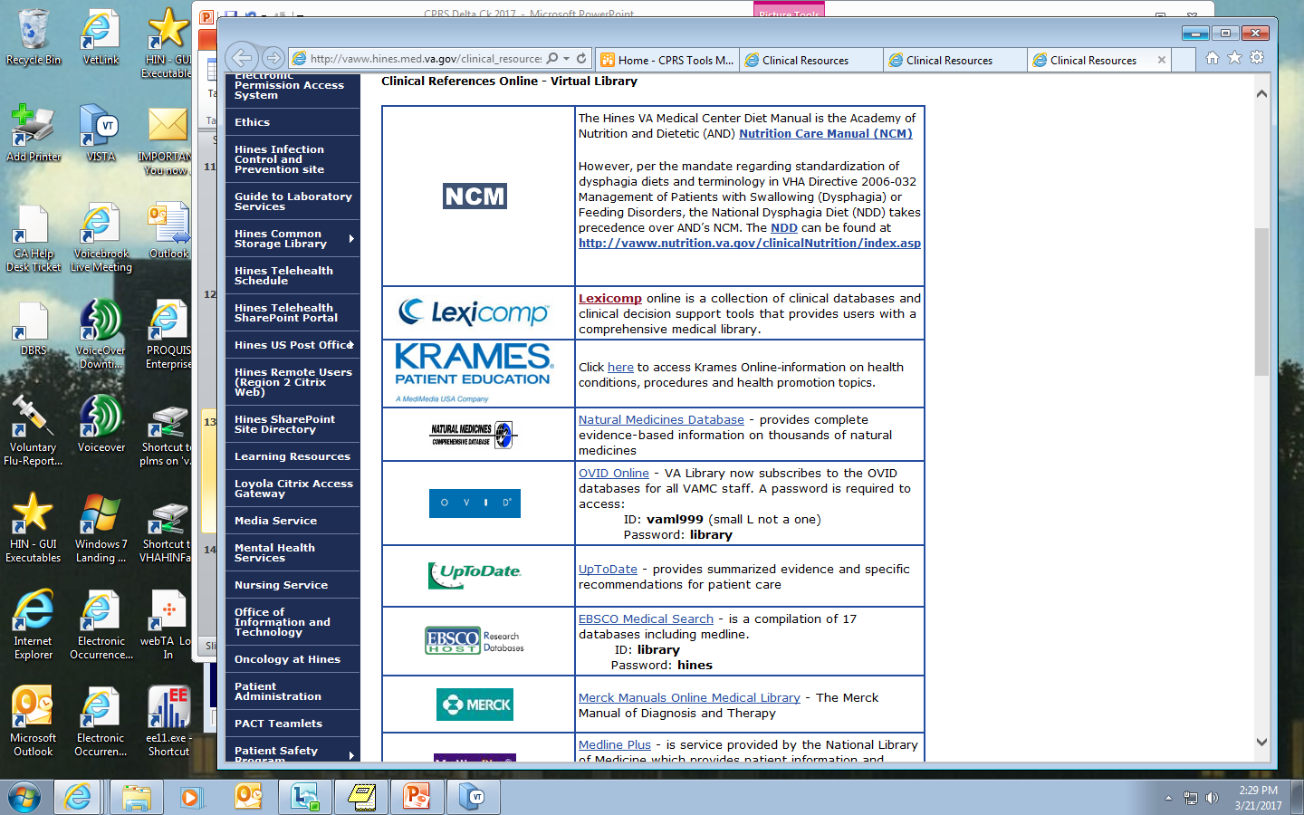
The screen on the left shows the clinical resources that are available. Click on “Lexicomp”; the screen on the right
will open. You can look up a number of items, drugs, diseases, etc.. In this case, we are interested in the drug
We saw in the patient’s chart. Typing in “Oxcarbazepine” and selecting “search” gives us:

Slide 15
The screen on the left shows the results of our search. Click on “Lexi-Drugs”, “Oxcarbazepine”.
The screen on the right appears. Again, there is a lot of information in Lexi-Comp on the drug selected.
If you scroll down the Navigation Tree on the left, you will see “Adverse Reactions”.
When you click on that option, the following screen appears:

Slide 16
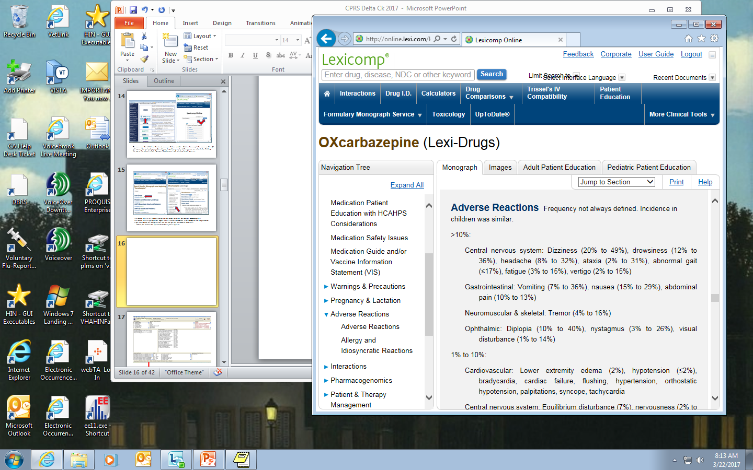
The adverse reaction are generally grouped according to frequency and body system.
For our purposes, we are most interested in “Hematologic: Adverse Reactions”. Scrolling down, we find:
“Hematologic and Oncologic: Bruise (2%), purpura, rectal hemorrhage and THROMBOCYTOPENIA”! So we know
that this drug is associated with a drop in the platelet count.

Slide 17
The next tab we will examine is the “Orders” tab.

Slide 18
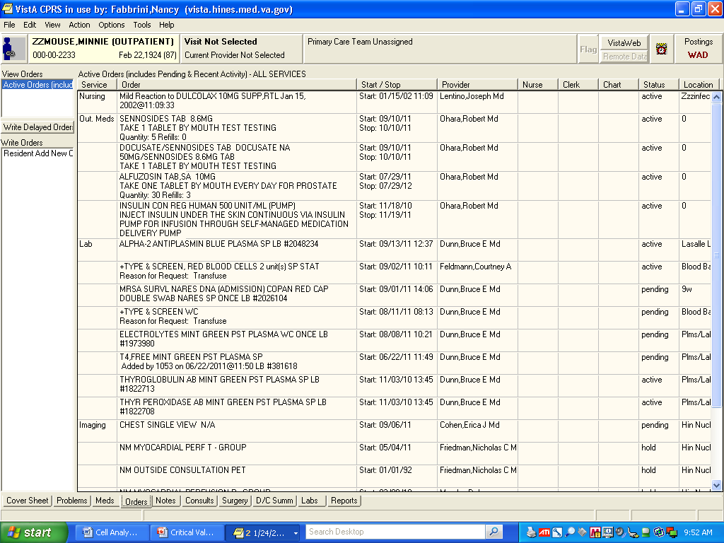
Note that this page lists the orders, order number, provider, status of the order and location. Lab
orders can be found on this screen that with information about the start date (or date of collection)
as well as who the ordering physician is.

Slide 19
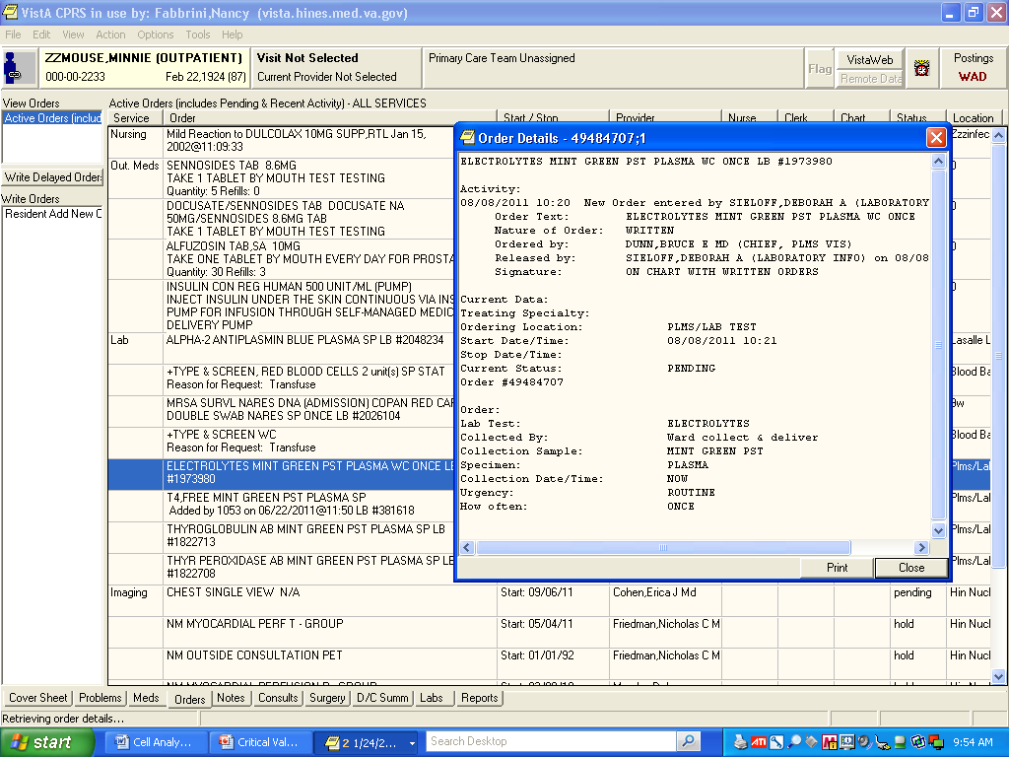
Clicking on an order will open an “Order Details” box with detailed information
regarding that order, such as who placed the order, when they did, if it is signed, if it is a ward
collect or send patient.

Slide 20
The next tab is the (Progress) “Notes” tab.

Slide 21
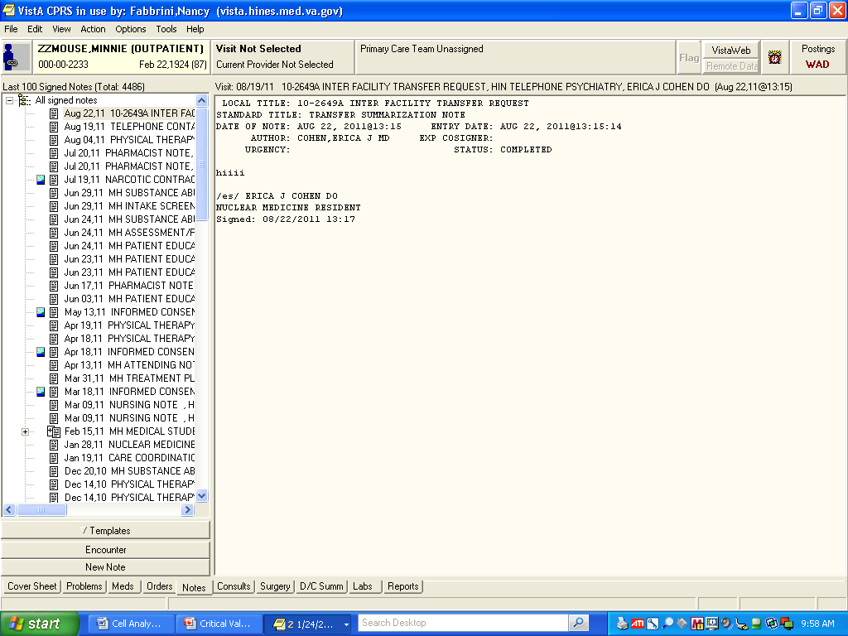
On the “Notes” tab you can find a listing of signed notes for each encounter on the left.
All encounters will have a note from physician, nursing, dental, radiology, etc.
Click on the date/provider you wish to review and the detailed note will open in center.
For an outpatient, clinic and pharmacy notes will be found here as well.

Slide 22
The “Consults” tab is next.

Slide 23
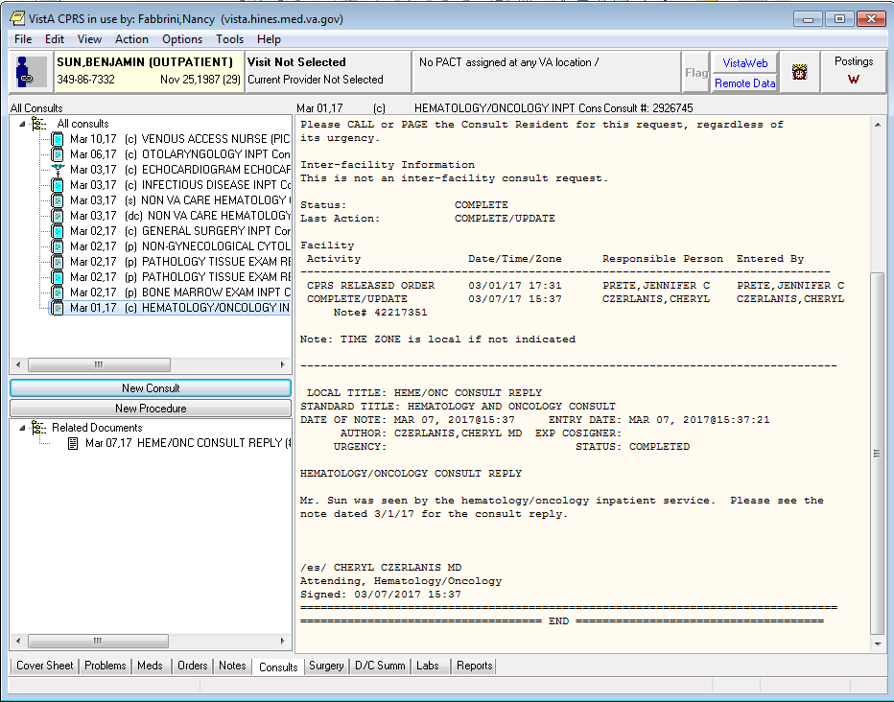
The top, left box has a listing of “All Consults” for this patient. Here you can find a renal or a Hem/Onc
consult. This particular patient had a bone marrow exam consult and an infectious disease consult
(among others).
Clicking on the consult desired will give you a detailed note or a note directing you to the “Notes” tab
for information.

Slide 24
By clicking on the Notes tab, we can read the reply to the Heme/Onc consult.

Slide 25
We will go to the “LABS” tab!

Slide 26
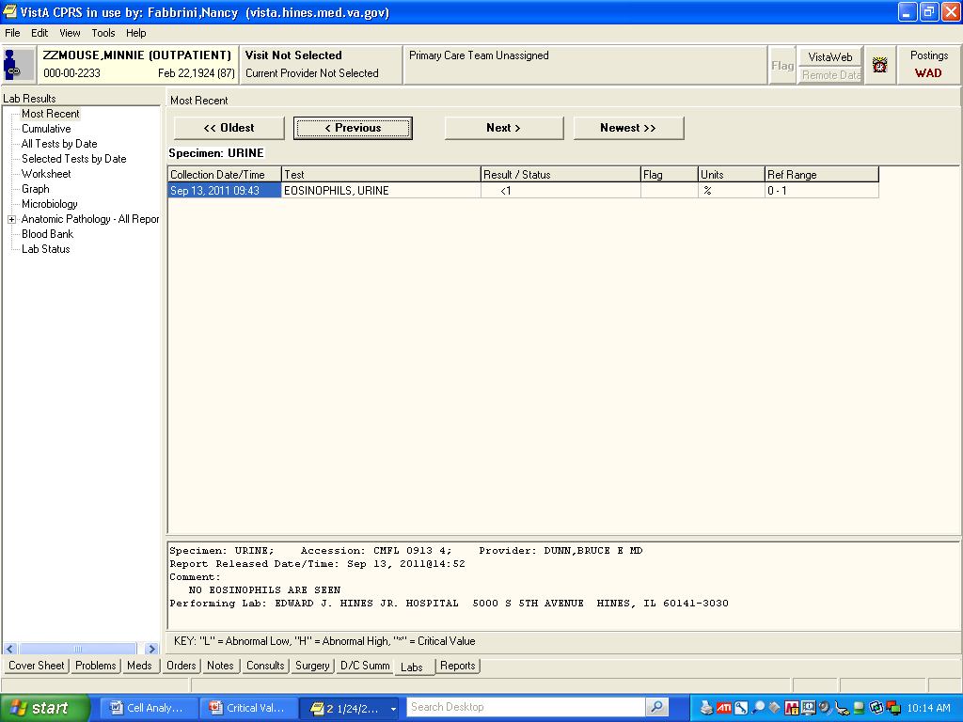
The options on the left of the page allow you to choose how you would like the results displayed. (have a problem sample? Want to know if there were other tests drawn at the same time? Select “Selected Tests by date”.
On this page, the most recent result appear first. The scroll buttons on the top will allow you to look at the patient
results from oldest to newest. Any comments related to the displayed result will show at the bottom of the screen.
On the left you can see various options with regards to lab results. In particular you can graph results over time, review
Blood bank reports (if they were transfused, blood type, antibody history, etc. from their time here at Hines), look only
at a selected test, etc.

Slide 27
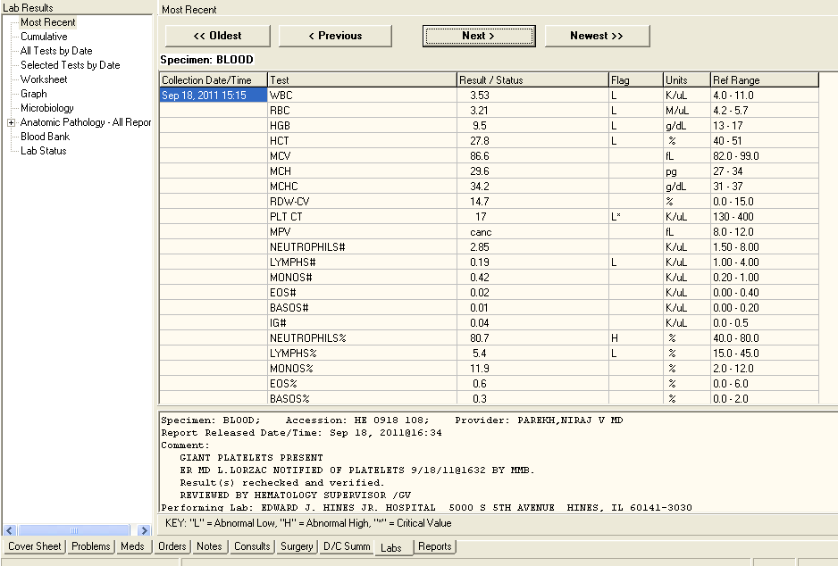
If you have a delta check and want to see what the patient’s platelet counts have been, you can select either
“Selected Tests by Date” or “Graph”. If you choose “Selected Tests by Date” the following screen appears.

Slide 28
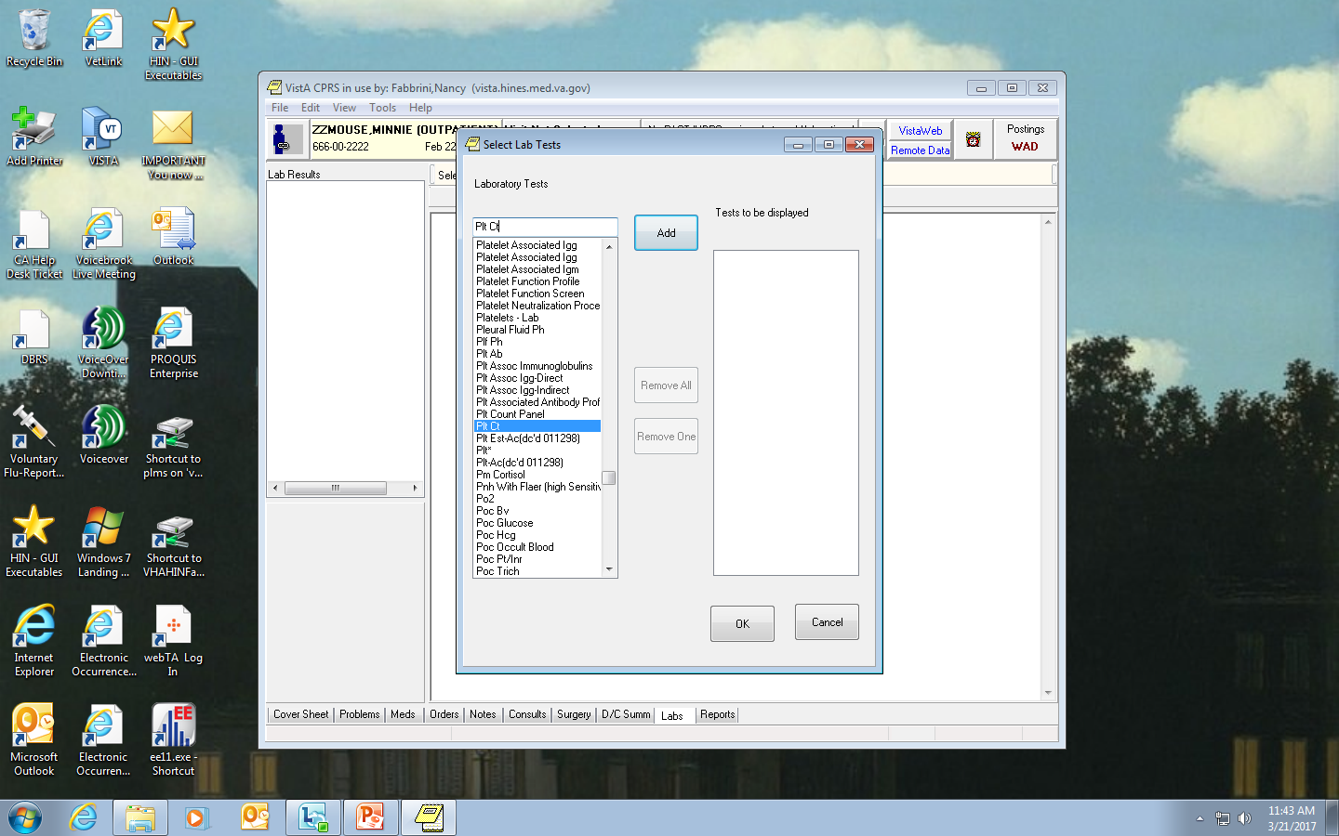
Plt Ct
If you want to look at platelet counts, enter “Plt Ct” (or whatever test you want) or select it from the list. Hit the “Add”
Button and the test will appear in the “Tests to be Displayed” box. You can add other tests if you want, following the
Same procedure. When you are finished, hit “OK”.

Slide 29
The first line indicated by the arrow, shows that the plt cts displayed are from Sep 19, 2016 to Mar 21, 2017. The selections on the second line allow you to pick your time frame. Do you want to see all the platelet counts within one week, one month, 6 months, etc. The display will change based on your selection.

Slide 30
You can also select the “Graph” option to show the trends in any test values. In this case, we have selected “Plt Ct” and have also selected the “All results” time frame. (This is useful for tracking a patient’s result over time; were his results consistent or do you have an outlier?)

Slide 31
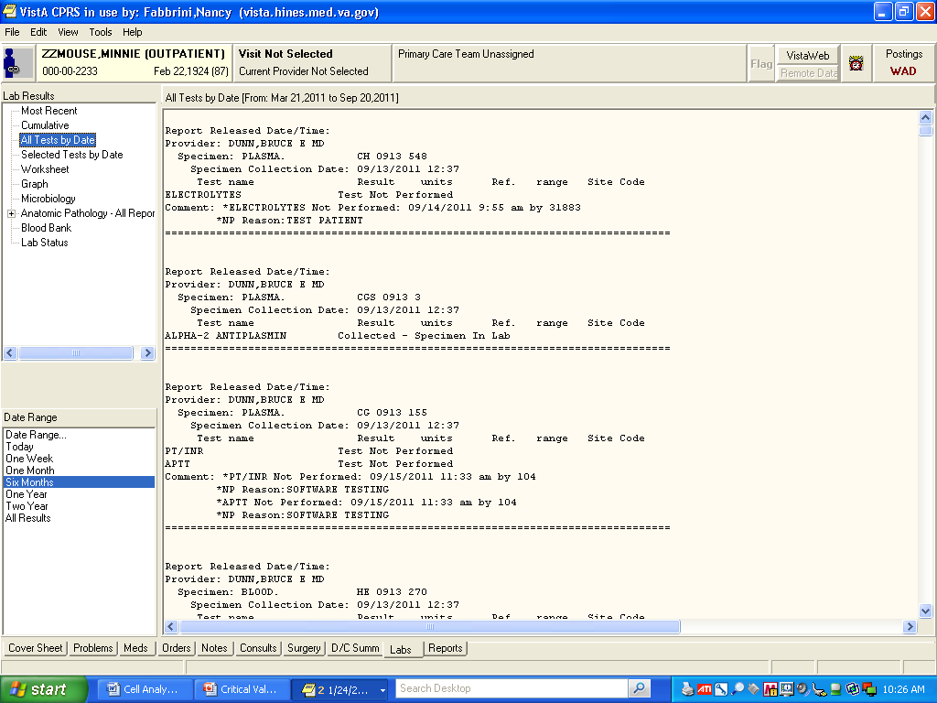
If you select “All Tests by Date”, you will see that you have options in the lower left box, “Date Range”
where you can select the length of time you would like to review (Today, One week, Two weeks, etc.).
You can then scroll through the results and comments on the right.

Slide 32
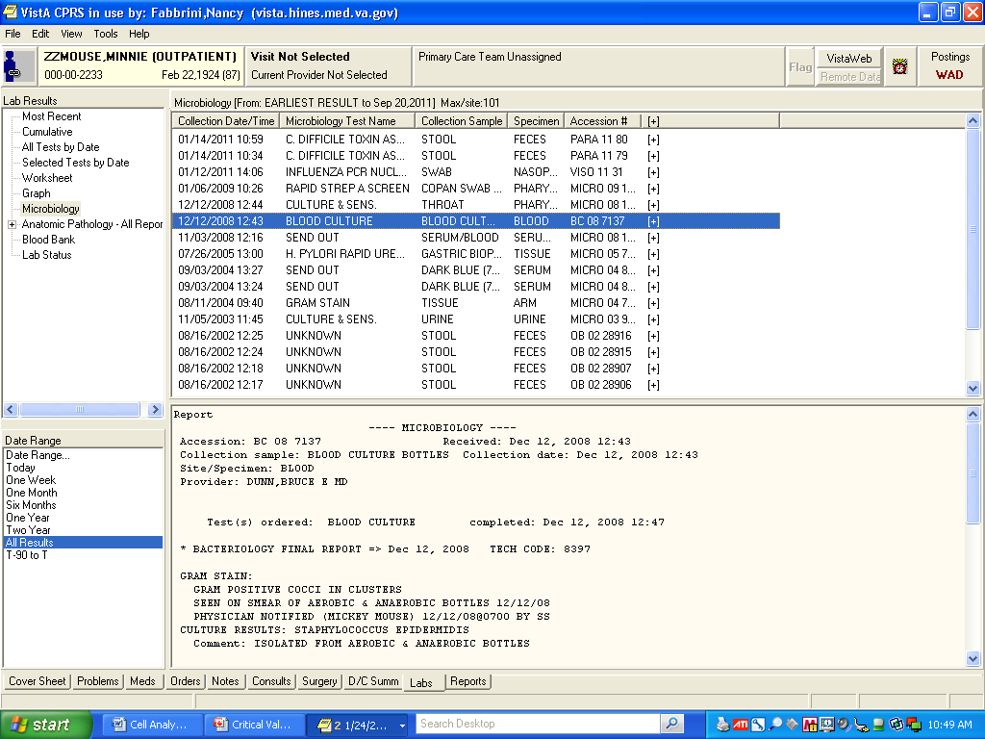
This is the Microbiology screen. When you select the specimen and date you want,
The details appear on the bottom of the screen.

Slide 33
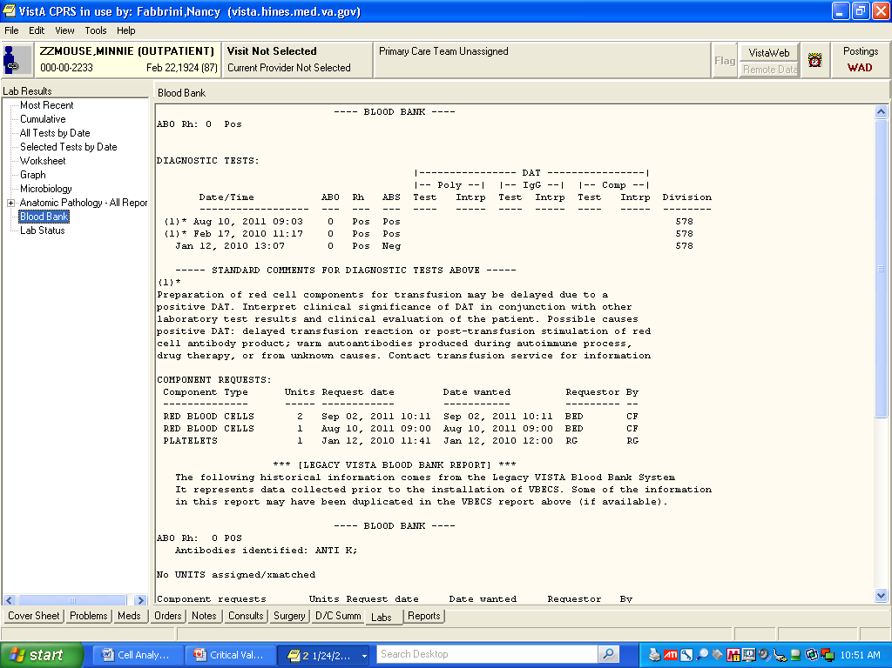
Blood Bank screen: Blood type, antibody screen results, antibodies identified, component
requests, etc. all appear here.

Slide 34
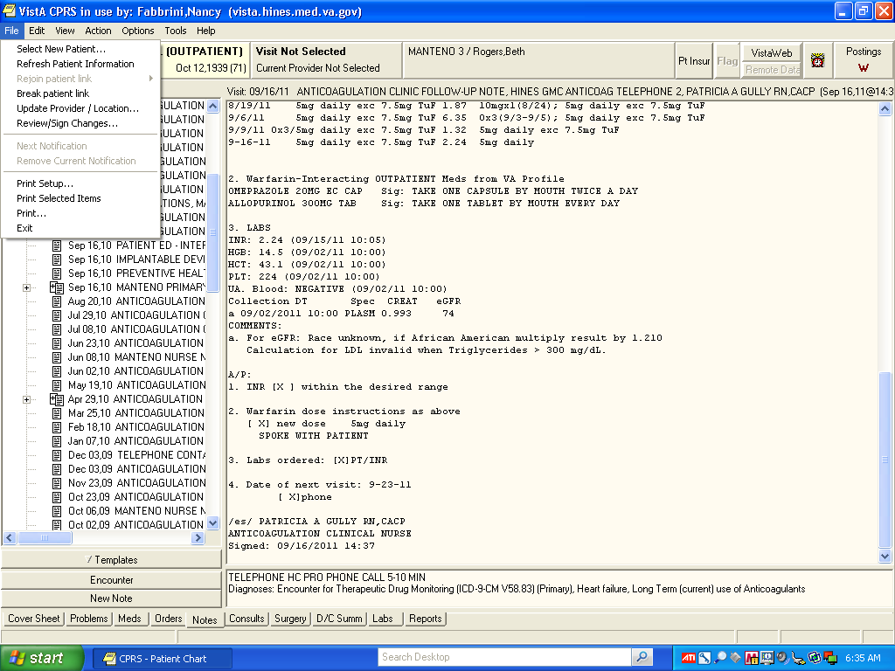
When you want to select a new patient, select “File” at the top of the page. From the
drop-down menu, highlight and click on “Select New Patient”

Slide 35
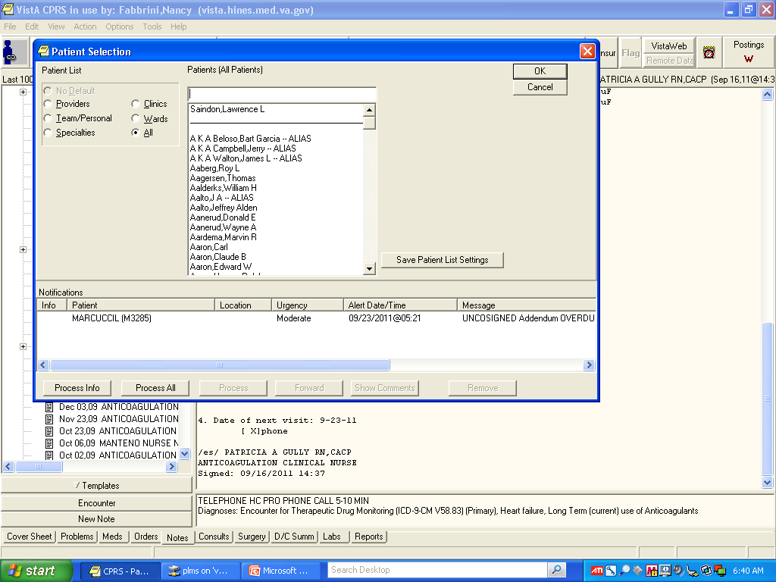
The patient selection box will appear and you can start over with a new patient.

