Slide 1
Electronic manifest & SPECIMEN PACKAGING REVIEW
MCGUIRE VAMC
ANCILLARY TESTING
CBOC LAB STAFF

Slide 2
PROCEDURE
Electronic manifest procedure is located on RIC SharePoint
Lab/Path → Active SOPs → Point-of-Care → CBOCs
POC.41 CBOC Automated HOWDY System and Electronic Manifest
POC.41A CBOC Electronic Manifest Spreadsheet

Slide 3
PURPOSE
Tool for the documentation and reconciliation of specimens collected by the CBOC facilities and transported to the Richmond Lab for analysis.

Slide 4
OVERVIEW
Electronic Manifest consists of 2 parts:
HOWDY Specimen labels
Scan accession number from EACH tube/specimen onto spreadsheet in Excel
CPRS (non-HOWDY) Specimen labels
Place a label for EACH specimen onto document
Must include:
date/time of draw
collector’s legible initials

Slide 5
PROCEDURE
Prepared at the end of the day, just prior to sample pick-up
Select “My Computer”
Locate the “Z” drive
Open your locations’ specific folder
Open the Master Manifest
Save a working document [select File → Save As → “location_mmddyyinitials” → Save
Example: Emporia CBOC_110516LG

Slide 6
PROCEDURE cont.
On the working document only (do NOT alter the master as it will corrupt the file), fill out the following:
CBOC Location
Manifest Date: MM/DD/YY (Include “/” )
Time of CBOC scan: HH:MM (military time)
Scanned By: Your initials
Enter “COMMENTS” if needed (add-ons, cancellations, hard stick, etc…)
*See next slide for example…

Slide 7
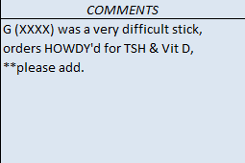
EXAMPLE OF REQUIRED INFO
Date
Location
Comments
Time
Initials

Slide 8
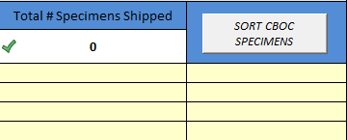
HOWDY SAMPLE ENTRY
Click in the 1st empty cell below the “Sort CBOC Specimen” target and scan the specimen tube label here.
Any comments pertaining to a sample can be entered to the left of the scanned specimen (Ex. TempMark, etc…)
All HOWDY tubes are to be scanned onto the manifest. Save and Print a copy.
A Sample Comment
Start Scan of Tubes here…

Slide 9
NON-HOWDY SAMPLE ENTRY
Using the 2nd set of labels printed, affix to the manifest under the “Un-Accessioned Order Labels/CPRS Printed Label”
CRITICAL: **All samples drawn/collected at the CBOC sites are required to be listed on the shipping manifest. No labels should be sent home with the patient.

Slide 10
PACKAGING SPECIMENS
Refrigerated
Place a barrier and/or absorptive material between the cold packs & samples to avoid hemolysis
Ensure a TempMark has been placed on a specimen for temp monitoring during transport
Room Temperature
Place in the green room temp transport bag
Place absorptive material in the bag in the event there is a leak

Slide 11
TRANSPORT TRACKING LOG
CBOC Lab must complete:
Clinic location
Date
Cooler #
Room temp sample box sent?
Your signature
Courier must complete:
Signature
Pick-up time
Make a copy & retain for 1 month
See
Next
Slide

Slide 12
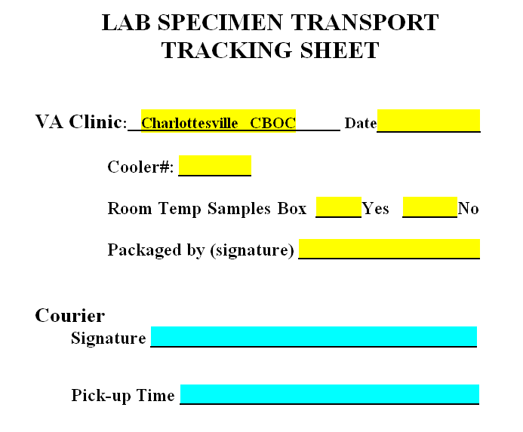

Slide 13
HELPFUL TIPS
Affix the HOWDY label with the patients’ last name at the top of the tube.
Never send urine and blood in the same bag.
Ensure all CPRS labels affixed to the manifest have an accompanying sample.
Use CPRS – Tools – Lab Test Description for helpful information about a test.
NEVER “HOWDY” lab orders until the patient is in the chair!

Slide 14
QUESTIONS OR DOUBTS?
Please call Ancillary Testing in Richmond at x3305 or x5885 if you have ANY questions, doubts or problems.
We are happy to assist you in any way we can ☺

