Slide 1
2017 i-STAT: Competency for Emergency Medicine
Ancillary Testing
October 2017
McGuire VAMC

Slide 2
Ancillary Testing
Policies and Procedures
Located on RIC SharePoint
Bottom of screen: click on Lab/Path
On the left: click on PLMS SOPs
Section: Point-of-Care
Subsection: i-STAT
    Troponin
    BHcG

Slide 3
Cartridges
Once warmed to room temperature, cartridges are good for 14 days – can not place back in the refrigerator
Handle cartridges by sides only
Don’t press on reagent bubble on top
Close sample well completely before inserting into meter

Slide 4
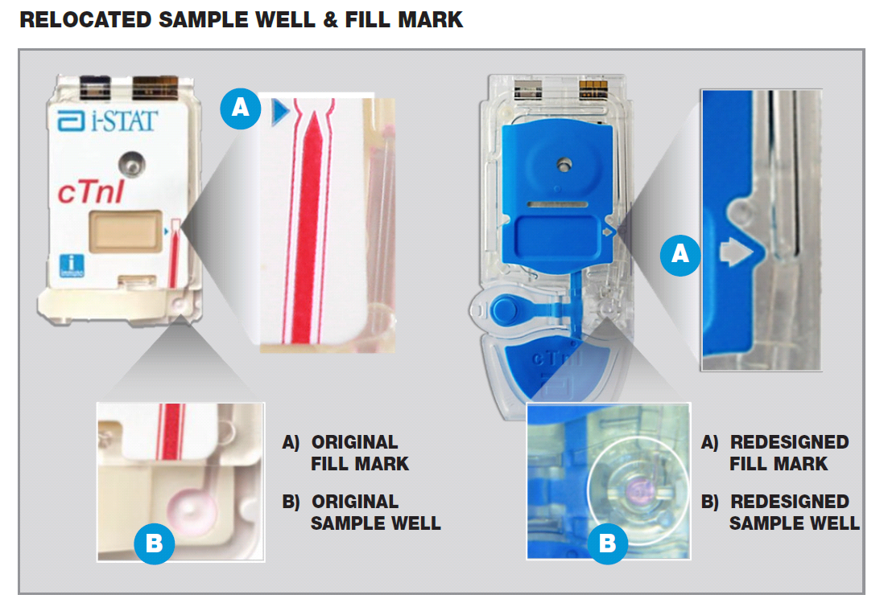
Troponin (cTnI) cartridge redesign
OLD DESIGN
NEW DESIGN
New sample fill mark

Slide 5
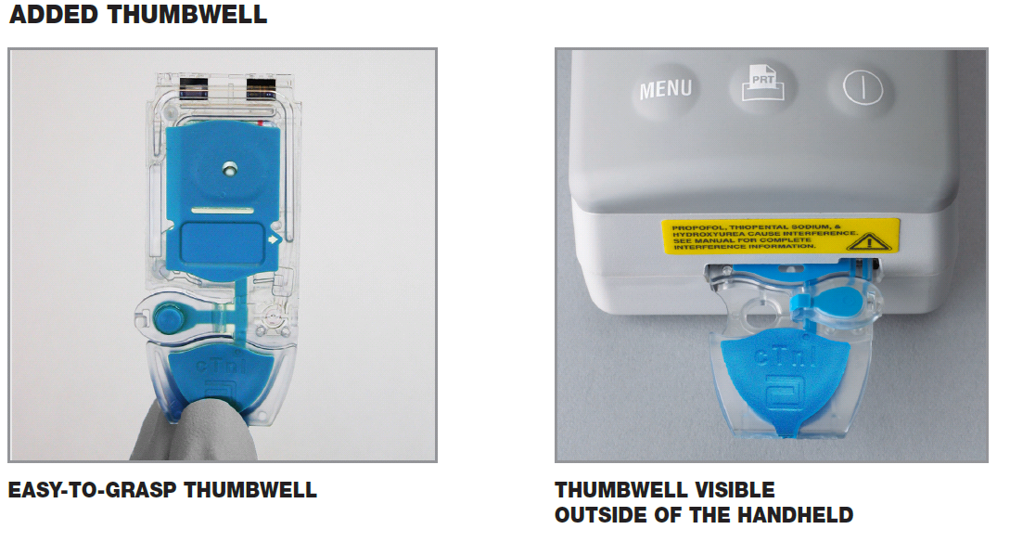
New sample fill mark

Slide 6
Specimen collection
Green top tube (for troponin and Bhcg) must be full and mixed well
Under-filled tubes can cause inaccurate results
  Good blood collection technique is CRITICAL!
Label all specimens with patient label
Retain ALL troponin samples until ancillary testing picks them up

Slide 7
PatientTesting
Sample is only acceptable for testing up to 30 minutes after collection
Do not overfill or underfill the cartridge
Avoid air bubbles when applying sample
Do not place i-STAT on the docking station while testing is occurring
Do not move the meter once cartridge is loaded

Slide 8
Interpretation of results
Troponin
Cut-off is now 0.10 ng/mL
Values > 0.10 are considered abnormally elevated for Troponin on i-STAT
Please note that values above the cut-off are considered abnormal but may NOT be consistent with an ischemic event.
Serial Testing
ONE elevated troponin result does not mean NSTEMI or an acute event.
Serial troponin testing is REQUIRED to determine if patient troponin levels are rising/falling/stable.
Current guidelines support 3-hour serial testing protocols.

Slide 9
Interpretation of results cont.
BHcG
  Negative: <5.0 IU/L hCG QUAL ( - )
  Indeterminate: 5.0 – 25.00 IU/L hCG QUAL ( ) → consult with provider
  Positive: >25.00 IU/L hCG QUAL ( + )

Slide 10
Limitations
Partially clotted samples can result in elevated readings as well as error codes.
Grossly hemolyzed samples can cause decreased detection of the analyte.
Motion of the analyzer during the testing process can cause suppressed results or quality checks.
For Tropinin, samples with hematocrit results above 65 may cause test imprecision and quality check codes.

Slide 11
Limitations
Interfering substances (such as heterophilic antibodies, non-specific proteins, or hCG-like substances) may falsely depress or elevate results. In cases where test results are inconsistent with clinical information, results should be confirmed by an alternate hCG method.
β-hCG results should always be used in conjunction with other data, e.g., patient’s medical history, symptoms, results of other tests, clinical impressions, etc. The i-STAT β-hCG test results should always be used and interpreted only in the context of the overall clinical picture.

Slide 12
Limitations cont.
Grossly hemolyzed samples can cause a decreased alkaline phosphatase activity, resulting in decreased detection of hCG or quality check codes.
Specimens from peri- or post-menopausal women may elicit weak positive results due to low β-hCG levels unrelated to pregnancy. With a weak positive result, it is good laboratory practice to resample and retest after 48 hours.

Slide 13
Quality Control
External controls are performed every 30 days:
  Levels 1 and 3 on all meters
  Stored in refrigerator
  Check expiration date
  Mix well
Staff should rotate performing QC; all operators are required to complete QC testing
Controls are programmed on a schedule
i-STAT screen will alert you when QC is due

Slide 14
Quality Control cont.
Only select Option 2: Schedule 1
Due date:1st Tuesday of the month @ 0300
Grace period: 48 hours
Can not be performed before the due date
Instruments will lock if QC is not performed within the grace period = will NOT be able to perform patient testing!

Slide 15
Cleaning
You MUST clean the i-STAT after each use with SaniWipes.
Cleaning is a Joint Commission requirement
Do not place medications, food or trash around or near the meters and docking stations.

Slide 16
Docking/Transmission
When meters successfully transmit data, the arrows on the screen will rotate in circles
If the arrows do not appear or rotate, do the following:
  Check data cable and battery cable
  If cables are connected, dock meter on another docking station (cradle), then….
  Call Ancillary Testing ASAP (x5003, x5885)

