Slide 1
Critical Values

Slide 2
Importance of Critical Values
Patient Care!
  In support of our Mission – to provide “high quality, accurate and timely laboratory testing and diagnostic services.”
  It is necessary that we communicate in a timely manner with the appropriate provider so that the best course of treatment may be determined.
  Imagine each patient is your loved one/family member!
  2. Regulatory/Accrediting Agencies!
    Joint Commission
    CAP

Slide 3
Laboratory Critical Value Policy
(SharePoint – Lab General – Administrative – Critical Results and Tests Reporting)
During business hours (0800-1630):
Call the ordering provider (wait 10 minutes)
To facilitate contacting the provider
  Inpatient – call the floor
  Outpatient – call the clinic
  After 20 minutes, call the Chief of Service/designee.
  After 30 minutes, call the Chief of Staff on call.

Slide 4
Laboratory Critical Value Policy
(SharePoint – Lab General – Administrative – Critical Results and Tests Reporting)
After hours (1630-0800), weekends, holidays:
Inpatient:
  Call ward and ask for physician on call for that patient.
  Page appropriate provider
2. Outpatient:
  Page the ordering provider (wait 10 minutes)
  If no response, call the ED and communicate result to Dr. or RN
  If unable to give result to a provider, call the Chief of Staff on call.

Slide 5



Locating Providers and Numbers
Use your resources!
  VISTA: ^TEL
  VISTA: ^New Person File Phone Number
  CPRS
  Richmond OnCall

Slide 6

Locating Providers and Numbers
VISTA:
Provider information is sometimes listed at the top of the results in VISTA.
If it is not, ^TEL has two search options:
1. Individual
2. Service (ex. Medical, Surgical, etc)
If the provider is not listed in the Individual listing, try “^New person file phone number” which lists some newer employees.
NOTE: ^TEL and ^New are not always updated with pager/phone numbers.

Slide 7

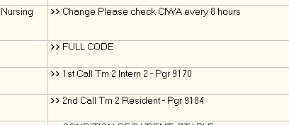

Locating Providers and Numbers
CPRS:
Information regarding the patient’s team or treating service can be found under the Orders tab at the bottom of the screen.
This patient had Nursing instructions to call Team 2 pager #9170 first.
(This is the virtual pager; dial *601 first, then follow the prompts.)

Slide 8
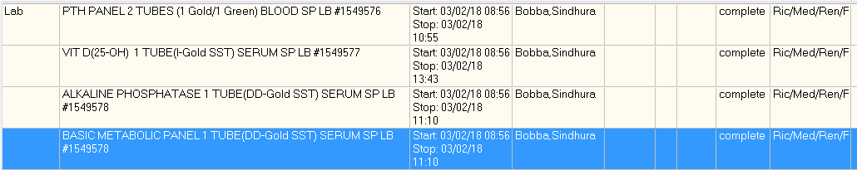

Locating Providers and Numbers
CPRS:
You can also find the Clinic/Service for the ordering provider under the Orders tab.
Locate the lab test you are verifying under the Lab section.
Scroll over to the location column. In this case, the location is “Ric/Med/Ren” indicating the Renal Service.

Slide 9
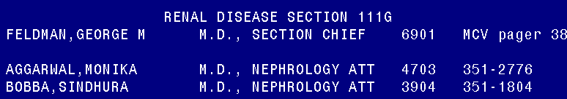

Locating Providers and Numbers
Once you have located the treating service (ex. Renal), you can search for a number using two options.
VISTA:
- Use ^TEL option #2 (Service Telephone Listing)
- Medical Service
- Press Enter until you reach the Renal Disease section
- Look for the ordering provider. (This example is Bobba, Sindhura.)

Slide 10
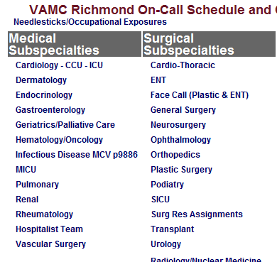

Locating Providers and Numbers
(Continued)
Once you have located the treating service (ex. Renal), you can search for a number using two options.
2. Richmond OnCall
Select the Subspecialty under Medical/Surgical. (In this case, Renal)
This will open the on call schedule for the service.

Slide 11
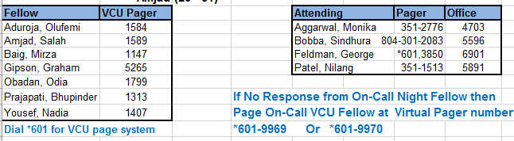
Locating Providers and Numbers
(Continued)
The physician pager numbers are usually listed at the bottom of the schedule.

Slide 12
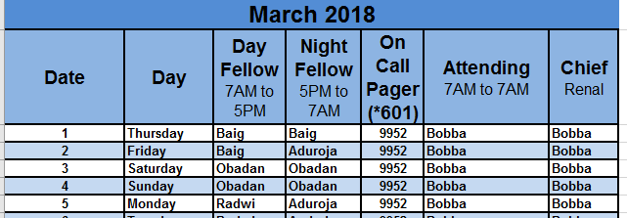
Locating Providers and Numbers
(Continued)
The On Call Schedule will show you:
Pager numbers for the physicians in the service.
Daytime On Call physician for each day of the month.
Service Chief/Designee on Call for each day of the month.

Slide 13
Critical Value Documentation
Remember to document properly!
Documentation should include:
  First and Last Name and Title (ex. RN, NP, MD) of the person who took the information
  Time of notification (Date and Time for Microbiology)
  Your Initials
  Turn-Around Time
  Read back requirement, using “CRIT” in VISTA
Example call back:
Phoned critical values, read back by Dr. John Doe @1340 JPA (TAT 2min).

Slide 14
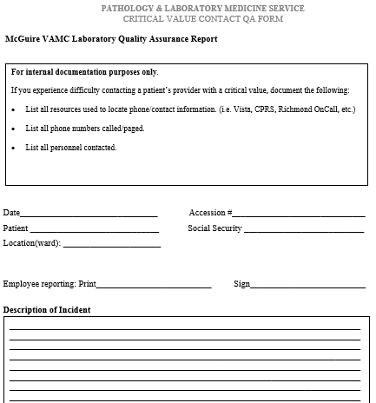
Quality Assurance Monitor
If you are having difficulty reaching a provider, you may fill out a Critical Value QA form.
This is an internal assessment that will be used to pinpoint problem areas/need for training.
Follow the instructions at the top of the form and list all steps and resources used.

Slide 15
Quality Assurance Monitor
Document your final call back in VISTA.
  Ex. Phoned critical values, read back by Dr. John Doe @1340 JPA (TAT 2min)
Record the steps you took to contact the physician on the QA form.
  You do not need to fill one out for every critical! Only if you feel that you experienced difficulty in locating a number/contacting the provider.
  QA forms can be filled out and returned to the QM/CAP mailbox or emailed to Jaime.almond@va.gov

Slide 16
Quality Assurance Monitor
QUESTIONS?
Please see your Supervisor/Lead
Or Contact Jaime Almond x4432
Jaime.almond@va.gov

