Slide 1
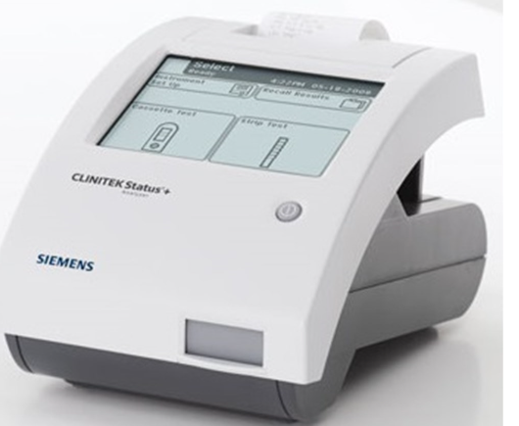
Clinitek Status Plus®
2020 Annual Competency
Must score 80% or higher on exam.

Slide 2
Purpose
To establish consistent reading of urinalysis tests in a point-of-care environment. The test is intended for use for patients experiencing a loss of kidney function, urinary tract infections, carbohydrate disorders, or liver function problems.

Slide 3
Principle
Clinitek Status Plus® is a semi-automated instrument designed to test urine Bilirubin, Blood (Occult), Glucose, Ketones, Leukocytes, Nitrites, pH, Protein, Specific Gravity, and Urobilinogen.

Slide 4
Specimen
Collect freshly-voided urine in a clean container and test as soon as possible. The container should be filled with enough urine to allow for complete dipping of the reagent test strip areas.
Samples are stable for 1 hour at room temperature or 4 hours refrigerated.
NOTE: Sample must be at room temperature prior to analysis.

Slide 5
Quality Control
Must be performed every 24 hours or before patient testing, if it is not done daily.
Uses Cardinal Health UA Controls dropper bottles, levels Normal and Abnormal.
Please select “Strip QC” from the analyzer’s display to perform.

Slide 6
Quality Control Troubleshooting
Check for
Expiration date on control solutions
Expiration date on reagent strips
If QC fails twice, repeat with new vials of controls.
If it fails again, notify Ancillary department.

Slide 7
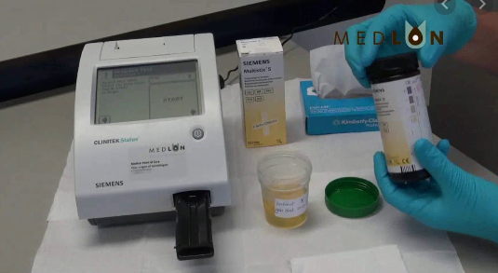
Post Analysis
Once the testing is complete, results will print.
Make sure to use full patient ID (SSN) in order for the results to transmit to CPRS.
No order is needed for urinalysis. Please do not use order number when entering patient ID.

Slide 8
Limitations:
The following substances in urine may affect the readability of the test pad
Visible blood
Drugs such as Azo
Nitrofurantoin
Riboflavin

Slide 9
Maintenance
On a daily basis
Clean the test table insert with wet gauze
Clean outside of instrument with Sani wipes
Ensure the analyzer operates properly
Note: Wear personal protective equipment and use universal precautions.

Slide 10
Weekly Cleaning/ Maintenance
Remove
Remove test table by pulling it slowly out of the analyzer
Lift
Lift the table insert from the test table
Drain
Drain the drip tray, if necessary
Wet
Wet a cotton-tipped stick with water and thoroughly scrub the test table and table insert, except the white calibration bar. Do not touch the white calibration bar.
Rinse
Rinse both sides of the table insert and test table under running water, except the white calibration bar.
Dry
Dry the test table insert, examine the white calibration bar to ensure it is clean and undamaged, and insert the test table slowly halfway to the instrument.
Clean
If the white calibration bar is dirty, clean with soft cloth or lint free tissue.

Slide 11
To access RIC SharePoint for the hospital policy and procedure
Use the following link and select “Point Of Care” from the list.
https://vaww.visn6.portal2.va.gov/apps/richmond/plms/PLMS%20SOPs/Forms/Current.aspx
Use the link “Point of Care SOPs”
A new website (Medialab) opens and the “Point Of Care/Ancillary” link will expand. Look for the correct instrument SOP and review.
You have completed this portion. Please go to the exam section. Passing score is 80% or above.

