Slide 1
i-STAT Competency for Emergency Medicine (Creatinine, Troponin and B-hcg)
Ancillary Testing
October 2020
Central Virginia Health System

Slide 2
Ancillary Testing Policies and Procedures
Use The Richmond intranet; select Share point home page from the upper left corner
Under the “Services” column, click on Pathology and Laboratory
On the left: click on “Point of Care/Ancillary”
Point-of-Care SOPs in highlighted in yellow
Point of Care/Ancillary link on the left
i-Stat
POC. 53 through POC.55

Slide 3
Cartridges
Once warmed to room temperature, cartridges are good for 14 days – can not place back in the refrigerator (look for new expiration date label)
Do not leave i-stat cartridges next to the GEM
Handle cartridges by sides only
Don’t press on the reagent bubble on top
See next slide for illustration of the sample fill mark. Be extra careful to
make sure enough sample has been added.
Close sample well completely before inserting into meter

Slide 4
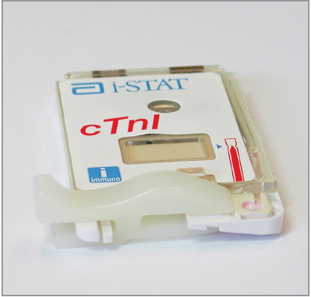
Sample Fill Mark (cTnI cartridge pictured, but sample is applied the same way for all 3 tests)

Slide 5
Specimen collection
Green top tube must be full and mixed well
Under-filled tubes can cause inaccurate results
Good blood collection technique is CRITICAL!
Label all specimens with patient label (must have a min. of 2 patient identifiers; full name, full social, and/or date of birth)
Retain ALL troponin samples until ancillary testing picks them up

Slide 6
Patient Testing
Sample is only acceptable for testing up to 30 minutes after collection
Do not overfill or underfill the cartridge
Avoid air bubbles when applying sample
Do not place i-STAT on the docking station with the cartridge while testing is occurring
Do not move the i-stat once cartridge is loaded

Slide 7
Interpretation of Troponin results
Cut-off is 0.1 ng/mL
Values > 0.1 are considered abnormally elevated for Troponin on i-STAT
Please note that values above the cut-off are considered abnormal but may NOT be consistent with an ischemic event.
Serial Testing
ONE elevated troponin result does not mean NSTEMI or an acute event.
Serial troponin testing is REQUIRED to determine if patient troponin levels are rising/falling/stable.
Current guidelines support 3-hour serial testing protocols.

Slide 8
Interpretation of B-hCG Results
Negative: <5.0 IU/L hCG QUAL ( - )
Indeterminate: 5.0 – 25.00 IU/L hCG QUAL ( ) → consult with provider
Positive: >25.00 IU/L hCG QUAL ( + )

Slide 9
Interpretation of Creatinine Result
Results are displayed with their units and depicted as bar graphs with reference ranges marked under graphs.
EXPECTED VALUE: 0.6 - 1.3 mg/dL
REPORTABLE RANGE: 0.2 – 20.0 mg/dL

Slide 10
Result troubleshooting
Repeat any questionable result or if there is an instrument error.
You may see the following: ***, “Failed Internal QC Check”, < > (result outside of reportable range).
Ancillary Testing should be notified at x5885, x3305, x5003 when any of these are observed.

Slide 11
Limitations
Partially clotted samples can result in elevated readings of troponin as well as error codes.
Grossly hemolyzed samples can cause decreased detection of troponin.
Motion of the analyzer during the testing process can cause suppressed results or quality checks.
For Troponin, samples with hematocrit results above 65 may cause test imprecision and quality check codes.

Slide 12
Limitations Cont.
Interfering substances may falsely depress or elevate results. Results should be confirmed by an alternate hCG method if inconsistent with clinical information.
The i-STAT β-hCG test results should always be used and interpreted only in the context of the overall clinical picture.

Slide 13
Limitations cont.
Grossly hemolyzed samples can decreased detection of hCG or create quality check codes.
Specimens from peri- or post-menopausal women may elicit weak positive results due to low β-hCG levels unrelated to pregnancy. It is good laboratory practice to resample and retest after 48 hours.

Slide 14
Interfering Factors for Creatinine

Slide 15
Quality Control
External controls are performed every 30 days:
Levels 1 and 3 on all meters for Crea, cTnI and β-hCG (total of 6 on each meter)
QC material is stored in refrigerator
Check expiration dates
Mix well (if not mixed, QC will fail and must repeat)
Staff should rotate performing QC; all operators are required to complete QC testing
i-STAT screen will alert you when QC is due
Should be performed the first Tuesday or Wednesday of each month

Slide 16
Quality Control cont.
Only select Option 2: Scheduled
Due date:1st Tuesday of the month @ 0300
Grace period: 48 hours
Can not be performed before the due date
Instruments will lock if QC is not performed within the grace period = will NOT be able to perform patient testing!

Slide 17
Cleaning
You MUST clean the i-STAT after each patient test, with purple top Sani Wipes (must remain wet for 2 minutes)
Cleaning is a Joint Commission requirement
Do not place medications, food or trash around or near the meters and docking stations.
Do not place medications or vaccines in the refrigerator under the bench in the point of care area

Slide 18
Docking/Transmission
When meters successfully transmit data, the arrows on the screen will rotate in circles
If the arrows do not appear or rotate, do the following:
Check data cable and battery cable
If cables are connected, dock meter (cradle), if still no rotating arrows then….
Call Ancillary Testing ASAP (x5003, x5885, x3305)

Slide 19
You have completed the presentation.
Please take the exam, passing is ≥ 80%
Complete your practical with Ana, Kiyana, or Ancillary
Thank you!

