Slide 1
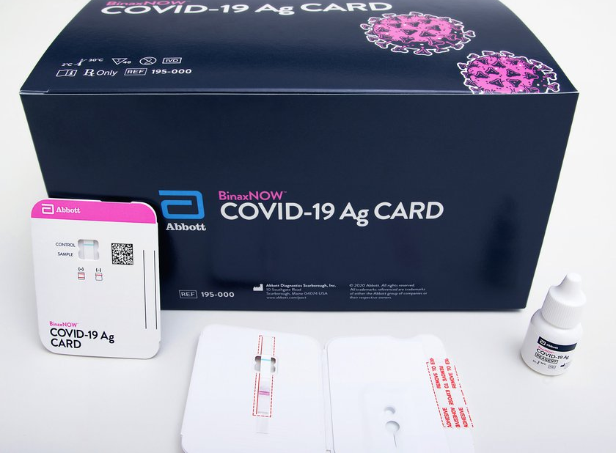
Abbott BinaxNow 1st Annual Competency
12/2021

Slide 2
Competency Requirements
Review this PowerPoint
Complete the online exam
Passing is an 80% or higher
Perform controls and return documentation to Ancillary testing

Slide 3
Overview
The BinaxNOW COVID-19 Ag Card is a rapid lateral flow immunoassay for the qualitative detection of SARS-CoV-2 directly from nasal swabs within 7 days of the onset of symptoms.
The BinaxNOW COVID-19 Ag Card employs an immunochromatographic membrane that uses highly sensitive antibodies to detect SARS-CoV-2 nucleocapsid protein.
The test strip is comprised of two distinct lines of antibodies immobilized on a membrane support: a SARS-CoV-2 specific antibody line and a control antibody line.
As the sample migrates across the test strip, any SARS-CoV-2 nucleocapsid protein present in the sample will bind to the antibodies embedded in the test strip, causing the presence of a line at the “test” location on the strip.

Slide 4
You will need
BinaxNOW COVID-19 Ag Card
Nares swab (use only the swabs provided with the test kit)
Extraction reagent
Timer
PPE

Slide 5
reagents
All BinaxNow components are stored and used at room temperature
Test kit components are good until the expiration date printed on outer packaging
Do not mix components of different kits
i.e. After all test cards in a kit have been used, discard the remaining extraction reagent. Do not use leftover reagent with a new box of test cards.

Slide 6
Quality controls

Slide 7
Internal procedural Controls
Verifies the performance of each test run
A pink/purple line at the “control” position indicates the sample migrated properly and that the reagents worked
The background color in the window should be light-pink to white and should not hinder reading of the test
If the line at the “control” position remains blue, the test is invalid. DO NOT report patient results. Repeat the test with a new sample and new test card.

Slide 8
External Positive & negative Controls
Verifies the performance of the reagents and the operator.
External controls should be performed weekly, or as directed by Ancillary personnel.
A Positive Control swab is included with each kit. An unused sterile swab from the test kit will be used as the Negative Control.
External controls are performed by the same process as patient testing, EXCEPT using 8 drops of extraction reagent instead of 6.
If the correct control results are not obtained, do not report patient results. Repeat the test with a new sample and a new test card. If the correct results are still not obtained, do not continue patient testing, contact Ancillary at ext. 3305, 5885, or 5003.

Slide 9
Specimen collection
**Treat all specimens as potentially infectious. Follow universal precautions**
Carefully insert the swab into the nostril
Using gentle rotation, push the swab until resistance is met at the turbinates (less than one inch into the nostril)
Rotate the swab 5 times or more against the nasal wall, then slowly remove from the nostril
Using the same swab, repeat in the other nostril
Test swab immediately after collection, no more than 1 hour
DO NOT place swab back in paper wrapper after collection; this can produce false negative results

Slide 10
Patient testing
Open the test card just prior to use. Label with the patient’s full name and DOB and/or SSN
Hold Extraction Reagent bottle vertically, hovering 1/2 inch above the TOP HOLE on the test card. Apply 6 drops of Extraction Reagent to the TOP HOLE of the test card. Do not touch the card with the dropper tip while dispensing
Insert sample swab into the BOTTOM HOLE and push upwards so that the swab tip is visible in the top hole. Rotate (twirl) the swab 3 times CLOCKWISE (to the right). Do NOT remove swab.
Note: False negative results can occur if the sample swab is not rotated prior to closing the card.
Peel off adhesive liner from the right edge of the test card, close and securely seal the test card.
Read the result in the window 15 minutes after closing the card.
It is important to read the result promptly at 15 minutes. Reading before 15 minutes could give a false negative result. Results should not be read after 30 minutes
Discard the test card and swab as biohazard waste.

Slide 11
Interpreting results
Negative
Positive
Invalid
A single pink/purple colored Control Line in the top half of the window. The Control Line means that the detection part of the test was done correctly, but no COVID-19 antigen was detected.
Two pink/purple colored lines, one Control Line in the top half of the window, and one Sample Line in the bottom half of the window. Any visible pink/purple colored line is positive; specimens with low levels of antigen may give a faint Sample Line.
The following results should be considered invalid. Invalid tests should not be reported. Obtain a new sample and repeat the test.
No lines seen
The Control Line is blue (rather than pink/purple)
Only the Sample Line is present

Slide 12
limitations
The BinaxNow COVID-19 Ag Card does not differentiate between SARS-CoV and SARS-CoV-2
The presence of mupirocin may cause false negative results
Samples stored in viral transport media could give inaccurate results
False negative results can occur if the sample swab is not rotated in the sample well prior to closing the card
False negative results can occur if the card is not read between 15-30minutes
Swabs in the kit are approved for use with BinaxNOW COVID-19 Ag Card. Do not use other swabs
A negative test result for this test means that antigens from SARS-CoV-2 were not present in the specimen above the limit of detection. Antigen tests are known to be less sensitive than molecular tests that detect viral nucleic acids.

Slide 13
The BinaxNOW SOP can be found at the following link: \\v06.med.va.gov\ric\service\LaboratoryAdministrativeManual
Select “POC Ancillary Backup”
Select “Point of Care Ancillary”
Select “Manual Tests”
Locate the Abbott BinaxNOW COVID-19 Ag Card procedure

Slide 14
What’s next?
Take the online exam – passing is an 80% or higher
1
Complete controls and return documentation to Ancillary
2
Thank you!
3

