Slide 1
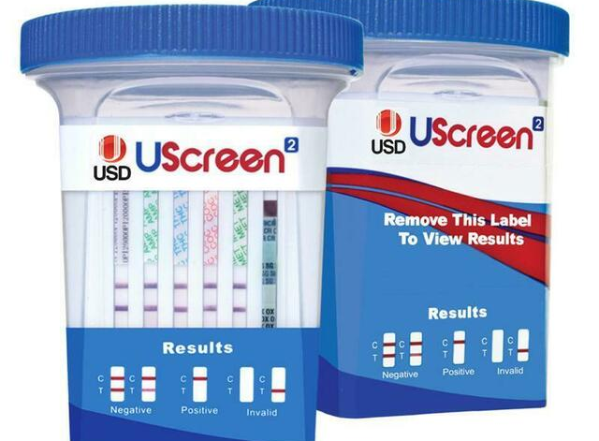
UScreen UDS Cup 1st Annual Competency

Slide 2
Competency Requirements
Review this PowerPoint
Complete the online exam
Passing is an 80% or higher
Perform controls

Slide 3
Overview
UScreen® Drugs of Abuse Cup is a competitive immunoassay used to screen for presence of various drugs in urine. It is a chromatographic absorbent device in which drugs in a urine sample competitively bind to a limited number of drug monoclonal antibody conjugate binding sites. When urine is absorbed into each test strip by capillary action, it mixes with the respective drug monoclonal antibody conjugate and flows across a pre-coated membrane. If the drug level in the urine sample is below the detection level of the test, respective drug monoclonal antibody conjugate binds to the respective drug-protein conjugate immobilized in the Test Region (T) of the test strip. This produces a colored test line in the Test Region (T) of the strip that indicates a negative result.
When the sample drug level is at or above the detection level of the test, the free drug in the sample binds to the respective drug monoclonal antibody conjugate, preventing the respective drug monoclonal antibody conjugate from binding to the drug-protein conjugate immobilized in the Test Region (T) of the device. This prevents the development of a distinct colored band in the test region, indicating a preliminary positive result

Slide 4
You will need
UScreen UDS Cup
Fresh urine specimen
2 levels of controls
Timer
PPE

Slide 5
reagents
UScreen UDS cups are stored and used at room temperature. UDS external controls are stored refrigerated, but must be brought to room temperature before testing.
Cups are good until the expiration date printed on packaging

Slide 6
Quality controls
1. Internal Procedural Controls
2. External Controls

Slide 7
Internal procedural Controls
Verifies the assay validity (performance of the cup)
A line at the “control” position indicates the sample migrated properly and that the reagents worked
If the line at the “control” position is not present, the test is invalid. DO NOT report patient results. Repeat the test with a new sample and new cup.

Slide 8
External Positive & negative Controls
Verifies the performance of the reagents and the operator.
External controls must be performed monthly.
External controls are performed by the same process as patient testing
If the correct control results are not obtained, do not report patient results. Repeat the test with new control samples and a new cup. If the correct results are still not obtained, do not continue patient testing. Contact Ancillary at ext. 3305, 5885, or 8036.

Slide 9
Specimen collection
**Treat all specimens as potentially infectious. Follow universal precautions**
Remove the cup from the sealed pouch.
Label the cup with patient’s full name, full social security number, date, and time of collection.
Instruct the patient to collect an adequate sample volume of urine (30 mL minimum) in the cup and secure the cap tightly.

Slide 10
Patient testing
Read the urine temperature between 2-4 minutes after the patient has voided. Temperature must be between 90-100F, or the test is invalid.
Place the cup on a flat surface and peel off the label on the cup to view the results.
Read the adulterant (creatinine) test at 45 seconds; see the color chart for interpretation. If the specimen indicates adulteration (<20mg/dL), do not interpret the drug results and collect a new sample.
Read the test results at 5 minutes. Results read after more than 30 min may not be accurate and should not be read.
The intensity of the control and test line may vary. Any line, without regard to intensity or size, should be noted.
Document results in WRX

Slide 11
Interpreting results
Preliminary Positive
Negative
Invalid
No line appears in the test zone (T). If no color band appears in the appropriate test “T” region, a preliminary positive result is indicated for the corresponding drug of that specific test zone.
One colored line appears in the Control zone and another line appears in the Test zone (T). The negative result indicates that the concentration of the corresponding drug of that specific test zone is absent or below the detection limit of the test.
If no C line or no C line and T line develop within 5 minutes, the test is invalid. Repeat the test

Slide 12
limitations
DO NOT USE this device to test substances other than urine
Adulterated urine samples may produce erroneous results. Strong oxidizing agents such as bleach can oxidize drug analytes.
This test is a qualitative screening assay. It is not designed to determine the quantitative concentration of drugs or the level of intoxication

Slide 13
The UScreen UDS SOP can be found at the following link: \\v06.med.va.gov\ric\service\LaboratoryAdministrativeManual
Select “POC Ancillary Backup”
Select “Point of Care Ancillary”
Select “Manual Tests”
Locate the UScreen UDS Procedure

Slide 14
What’s next?
Take the online exam – passing is an 80% or higher
1
Complete controls and enter in WRX
2
Thank you!
3

