Slide 1
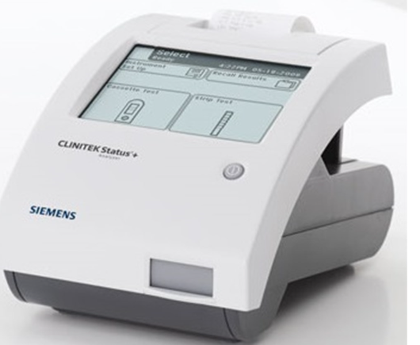
Clinitek Status Plus®
2024 Annual Competency
Must score 80% or higher on exam.

Slide 2
Purpose
To establish consistent reading of urinalysis tests in a point-of-care environment. The test is intended for use for patients experiencing a loss of kidney function, urinary tract infections, carbohydrate disorders, or liver function problems.

Slide 3
Principle
Clinitek Status Plus® is a semi-automated instrument designed to test urine Blood (Occult), Glucose, Leukocytes, Nitrites, pH, Protein, and Specific Gravity.

Slide 4
Specimen
Collect freshly-voided urine in a clean container and test as soon as possible. The container should be filled with enough urine to allow for complete dipping of the reagent test strip areas.
Samples are stable for 2 hour at room temperature or 4 hours refrigerated.
NOTE: Sample must be at room temperature prior to analysis.

Slide 5
Quality Control
Must be performed every 24 hours, or before patient testing if it is not done daily.
Uses Cardinal Health UA Controls dropper bottles, levels Normal and Abnormal.
Please select “Strip QC” from the analyzer’s display to perform.

Slide 6
Quality Control Troubleshooting
Check for
Expiration date on control solutions
Expiration date on reagent strips
If QC fails twice, repeat with new vials of controls.
If it fails again, notify Ancillary department.

Slide 7
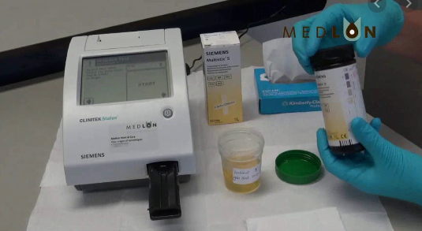
Performing Patient Testing
Once the testing is complete, results will print.
Make sure to use full patient ID (SSN) for the results to transmit to CPRS.
Please do not use order number when entering patient ID. Provider written order is required in CPRS per The Joint Commission.

Slide 8
Limitations:
The following substances in urine may affect the readability of the test pad
Visible blood
Drugs such as Azo
Nitrofurantoin
Riboflavin
Hypochlorite

Slide 9
Maintenance
Daily
Clean the test table insert with wet gauze
Clean outside of instrument with Sani wipes
Ensure the analyzer operates properly
Note: Wear personal protective equipment and use universal precautions.

Slide 10
Weekly Cleaning/ Maintenance
Remove
Remove test table by pulling it slowly out of the analyzer
Lift
Lift the table insert from the test table
Drain
Drain the drip tray, if necessary
Wet
Wet a cotton-tipped stick with water and thoroughly scrub the test table and table insert, except the white calibration bar. Do not touch the white calibration bar.
Rinse
Rinse both sides of the table insert and test table under running water, except the white calibration bar.
Dry
Dry the test table insert, examine the white calibration bar to ensure it is clean and undamaged, and insert the test table slowly halfway to the instrument.
Clean
If the white calibration bar is dirty, clean with soft cloth or lint free tissue.

Slide 11
Point of Care/Ancillary procedures are in Media Lab Federal. You can access the SOP from RIC SharePoint using the link below.
Pathology & Laboratory - POC Ancillary SOPs - All Documents (sharepoint.com)
You can also contact Ancillary department or your supervisor if you need assistance.

Slide 12
You have completed this portion. Please go to the exam section. Passing score is 80% or above.

