Slide 1
2024 i-STAT Competency for
Emergency Medicine
(Creatinine, Troponin,
B-hcg)
Ancillary Testing
October 2024
Central Virginia Health System

Slide 2
Ancillary SOPs are on the Pathology and Laboratory Medicine SharePoint, at the link:
& Laboratory - Home (sharepoint.com)
1. From the link, scroll about half way down. On the left side of the screen, select the link that says “POC Ancillary SOPs”
2. Open the folder “i-STAT”
3. There is document for each test
Policies and Procedures

Slide 3
All POC tests must have a nursing order entered by a provider before performing

Slide 4
Cartridges
Once warmed to room temperature, cartridges are good for 14 days – can not place back in the refrigerator (look for new expiration date label)
Do not leave i-stat cartridges next to the GEM – it is too warm for their required temperature
Handle cartridges by the sides only
Don’t press on the reagent bubble on top of the cartridge
See next slide for illustration of the sample fill mark. Be extra careful to
make sure enough sample has been added, but do not over-fill.
Close sample well completely before inserting into meter

Slide 5
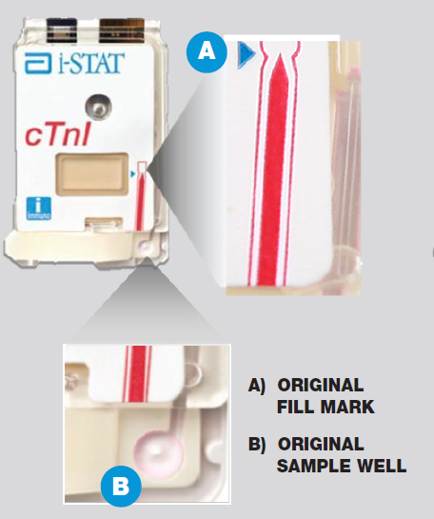
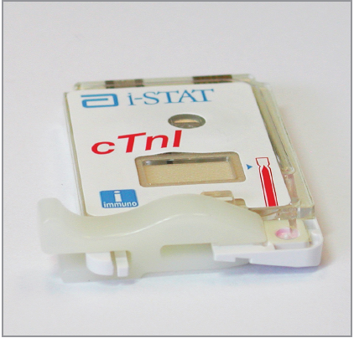
Sample Fill Mark
(cTnI cartridge pictured, but sample is applied the same way for all 3 tests)

Slide 6
Specimen Collection
Green top tube must be full and mixed well
Under-filled tubes can cause inaccurate results
Good blood collection technique is CRITICAL!
Label all specimens with patient label (must have a minimum of 2 patient identifiers: full name, full social, and/or date of birth)

Slide 7
Patient Testing
Sample is only acceptable for testing up to 30 minutes after collection
Do not overfill or underfill the cartridge
Avoid air bubbles when applying sample
Do not place i-STAT on the docking station while test is in progress
Do not move the i-stat once cartridge is loaded

Slide 8
Interpretation of Troponin Results
Cut-off is 0.1 ng/mL
Values > 0.1ng/mL are considered abnormally elevated for i-STAT Troponin
Please note that values above the cut-off are considered abnormal but may NOT be consistent with an ischemic event.
ONE elevated troponin result does not mean NSTEMI or an acute event.
Serial troponin testing is REQUIRED to determine if patient troponin levels are rising/falling/stable.
Current guidelines support 3-hour serial testing protocols for i-stat cTnI

Slide 9
Interpretation of β-hCG Results
Negative: <5.0 IU/L hCG
QUAL ( - )
Indeterminate: 5.0 – 25.00 IU/L hCG QUAL ( ) → consult with provider
Positive: >25.00 IU/L hCG QUAL ( + )

Slide 10
Interpretation of Creatinine Results
Results are displayed with their units and depicted as bar graphs with reference ranges marked under graphs.
EXPECTED VALUE: 0.6 - 1.3 mg/dL
REPORTABLE RANGE: 0.2 – 20.0 mg/dL

Slide 11
Troubleshooting
Repeat any questionable result or if there is an instrument error.
You may see the following: ***, “Failed Internal QC Check”, < > (result outside of reportable range).
Ancillary Testing should be notified at x15885, x13305, x18036 when any of these are observed.

Slide 12
cTnI Limitations
Partially clotted samples can result in elevated readings of troponin as well as error codes.
Grossly hemolyzed samples can cause decreased detection of troponin.
Motion of the analyzer during the testing process can cause suppressed results or quality checks.
For Troponin, samples with hematocrit results above 65 can cause test imprecision and quality check codes.

Slide 13
β-hCG Limitations
Interfering substances may falsely depress or elevate results. Results should be confirmed by an alternate hCG method if inconsistent with clinical information.
The i-STAT β-hCG test results should always be used and interpreted only in the context of the overall clinical picture.

Slide 14
BhCG Limitations
Grossly hemolyzed samples can decrease detection of hCG or create quality check codes.
Specimens from peri- or post-menopausal women may elicit weak positive results due to low β-hCG levels unrelated to pregnancy. It is good laboratory practice to resample and retest after 48 hours.

Slide 15
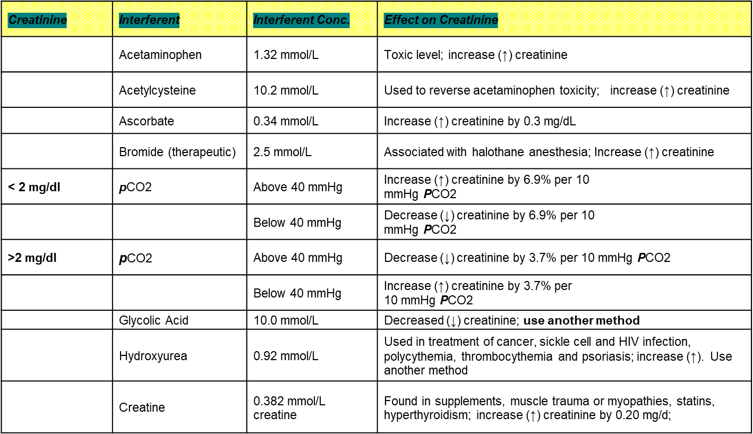
Interfering Factors for Creatinine

Slide 16
Quality Control
External controls are performed every 30 days:
Levels 1 and 3 on all meters for Crea, cTnI and β-hCG (total of 6 on each meter)
QC material is stored in refrigerator
Check expiration dates – Trop and BhCG controls are good for 30 days after opening
Mix well (if not mixed, QC will fail and must repeat)
Staff should rotate performing QC; all operators are required to complete QC testing
i-STAT screen will alert you when QC is due
Must be performed the first Tuesday or Wednesday of each month

Slide 17
Quality Control
Only select Option 2: Scheduled
Due date:1st Tuesday of the month @ 0300
Grace period: 48 hours
Can not be performed before the due date
Instruments will lock if QC is not performed within the grace period = will NOT be able to perform patient testing!

Slide 18
Cleaning
You MUST clean the i-STAT after each patient test with purple top Sani Wipes (must remain wet for 2 minutes)
Cleaning is a Joint Commission requirement – pay close attention to the area around the cartridge port, as this is where blood tends to splatter
the docking stations must be cleaned as well
Do not place medications, food, or trash around or near the meters and docking stations
Do not place medications or vaccines in the refrigerator located under the bench in the point of care area

Slide 19
Docking/Transmission
When meters successfully transmit data, the arrows on the screen will rotate in circles
If the arrows do not appear or do not rotate, do the following:
Check data cable and power cable are securely connected
If cables are connected, dock meter (cradle), if still no rotating arrows then….
Call Ancillary Testing ASAP (x15885, x13305, x18036)

Slide 20
You have completed the presentation.
Please take the exam, passing is ≥ 80%
Complete your practical with Ana,Kushal, Sayra or Ancillary staff.
Thank you!

