Slide 1
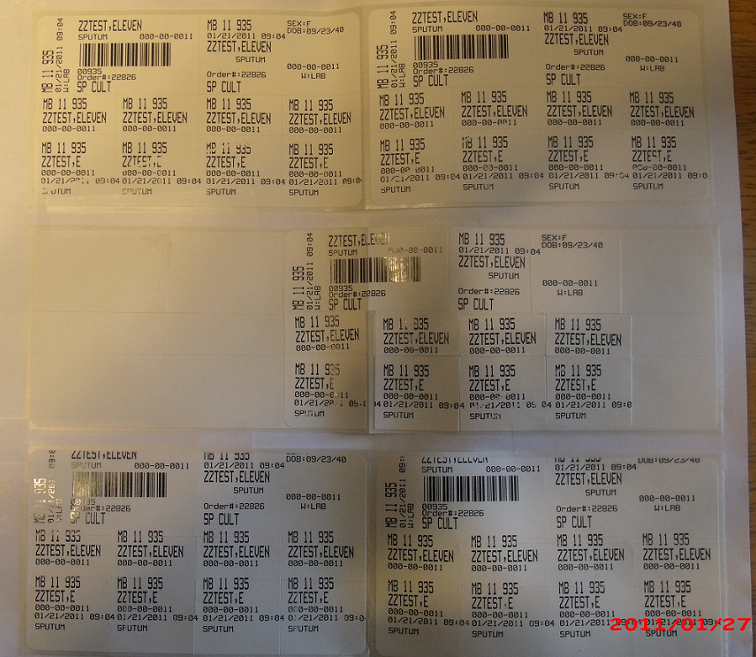
Specimen Labeling
The following labels contain the information needed throughout the testing and reporting process:
Accession number: a unique identifier applied to the test request for Howdy Specimens.
Patient ID or hospital number: a unique identifier for the patient (SS#)
Patient birth date, age and sex: BD=birth date; 49Y= 49 years old; F=female
Date and time of Collection and Initials of collector: xx/xx/DATE 00:00 xx
Location: The clinic or hospital ward requesting the test (Howdy specimens)
(LAB = Laboratory) , (DIAL=Dialysis)
Tube type: 1 RED 10 = red top tube, 10 ml
Test name: SP CULT = Culture Sputum
ZZTEST, ELEVEN
000-00-0011
XX/XX/DATE @ 00:00 ZZ
Non-Howdy Labels
Howdy Specimens
Notes:
When labeling specimens decide if they will or can go through the howdy system or if they will need regular labels.

