Slide 1
Tzanck & Ectoparasite Quiz
Spring 2012

Slide 2
Question 1
The following slide is positive (+) or negative (-) for changes of Herpes virus infection?

Slide 3
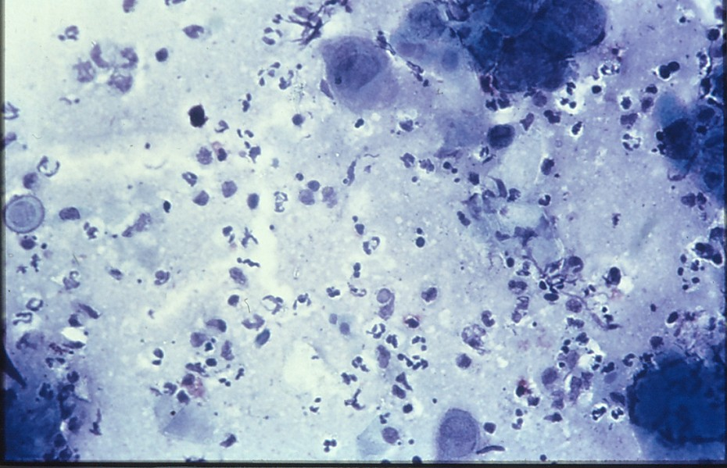

Slide 4
Question 2
The following slide is positive (+) or negative (-)
for head lice infestation?

Slide 5
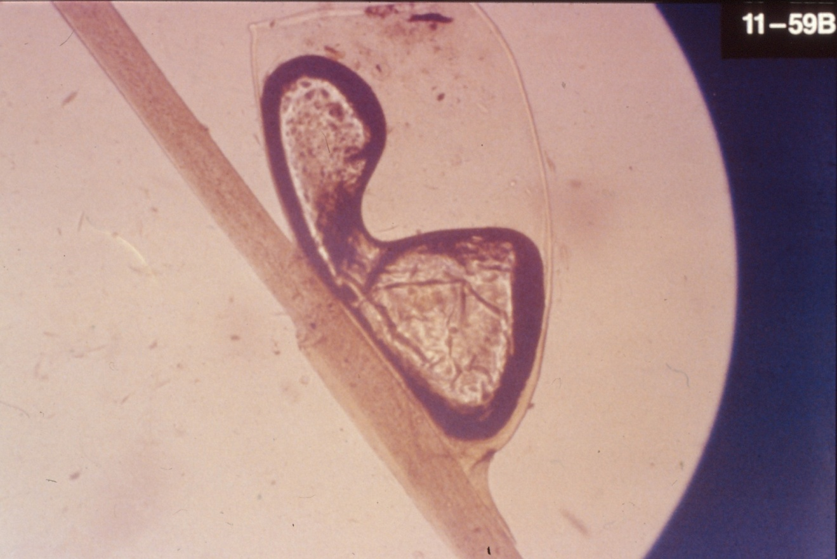

Slide 6
Question 3
The following slide is positive (+) or (-) for scabies?

Slide 7
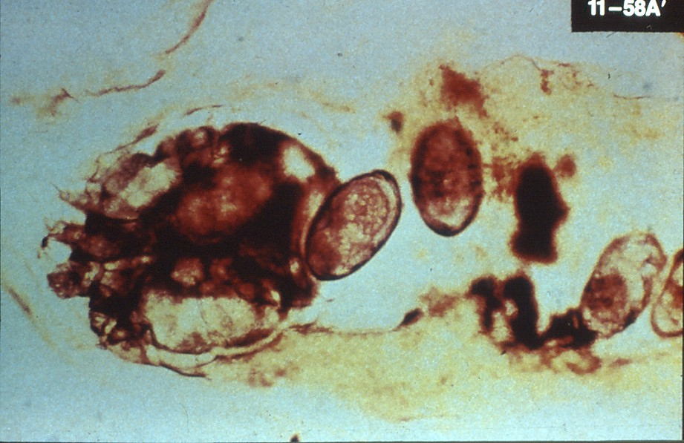

Slide 8
Question 4
The following slide is positive (+) or negative
(-) for changes of Herpes virus infection?

Slide 9
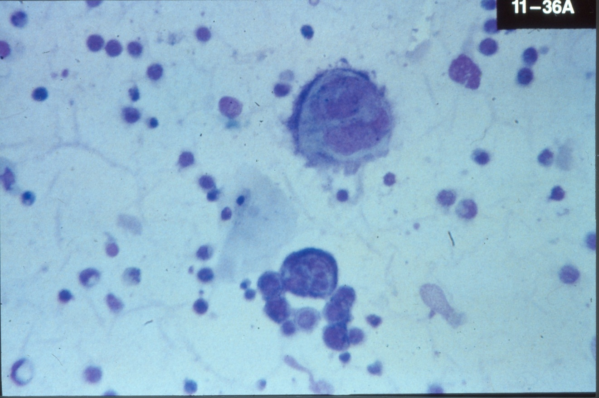

Slide 10
Question 5
The following slide is positive (+) or negative (-) for lice?

Slide 11
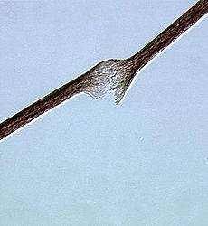

Slide 12
Question 6
Positive (+) or negative (-) for Herpes virus infection?

Slide 13
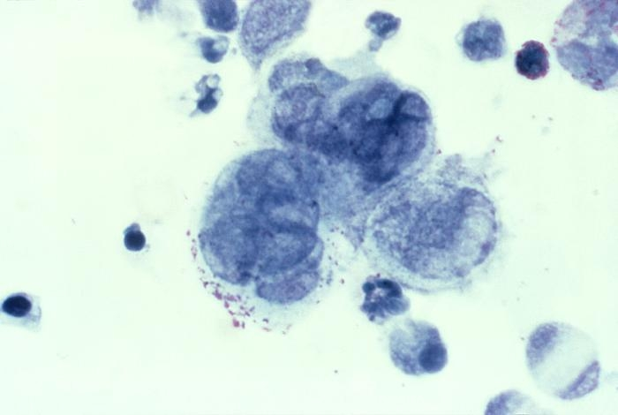

Slide 14
Question 7
Positive (+) or Negative for scabies?

Slide 15
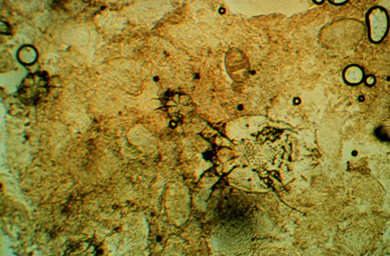
Question 7

Slide 16
Question 8
Positive (+) or negative (-) for pubic lice?

Slide 17
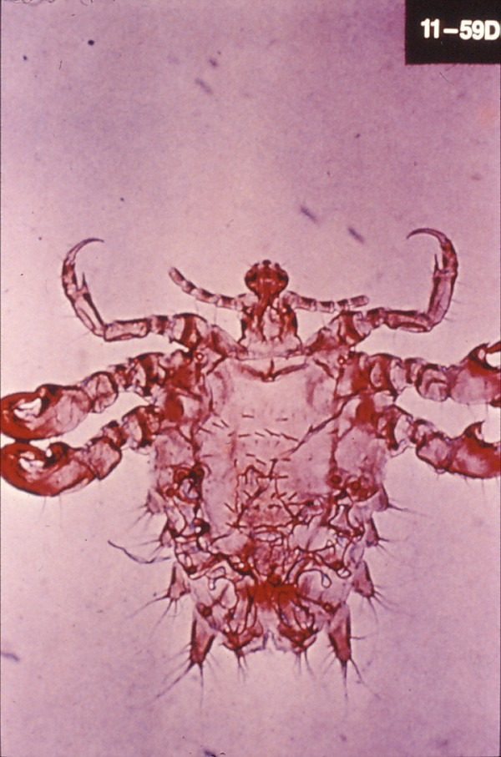

Slide 18
Question 9
Positive (+) or negative (-) for Herpes virus infection

Slide 19
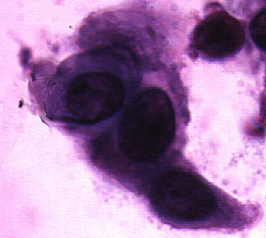

Slide 20
Question 10
Positive (+) or negative(-) for scabies?

Slide 21
