Slide 2
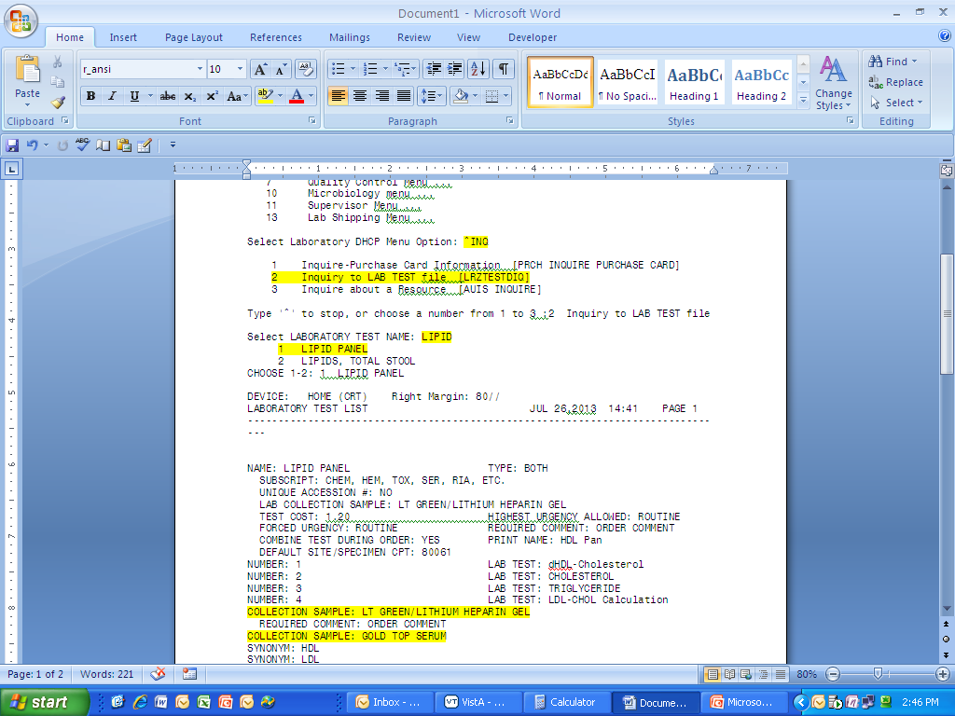
Look for Acceptable sample

