Slide 1

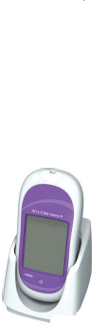
Accu-Chek Inform II
Blood Glucose Monitoring System.
Ancillary Testing Coordinator:
Michelle Roberts MT (AMT)

Slide 2
Why Training?
“The use of blood glucose meters by untrained staff, without adequate management supervision of the equipment and without the use of quality control procedures, can lead to misleading results, adversely affecting the treatment of patients”
It is a CAP and JCAHO requirement.
Notes:
Due to adverse incidents arising using Blood Glucose Monitoring equipment , the DOH and the Medication & Healthcare Products Regulation Agency issued Hazard & Safety Notices, both of which highlighted the need for all staff to be trained properly in their use.
All nursing staff are accountable for ensuring they keep updated with their personal training needs.
Department of Health – In 1987 the DoH issued a hazard notice: Blood Glucose Measurements: Reliability of Results Produced In Extra Laboratory Areas HN (Hazard) (87) 13. They stated: “The use of blood glucose meters by untrained staff, without adequate management, supervision of the equipment & without the use of quality control procedures, can lead to misleading results, adversely affecting the treatment of patients”
MHRA – In 1996 the MHRA issued a safety notice: Extra Laboratory use of Blood Glucose Meters & Test Strips: Contra-indications, training & Advice to the users. MDA SN 9616 June 1996. They stated: “Staff who are responsible for extra-laboratory glucose testing, including near patient testing & for training self monitoring diabetic patients, need to be aware that the clinical condition of the patient may be associated with the production of misleading results. Contraindications & interpretation of results should be covered in staff training sessions”.
Nursing & Midwifery Council (NMC) – Code of Conduct (NMC 2002) states: “Maintain your professional knowledge & competence”.
Trust – Blood glucose monitoring policy/guidelines. The more staff who attend training – the less likely there is to be a clinical incident / negligence claim against Trust.
Royal College Nursing (RCN) – The Diabetes Nursing Forum of RCN issued guidelines on the use of blood glucose monitoring equipment by nurses in clinical areas .They stated: “No nurse should use blood glucose monitoring equipment without complete training”. The RCN also advised that the training should be mandatory.

Slide 3
Training Objectives
By the end of this session you will be able to:
Explain why training is required.
Identify contraindications/test interferences.
State Why and When you have to quality control your meter.
Perform a Quality control test as per hospital policy.
Identify Point of Care contact on site and where you get your meter supplies.

Slide 4
Contraindications for use of Blood Glucose System.
Due to the Hazard Notices being issued the MHRA recommend that therapeutic decisions should not be based on a capillary sample in these circumstances:
Dehydration
Hypotension
Shock
Peripheral Occulsive Disease
Hyperosmolar Non-Ketotic Coma
Diabetic Ketoacidosis
Unconscious Patients
Decompensated Heart Failure NYHA Class IV
Venous Sample should be sent to the Lab for verification of blood glucose level
Notes:
Severe Dehydration – refer to Hazard article “Patient Death Sparks Change At Hospital” where a lady died due to being treated from capillary blood glucose readings whilst in a dehydrated state.
Hypotension – Due to peripheral shutdown
Shock – Due to peripheral shutdown as blood is directed to major organs.
Peripheral Circulatory Failure – possible causes: severe dehydration, hyperglycaemic Hyperosmolar state with or without Ketosis, Hypotension, shock, peripheral vascular disease.
Hyperosmolar Non-Ketotic Coma – occurs in patients with adult onset diabetes & causes a metabolic derangement characterized by hyperglycaemia, severe dehydration & focal or global neurological deficits.
Ketoacidocis – usually caused by a lack of insulin leading to high blood sugar levels, ketones in urine & acids in blood.
The secretion of glucose into the urine causes large quantities of water and salts to be lost leading to serious dehydration.
Unconscious Patients – If collapsed and peripherally shut down a venous sample should be sent to laboratory. The meter is designed to monitor blood sugar levels, all diagnosis should be made from a venous sample.

Slide 5
LIMITATIONS.
Hematocrit should be between 10-65%
IV administration of abscorbic acid resulting in >3 mg/dL. (May cause overestimation)
Galactose >15 mg/dL (May cause overestimation)
Lipids Triglycerides >1800 mg/dL (May increase glucose)
Dehydration
Hypotension
Shock
Peripheral Occulsive Disease
Hyperosmolar Non-Ketotic Coma
Diabetic Ketoacidosis
Unconscious Patients
Decompensated Heart Failure NYHA Class IV

Slide 6
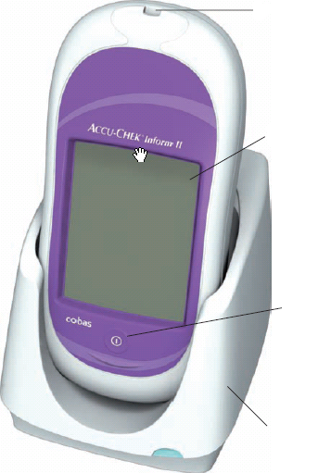
Inform II – Front View.
Test Strip Port
Touch screen
On/off button
Base unit
Notes:
On/Off Button – Press and hold down to display screen contents. Check that screen is full of icons and the segments that form the “8”s are intact.
Ensure all areas of the screen are clearly visible. Screen should be checked each time meter is switched on , minimum daily.
(meter may have been dropped and the screen may have been damaged / not display figures clearly e.g may display a 3 but should be an 8 – this could have implications to the treatment given)
Memory Buttons – Do not use memory function in clinical setting as not able to input patient identification into meter. This should NEVER be used in a professional setting.
Storage – The meter and all associated consumables should be stored at room temperature. Avoid extremes of heat/cold.
Measuring Range – 0.6 – 33.3mmol/L

Slide 7
Inform II – Back View.
Bar code scanner
Battery Pack

Slide 8
Accu-Check Inform II Test Strip.
Sample volume detection
Robust End Dosing Strip
Fast 5 Second Result
0.6μL sample size
Notes:
Test Strip – Is robust and can be handled as long as hands are clean, dry & free from alcohol gel. They are dosed at the tip of the strip. (End dosing strip).
You must ensure when applying blood/QC solution that the yellow test pad is completely covered for accurate results.
Storage of test strips: The lid must be kept firmly closed on the pot as exposure to heat & humidity can cause the test strips to give inaccurate results. If the lid is left off – dispose of the pot of test strips. Performa test strip pot has a flip top lid to prevent lid becoming stuck in the workstation!
Validation before use – On insertion of the test strip you must validate that the 3 digit code on the pot of test strips corresponds with the code displayed on the screen of the meter before performing a test.
Check expiry date of test strips before use.
Uderdose detection (error code E4) prevents using a strip with insufficient sample.
The Performa strip also compensates for temperature, humidity & Haematocrit – gives error messages if unable to compensate.
The Performa strip also detects sample type: blood /QC

Slide 9
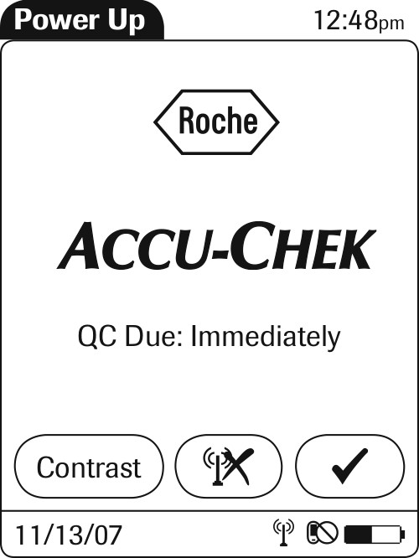

Accu-Chek Inform II
Power up screens

Slide 10
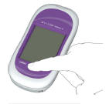
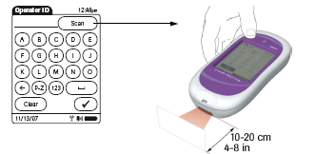
Start Up – User Identification.
1 Press and release the On/Off button . The system is now on.
2 The Power Up screen appears.
User ID is 4 digits long (last 4 of SSN)
User ID unique to user and
compulsory for all activities

Slide 11
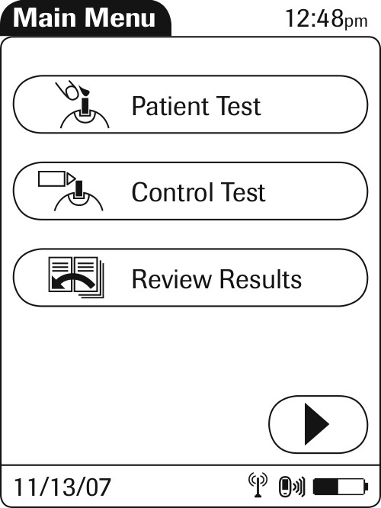
Main Menu Screen Shot.

Slide 12
Quality Control Testing
Why Quality Control?
How to Quality Control Inform II Meter
When to Quality Control?
Quality Control Lockout.
EQA
Notes:
Why Quality Control? This is the only way to ensure meter is working accurately. If a clinical incident occurred, the QC Logbook is used as evidence of maintenance for the nurse’s defence that the result being acted upon was accurate.
When to Quality Control? QC expires 3 months after opening – write 3 month expiry date on QC bottle. Mix QC before using (main reason QC fails) – wipe off any crystalising of QC solution from top of QC bottle onto tissue.
If meter is used daily – QC should be performed every 24 hours. (refer to Trust Policy)
If used infrequently – QC should be performed weekly and on day of test.
QC should also be performed in the following situations:
New Test Strips
New QC Solution
If meter is dropped
New Battery
Unexplained result versus clinical appearance
How to QC the Performa Meter – Demonstrate how to perform QC either by checking the results off the range on the pot of test strips or by using the buttons on the top of the meter. Always demonstrate where to locate the QC range on the pot of test strips. Staff being trained must demonstrate how to do a QC test.
Documentation of Results: Go through how to complete Logbook. Legal document need to keep for minimum of 7 years if used on >18years or minimum 21 years if nursing <18 years. No ditto marks, black ink. Ensure meter serial number written in Logbook. Every nurse using meter is accountable for ensuring the QC test is carried out according to hospital policy & should check QC has been done before using meter.
External Quality Assurance: Explain this is a sample sent to all wards from Biochemistry, it tests the accuracy of the meter and also that the user is following procedures (result only known by lab). Explain It is processed like a patient sample, how to complete paperwork & return to laboratory. Everyone’s responsibility to perform EQA samples. Hospital is audited on numbers of tests returned and accuracy.

Slide 13
Quality Control Screens:
Press barcode icon
and scan control vial.
Press “Control Test”

Slide 14
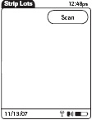
Strip Confirmation Screens
From this screen press scan, then
scan the strip vial.

Slide 15
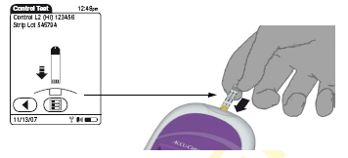
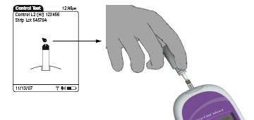
Performing a Quality Control Test.
Insert strip and wait for the
screen with the droplets to
appear prior to placing control
drop. *Note: The drop does not get placed on top
of the yellow portion but rather the very end of
the strip.

Slide 16
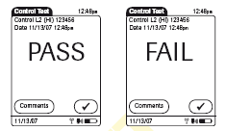
Result Screen:

Slide 17
Quality Control Test:
Checks accuracy of test strips and Inform Meter
Level 1 & 2 controls MUST be analysed every 24 hours – otherwise the user will be locked out of analysing patient samples.

Slide 18
Failed Quality Control Test
Level 1 & 2 solutions must pass QC test.
If test displays FAIL: Add Comment and repeat test.
Troubleshoot:
Ensure there are no bubbles present at tip of control vial when performing test.
Check expiry dates, mix/change QC solutions & test strips – repeat test.
Contact ATC in the lab to report fault and obtain replacement meter.
If meter continues to fail DO NOT use it!

Slide 19
Patient Preparation.
Infection Control
Handwashing
Sites for lancing
Notes:
Consent: Explain procedure to patient. Informed consent is required for this procedure.
Infection Control: Gloves should be worn as handling blood products.
Discuss safe disposal of lancets – should go into sharps bin.
Discuss safe disposal of test strips – should go into clinical waste bin.
Highlight there should be no blood stained equipment in workstation & the only reason for this is if staff are placing used equipment in workstation following a test.
Inform staff they will be audited on this so any blood stained equipment should be cleaned or replaced as appropriate.
Handwashing: To prevent contamination of the blood sample, both nurse & patients hands should be washed in soap & water, rinsed & dried thoroughly. Or alternatively plain tap water. Do not use alcohol wipes/gel as can cause inaccurate results.
Explain other factors which could affect results:
Food, Fruit juice, Newspaper print, perfumes, hand creams, Glossy magazines (paper contains glycerine), hairspray, hair gel.
Sites for Lancing: Avoid using index finger & thumb as used for fine motor movements. Lance sides of fingers – not pad or tip. Explain if patient was to become visually impaired using the pad could affect their ability to read Braille & more painful in pad. Lance no lower than nail bed avoiding edge of nail. Earlobe is also an approved site for lancing. Never use toes.
Always rotate sites to prevent sore areas.

Slide 20
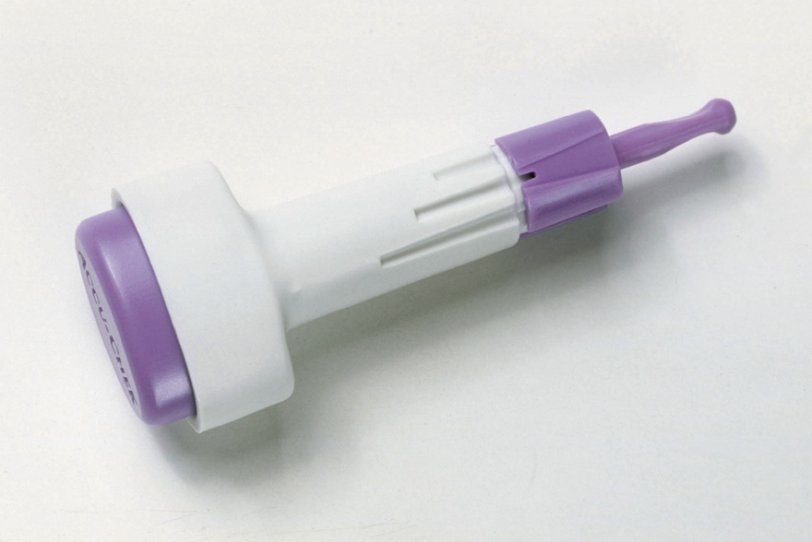
Safe T Pro Plus
Single Use Lancing Device
Depth Setting Protective Cap
Trigger Button
Notes:
Three Simple Steps:
Hold the lancet and twist off the sterility cap by twistng it in either direction. Throw the sterility cap away.
Select the depth you want by turning the depth adjuster.
Ensure the finger is clean and dry (wash with soap & water). Hold the Accu-chek Safe-T-pro plus firmly against the side of the fingertip and press the purple button on the top of the lancet. Dispose of in sharps container.

Slide 21
Patient Testing.
Select patient test from menu.
Scan patient badge. (If pt. does not have badge, ensure you enter correct ID number)
Meter will prompt you to confirm patient details
Scan in Test strips

Slide 22
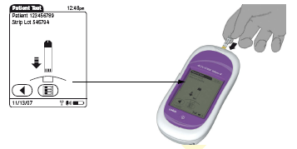
Check test strip code and insert strip.
~ Check Patients details at top of screen

Slide 23
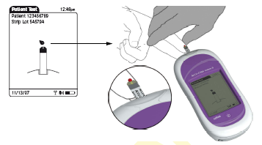
Apply patient blood when prompted.
Always perform a visual inspection of the yellow test area.

Slide 24

Results.
Normal Range = 74 – 106 mg/dL
Critical Range = <40 and >400 mg/dL
All critical results MUST be repeated by an RN.
All repeated and confirmed critical results MUST
have the comment “MD Notified”
Follow section protocol for critical glucose
results.

Slide 25
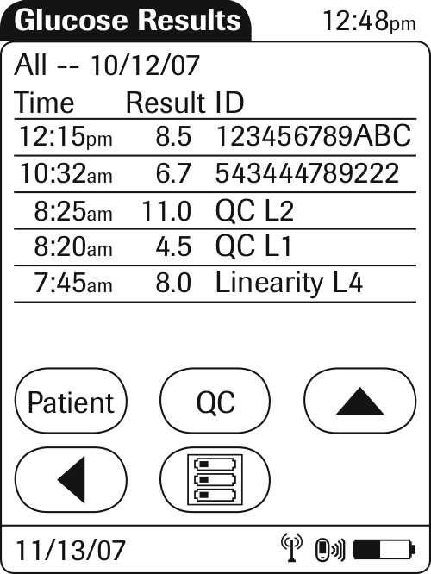
To Review Results
From main menu – select review result
All results are displayed on screen – Patient & QC.
Select patient – to view patient results - scan ID
Select QC – to view QC results.

Slide 26
Cleaning the Meter.
It is a requirement that the meter
be cleaned after each use.
Use the germicidal wipes approved by the facility.
Protect the strip port from moisture.

Slide 27
Report to Clinical Advisor/Manager, Diabetic Specialist Nurses or Biochemistry Department
Quarantine the Meter, Test Strips, Quality Control Solutions and Log Book.
DO NOT USE THE METER
Note the serial number of the meter, test strips & quality control solution
Inform local representative or Nurse Educator.

Slide 28
Training Objectives
By the end of this session you will be able to:
Explain why training is required.
Identify contraindications/test interferences.
State Why and When you have to quality control your meter.
Perform a Quality control test as per hospital policy.
Identify Point of Care contact on site and where you get your meter supplies.

Slide 29
Thank you for listening…
Any further questions?

