Slide 1
MICROSCAN MISMATCHED RESULTS
Process Improvement Project
By: Mariam Imsaiah

Slide 2
WHAT DOES A MICROSCAN MISMATCHED RESULT ALERT MEAN?
Microscan Mismatched results occur when an isolate’s preliminary identification sent from SOFT does not match the Microscan final identification.

Slide 3
HOW TO PROCEED WITH A MICROSCAN MISMATCHED RESULT?

Slide 4
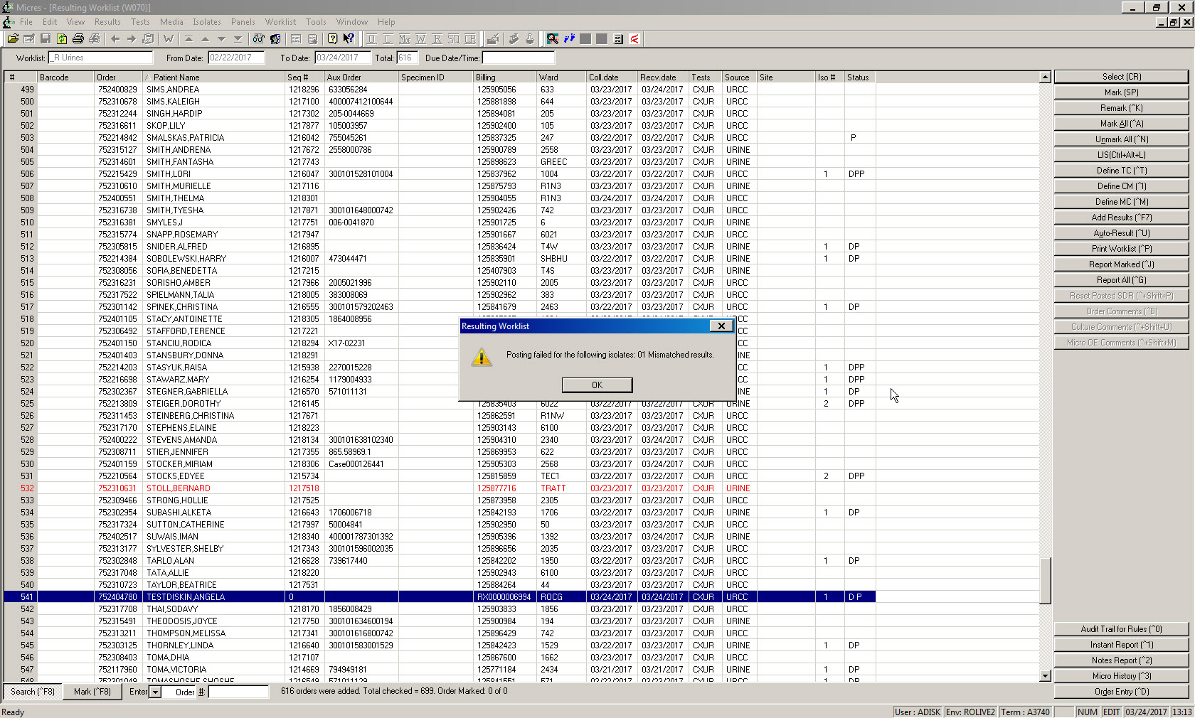
1. SCAN SPECIMEN, THIS ALERT WILL COME UP, CLICK OK

Slide 5
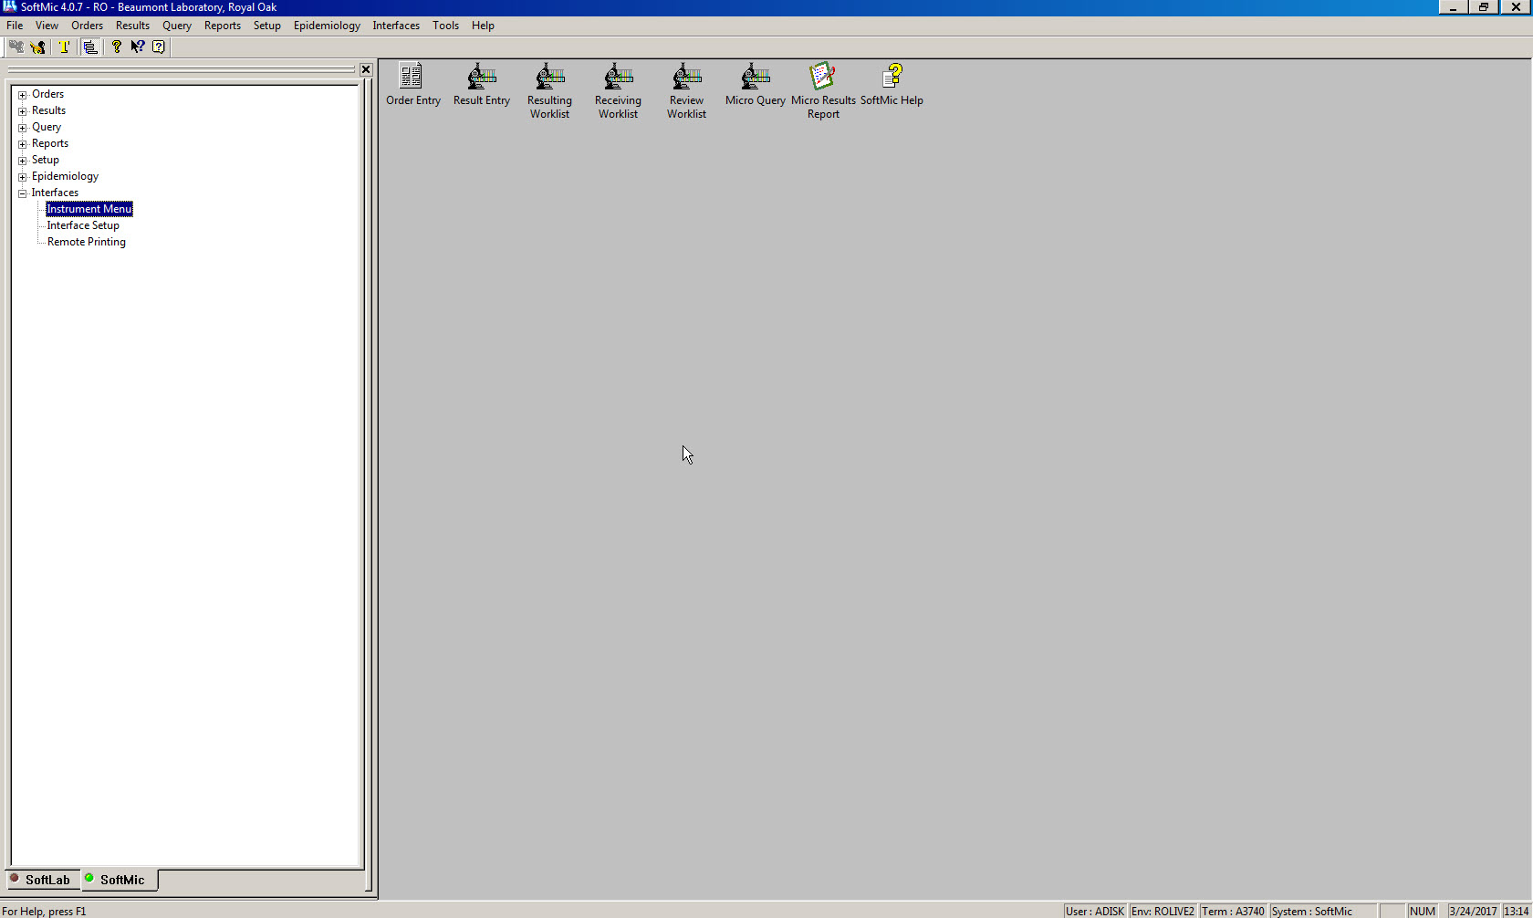
3. CLICK ON INTERFACE
4. SELECT INSTRUMENT MENU
2. ENTER SOFTMIC

Slide 6
5
6

Slide 7
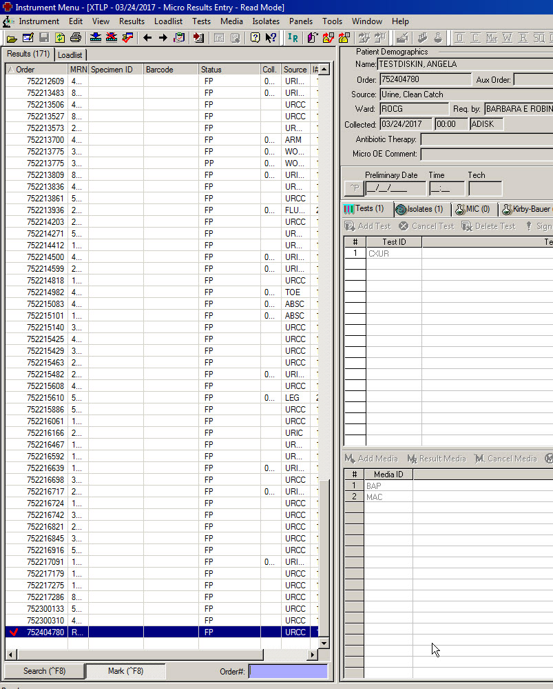
7. SCAN SPECIMEN AND SELECT IT

Slide 8
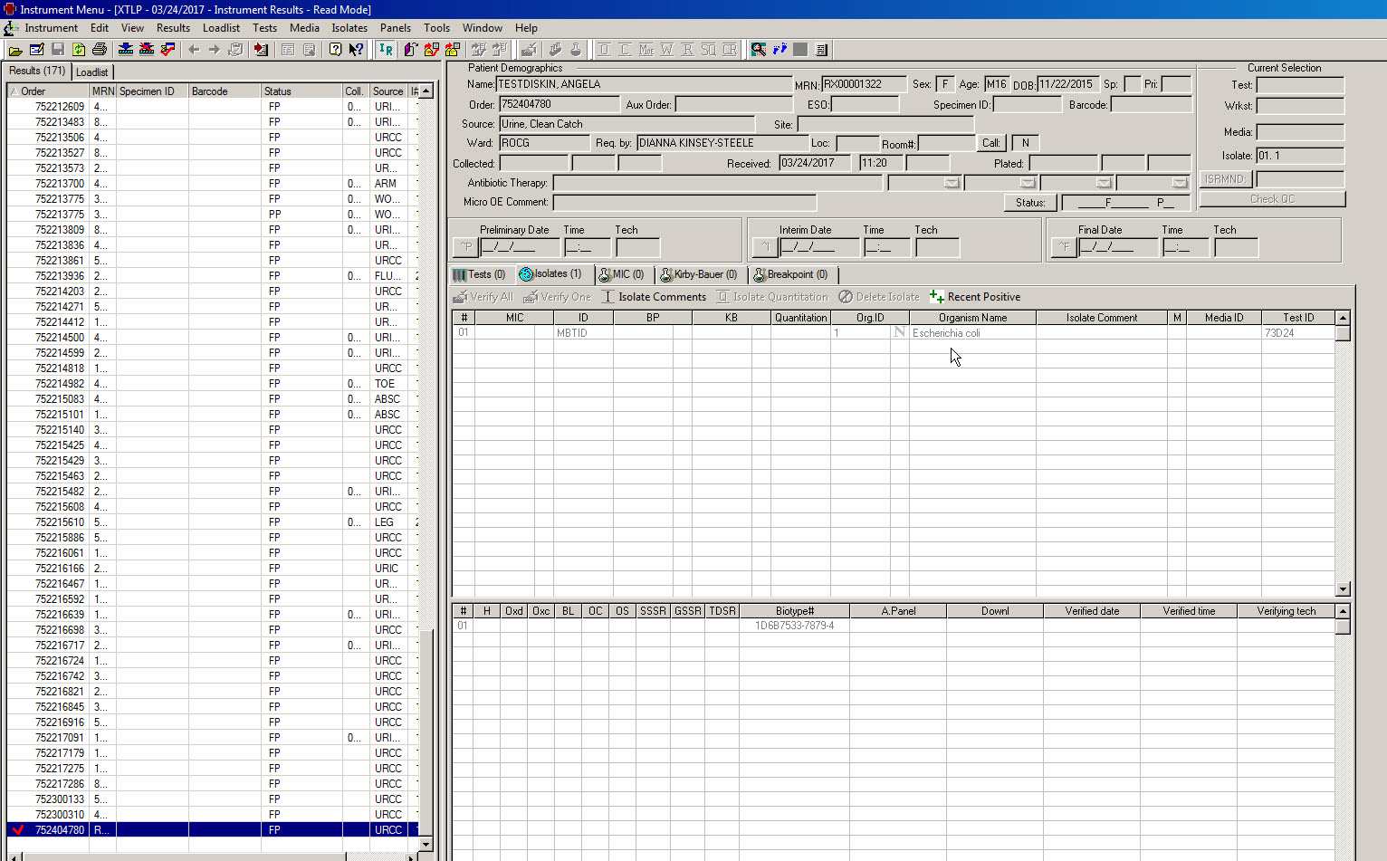
8. CLICK ON IR ICON
9. SEE ID

Slide 9
10. CLICK ON RED CHECKMARK ICON BELOW “TOOLS”

Slide 10
11

Slide 11
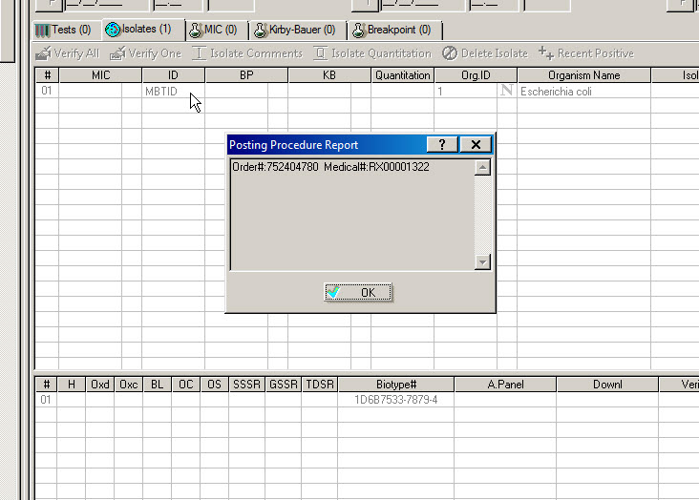
12

Slide 12
After previous steps, the Microscan result will be posted in SOFTMIC.
The medical technologist should troubleshoot why a mismatched result occurred and identify the source of error.
A corrected report needs to be made and called.

Slide 13
MTS Quiz
I. Which of the following would lead to a Microscan mismatch alert ?
A) SOFT preliminary Catalase positive organism, Microscan ID = Staph aureus
B) SOFT preliminary Oxidase negative organism, Microscan ID = E. Coli
C) SOFT preliminary Enterococcus species, Microscan ID = Aerococcus species
II. Is a corrected report necessary in this instance?
A) Yes
B) No

Slide 14
Is a corrected report necessary if the final identification does not correlate with the
preliminary identification?
A) Yes
B) No

Slide 15
2) If a mismatch result comes up, which menu in SOFT is used to resolve it?
a) Reports
b) Interface→ instrument menu
c) Results

Slide 16
3) List the steps, in order, of how to proceed with a Microscan mismatched result AFTER entering Softmic:
Click on MicoScan walkaway and open results
Click on interface
Click on IR icon and see Id
Select instrument menu
Click on Red Checkmark icon below “tools”
Scan specimen and select it

