Slide 1
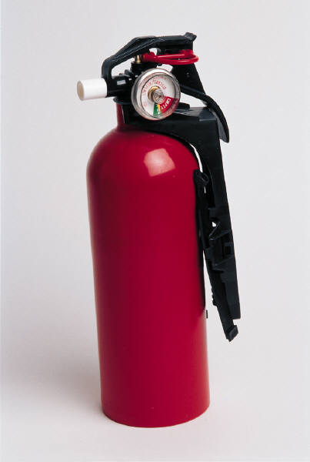
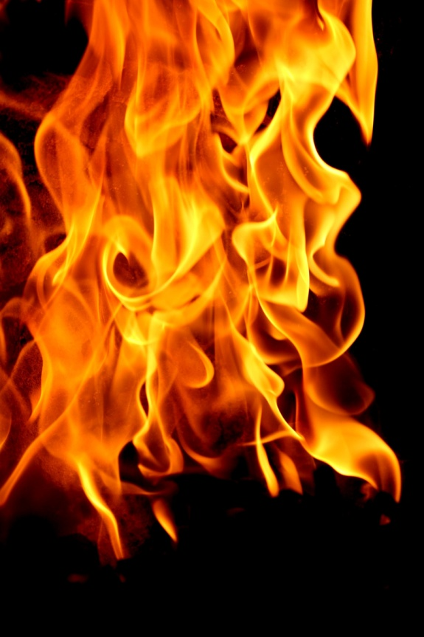
Bullex Fire Extinguisher Training
Beaumont Laboratory
Beaumont Hospital
Royal Oak, MI 48073
Notes:
Welcome everyone.
CAP recommends that everyone in the lab have “hands on” fire extinguisher training.
Since there are budget cuts at the fire departments, we cannot get the fire marshals to train us any more (used to).
So now the Bullex company has come up with an electronic version.
The TV screen will have flame on it, and the fire extinguishers are the same size, weight and configuration as real fire extinguisher. They even sound the same. However, a green laser will come out of the hose, and this is what you are going to use to put out the fire.

Slide 2
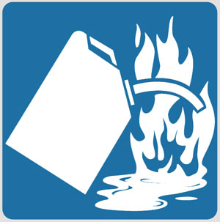
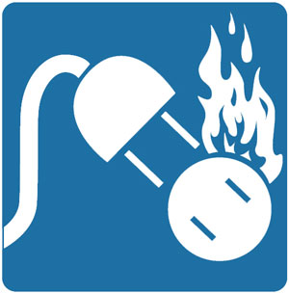
Different Types of Fires
A = Paper, Wood, Cloth,
Rubber, some Plastics
B = Gasoline, Oil,
Flammable Liquids
C = Electrical Equipment
Notes:
Reminder about the 3 main types of fires that might be found in labs.
A = waste paper baskets would be a common type.
B = flammable liquids = alcohol, xylene, etc. – found in many labs
C = electrical = all the equipment that is plugged in, including computers.

Slide 3
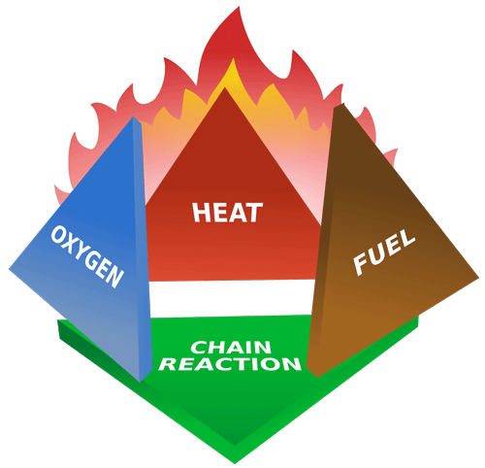
3 Elements Required for a Fire
Heat
Fuel (paper, flammable liquids, electricity, etc.)
Oxygen
If you disrupt one of
these – the fire goes out.
This is the role of the
fire extinguisher
Notes:
Need 3 things for a fire to occur:
Heat = everything thing burns at it’s own temperature (paper = 451 F, ethanol = 55 F, acetone = 0 F.
Fuel = that’s the A, B, C we were talking about on slide 2. Fuel = paper, cloth, flammable chemicals, electricity.
Oxygen = in the room
When all 3 are combined, then a chemical (chain) reaction occurs, and we have a fire.
If one of these 3 is disrupted, then the fire goes out.
There are several types of fire extinguishers (chemical, water, carbon dioxide), but they all interfere with one of these three things =
cooling down the heat
cutting off the supply of oxygen
Coating the fuel

Slide 4
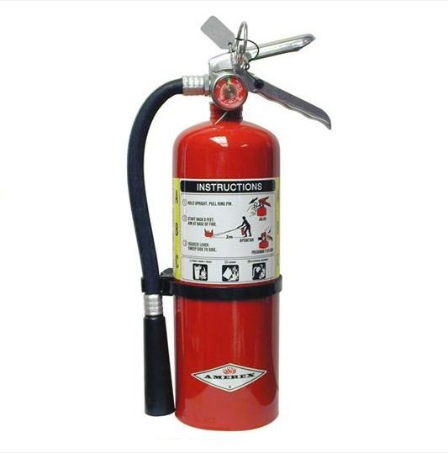
Multi-Purpose Dry Chemical Fire Extinguisher (BHS)
Will put out A, B and C fires.
Has all three symbols.
Has a non-toxic yellow sticky powder
Monoammonium phosphate
Will ruin computers
Try unplugging first
Do NOT use on
D Fires = burnable metals
K Fires = kitchen/grease
Notes:
WBH, in most areas, uses just the Mult-purpose Dry Chemical. They don’t want to have several types of fire extinguishers around, and have people grab the wrong one to put out the fire (example = electrical fire and a fire extinguisher with water in it_.
The Dry chemical will put out all three of the A, B and C types of fires – note the 3 symbols at the yellow arrows.
The chemical is a yellow, sticky powder that is non-toxic.
It will put out an electrical fire, but will “gum up” the electrical equipment, such as a computer, and it will be ruined. If possible, try unplugging the electrical equipment. That will stop the electricity (fuel). First, check to make certain you care not going to get a shock from the plug - touch the plug with the BACK of your hand. If there is a shock, you will not grab hold of the plug/cord, which could electrocute you.
There are 2 other types of fires, not usually found in WBH labs, and which should NOT be put out with a dry chemical fire extinguisher:
D fire – burnable metals, such as sodium, magnesium, potassium, lithium
K fire = kitchen fire = grease fire. Easiest way to put this out is to put a lid on the pan. Pouring backing soda on the K fire may cause the grease to splash, making a larger area on fire, or flour might be grabbed instead, which is flammable.

Slide 5
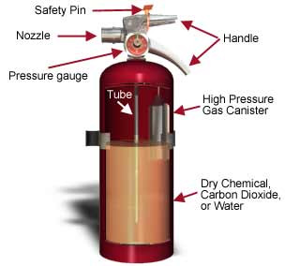
Parts of a Fire Extinguisher
Hose &
BHS
Notes:
Outside canister.
Inside canister with high pressure gas.
WBH JLL checks the pressure on the gauge, to make sure it’s in the green zone (correct amount of pressure)
Material inside canister to put out fire, dry chemical (WBH – A, B, C), water or carbon dioxide
When the Safety pin is pulled
And the handle squeezed
The high pressure gas is released, causing the dry chemical to go up through the tube
Out through the nozzle, and usually to a hose (which is not shown in the photo)

Slide 6
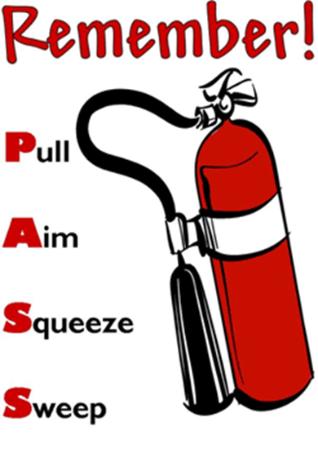
Notes:
Remember P-A-S-S.
If forget, it’s on your Safety badge.

Slide 7
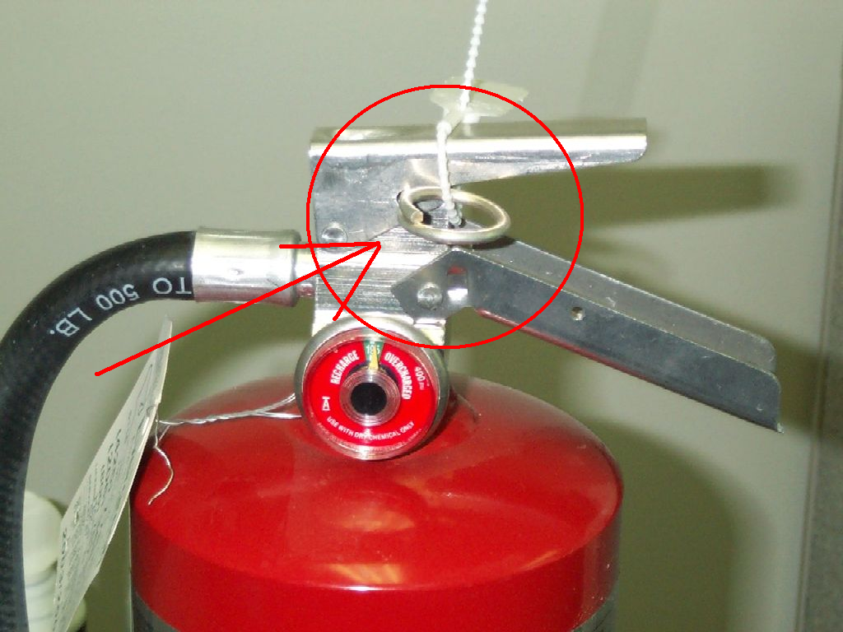
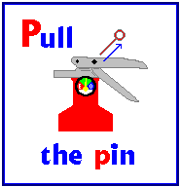
Remember P-A-S-S
Pull the Pin – twist to break tie
Notes:
P = Pull the pin.
Notice white twist tie = needs to be broken. Usually have to turn pin around, like a key to start the car, to break the pin. Sometimes need to twist more than once.
For this demo, we are NOT going to put the twist ties on.
The pin is attached to the canister with a plastic “string”. Do NOT break this plastic string. The string is so that we don’t lose the pins when everyone is putting out their fire.

Slide 8
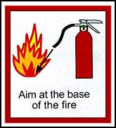
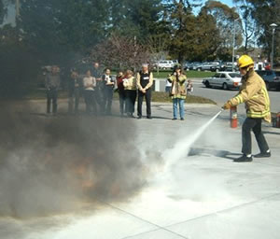
Remember P-A-S-S
Aim the hose at the base of the fire
Notes:
A = Aim at the base of the fire.
Remember, we want to attack the fuel = cool it down, cut off the oxygen, or coat it. Aiming at the top of the fire does not attack the fuel.
Notice the person putting out the fire is aiming at the ground level of the fire.

Slide 9
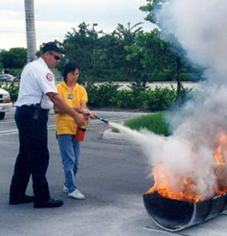
Do NOT Aim at Top of Fire
WRONG!!
Too High!
Notes:
WRONG!
The flames do NOT have the fuel. Need to aim at the base of the fire.

Slide 10
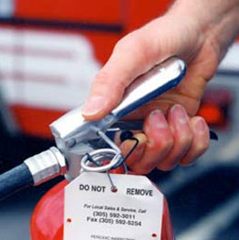
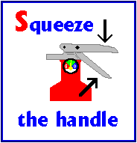
Remember P-A-S-S
Squeeze the handle
Oops!
Notes:
First S = Squeeze.
Then handle should squeeze very easily.
If you are squeezing so hard that your fingers are turning red, and your knuckles are turning white (point to photo), you probably forgot to do “P” = pull the pin.
In the excitement/fear to having to put out a fire, it is very easy to forget to do “P” – pull the pin.
So if you are having a lot of problems squeezing the handle, stop for 1 second, calm yourself, and check for the pin.
Don’t take too long. Fires double in size every 30 seconds.
I you can’t find the fire extinguisher, and do PASS within 30-60 seconds – LEAVE!

Slide 11
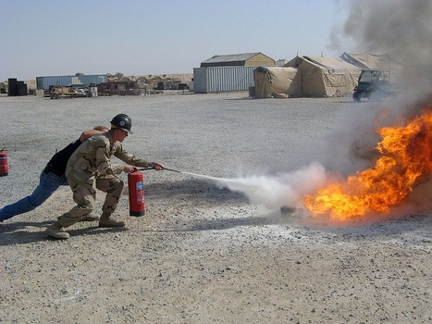
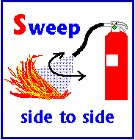
Remember P-A-S-S
Sweep hose side to side at the base (until fire is out)
Notes:
Last “S” = sweep the hose from side to side at the base.
Notice that the person is crouching down, to get at the base.
The person started on the left side of the fire, and will sweep to the right, then back to the left, and then back to the right.
Keep repeating this back and forth, until the fire is completely out. There will be little flare ups.
Do not sweep too fast, as that can scatter the paper, etc.
Do not sweep too slow, as by the time you get to the other side, the first side flare ups have had time to get much larger.
Notice, you need to be about 6-8 feet away from the fire, when you start putting out the fire.
To far away, and the chemical won’t reach the fire. Once the fire starts to go out, you can move a little closer while spraying the extinguisher.
Too close, and the force of the spray from the extinguisher will move the fuel around.

Slide 12
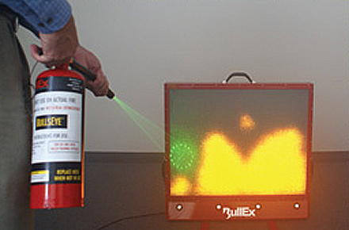
Bullex Fire Extinguisher
Do the P-A-S-S until fire is out
Aim green laser at base of fire
Just above the bottom of “TV”
Notes:
It’s now time to put out our fire with the Bullex Fire Extinguisher.
The screen will show a fire.
You are to do P-A-S-S with the fire extinguisher.
Aim the green laser at the base of the fire, above the red bottom of the screen. Where the green laser is on the screen is too high. Aim for where the arrows are when you sweep from side to side.
NOTE TO INSTRUCTORS:
- Remember to hit the reset button in the fire extinguisher (under the hose, near where the hose attaches to the canister). Works best if you do this after each person.
- To get people out more quickly, just use setting A-1. It’s the simplest, but there are little fare ups. If you use B or C, and especially if you use 3 &4, it takes a long time to put out, and sometimes, it takes 2-3 tries with the extinguisher. You may run out of charge, and then can’t do the rest of your training.

Slide 13
QUESTIONS? 1st VOLUNTEER?
Notes:
Ask for questions.
Ask for the first volunteer. (everyone has to put out a fire, it’s just – who is going to go first.)
Your department’s choice as to whether people have to stay the entire time, or if they can go back to their job as soon as they put out a fire.

