Slide 1
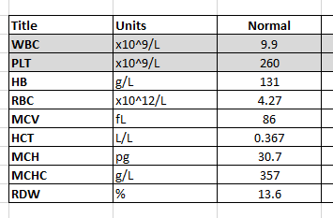
Presented are the parameters of a NORMAL FBE.
HB, RBC, MCV and RDW are measured directly on the analyser.
The HCT is calculated from RBC x MCV / 1000.
The MCH is calculated from HB / RBC.
The MCHC calculation is expressed in a number of ways
a) HB / ( RBC x MCV ) x 1000
b) HB / ( HCT )
c) MCH / MCV x 1000

