Slide 1
HemaTrax Unity Standalone v7.0: End-User Printing Blood Labels
This presentation is to be used in conjunction with the HemaTrax Unity Standalone v7.0: End-User Printing Blood Labels Instructional Aid created by CHRISTUS HEALTH IM Learning & Development

Slide 2
Introduction
HemaTrax Unity, a Digi-Trax Corporation on-demand labeling system, can be used to print the full range of ISBT-128 labels that meet the ICCBBA U.S. Consensus Standards. The standalone version of HemaTrax is installed directly on a designated workstation in the blood bank to allow for blood product label printing when either MEDITECH or the HemaTrax print servers are unavailable.

Slide 3
Getting Started

Slide 4
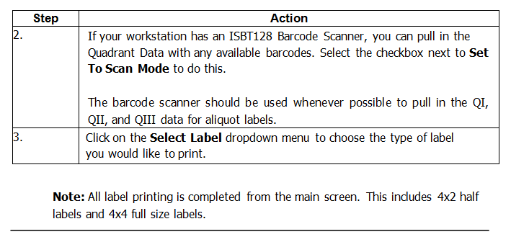
SPN Note:
ALWAYS use barcode scanner

Slide 5
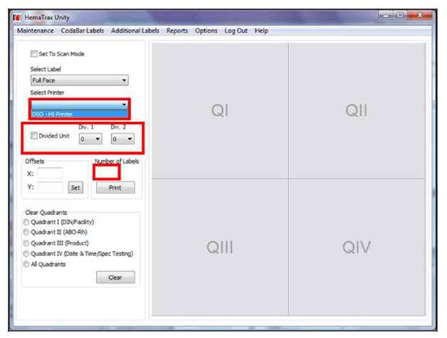
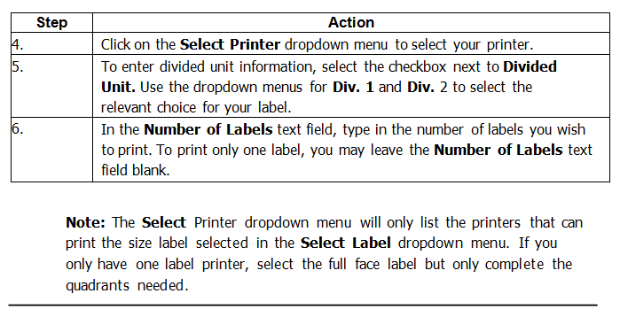

Slide 6
Quadrant I

Slide 7
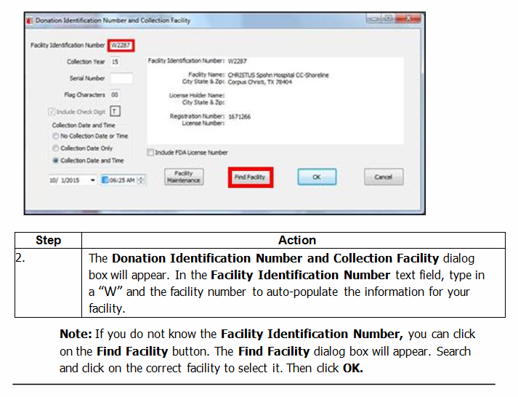

Slide 8
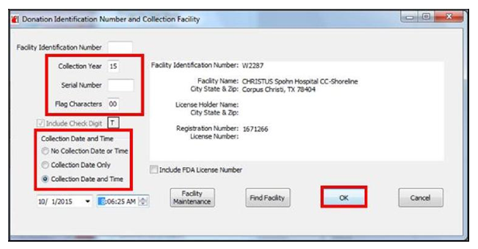
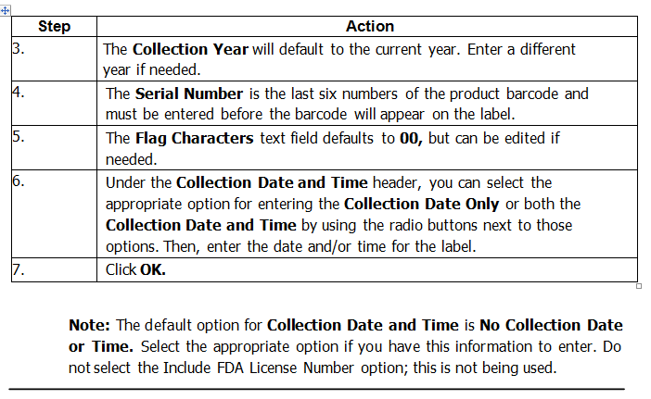

Slide 9
Quadrant II

Slide 10
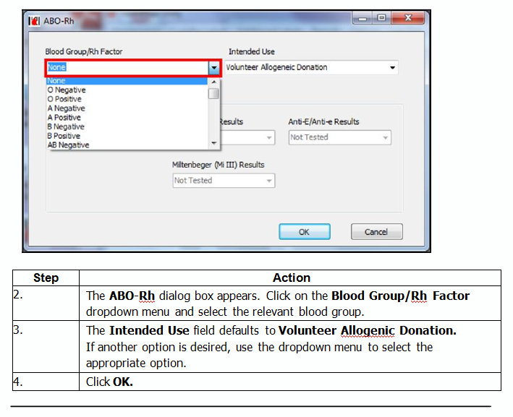

Slide 11
Quadrant III

Slide 12
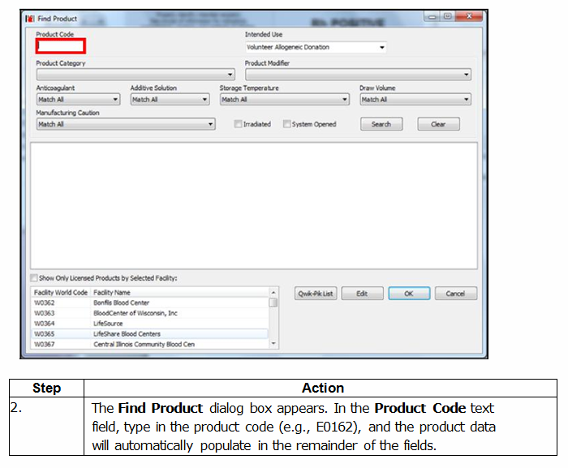

Slide 13
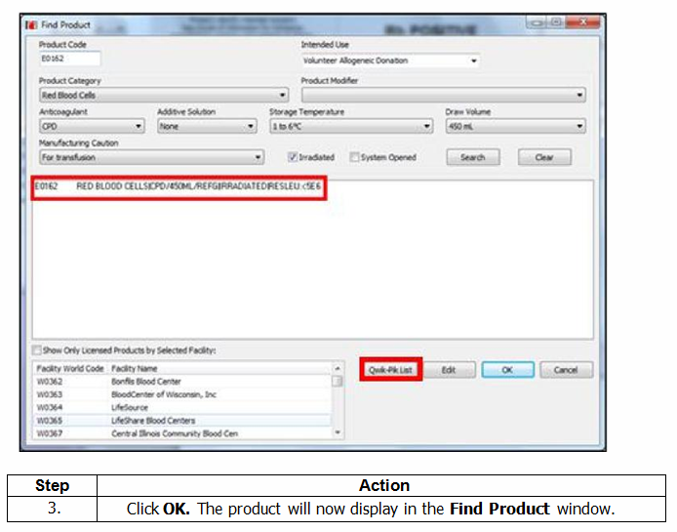

Slide 14
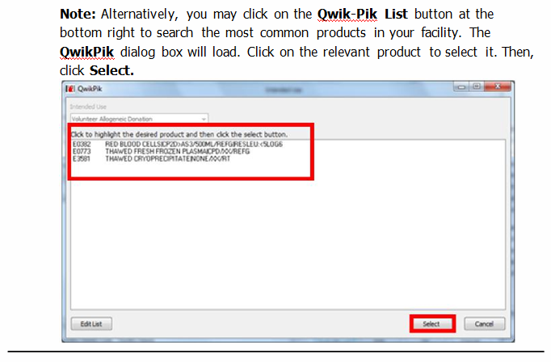

Slide 15
Quadrant IV

Slide 16
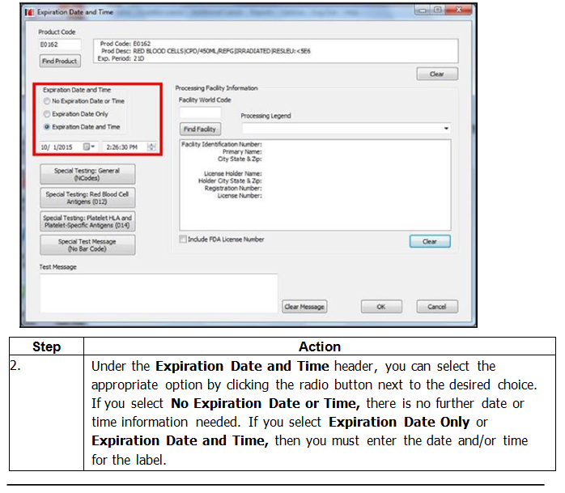

Slide 17
QIV Special Testing Buttons
SPN Note:
Special Testing: General (NCodes) is the ONLY button used in the SPN region

Slide 18
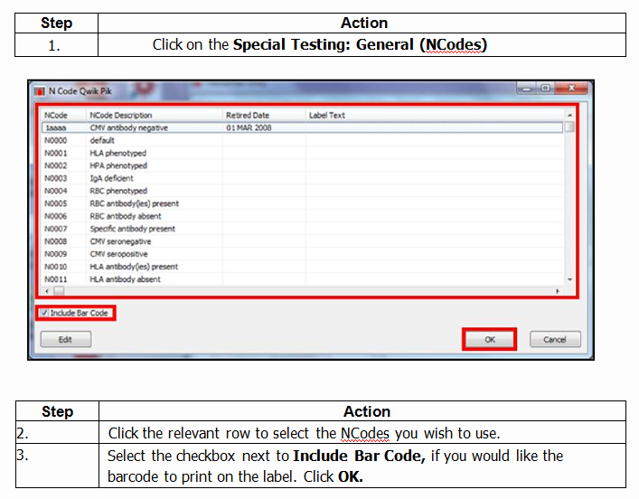

Slide 19
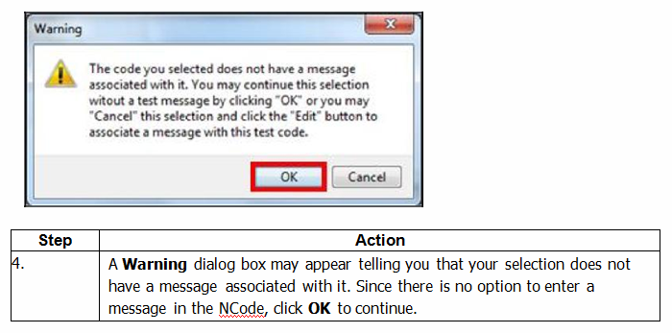

Slide 20
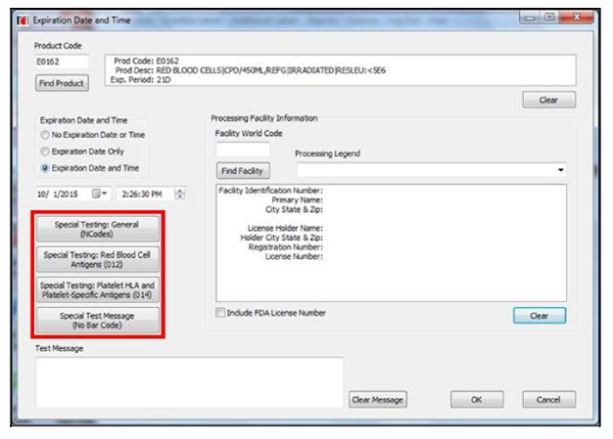
SPN Note:
Since the next 3 buttons are NOT used in the SPN region, we will skip the remaining portion of the QIV Special Testing Buttons section (steps 5-19).
Special Testing: Red Blood Cell Antigens (012)
Special Testing: Platelet HLA and Platelet Specific Antigens (014)
Special Test Message (No Bar Code)

Slide 21
Clear Quadrant Data

Slide 22
Printing the Label

Slide 23
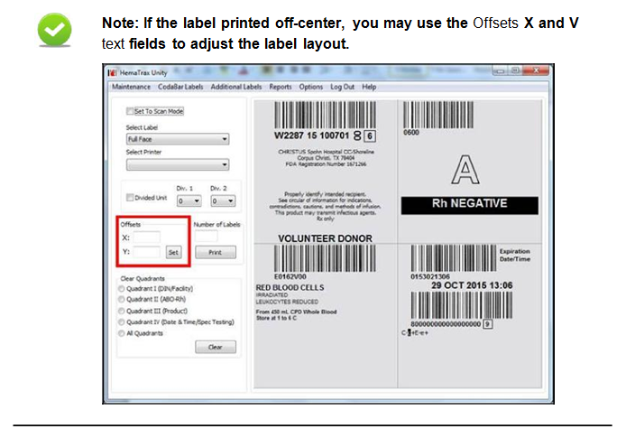

Slide 24
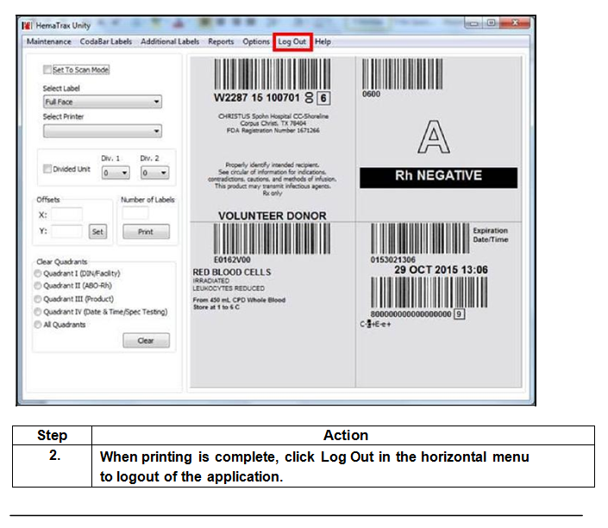

Slide 25
Questions?

