Slide 1
Data Inovations (DI) Instrument Manager(IM) The DI/IM is the middleware computer connecting the Cobas to Cerner. IM will be used to review and release Cobas results.
Click on the IM icon on the Desktop

Slide 2
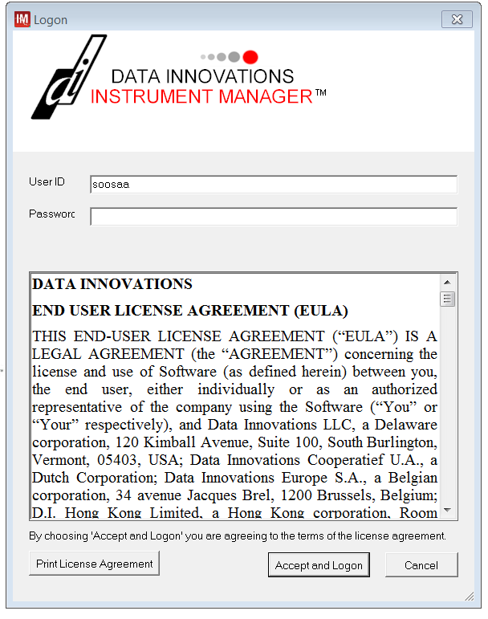
Log on the DI/IM with your network Username and password

Slide 3
The screen below will appear after logging on.

Slide 4
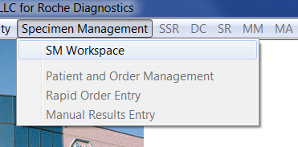
The functions that will be used to Review and Release Results will be under Specimen Management, SM Workspace Click on SM Workspace

Slide 5
This screen will appear after selecting SM Workplace at initial log in. For Results Review Edit Release Select the arrow to the left of the icon (Table 1 will have a list of the icons and their explanations )to bring up all of the review options.

Slide 6
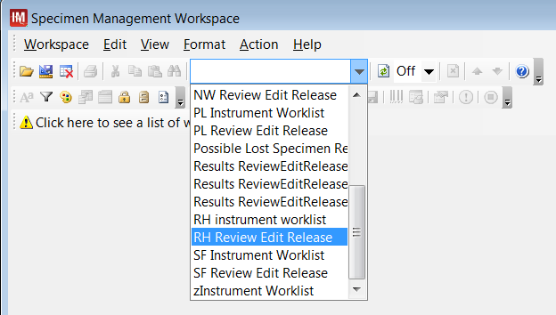
From the drop down choices, select your location. The First letters are the abbreviations of the sites. Example: At Roper, select RH Review Edit Release

Slide 7
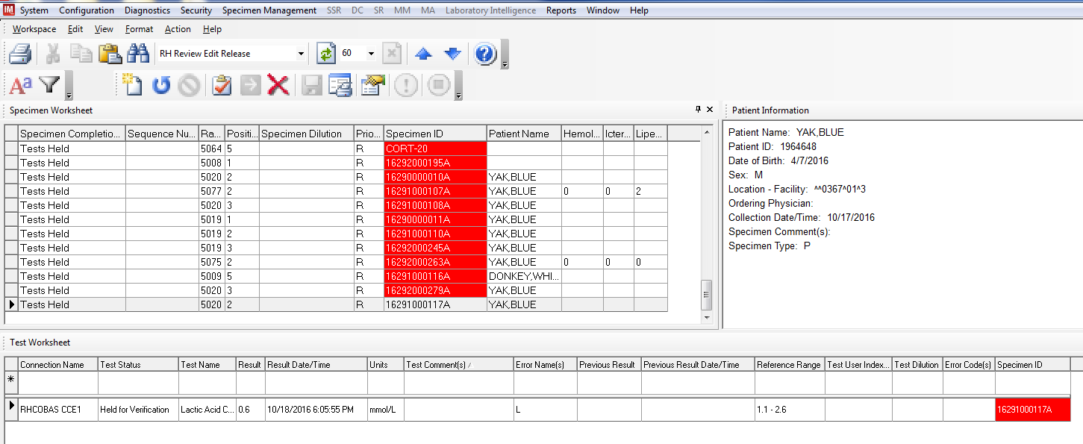
After selecting the appropriate Review Edit Release Screen, the following will appear. All results that have have not autoverified will be listed. If a specimen has autoverified, it will not be on the Result Edit Release page. The top section Specimen Worksheet lists samples held for verification The bottom section Test Worksheet shows the details of the specimen with the arrow in the far left hand side of the page. (Tables 1 and 2 will have explanations for Error codes and how to handle them and Descriptions of Tool Bar Icons)

Slide 8
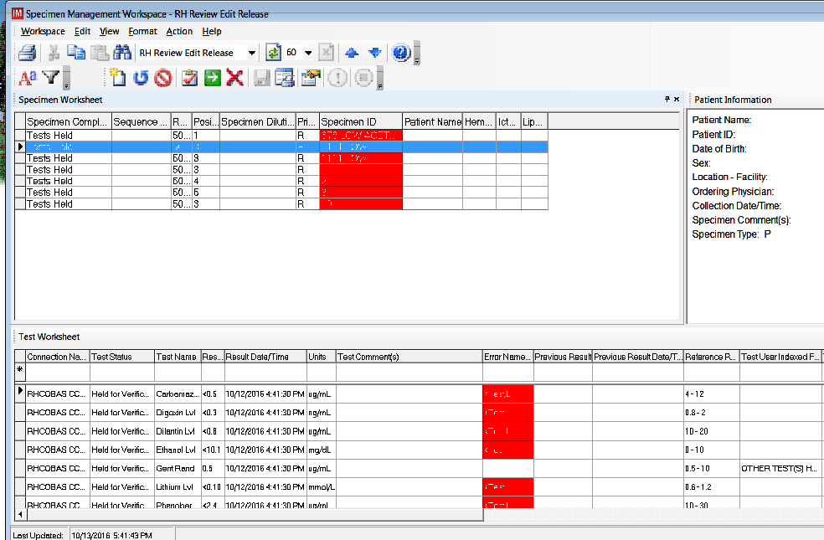
Samples with error codes are Held for verification .( Error codes and explanations are listed on Appendix B) Review Results If results are acceptatble for release to Cerner, Click on the Arrow to release results.

Slide 9
Tables 1 Order New Test Order Rerun /Reflex Cancel Release Send to Host Reject Result Print Report Refresh

Slide 10
To log off, select Log Off form the drop down under System. ToExit, select Exit from the drop down under System.

