Slide 1
Blood Parasites
Yale-New Haven Hospital
Lab Medicine: Hematology

Slide 2
The features to look for to identify a malaria parasite are:
Morphology of trophozoites and schizonts, including the number of nuclei in meront
Morphology of gametocytes -round or crescent shaped
The quality of malarial pigment -coarse pigment is suggestive of P.malariae
The level of parasitemia and presence of multiple infections of red cells, suggestive of P. falciparum
Size of the red cell: enlarged red cell is suggestive of P. vivax or P. ovale
Presence of stippling on the red cell - learn to differentiate between Schüffner and Maurer's dots
Different stages present - late trophozoites and schizonts of P. falciparum are not normally present in the peripheral blood, while they are for other species
Notes:
“Microscopy: identification of species” Impact malaria by Sanofi
http://www.impact-malaria.com/web/malaria_training/identification_species_

Slide 3
Malaria Identification :Size of the RBC

Slide 4
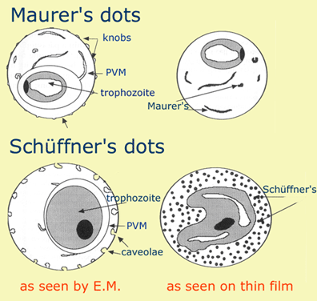
Mauers dots vs. Schüffner dots

Slide 5
Malaria

Slide 6
Babesia

Slide 7
Ehrlichia

Slide 8
Plasmodium Falciprum

Slide 9
Plasmodium Vivax

Slide 10
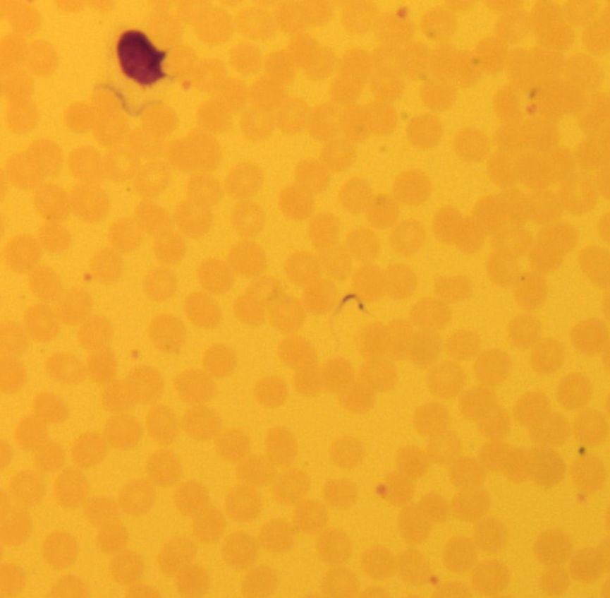
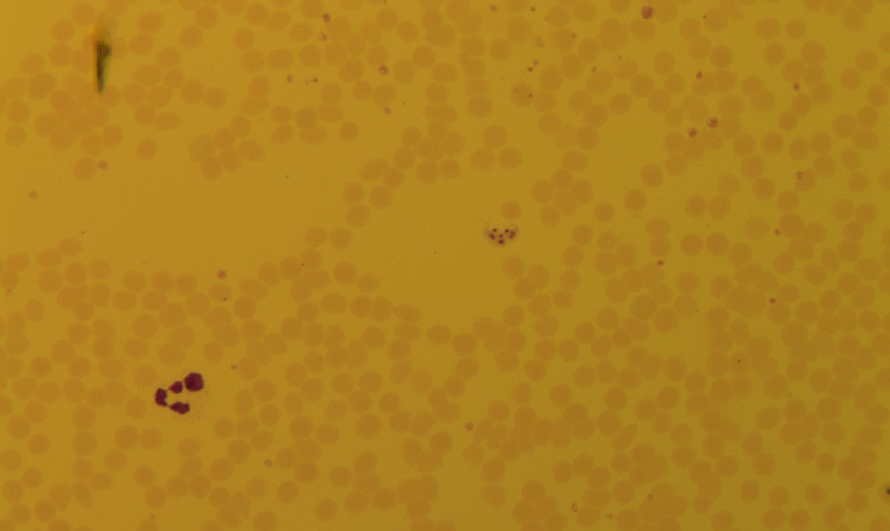
Trypanosoma Cruzi

