Slide 1
Blood Parasites
Yale-New Haven Hospital
Lab Medicine: Hematology

Slide 2
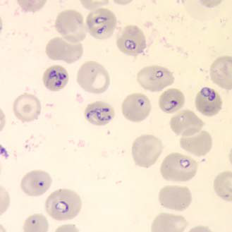
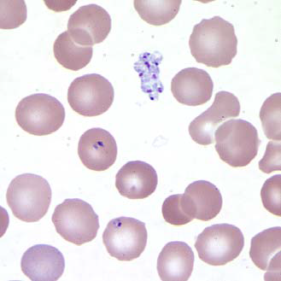
Babesia sp.
Rings of Babesia spp. have delicate cytoplasm and are often pleomorphic. Infected rbcs are not enlarged; multiple infection of rbcs can be common. Rings are usually vacuolated and do not produce pigment. Occasional classic tetrad-forms (Maltese Cross) or extracellular rings can be present.

Slide 3
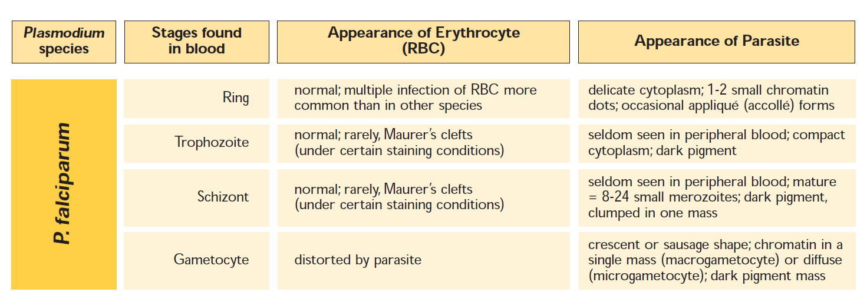
P.falciparum

Slide 4
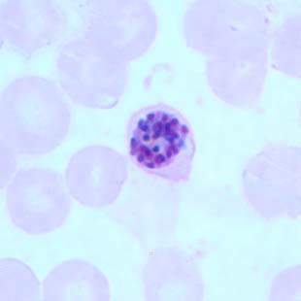
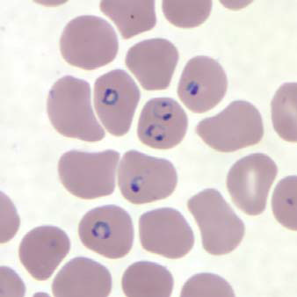
P. falciparum
P. falciparum rings have delicate cytoplasm and one or two small chromatin dots.
Rbcs that are infected are not enlarged; multiple infection of rbcs is more common in P. falciparum than in other species.
Occassional appliqué forms (rings appearing on the periphery of the rbc) can be present
Note the classic “headphones” appearance of many of the rings.
P. falciparum schizonts are seldom seen in peripheral blood. Mature schizonts have 8 to 24 small merozoites; dark pigment, clumped in one mass.

Slide 5
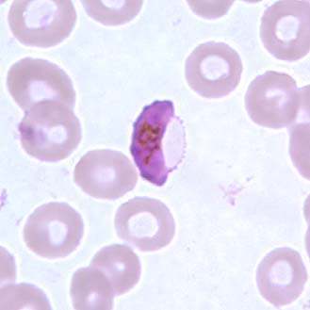
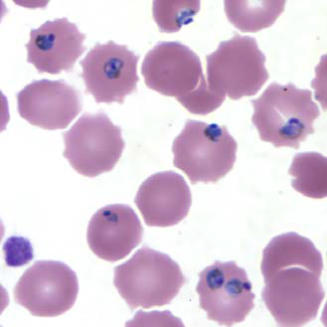
P. falciparum
P. falciparum gametocytes are crescent or sausage shaped. The chromatin is in a single mass (macrogamete) or diffuse (microgamete).
P. falciparum trophozoites are rarely seen in peripheral blood smears. Older, ring stage parasites are referred to as trophozoites. The cytoplasm of mature trophozoites tends to be more dense than in younger rings.
As P. falciparum trophozoites grow and mature, they tend to retain their ring-like shape and some-times trace amounts of yellow pigment can be seen within the cytoplasm. Growing trophozoites in P. fal-ciparum can appear slightly amoeboid in shape.

Slide 6
P. vivax

Slide 7
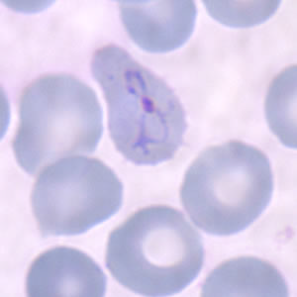
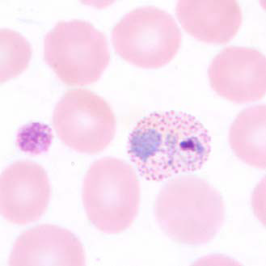
P. vivax
P. vivax rings have large chromatin dots and cytoplasm can become ameboid as they develop.
P. vivax trophozoites show amoeboid cytoplasm, large chromatin dots, and have fine, yellowish-brown pigment. Schüffner's dots may appear more fine in comparison to those seen in P. ovale.

Slide 8
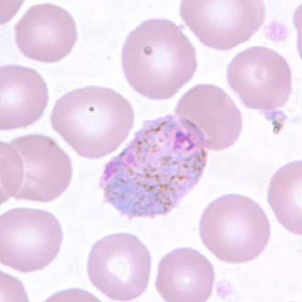
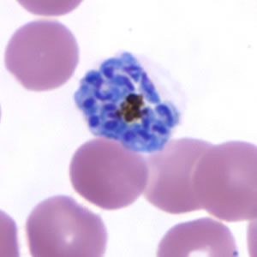
P. vivax
P. vivax gametocytes are round to oval with scattered brown pigment and may almost fill the rbc. Schüff-ner's dots may appear more fine in comparison to those seen in P. ovale.
P. vivax schizonts are large, have 12 to 24 merozoites, yellowish-brown, coalesced pigment, and may fill the rbc.

Slide 9
P. ovale

Slide 10
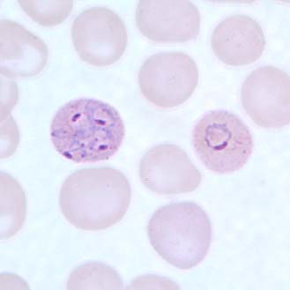
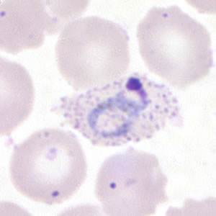
P. ovale
P. ovale rings have sturdy cytoplasm and large chromatin dots.
P. ovale trophozoites have sturdy cytoplasm, large chromatin dots, and can be compact to slightly irregular.

Slide 11
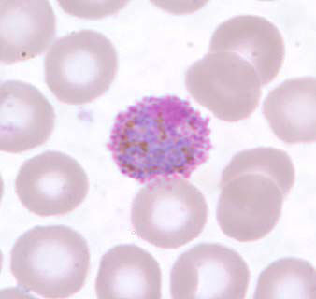
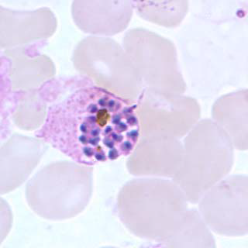
P. ovale
P. ovale gametocytes are round to oval and may almost fill the red blood cells. Pigment is brown and more coarse in comparison to P. vivax.
P. ovale schizonts have 6 to 14 merozoites with large nuclei, clustered around a mass of dark-brown pigment.

Slide 12
P. malariae

Slide 13
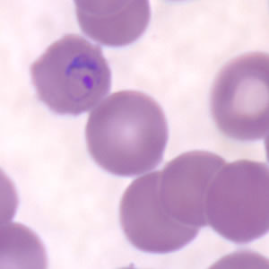
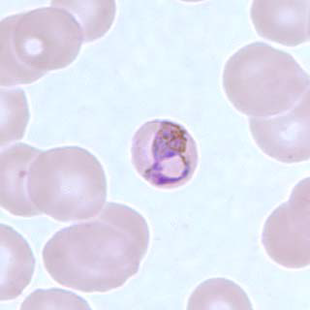
P. malariae
P. malariae rings have sturdy cytoplasm and a large chromatin dot.
P. malariae trophozoites have compact cytoplasm and a large chromatin dot. Occasional band forms and/or “basket” forms with coarse, dark-brown pigment can be seen.

Slide 14
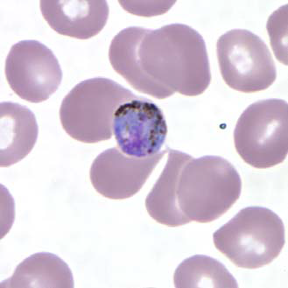
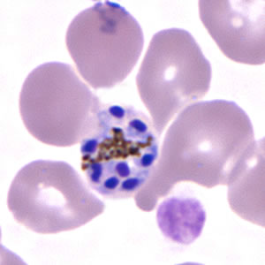
P. Malariae
Schizonts P. malariae schizonts have 6 to 12 merozoites with large nuclei, clustered around a mass of coarse, dark-brown pigment.
Merozoites can occasionally be arranged as a rosette pattern.
P. malariae gametocytes are round to oval with scattered brown pigment; they may almost fill the infected red blood cell

Slide 15
Ehrlichia
During the first week of illness a microscopic examination of blood smears may reveal morulae (microcolonies of ehrlichiae) in the cytoplasm of white blood cells in up to 20% of patients.

