Slide 1
Downtime
The How’s and Why’s of Downtime Reporting

Slide 2
Why is properly filled out downtime paperwork important?
Patient Safety
  Our most important goal is to keep our Patient’s Safe
Accuracy of Patient Information
  All information has to be documented as to when it was done, why it was done, and by whom to ensure Quality of Care.
Employee Liability
  Upon review of records if information is inaccurate or incomplete this can be considered fraud and fines can be attached
  Also in legal cases, you may be questioned as to why information was missing or inaccurate.

Slide 3
What is a downtime, and when do we need to use Downtime forms?
“Downtime” refers to any system (EPIC, DI, etc.) that is unavailable that causes laboratory results to be provided manually or in a different than expected way to the ordering physician.
It differs from manual entry, in that results are not immediately available in our Epic Beaker system.
Even in a downtime our normal turn around times still apply. Therefore if STAT results are completed, these need to be sent to the floor/physician as soon as possible using the Downtime forms
The paper results must be filled out completely and accurately so when the system comes back up, the information can be inputted into the Epic Beaker system.
Improperly filled out downtime forms can affect patient care.

Slide 4
A worse case example #1
Computer system was down 3 hours from 7-10am, a troponin was ordered at 8am on Wrong, Tim E. with a value of 16. This value was sent over on an incomplete downtime form with collection information left off. At 10am the system came back up and another troponin was sent to the laboratory. This value was 25 and it was sent via Beaker at 10:20am. Another tech was still catching up with the downtime orders and reported the first one of 16 at 10:45. Because the tech wasn’t sure of the collection times, she put in now. The current doctor, upon reviewing the chart at 11 am, saw what looked like a 2nd troponin of 16, lower than what he thought was the 1st troponin of 25, and then he proceeded to discharge the patient.

Slide 5
Example #2
Patient had a lactic acid drawn. The paper requisition had the time and date of collection and initial on the paper 3/3/2022 at 10:00, but the tech bringing it into the laboratory did not write when it was received. At 1pm the critical lactic was called to the floor and the patient was admitted due to sepsis. Upon review, the sample appeared to not get into the laboratory until 12:30. Could that be why the lactic was so high?

Slide 6
Ok, so maybe these example aren’t real, but they could have been.
Remember: when it is downtime for us, it is usually chaotic for others. Don’t assume other people will know what you mean, or that we can catch up with the information later. What if we ended up being down for much longer than expected?
Do what you can to get it correct now so everyone can understand it, and then we can get it correct in the system.
So what’s needed when we have a downtime?

Slide 7
An Order
Orders may already be in Beaker when the system goes down.
  If so, you can see the orders in the View Only WakeOne.
  If that is unavailable, the BCA downtime should have the orders.
  If everything else is unavailable, contact floor where specimen came from and get paper order.
If Orders are not in Beaker or are unavailable , a paper requisition must be used.
  The requisition must be filled out correctly.
  If the requisition is incorrect or missing information this must be fixed before proceeding with testing (if sample stability is not an issue, for example blood gases, you may need to run 1stand then get the paperwork fixed)

Slide 8
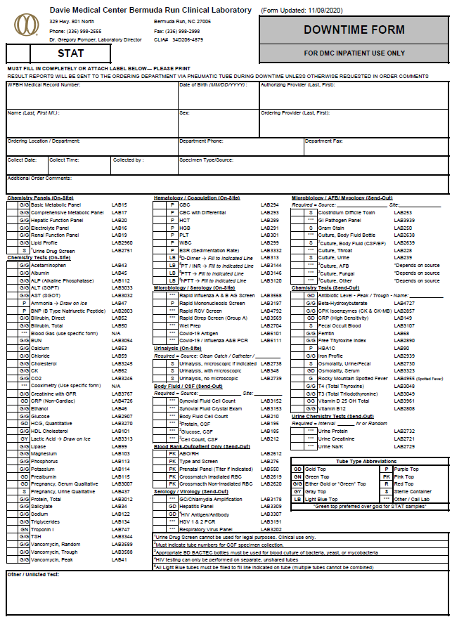
So what needs to be on the requisition?

Slide 9
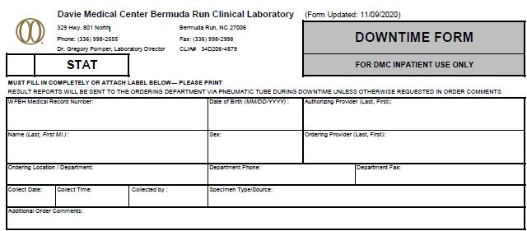
Yellow areas must be filled out! If MRN is known include that in the 1st box

Slide 10
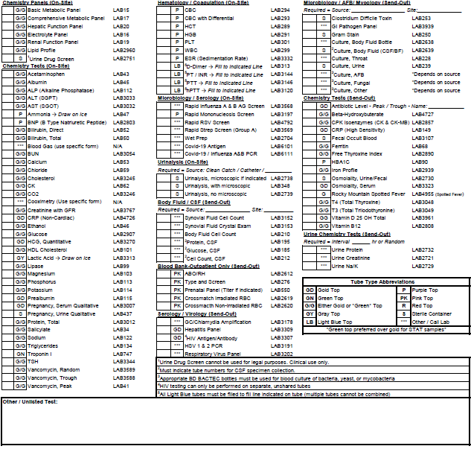
Tests should be clearly marked or written on the bottom of the form

Slide 11
So the order is acceptable, now what?
Samples should match the requisition. If no label is on the specimen, handwritten information must include legible 1st and Last name, and MRN if available or Date of Birth (DOB).
Specimens must be rejected if name is spelled wrong, name or DOB don’t match requisition, specimen was collected incorrectly, etc. Please call floor and document on order who was called, date and time, and reason.
If specimens are okay, write the RECEIVED DATE/TIME and initial on the bottom of the order and follow normal downtime procedures. Downtime labels should be used and filled out correctly.
(If a short downtime is expected, routine specimens may wait until the system is back up. Priority is placed on running STAT specimens.)

Slide 12
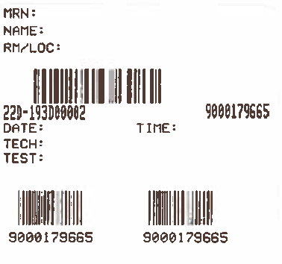
Downtime Specimen labels
Yellow areas must be filled out. If no MRN is available use DOB
(Do not cover up hand written name if possible)
This information is important for sample retrieval and lookback studies. Especially when multiple samples may be drawn from the same patient at different times during the day
2 copies should be filled out: 1 for tube and 1 for instrument printout

Slide 13
So you have the instrument printout...
Once you get the instrument printout with the results, we need to put this information onto a downtime form. Any result going out of the laboratory when Beaker is unavailable needs to be on a downtime form. (Even CBC results, the instrument printout is missing some information)

Slide 14
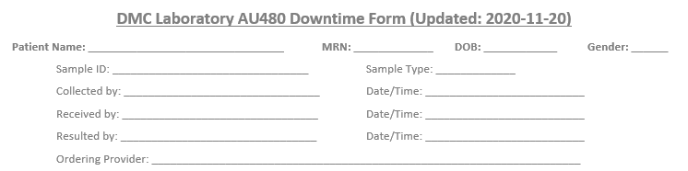
What information is needed on the Downtime Form?
Aside from the Title, the top of all downtime forms should be the same. All fields must be addressed. If MRN is unknown, write unavailable or unknown
Collection information and Received information should be on the paper requisition.
If collection and orders in Beaker refer to View only or BCA computer

Slide 15
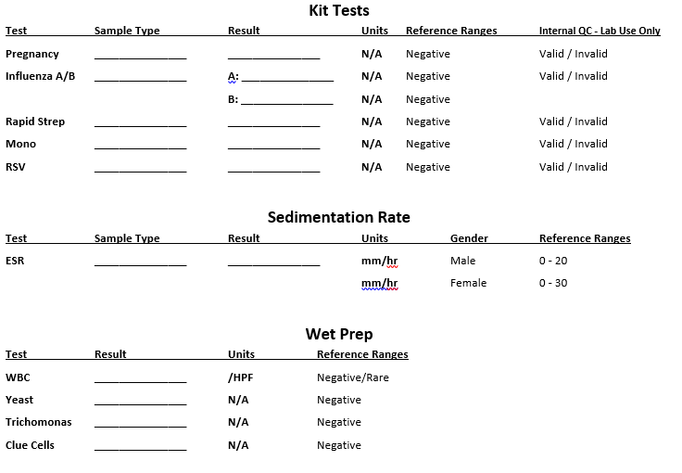
The Bottom of the downtime form is different but be aware of:
You must circle that the testing was valid
Also your critical value documentation must be
beside the result, so it can go
into Beaker.

Slide 16
The footer at the bottom of the downtime forms must have:

Slide 17
When everything is filled out correctly
Make a copy. Keep instrument printout, requisition, and copy of downtime result form in the laboratory and send original copy of downtime form results to the patient’s location.
When the computer system comes back up, remember we need to place the orders and manually enter results, have a 2nd person verify that manual entry was done correctly and all requested testing has been performed before scanning report into media manager.

