Slide 1
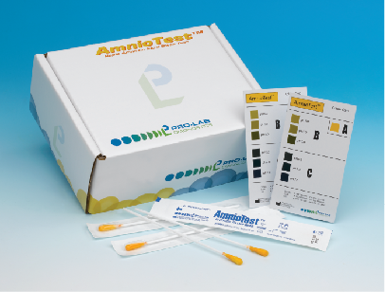
AmnioTest
™
Nitrazine Testing

Slide 2
Objectives
Complete this education
Understand procedure
Complete quiz
Complete quiz yearly

Slide 3
Point of Care Testing (POCT)
Requirements of Accreditation Canada indicate:
All healthcare professionals who perform POCT require an education session, quiz and yearly review
POCT performed at a bedside with the result leading to possible change in the care of the patient requires the hospital to monitor this practice

Slide 4
AmnioTest™ Nitrazine Swab
Is a pH-based sterile swab to aid in detecting rupture of amniotic membrane in pregnant women used by qualified medical personnel ONLY
The swab is impregnated with nitrazine yellow dye. When brought into contact with the upper vagina, the swab absorbs the fluid and develops a colour which correlates with the pH of the absorbed fluid (pH ranges from 5.0 to 7.5)

Slide 5
AmnioTest™ Nitrazine Swab
Ensure the expiry date has not been reached. The expiry date is listed on the packaging of the swab. DO NOT use if expired.

Slide 6
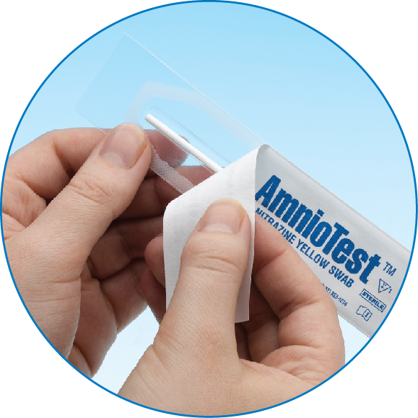
Procedure
Remove swab from protective sleeve (keep swab tip dry away from any liquid)

Slide 7

Procedure
Part the labia and carefully insert the swab into the vagina
Ensure swab tip comes into contact with upper vaginal tissue (posterior vaginal fornix and external cervical os)
Do not use on peri-pad ***

Slide 8

Procedure
Allow tip to remain in contact with upper vaginal tissue x 15 seconds

Slide 9
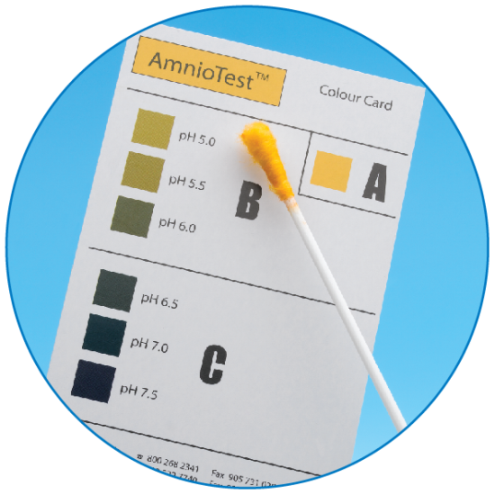
Procedure
Carefully remove swab from vagina and immediately examine colour with AmnioTest™ colour card

Slide 10
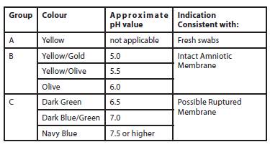
Interpretation of Results
Determine if predictive pH result as positive (possible membrane rupture) or negative (intact)

Slide 11
Interpretation of Results
Interference with interpretation of results can occur if swab comes into contact with
  Blood
  Semen
  Infections of vagina
  Antibiotic therapy

Slide 12
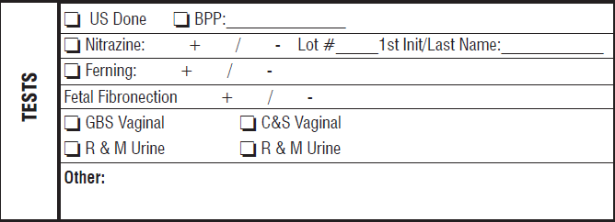
Document
On the Obstetrical Assessment Record OAU/Triage
  Name of person completing test, lot number, and result (+ or -)

Slide 13
Reference
Product Code PL.901
Health Canada Approved Instructions For Use:
Retrieved January 4, 2017 from: www.Pro-Lab.com

Slide 14
QUIZ
Answer the next 5 questions
Must obtain 80% to pass
If you do not pass – please see Clinical Educator for further direction

Slide 15
Question 1
Q: When obtaining a swab for use, what important piece of information should be inspected beforehand?
  The colour of the packaging
  The expiry date
  The company’s logo
  The company’s phone number

Slide 16
Question 2
Q: How long should the swab remain in contact with the upper vaginal tissue?
  5 seconds
  10 seconds
  15 seconds
  30 seconds

Slide 17
Question 3
Q: What can interfere with the interpretation of the result?
  Blood
  Semen
  Bacterial vaginosis
  All of the above

Slide 18
Question 4
Q: The swab displays a dark blue/navy colour after use. What does this mean?
  Possible ruptured membrane
  Intact membrane
  Swab is bad. Test should be repeated.
  None of the above.

Slide 19
Question 5
Q: When the Obstetrical Assessment Record is being completed, what information must be included?
  Your name, result, time
  Your name, lot number, time
  Your name, date, time
  Your name, lot number, result

Slide 20

Congratulations!
You have completed the quiz!

