Slide 1
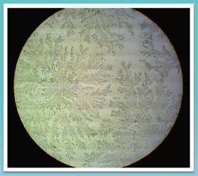
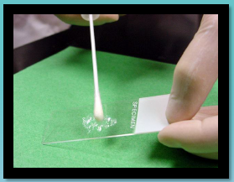
FERN
TESTING

Slide 2
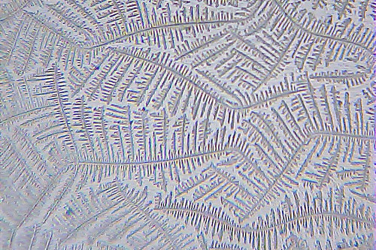
The Fern Test is used to detect amniotic fluid leakage from the membrane surrounding the fetus during pregnancy. If rupture of the membrane has occurred evidence of amniotic fluid will be present. Amniotic fluid will crystallize when dried on a glass slide forming a fern pattern due to relative concentrations of sodium chloride, proteins, and carbohydrates in the fluid. Normal vaginal secretions that do not contain amniotic fluid will not show the ferning pattern. The Fern Test may also be used for monitoring fertility. Cervical mucus smears form a fern pattern when estrogen secretion is elevated.

Slide 3
Vaginal Specimen Collection
Prior to collecting specimens, perform hand hygiene and put on gloves. Standard precautions should be taken when collecting and handling blood or body fluid specimens.
Collect a vaginal secretion with a sterile cotton swab from the posterior vaginal pool during the sterile speculum exam.
Collect a sample from the external cervical os if pool of fluid is not evident.
Fern Test Slide Preparation
Label a clean microscope slide with specimen identification.
Roll the swab across the glass slide while applying pressure to express the fluid and creating a thin smear immediately after collection.
Allow slide to completely air dry (3–5 minutes).
Do not heat the slide or apply a coverslip.
Fern Test Microscopic Examination
Place slide on microscope for examination.
Focus using low power (10X) and low light.
Scan the entire slide.
Identify evidence of fernlike pattern.
Observe slide using high power (40X) to confirm ferning pattern.
Examine the entire slide using an “S” shaped viewing pattern.
Record findings.

