Slide 1
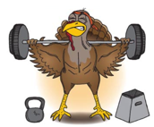
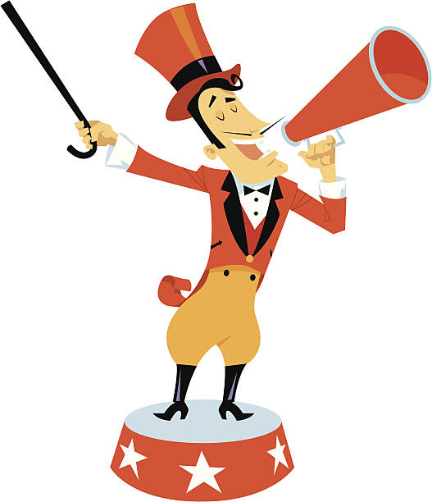

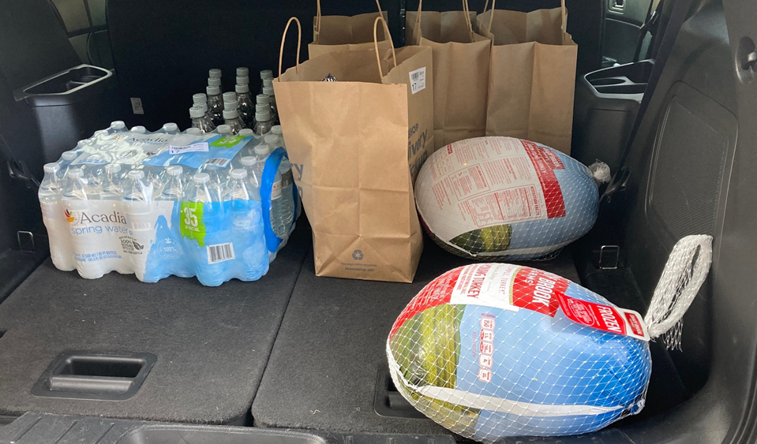
JR is raffling off 2 turkeys for Thanksgiving.
Guess their weight XX.XX
Limitations: 1 turkey per person so we can have 2 winners!
Tie Breaker: If 2 people guess the same weight, whoever has the closest birthday (month/day) to JR wins.
How to qualify:
To participate employees must complete their dry ice/liquid
Nitrogen training and also complete their yearly fire drill.
He has to give it to you on Thursday in order to be ready for Thanksgiving!
To obtain this submission form – go to MTS – acknowledge reading this flyer and print the form. Submit to Tanya or JR by Thursday 9 am.
Submission Form:
Name:
Weight of the Turkey (XX.XX) ____________
Birthday (for use in a tiebreaker)__________

