Slide 1
COMMUNICATION LOG QUIZ

Slide 2
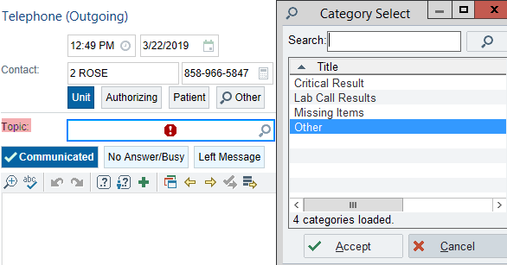
I got a result of 6.2 mmol/L Potassium on a patient from NICU, what Comm Log topic should I select from the category list to document the call?
Missing Items
Critical Result
Other
Lab Call Results

Slide 3
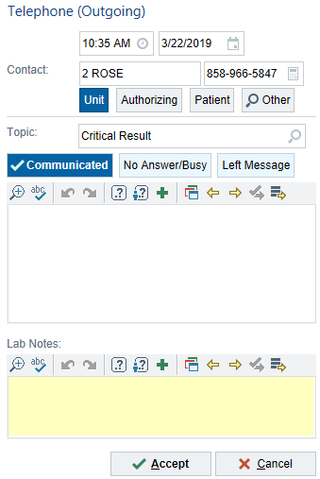
2. I communicated a positive Blood Culture and I am completing a Comm Log documentation. Where should I enter a comment of “Positive BC=GNR” in Comm Log so only my co-workers can see my comment?
In the White box
Under Lab Notes
In the Yellow box
B or C

Slide 4
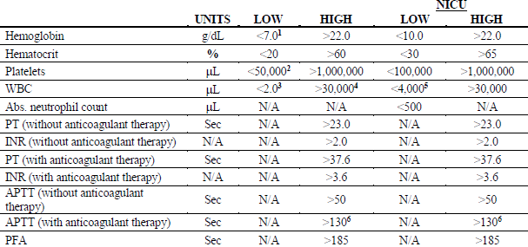
3. An order for Protime-INR from 2Rose is received in the lab and according to the Order Question the patient is receiving Warfarin. PT result is 36.3 seconds. According to the P&P AD036 below, can I proceed to Final Verification of this test?
Yes – but I have to complete the Comm Log first
Yes – I need to call the nurse and complete the Comm Log
Yes – I can clear the HOLD and enter a reason “Patient on Anti-Coagulant therapy”
Yes – I can clear the HOLD and enter a reason “Provider Notified”

Slide 5
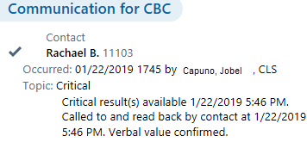
4. Below is a screenshot of a completed Comm Log documentation in Chart Review. Is this an accurate documentation?
Yes – all necessary information are entered correctly
No – there is one or more inaccurate entries

Slide 6
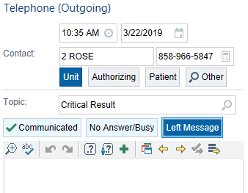
5. I have a critical Glucose result for an Outpatient. I called the Dr.’s office but they are closed for lunch and was unable to speak to a Nurse. What Topic and Contact Outcome should I use to document the call?
Critical Result & Communicated
Lab Call Results & Left Message
Missing Items & Communicated
Critical Result & No Answer/Busy

Slide 7
6. Communication Log can be accessed in Beaker from the following activities except from:
Chart Review
Follow Up Work list
Outstanding List
Result Entry
7. The Blood Culture result was Prelim Verified on 03/14/2019 at 0738 and was called to the Provider at the same time. Comm Log was not opened and completed until 0930 on the same day. What do I need to do to ensure proper documentation is completed.
Open the Comm Log without any smartphrases/comments added
Enter a smartphrase and edit the default date and time of call
Select the Unit name instead of the RN I gave the result to
B & C

Slide 8
8. I am a night shift CLS and I just entered a Gram Positive Cocci in Chains from a Blood Culture specimen which flagged as Abnormal. What will happen next and what do I need to do?
No Holds fired so I will not do anything
A Hard Hold will fire and I will clear the Hold
Call the Provider (RN, MD etc.), complete a Comm Log documentation and Prelim Verify the test
Wait for the Micro staff to create a Comm log in the morning
9. I called a nurse in NICU for a critical Hemoglobin result. When I opened Comm Log, the name on the Contact is not the person I spoke with. What do I need to do first?
Change the Contact info to the Unit since the RN is from NICU
Leave the Contact as is, enter the smartphrase .ccall and complete the Comm Log
Click Other and look up the RN’s name and select the correct name and credential
Proceed to Final Verification, clear the Hold with reason “Provider Notified"

Slide 9
10. I communicated a critical WBC result to an RN named Tracy Miller in CVICU. In Comm Log the Contact says Nancy Smith, RN. I clicked Other to look up her name and couldn’t find Tracy Miller. How do I enter an accurate Contact info for Comm Log documentation?
Type over the Contact box and enter Tracy Miller, RN
Leave Nancy Smith, RN as the contact
Select Unit CVICU as the contact
Attempt to Final Verify and clear the Hold with reason “Provider Notified”

