Slide 1
QC MANAGEMENT
~What to do when it doesn’t work

Slide 2
Help! My QC is out
Now what?

Slide 3
Review Statistics for the analyte
Looks like a trend…
One level trending
Only one level trend
Both levels trend
Is the other level trending?
No
Is the other level trending?
Yes
Replace or remix QC material
Repeat QC
Recalibrate and repeat QC

Slide 4
Upon Further review…
No apparent trends
Remix or replace QC material
Repeat QC

Slide 5
This qc is WAY out!
What is going on?

Slide 6
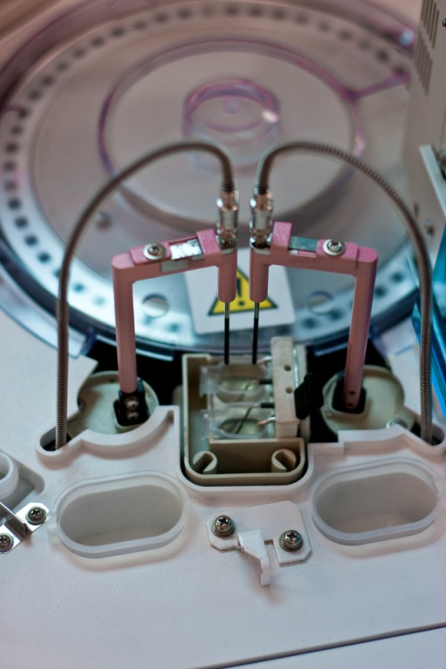
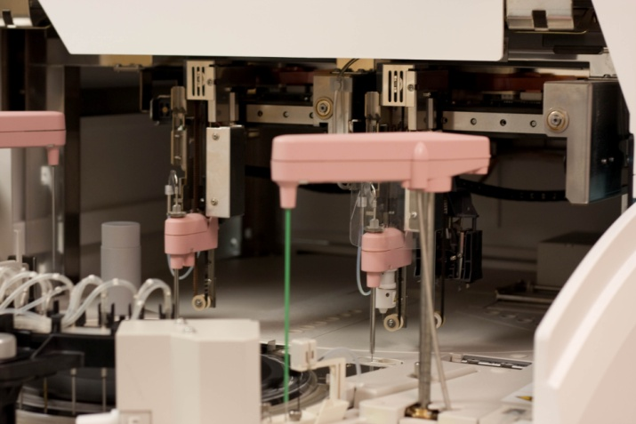
Look elsewhere for the cause
Incorrect or outdated calibrator or QC material
Missing part of the calibrator
Mechanical error from the analyzer

