Slide 1
Point of Care Urine Pregnancy Testing for Non-Laboratory Staff
Rev. 6/25/14

Slide 2
Point of Care (POC) Urine Pregnancy Testing
Objectives
Principle
Supplies
Specimen Collection
Quality Control
Testing
Interpretation
Interfering Substances
Result Reporting
CAP Proficiency Testing

Slide 3
POC Urine Pregnancy Testing
Principle
Human chorionic gonadotropin (hCG) is secreted by the developing placenta shortly after conception.
In most cases, at the time of the first missed menstrual period, the hCG concentration is at about 100mIU/mL and may be detected in urine.
Urine specimens positive for hCG react with specific colored antibody conjugates to form a colored line a the test line region of the test cassette. Absence of this colored line suggests a negative result.
To serve as a procedural control, a colored line will appear at the control line region if the test has been performed properly, regardless of the presence of hCG.

Slide 4
POC Urine Pregnancy Testing
Supplies
Timer
SP™ Brand Rapid Test hCG Combo Test Cassette
SP™ Brand Rapid hCG controls (positive and negative)
Urine Pregnancy Quality Control Log Sheet
Protective Gloves
Urine Specimen Cup
Disposable Dropper – included in test cassette pouch
Pen to label specimen cup and test cassette

Slide 5
POC Urine Pregnancy Testing
Specimen Collection
Urine is the only specimen used for hCG testing by non-laboratory testing staff.
Two patient identifiers will be used to identify patients PRIOR to specimen collection.
Specimens are collected in a clean, dry container that is labeled with patient’s full name, social security number, date and time of collection, and initials of the person collecting the specimen.
First morning specimens are most desirable, as they will contain the highest levels of hCG.

Slide 6
POC Urine Pregnancy Testing
Specimen Collection (continued)
If a specimen has been brought in by the patient, it must be properly labeled prior to processing and be at room temperature.
Urine specimens for testing should be clear. Specimens exhibiting visible precipitates should be filtered, centrifuged, or allowed to settle to the bottom of the specimen.
Specimens may be refrigerated at 36-46°F (2-8°C) for up to 72 hours before testing.

Slide 7
POC Urine Pregnancy Testing
Quality Control – External Liquid Controls
A positive and negative liquid control specimen must be performed at testing site:
1) Every 30 days
2) When a new test kit lot is started
The results of the positive and negative control specimens are recorded on the appropriate form, along with the lot number of all reagents used. (See procedure manual)

Slide 8
POC Urine Pregnancy Testing
Quality Control – External Liquid Controls (continued)
Example of Control Result Document:
Testing Location: | Lansing CBOC
Reagent Lot#/ Expiration Date | Control Lot#/ Expiration Date | Positive Control Result (Pos) | Negative Control Result (Neg) | QC Decision (Accept/Reject) | Internal QC Line Present? (yes/no) | Tech Initials/Date | FAXed to ATC for Review
hcG 2120259 2014-11 | KN145 2016-11 | POS | NEG | accept | yes | KT 5/17/14 | yes on 5/17/14

Slide 9
POC Urine Pregnancy Testing
Quality Control – Internal Controls
A pink colored band must always appear (positive control) at the Control Region (C). Presence of the band confirms that sufficient volume of reagent and specimen was available, proper flow was obtained, and reagents are reactive.
ABSENCE OF THIS BAND INICATES THE TEST IS INVALID

Slide 10
POC Urine Pregnancy Testing
Testing
Only trained, authorized personnel may perform urine pregnancy testing. Use of serum is prohibited.
All test products and specimens must be at room temperate, 59-86°F (15-30°C) prior to testing.
Testing must be performed on a flat surface. Do not move the test cassette during the timing process.
Wear protective gloves during testing.
Once the labeled urine specimen is available, remove the test cassette from its protective pouch.
Label the cassette with two patient identifiers.
Set the lab timer for three minutes.

Slide 11
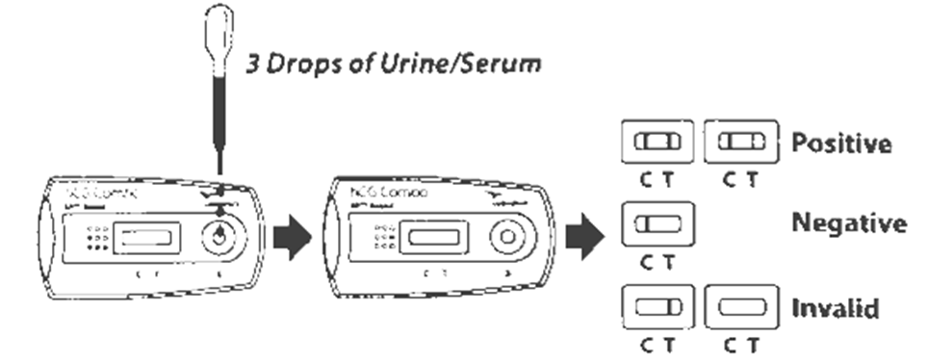
POC Urine Pregnancy Testing
Testing (continued)
Use the pipette enclosed in the pouch to dispense 3 drops (approximately 100 mL) of the specimen into the sample well (S) of the test cassette.
Avoid air bubbles. Do not use any other pipette. Discard the pipette after use. For each test use a separate, clean pipette and test cassette.

Slide 12
POC Urine Pregnancy Testing
Testing (continued)
Start the timer.
Read the test cassette results at 3 minutes.
It is important for the background to be clear before the result is read.
Results must be read between 3 and 4 minutes only.
A written procedure will be available in the testing area.
Dispose of test cassette, pipette and used gloves in the approved trash receptacle.

Slide 13
POC Urine Pregnancy Testing
Interpretation of Results
Negative: One red colored line appears on the control (C)
Region. No apparent red or pink line appears in the patient
test (T) region.
Positive: Two distinct red/pink lines appear. One line should be in the control region (C) and another line should be in the patient test region (T).

Slide 14
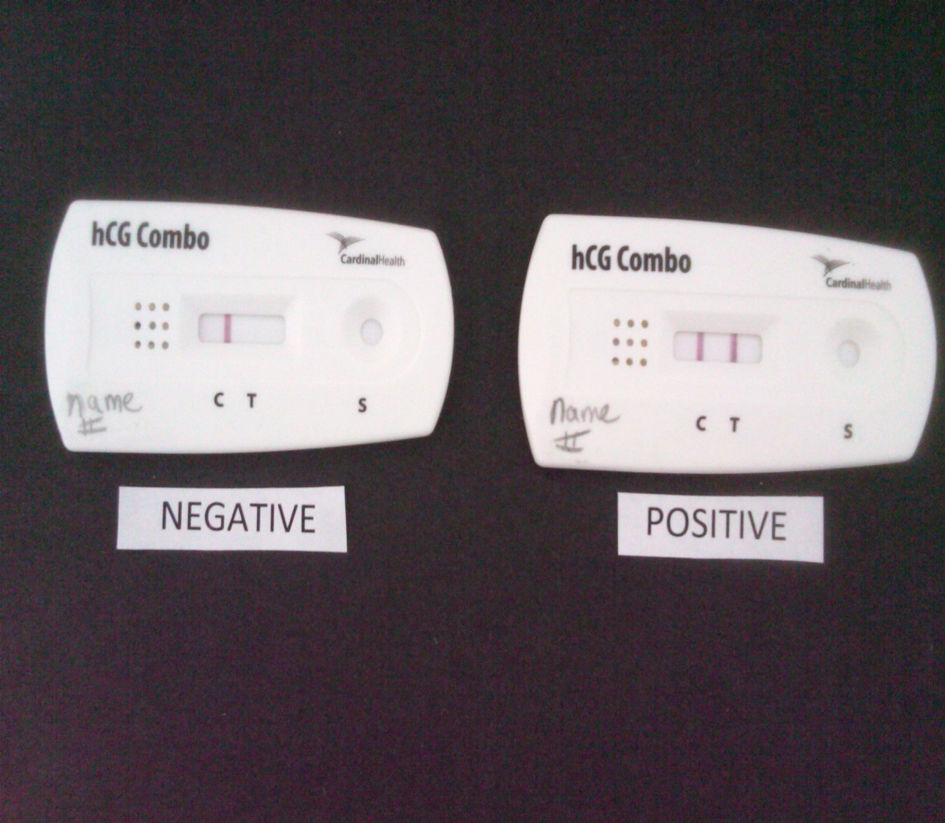
POC Urine Pregnancy Testing
Interpretation of Results (continued)
C = control region
T = test region
S = sample application
well

Slide 15
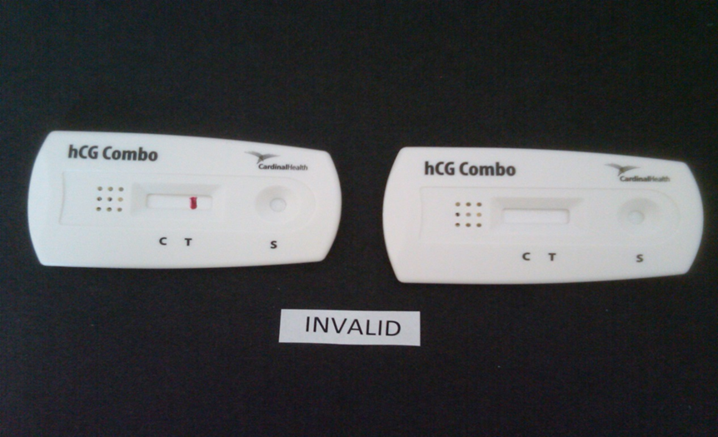
POC Urine Pregnancy Testing
Interpretation (continued)
Invalid: Control line (C) fails to appear.
A total absence of color in the control band region may be due to test reagent deterioration, insufficient specimen volume, or incorrect procedural techniques.

Slide 16
POC Urine Pregnancy Testing
Interpretation (continued)
Questionable or negative results in a patient suspected to be pregnant should be retested with a urine sample obtained 48 to 72 hours later or the PCP can order a serum pregnancy test to be collected and sent to the main lab for processing.
It is important to interpret negative results at the end of the specified reaction time of 3-4 minutes, as tests of normal non-pregnant females with low levels of hCG may develop color over time.

Slide 17
POC Urine Pregnancy Testing
Interpretation (continued)
The shade of red/pink on the test band region and control band region will vary depending on the concentration of hCG present.
For questions or concerns regarding testing contact the Ancillary Testing Coordinator (ATC) at the Battle Creek VAMC lab at 1-269-966-5600, extension 31250, or the product technical support line found on the test kit box package insert.

Slide 18
POC Urine Pregnancy Testing
Results Reporting
The PCP will enter an order for a STAT urine pregnancy test in the patient’s Computerized Patient Record System (CPRS).
The staff member who performs the test will notify the PCP of the test results within 15 minutes of obtaining the result.
The staff member who performs the test will enter the result in the appropriate (CPRS) template: “LAB-PREGNANCY TEST, URINE”

Slide 19
POC Urine Pregnancy Testing
Results Reporting (continued)
The staff member who performed the test will record the result in the PREGNANCY TEST, URINE Note in the patient’s CPRS to document the following:
Result of the internal control (C)
Test cassette/device lot #
Test cassette/device expiration date
Date/Time of specimen collection
Patient result
Name of PCP notified
Date/time PCP was notified

Slide 20
POC Urine Pregnancy Testing
Results Reporting (continued)
Completed CPRS “LAB-Pregnancy Test, Urine” template:
LOCAL TITLE: LAB - PREGNANCY TEST, URINE
STANDARD TITLE: LABORATORY NOTE
DATE OF NOTE: JUN 13, 2014@12:51 ENTRY DATE: JUN 13, 2014@12:51:40
AUTHOR: TILMA,KIM L EXP COSIGNER:
URGENCY: STATUS: COMPLETED
URINE PREGNANCY TEST RESULTS
Internal Control: Satisfactory
Device Lot#:hCG2120259
Device Expiration Date:2014/11
Date/Time of collection: Jun 13,2014@10:15
Patient Test Results: Negative
Comments: Result given to Dr. M. Mouse on 6-13-14 at 10:30.
/es/ KIM L TILMA, BS, MT(ASCP)
MEDICAL LABORATORY TECHNOLOGIST
Signed: 06/13/2014 12:53

Slide 21
POC Urine Pregnancy Testing
Results Reporting (continued)
A copy of the PREGNANCY TEST, URINE Note will be automatically sent to the printer in the main lab for review by the Ancillary Testing Coordinator (ATC) or designee.
The ATC or designee will enter the result of the urine pregnancy test in the VistA lab package as appropriate.

Slide 22
POC Urine Pregnancy Testing
College of American Pathologists (CAP) Proficiency Survey Testing
Proficiency testing is defined as determination of laboratory testing performance by means of interlaboratory comparisons, in which a PT program periodically sends multiple specimens to members of a group of laboratories for analysis and/or identification; the program then compares each laboratory’s results with those of other laboratories in the group and/or with an assigned value.
Participation in this process is required for each test site to maintain accreditation status.

Slide 23
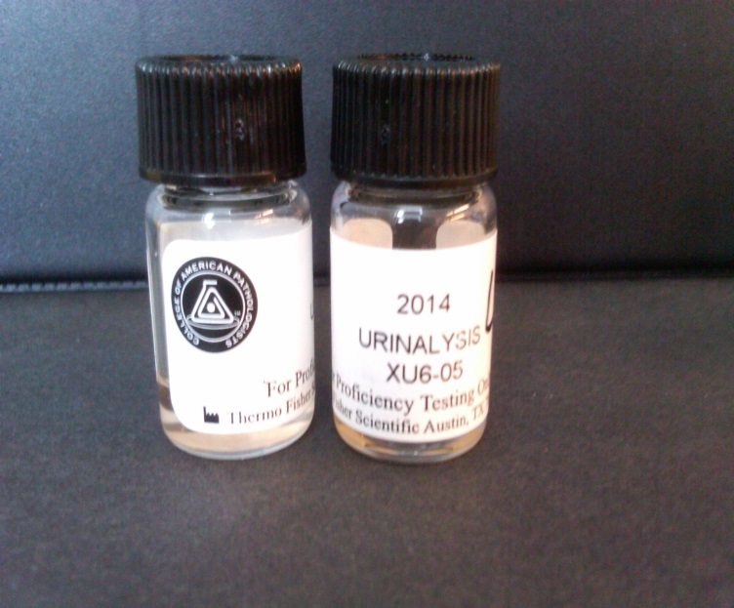
POC Urine Pregnancy Testing
CAP Proficiency Survey Testing (continued)
Survey samples of unknown results are received three times per year.
Survey samples are processed by personnel who routinely test patient specimens, and rotated among testing staff.

Slide 24
POC Urine Pregnancy Testing
(CAP) Proficiency Survey Testing (continued)
Follow the processing instructions provided in each test kit.
Treat all survey samples as if they are potentially infectious and use proper infection control guidelines.
There is no interlaboratory/test site communication about proficiency testing samples results until after the deadline for submission of data. The ATC may be contacted for questions of clarification of the testing process.
The ATC evaluates and archives proficiency testing data, and implements the appropriate corrective actions when survey results are “unacceptable”.

Slide 25
POC Urine Pregnancy Testing
References
Veterans Health Administration Handbook 1330.01, “Health Care Services for Women Veterans,” May 21, 2010
Point of Care Urine Pregnancy Test Procedure, May 6, 2014.
SP™ Brand Rapid Test hCG Combo kit package insert
College of American Pathologists All Common Checklist, July 29, 2013
CAP Point of Care Point-of-Care Testing Checklist, July 26, 2013

Slide 26
Congratulations! You have just completed this online module.
Please click RECORD LEARNING below and then click the "return to content structure" button to continue to the test.
RECORD LEARNING

